Slide 1
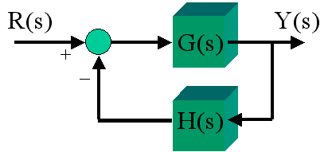
Piraeus University of Applied Sciences Department of Computer Systems Engineering
Introduction to Automatic Control Systems
Anastasia Veloni

Slide 2
What is Automatic control theory?
A field of knowledge which explores the possibilities of reducing or eliminating the human role in the activities connected with controlling of various physical objects.

Slide 3
Why automatic control is important?
Automatic control is essential in any field of engineering and science.
Automatic control is an important and integral part of space-vehicle systems, robotic systems, modern manufacturing systems, and any industrial operations.
It is desirable that most engineers and scientists are familiar with theory and practice of automatic control.
The reasons for automation of process plants are to provide safety and at same time maintain desired product quality and reduce demand on human labor.

Slide 4
GOALS FOR LEARNING
Given a control system, Identify the system components and their function.
Given a variable to be controlled, Determine the structure of a system that will control that variable.
Given a control system design problem, To appreciate and understand that the complexity of most systems makes it difficult to predict their behavior.

Slide 5
Required Knowledge
Linear algebra
Vectors and matrices
Complex numbers
Basic Physics
Linear systems and signals
Laplace and Z Transform
Software for control systems analysis and design

Slide 6
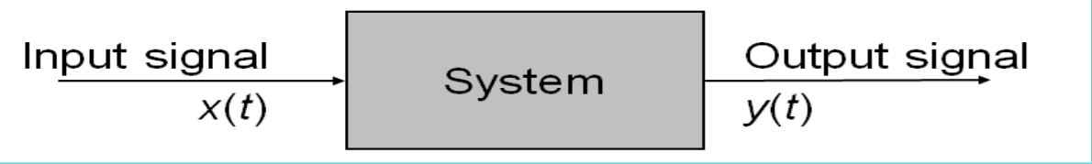
System
A system takes a signal as an input and transforms it into another signal
input
system
output
Visual representation of a system

Slide 7
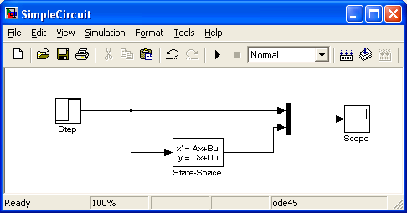
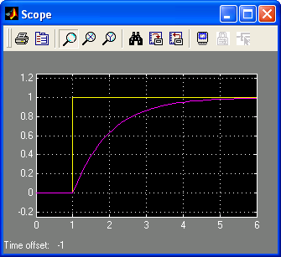

Example: An Electrical Circuit System
R
v_{s}
+
-
i
C
v_{c}
Simulink representation of the electrical circuit
v_{s}, v_{c}
v_{s}(t)
v_{c}(t)
first order
system
t

Slide 8
What is a control system?
Generally speaking, a control system is a system that is used to realize a desired output or objective.
Control systems are everywhere
They appear in our homes, in cars, in industry, in scientific labs, and in hospital.

Slide 9
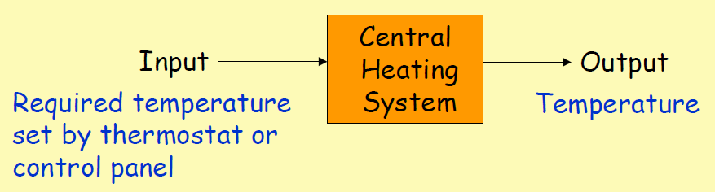
The central heating system in a house

Slide 10
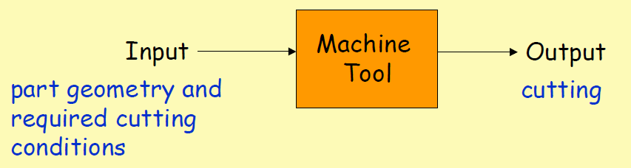
A machine tool

Slide 11
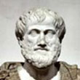
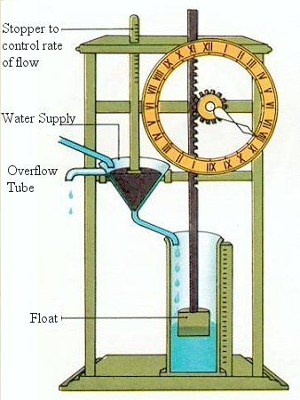
A brief history of control
Ctesibius's water clock (159 BC)
Water drips from the higher container to the lower container.
As the water level rises in the lower container, it raises the float on the surface of the water.
The float is connected to a stick with notches, and as the stick rises, the notches turn a gear, which moves the hand that points to the time.

Slide 12
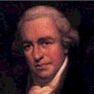
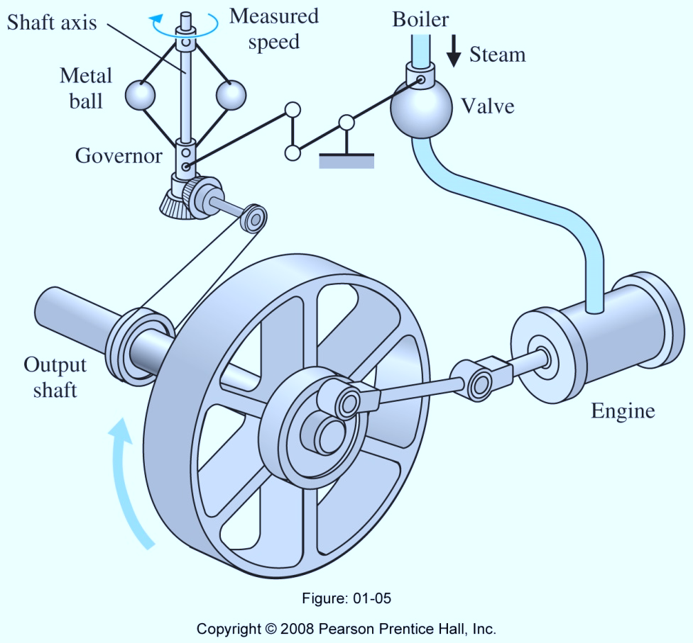
A brief history of control
Fly-ball governor (James Watt,1769)
The Invention That Changed The World
A governor is a feedback design on a machine or engine used to provide automatic control, as of speed, pressure or temperature
A fly-ball governor is a specific type of governor, that controls the speed of an engine, by regulating the fuel admitted.
When the load of the engine increases, its speed decreases, then the governor increases the supply of fuel & vice-versa in case of decrease of load.

Slide 13
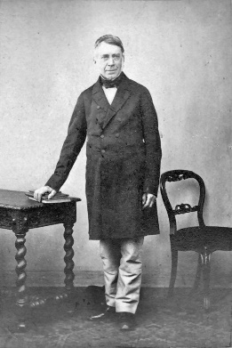
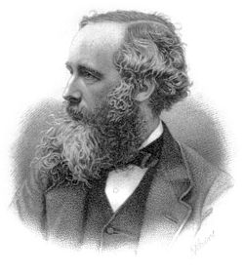
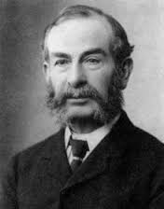
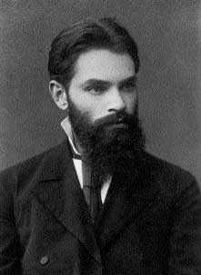
Birth of mathematical control theory
G. B. Airy (1840)
the first one to discuss instability in a feedback control system
the first to analyze such a system using differential equations
J. C. Maxwell (1868)
the first systematic study of the stability of feedback control
E. J. Routh (1877)
deriving stability criterion for linear systems
A. M. Lyapunov (1892)
deriving stability criterion that can be applied to both linear and nonlinear differential equations

Slide 14
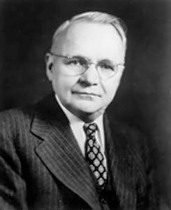
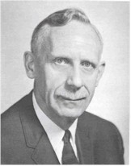
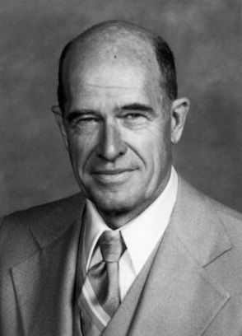
Birth of classical control design method
H. Nyquist (1932)
developed a relatively simple procedure to determine stability from a graphical plot of the loop-frequency response.
H. W. Bode (1945)
frequency-response method
W. R. Evans (1948)
root-locus method
With the above methods, we can design control systems that are stable, acceptable but not optimal in any meaningful sense.

Slide 15
Late 1950s: designing optimal systems in some meaningful sense
1960s: digital computers help time-domain analysis of complex systems, modern control theory has been developed to cope with the increased complexity of modern plants
1960s~1980s: optimal control of both deterministic and stochastic systems; adaptive control and learning control
1980s~present: robust control, H-infinity methods ( H∞) are used in control theory to synthesize controllers achieving stabilization with guaranteed performance.
Development of modern control design

Slide 16
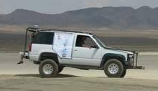
Control = Sensing + Computation + Actuation
In Feedback “Loop”
Actuate
Gas Pedal
Sense
Vehicle Speed
Compute
Control “Law”
Goals
Stability: system maintains desired operating point.
Performance: system responds rapidly to changes.
Robustness: system tolerates perturbations in dynamics.

Slide 17
Types of Control System
Control Systems
Natural
Man-made
Manual
Automatic
Open-loop
Closed-loop
Non-linear
linear
Non-linear
linear
Time variant
Time invariant
Time invariant
Time variant

Slide 18
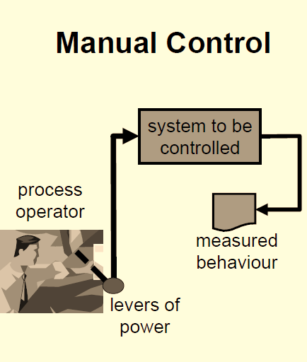
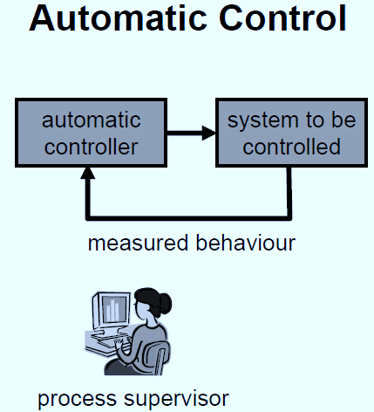
Types of Control System
Room Temperature regulation Via Electric Fan
Water Level Control
Room Temperature regulation Via A.C
Human Body Temperature Control

Slide 19
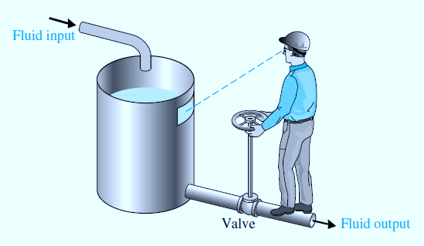
Example of a Manual Control System
The reference is a desired level of fluid that operator is instructed to maintain.
The actuator is the valve that opens or closes the fluid flow out.
The sensor is visual.
The controller is the operator.
A manual control system for regulating the level of fluid in a tank by adjusting the output valve.
The operator views the level of fluid through a port in the side of the tank.

Slide 20
Manual Open Loop Diagram
Water
Tap Handle
Valve
Water level
Flood

Slide 21
Manual Closed Loop Diagram
Correct level
Tap Handle
Valve
Water level
Water
Hand
Eyes / Brain

Slide 22
Automatic Closed Loop Diagram
Water
Correct level
Press
Start Switch
Valve
Water level
Control Unit
Level Sensor

Slide 23
Classification of control systems
According to structure
Open-loop control
Closed-loop control
Composition control
Open-loop＋Closed-loop＝Composite control system

Slide 24
Open-Loop Control System
In an open-loop control system the output is neither measured nor “fed back” for comparison with the input.
An open-loop system cannot self-correct any errors it could make when the preset value drifts.
Input
Controller
Process
Output
Note that any control systems that operates on a time basis are open-loop.

Slide 25
Practical Examples of Open Loop Control Systems
Timer Based Clothes Drier – This machine dries wet clothes for pre – adjusted time, it does not matter how much the clothes are dried.
Automatic Washing Machine – This machine runs according to the pre-set time irrespective of washing is completed or not.
Light Switch – lamps glow whenever light switch is on irrespective of light is required or not.
Automatic Tea/Coffee Maker – These machines also function for pre adjusted time only.
Bread Toaster - This machine runs as per adjusted time irrespective of toasting is completed or not.
Electric Hand Drier – Hot air (output) comes out as long as you keep your hand under the machine, irrespective of how much your hand is dried.
Volume on Stereo System – Volume is adjusted manually irrespective of output volume level.

Slide 26
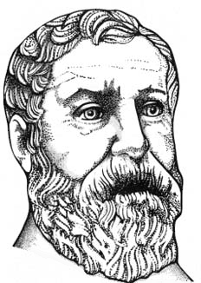
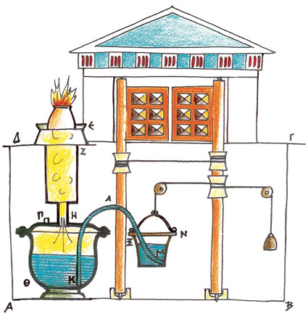
Hero’s of Alexandria
Temple doors
(c. 10 CE - c. 70 CE)
Heron designed an automatic temple door opener, which used heat and pneumatics to open a set of temple doors.
To open the doors, the priest lit a fire on the altar, heating the air within and causing it to expand.
This expansion in volume forced water out of the sphere and into the bucket, which moved downwards under the extra weight.
This bucket was connected to a rope coiled around a spindle and, as the bucket moved downwards, this spindle revolved, making the doors open.

Slide 27
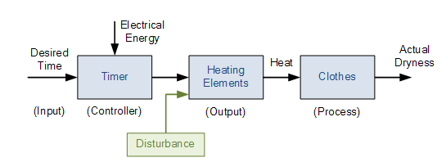
Open loop drying system
Depending upon the amount of clothes or how wet they are, a user would set a timer (controller) to say 30 minutes and at the end of the 30 minutes the drier will automatically stop and turn-off even if the clothes are still wet or damp.

Slide 28
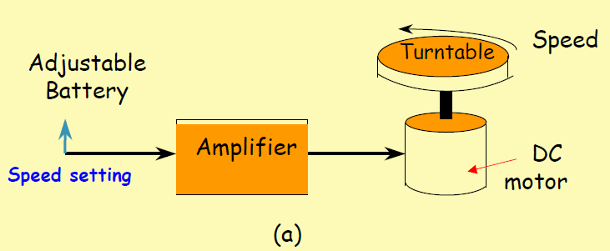
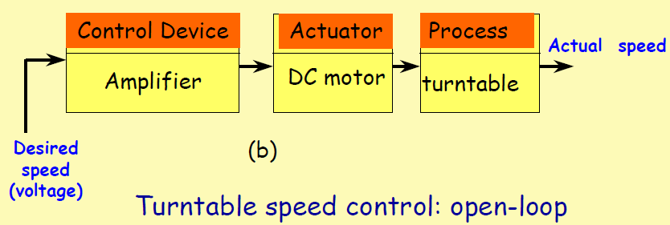
Open loop Control of the speed of a turntable

Slide 29
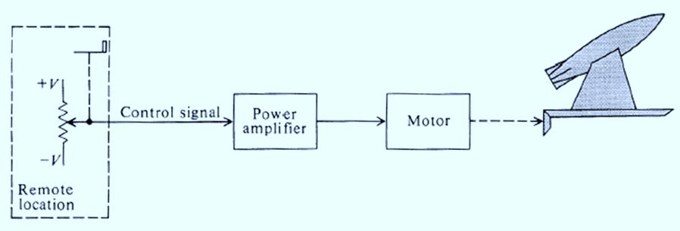
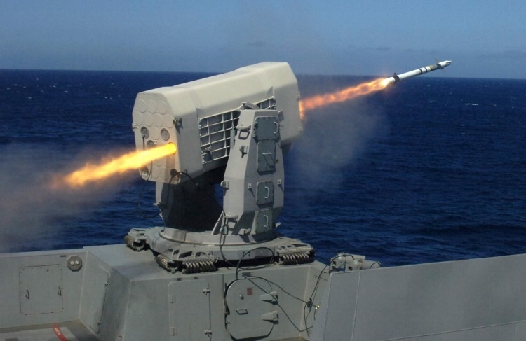
Open-Loop Control System
Missile Launcher System
The control system consists of potentiometer, power amplifier, motor, gearing between the motor and missile launcher, and the missile launcher.
The input is the desired angular position of the missile launcher.

Slide 30
A microwave oven
2nd Subsystems
1st Inputs
Set time
Timer
5th outputs
Magnetron
Electrical energy
Heat, Light, Hot food
On/Off
Turntable
3rd Boundary
Food
4th Flow of information arrows

Slide 31
Some comments on open-loop control systems
Simple construction and ease of
maintenance.
Less expensive than a closed-loop system.
No stability problem.
Recalibration is necessary from time to time.
Sensitive to disturbances.

Slide 32
When should we apply open-loop control?
The relationship between the input and output is exactly known.
There are neither internal nor external disturbances.
Measuring the output precisely is very hard or economically infeasible.

Slide 33
Closed-Loop Control System
Input
Controller
Process
Output
Comparator
Measurement
A closed-loop control system measures the value of the parameter being controlled at the output of the system and compares this to the desired value.
The term feedback is used to refer to a situation in which two (or more) dynamical systems are connected together such that each system influences the other and their dynamics are strongly coupled.

Slide 34
Closed Loop Control System
Disturbance
Controlled Signal
Manipulated Variable
Set-point or Reference input
Error
Actual Output
+
+
+
Controller
Actuator
+
+
Process
-
Sensor
Feedback Signal
comparison component :
its output equals the algebraic sum of all input signals.

Slide 35
Basic components of a control system
Plant
Controlled Variable
Expected Value
Controller
Actuator
Sensor
Disturbance

Slide 36
Basic concepts of a control system
1.Plant: a physical object to be controlled such as a mechanical device, a heating furnace, a chemical reactor or a spacecraft.
Plant
2.Controlled variable: the variable controlled by Automatic Control System , generally refers to the system output.
Controlled
variable
3.Expected value : the desired value of controlled variable based on requirement, often it is used as the reference input.
Expected
value
Notes:
.

Slide 37
4.Controller: a hardware device or a software program that can calculate the required control signal.
Controller
5.Actuator: a mechanical device that takes energy, usually created by air, electricity, or liquid, and converts that into some kind of motion.
Actuator
6.Sensor : a device that measures a physical quantity and converts it into a signal which can be read by an observer or by an instrument.
Sensor
7.Disturbance: the unexpected factors disturbing the normal functional relationship between the controlling and controlled parameter variations.
Disturbance

Slide 38
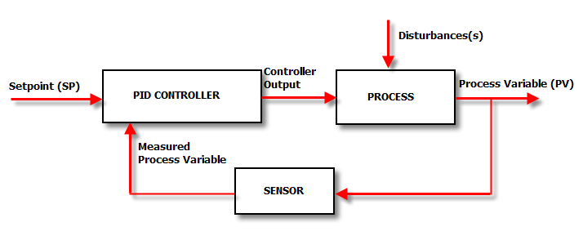
What is a Controller?
A controller is a device that generates an output signal based on the input signal it receives.
The input signal is actually an error signal, which is the difference between the measured variable and the desired value, or set point.
This input error signal represents the amount of deviation between where the process system is actually operating and where the process system is desired to be operating.

Slide 39
Structure of a Controller
The controller provides an output signal to the final control element, which adjusts the process system to reduce this deviation.
Deviation is the difference between the set point of a process variable and its actual value. This is a key term used when discussing various modes of control.
The characteristic of this output signal is dependent on the type, or mode, of the controller.

Slide 40

PID Controller
PID controller is a generic name for a controller containing a linear combination of
Propotional (P)
Integral (I)
Derivative (D)
terms acting on a control error.
An ideal PID controller is described by the control law

Slide 41
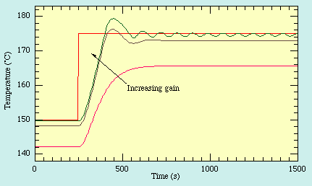
Proportional Control in Action
Increasing gain approaches setpoint faster
Can leads to overshoot, and even instability.
Steady-state offset.

Slide 42
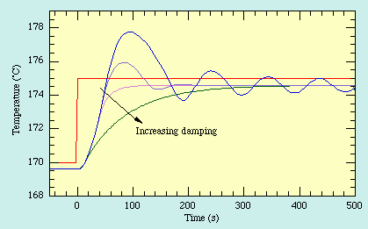
Derivative Control in Action
Damping fights oscillation and overshoot.
But it’s vulnerable to noise.

Slide 43
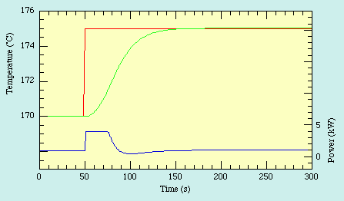
PID Control in Action
But, good behavior depends on good tuning!

Slide 44
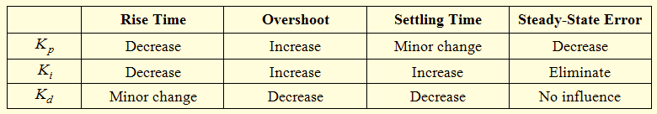
The effects of the increasing each of the controller parameters are:
The time for the plant output to rise beyond 90% of the desired level for the first time.
How much the peak level is higher than the steady state.
The time it takes for the system to converge to its steady state.
The difference between the steady state output and the desired output.

Slide 45
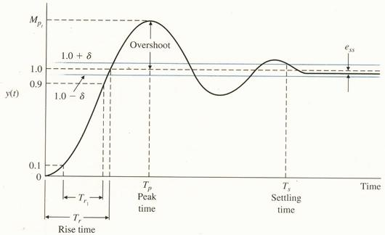
Time response of a 2nd order system

Slide 46
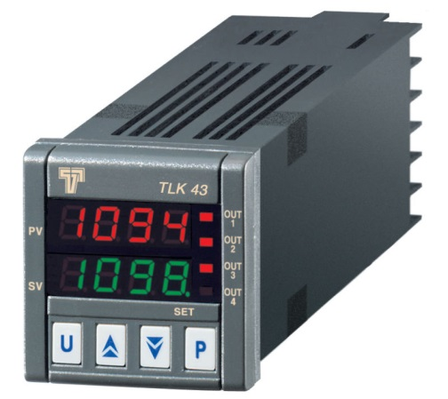
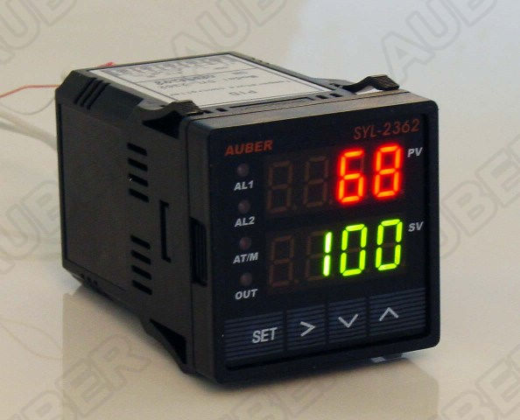
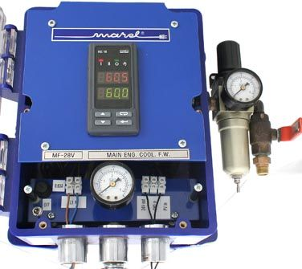
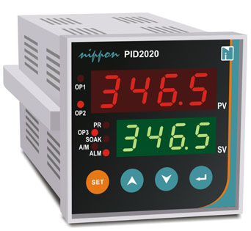
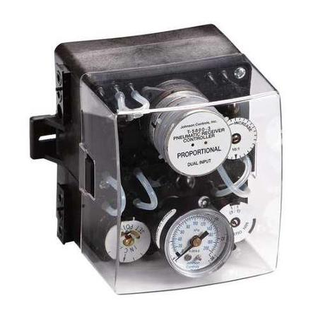
Industrial PID controllers

Slide 47
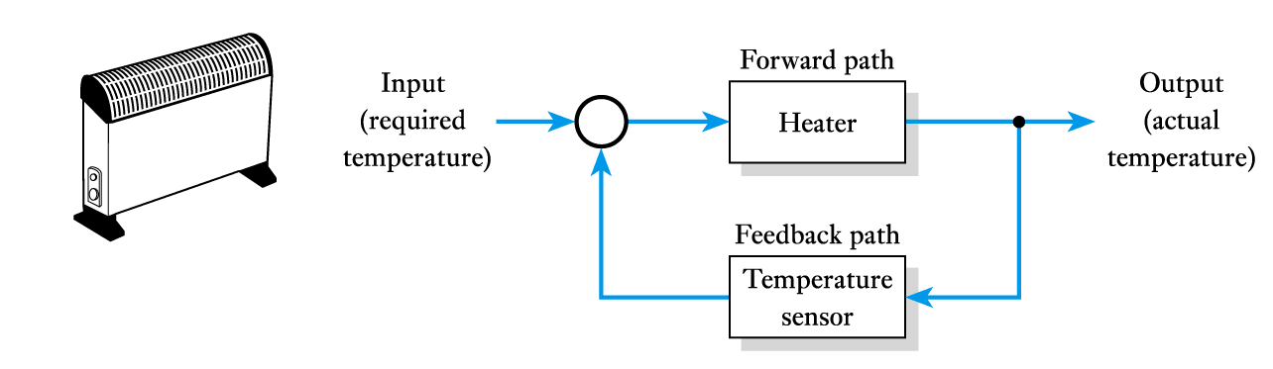
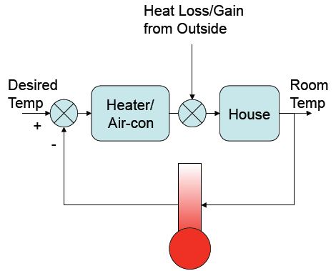
Examples of feedback control systems:
Temperature control using a room heater

Slide 48
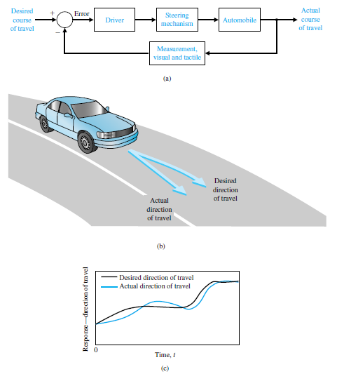
Automobile steering control system
The driver uses the difference between the actual and the desired direction of travel to generate a controlled adjustment of the steering wheel.
Typical direction
of
travel response.

Slide 49

Cruise control in a car
Cruise control (sometimes known as speed control) is a system that automatically controls the speed of a motor vehicle. The system is a servomechanism that takes over the throttle of the car to maintain a steady speed as set by the driver.

Slide 50
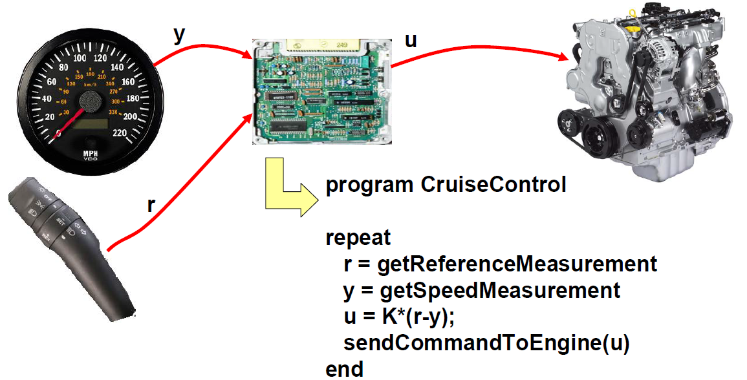
A controller is a computer in the car, measuring speed and desired speed, and sends command signals (desired torque) to the engine.

Slide 51
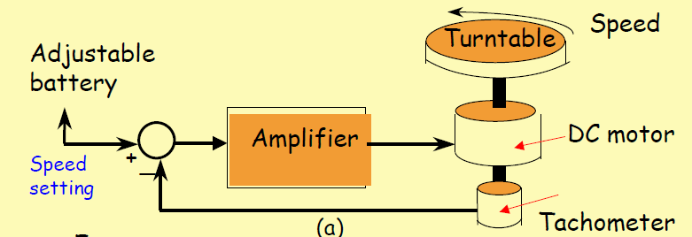
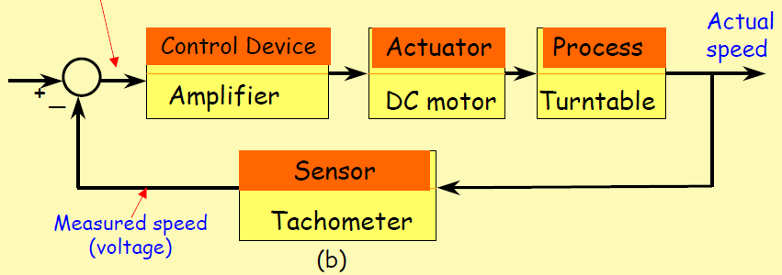
Closed loop control of the speed of a turntable
error

Slide 52
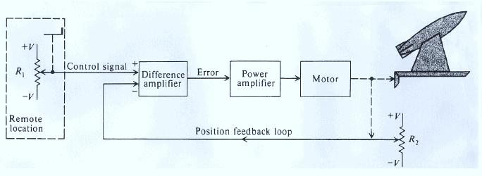
Missile Launcher System
This potentiometer feeds a signal back to the difference amplifier.
Should an error exist, it is amplified and applied to a motor drive which adjusts the output-shaft position until it agrees with the input-shaft position and the error is zero.

Slide 53
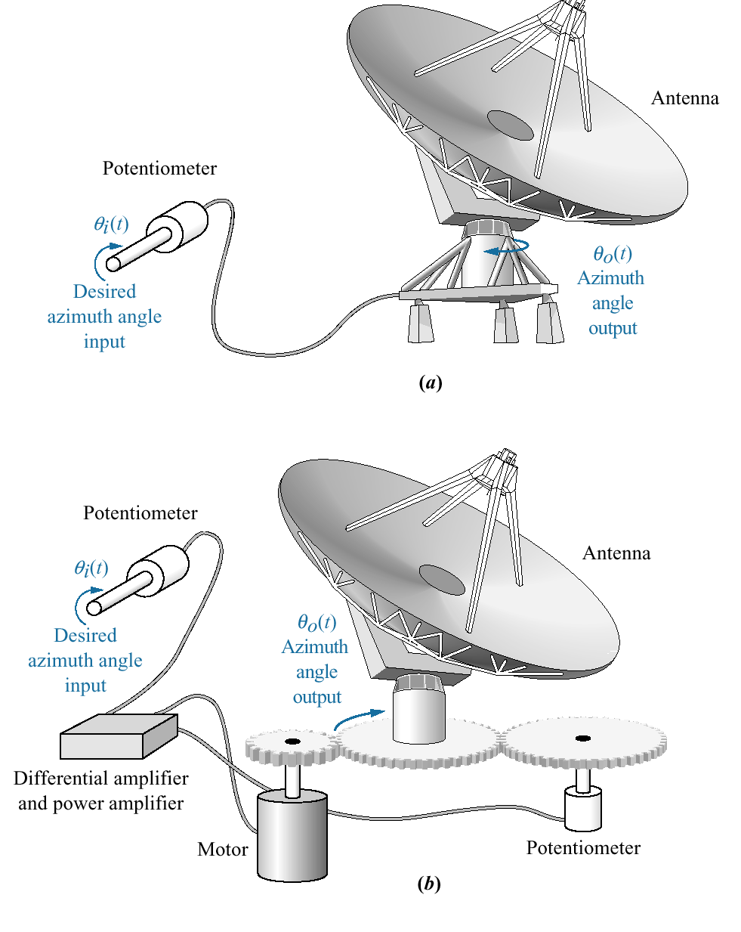
Antenna azimuth position control system:
a. system concept
The purpose of this system is to have the azimuth angle output of the antenna , follow the input angle of the potentiometer.
b. detailed layout

Slide 54
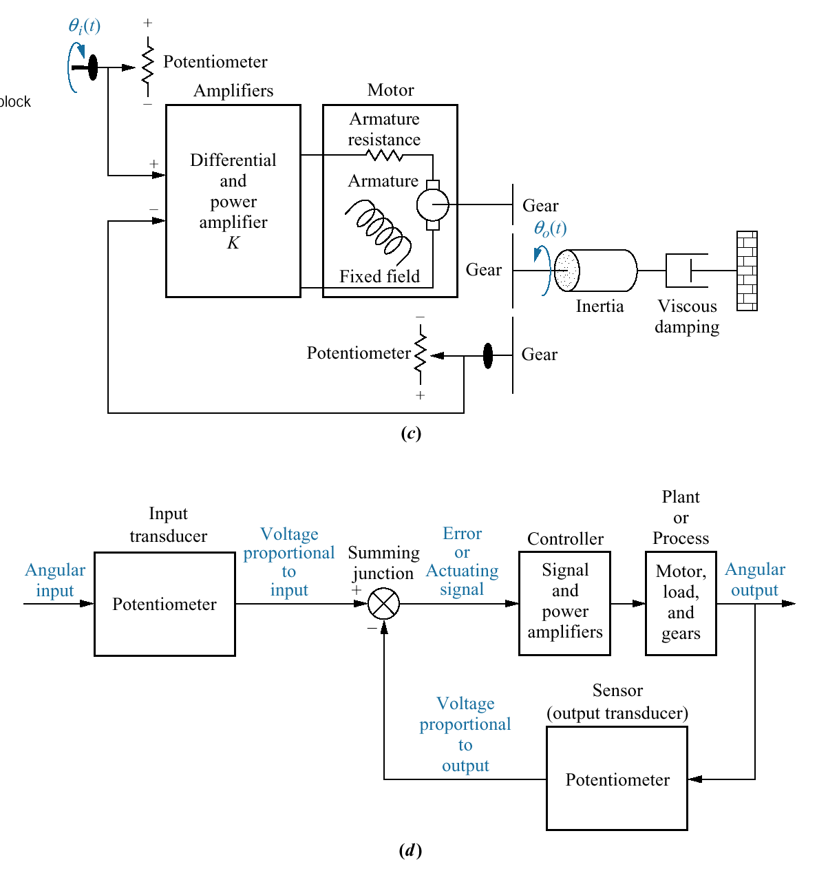
Antenna azimuth position control system:
c. schematic
The input command is an angular displacement.
The potentiometer converts the angular displacement into a voltage.
Similarly, the output angular displacement is converted to a voltage by the potentiometer in the feedback path.
The signal and power amplifiers boost the difference between the input and output voltages. This amplified actuating signal drives the plant.
When the input and output match, the error will be zero, and the motor will not turn.
d. functional block diagram

Slide 55
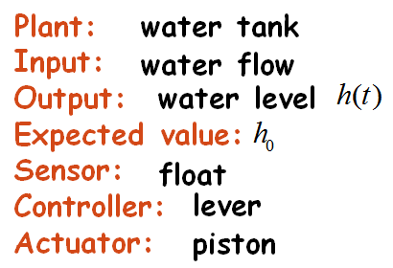
Flush toilet
lever
Controller
Actuator
Plant
Lever
Piston
Water Tank
Float
Sensor

Slide 56
Block Diagram for the water level control system
resistance comparator
Actuator
Desired
Actual
water level
water level
amplifier
Motor
Gearing
Valve
Water
Input
Error
container
Output
controller
Process
Float
Feedback signal
measurement (Sensor)

Slide 57
Open-loop vs. closed-loop
Open-loop control
Closed-loop control
Ability to correct error
Simple structure,
low cost
High
resistance of disturbance
Easy to regulate
Complex structure,
high cost
Low resistance to disturbance
Selecting parameter is critical (may cause stability problem)
Notes:
.

Slide 58
Classification of control systems
According to reference input
Constant-value control
Servo/tracking control
Programming control
the reference input (expected value) is a constant value
the controller works to keep the output around the constant value
e.g. constant-temperature control, liquid level control and constant-pressure control.
the reference input may be unknown or varying
the controller works to make the output track the varying reference
e.g. automatic navigation systems on boats and planes, satellite-tracking antennas
the input changes according to a program
the controller works according to predefined command
e.g. numerical control machine

Slide 59
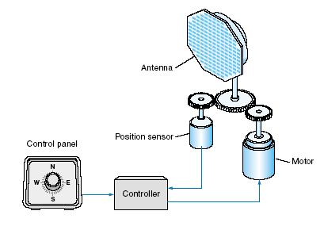

Servo System
A Servo System (or servomechanism) is a feedback control system in which the output is some mechanical position, velocity or acceleration.
Modular Servo System (MS150)
Antenna Positioning System

Slide 60

A demonstration robot containing several servo motors

Slide 61
Classification of control systems
According to system characteristics
Linear control system
Nonlinear control system
superposition principle applies
described by linear differential equation
described by nonlinear differential equation

Slide 62
Linear vs. Nonlinear Control System
A Control System in which output varies linearly with the input is called a linear control system.
output has linear relationship
output has nonlinear relationship

Slide 63
Inverted pendulum
Inverted pendulum system is a nonlinear unstable system , an ideal experiment platform for teaching control theories and conducting various control experiments.
The pendulum is controlled to remain upright by a feedback controller.
The controller receives system state information from sensors, and performs calculations for the control signal that is sent to an actuator to control the pendulum.

Slide 64

Examples of real systems that behave as inverted pendulums
Segway Personal Transporter, a self-balancing vehicle
Rocket MAXUS 1 in starting position

Slide 65
Classification of control systems
According to signal form
Continuous control system
Discrete control system
All the signals are functions of continuous time variable t
Signals are in the form of either a pulse train or a digital code

Slide 66
Computer Control System
r(t)
e(t)
e*(t)
u*(t)
u (t)
Controlled
process
c(t)
A/D
computer
D/A
－
feedback
Reference input: The ideal or desired output of the system.
Process: The system or subsystem, which is controlled by the closed-loop system.
Analog-to-Digital Converter (A/D): A device that converts an analog signal into a digital signal, usually a numerically coded signal.
Digital-to-Analog Converter (D/A): A device that converts a digital signal into an analog signal.

Slide 67

Signal Forms in a Digital Control System
(Sampled data system)
Sample-and-Hold (S/H):
A circuit that receives an analog input signal and holds this signal at a constant value for a specified period of time.
Transducer: A device that converts an input signal into an output signal of another form (converting a pressure signal into a voltage output).

Slide 68

Computer controlled system (CCS)
The controller: Computes the error signal (or the difference) and generates an appropriate input signal to the controlled process in order to provide the desired output signal.
Using the controller, a transfer function is being implemented, the design of which can be made via a suitable algorithm that is programmed into the PC or by using special equipment.
The computer may be a digital filter or a microprocessor, depending on the complexity and size of the system.

Slide 69


Digital Control of hot air blower – system interfaced with digital computer for control purpose
The information regarding the measured value of air temperature is obtained in the form of analog signal.
An ADC is used to convert the analog signal into digital signal before it is fed to the computer.
The status of fully open or fully closed position of the fan inlet valve is obtained in the form of digital signals.
For the output generated by the computer, DAC is used to send control signal in analog form to the motor control.

Slide 70


Computer control of Aircraft turbojet engine
The control requires feedback of the engine state (speed, temperature and pressure), measurements of the aircraft state (speed and direction) and pilot command.

Slide 71

Closed-Loop Drug Delivery System
A sensor is utilized to measure the levels of the regulated drug or nutrient in the blood.
This measurement is converted to digital form and fed to the control computer, which drives a pump that injects the drug into the patient’s blood.

Slide 72
ADVANTAGES OF DIGITAL CONTROL SYSTEMS AND APPLICATIONS
Great flexibility in modifying the controller’s features that can easily be altered by modifying the program.
Data processing is easy. Complex calculations can be performed easily and quickly.
They present better technical behavior in comparison to the analog control systems in terms of reliability and sensitivity to disturbances.
They have an improved stability, a lower physical weight and, in many cases, a lower implementation cost.

Slide 73
DISADVANTAGES
OF DIGITAL CONTROL SYSTEMS
The errors introduced during both the sampling process of continuous systems, and the quantization of discrete-time signals.
The difficulty in the digital control system design, if the process is complicated.
In the digital control of a complex process, the designer must have a good knowledge of the process to be controlled and should be able to obtain its corresponding mathematical model.

Slide 74
Classification of control systems
According to parameters
Time-invariant system
Time-varying system
The parameters of a control system are stationary with respect to time
System contain elements that drift or vary with time

Slide 75
Deterministic vs. Stochastic Control System
A control System is deterministic if the response to input is predictable and repeatable.
If not, the control system is a stochastic control system.
x(t)
y(t)
t
t
z(t)
t

Slide 76
Multivariable Control System
Desired Output Response
Controller
Process
Output Variables
Measurement
Multi Input - Multi Output (MIMO) System

Slide 77

Process Industry – Boiler generator
Control used to regulate level, pressure and pressure of refinery vessel

Slide 78
Adaptive Control System
The dynamic characteristics of most control systems are not constant for several reasons.
The effect of small changes on the system parameters is attenuated in a feedback control system.
An adaptive control system is required when the changes in the system parameters are significant.

Slide 79
Learning Control System
A control system that can learn from the environment it is operating is called a learning control system.

Slide 80
The control system design process
1. Establish control goals
6. Describe a controller and select
key parameters to be adjusted
2. Identify the variables to control
3. Write the specifications
for the variables
7. Optimize the parameters and
analyze the performance
Performance
meet the
specifications
4. Establish the system configuration
Identify the actuator
Performance does not
meet the specifications
Finalize the design
5. Obtain a model of the process,
the actuator and the sensor

Slide 81
System Modeling
Purpose of models in control systems:
The mathematical model of a system is the basis for all control system analysis and design methods.
Mathematical models of the control systems are the mathematical relationships between the system’s variables.
A detailed model allows some verification of the performance of the control system through simulation, before it is implemented on the actual system.

Slide 82
Types of Models
Physical Models
scale models
analogue models
Mathematical Models
analytically based
experimentally based
A model for a given system depends upon:
defined system boundaries
objective of the study
level of approximation required

Slide 83
Mathematical models of
control systems
1) Differential equations
2) Transfer function
3) Block diagram
4) Signal flow graph
5) State variables (modern control theory)

Slide 84
Examples
1) Differential equations

Slide 85
Example : A mechanism
Define: input → F ，output → y. We have:

Slide 86
Transfer Function
Transfer Function is the ratio of Laplace transform of the output to the Laplace transform of the input.
Plant
u(t)
y(t)

Slide 87


LAPLACE TRANSFORM
Laplace transform is a mathematical tool particularly suitable for the study and design of LTI systems.
LTI systems are usually described by linear differential equations with constant coefficients.
Laplace transform converts a linear differential equation with constant coefficients to an algebraic equation.

Slide 88
Examples
2) Transfer function

Slide 89

Example : A RC circuit

Slide 90
Block Diagram
Block diagrams are used as schematic representations
of mathematical models.
The various pieces correspond to mathematical entities.
Can be rearranged to help simplify the equations used
to model the system.

Slide 91
Examples
3) Transfer function - The water level control system

Slide 92

Example :Displacement control system of a hydraulic amplifier

Slide 93


Example :Displacement control system of a hydraulic amplifier
The equations that describe the displacement-control system of the hydraulic amplifier are

Slide 94



We apply Laplace transform to the system equations, assuming zero initial conditions, and we plot the block diagram of the system.

Slide 95
4) Signal flow graph
Signal flow graphs display the transmission of signals through the system, as does the block diagrams, but it is easier to draw and easier to manipulate than the block diagrams.
Alternative method to block diagram representation, developed by Samuel Jefferson Mason.
A signal-flow graph consists of a network in which nodes are connected by directed branches.

Slide 96


Example: From Block Diagram to Signal-Flow Graph Model

Slide 97


Example: From System to Signal-Flow Graph Model

Slide 98

5) State variables
In control engineering, a state space representation is a mathematical model of a physical system as a set of input, output and state variables related by first-order differential equations.
We group these first-order equations using a compact matrix notation in a model known as the state variable model.
The state variable differential equation
The output equation

Slide 99


Example: RLC circuit
The state-space representation of the system is

Slide 100
Example: RLC circuit
The state-space representation of the system is

Slide 101



Example: Hydraulic system
The state equations that describe the system are

Slide 102
Control System Design
Define the control system objectives.
Identify the system boundaries.
define the input, output and disturbance variables
Determine a mathematical model for the components and subsystems.
Combine the subsystems to form a model for the whole system.
Choose of a suitable controller so that closed performance meets the specifications.
Use methods and techniques for analysis and design.

Slide 103
Methods and Techniques?
Stability analysis. Stability criteria.
Analysis of ACS in time (root locus) and frequency domain (Nyquist, Bode, Nichols).
Stability of ACS in frequency domain (gain margin, phase margin, Nyquist criteria).
Second order systems- Steady state and transient specifications (sensitivity, rise time, settling time, overshoot etc.)

Slide 104
Control Tools
Modeling
Analysis
Input/output representations for subsystems + interconnection rules
Stability of feedback systems, including robustness “margins”
System identification theory and algorithms
Performance of input/output systems (disturbance rejection, robustness)
Theory and algorithms for reduced order modeling + model reduction
Synthesis
Constructive tools for design of feedback systems
+ SIMULATION TOOLS

Slide 105
SIMULATION
A computer simulation is a computer program that attempts to simulate an abstract model of a particular system.
A model is a schematic description of a system and can be used for further study of its characteristics.
System modeling is the procedure of expressing a (usually) simplified version of the system in terms of differential equations.

Slide 106
The simulation procedure is implemented in the following steps:
The problem and the study procedure are specified.
The mathematical model of the system is derived.
A suitable simulation software is selected.
Simulation tests are run and are compared with the real system (if available).
Extensive simulations are run and the results are analyzed.

Slide 107
Software for Modeling and Simulating control systems
MATLAB is a Mathworks product. It is a very popular software tool designed for scientific and engineering computing. It comes with a control systems toolbox, a toolbox that provides a way for systematically analyzing, designing, and tuning linear control systems.
Simulink is also a Mathworks product. It provides an interactive graphical environment and a set of block libraries that let you design, simulate, implement, and test a variety of time-varying systems.
Program CC is a Systems Technology product. It provides a control system design package containing many tools and algorithms of current control system theory and practice.

Slide 108
Simulation tools:
SIMAPP is another computer simulation software for modeling systems in the time and frequency domains. The model is built visually through block diagrams.
SCILAB is an open-source software similar to MATLAB. It comes with toolboxes appropriate for the simulation, design, and optimization of control systems.
LabVIEW uses the technique of graphical programming. This type of coding is referred to as G-Code (for graphical code). The program developed by National Instruments is widely used in industry for a variety of applications. When using LabVIEW many settings of the instruments can be changed remotely instead of manually.

Slide 109
Simulation tools
SIMVIEW is a set of freely available simulators in the area of control engineering. The simulators are developed in LabVIEW. The simulators can be used without LabVIEW being installed, but in that case the freely available LabVIEW Run-Time Engine must be installed.
CODAS is an application for Control System Design using a Multiple Document Interface (MDI) which allows an arbitrary number of child windows to be created. In each child window the behaviour of a system may be examined in different ways.
VisSim is a Windows-based program for the modeling and simulation of complex dynamic systems. VisSim combines a drag-and-drop block diagram interface with a powerful mathematical engine that offers a simple method for constructing, modifying and maintaining complex system models.
.

Slide 110
Simulation tools
DYMOLA is a complete tool for modeling and simulating integrated and complex systems. It is used in automotive, aerospace, energy, robotics, packaging, process and other industries. Dymola is based on the Modelica open standard, an object-oriented multi-domain language for component-oriented modeling of complex systems.
.
Simscape enables to create models of physical systems within the Simulink environment. With Simscape, we build physical component models based on physical connections. Simscape helps to develop control systems and test system-level performance.

Slide 111

Future evolution of Control Systems

Slide 112
Modern Engineering Applications of Control
Chemical Process Control
Regulation of flow rates, temperature, concentrations, etc.
Long time scales, but only crude models of process
Communications and Networks
Amplifiers and repeaters
Congestion control of the Internet
Power management for wireless communications
Automotive
Engine control, transmission control, cruise control, climate control, etc
AND MANY MORE...
Flight Control Systems
Modern commercial and military aircraft are “fly by wire”
Autoland systems, unmanned aerial vehicles (UAVs) are already in place
Robotics
High accuracy positioning for flexible manufacturing
Remote environments: space, sea, non-invasive surgery, etc.

Slide 113



Examples of Control Applications
Robotics:
Robots perform automated tasks in assembly lines, where precision is important and dangerous tasks physically impossible for humans

Slide 114

Aircraft Applications
Aircraft Flight Control
.• Stability augmentation
.• Configuration management
.• Maneuver enhancement
.• Maneuver limiting
.• Load alleviation
.• Structural mode control
.• Buffet alleviation (especially for twin-tail aircrafts)
.• Flutter margin augmentation

Slide 115

Aerospace Applications
Control systems play a critical role in space flight

Slide 116



Control systems in health

Slide 117

Pharmaceutical Industry
Inventory
Recipe management
Packaging
Sampling
Tracking & tracing
Typical of batch processes

Slide 118

Control Systems in Manufacturing

Slide 119

For Substations
Protection (Lines, transformers, generators) very high speed response
control (remote or local) to guarantee power flow, safe operation (interlocking)
measurement (local and remote), electricity bill, power flow in grid

Slide 120

Building Automation
basics: fire, intrusion, climate, energy management
HVAC = Heat, Ventilation and Cooling = air conditioning

Slide 121

In Agriculture

Slide 122


At Greenhouses
Humidifier System

Slide 123

Feedback control is every where you just have to look for it

Slide 124
End of the lecture Thanks for your attention

