Slide 1
Welding processes in shipbuilding industry
C.G. Politis
Deptartment of Naval Architecture
Technological Educational Institute of Athens
email: cpolitis@teiath.gr

Slide 2
General
General
Welding is the fusing of two metals by heating in order to produce a joint which is as strong as the parent metals. In principle all metals may be welded, but the degree of simplicity and the methods used vary considerably.
In shipbuilding, welding process is now the accepted method of joining metals. All shipyard welding processes are of fusion type, where the edges of the joint are melted and fuse with the molten weld metal. The heat source of a fusion welding may be provided by gas torch, electric arc or electric resistance.

Slide 3
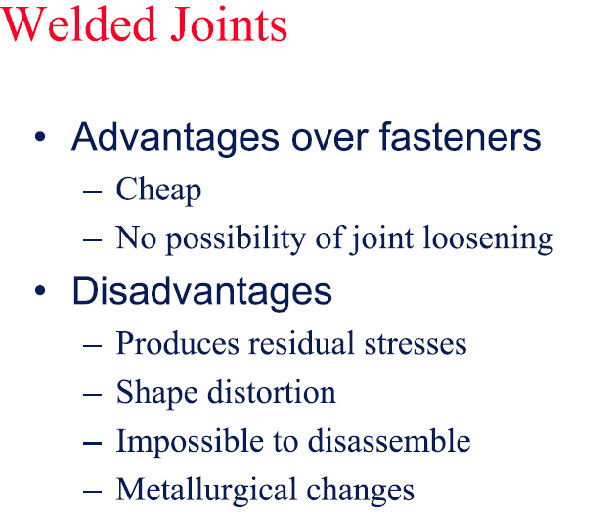
Advantages over fasteners

Slide 4
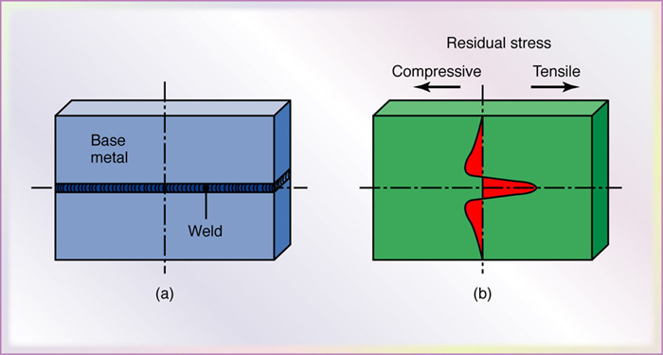
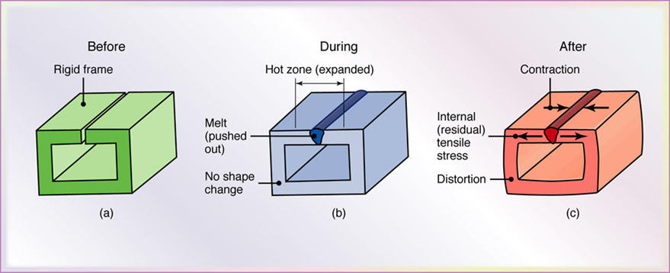
Residual Stresses and Distortion
Residual stresses developed in a straight butt joint. Note that the residual stresses in (b) must be internally balanced.
Distortion of a welded structure.

Slide 5
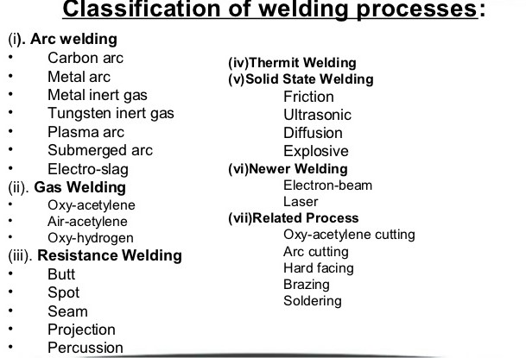
Types of Welding

Slide 6
Welding Standards
List of Welding Standards
http://www.wikiwand.com/en/List_of_welding_codes

Slide 7
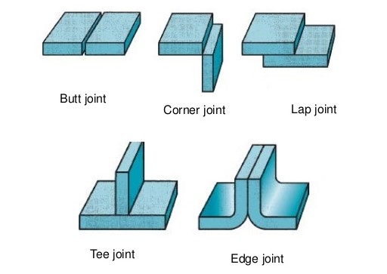
Joint types
Welds are made at the junction of the various pieces that make up the weldment. The junctions of parts, or joints, are defined as the location where two or more members are to be joined. Parts being joined to produce the weldment may be in the form of rolled plate, sheet, pipes, castings or forgings. The five basic types of welding joints are listed below.

Slide 8
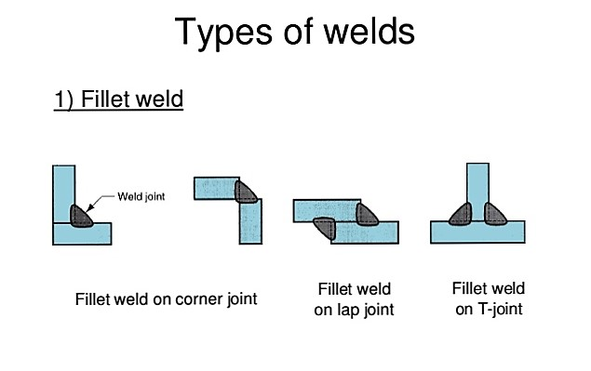
Types of Welds (1)

Slide 9
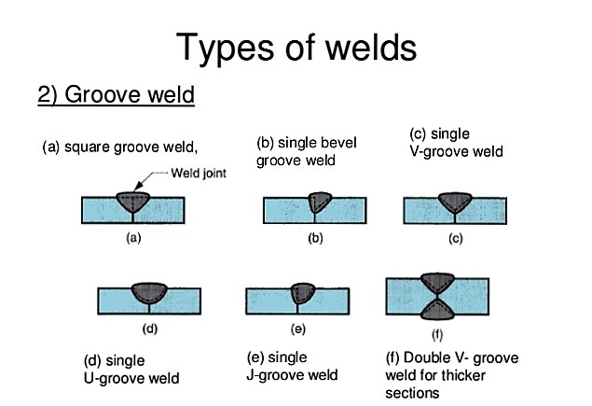
Types of Welds (2)

Slide 10
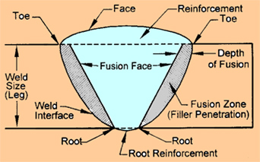
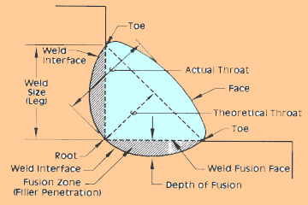
Types of Welds (3)
Groove Weld
Fillet Weld

Slide 11
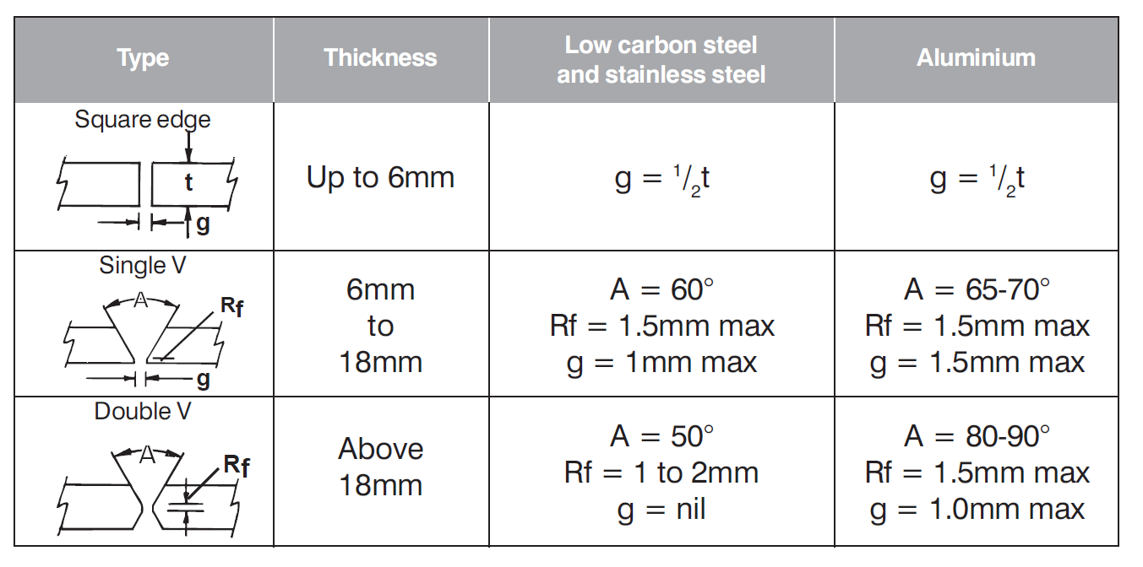
Types of Welds (4)

Slide 12
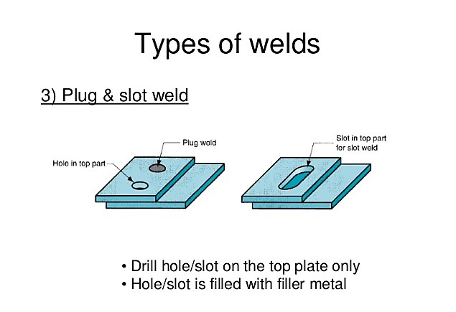
Types of Welds (5)

Slide 13
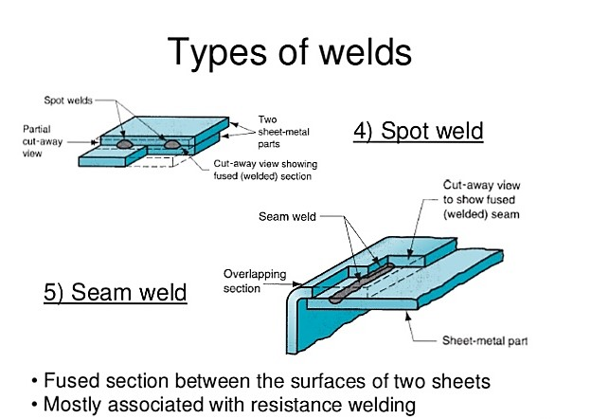
Types of Welds (6)

Slide 14
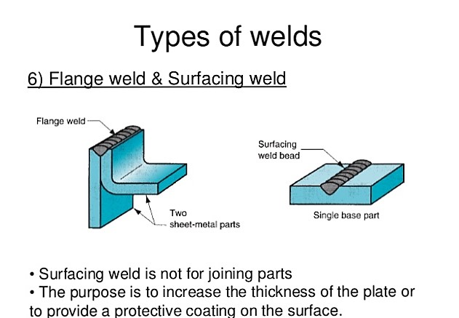
Types of Welds (7)

Slide 15
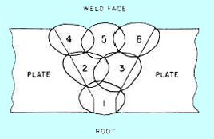
Multi-pass weld
This is the standard practice when welding a large joint. Because one bead of weld can’t do the job, the welder lays down a series of passes, using the order indicating in the Figure. Notice how the beads overlap. To prevent any gap in the weld the beads must be “wedded” together. In addition, a multipass weld has a tempering effect on the heat-affected zone.

Slide 16
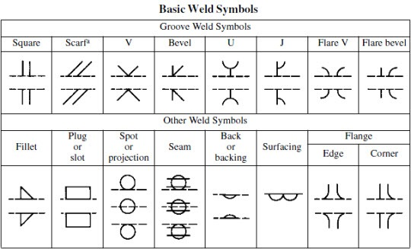
Basic Weld Symbols

Slide 17
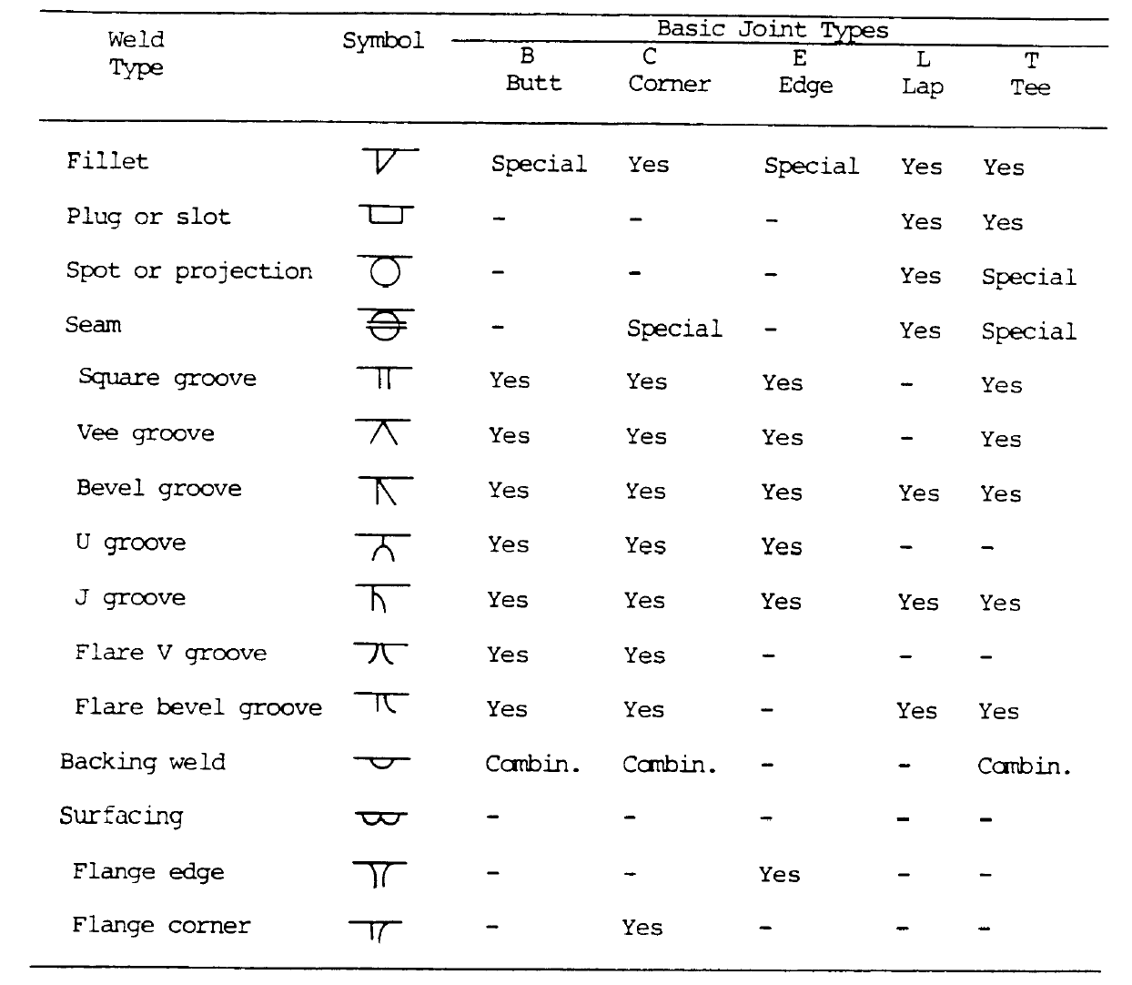
Weld joints

Slide 18
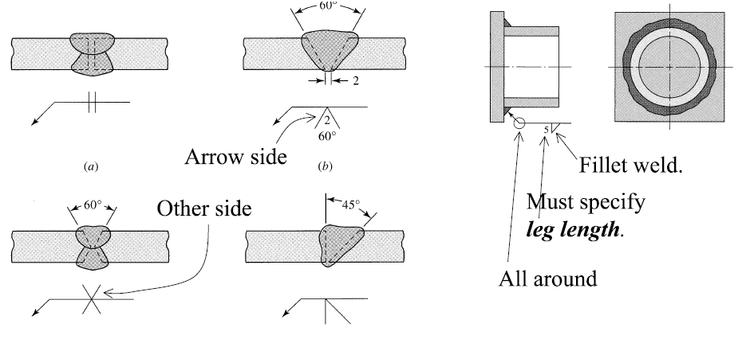
Weld Symbols

Slide 19
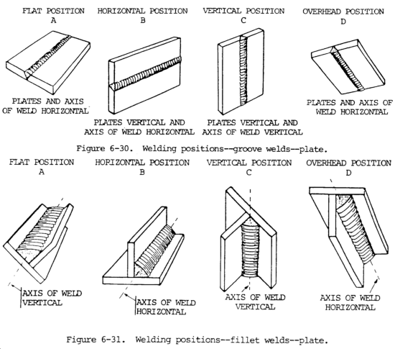
Welding Positions

Slide 20
Methods of Welding
Processes described include:
Shielded Metal Arc Welding (SMAW)
Gas Metal Arc Welding (GMAW or MIG – MAG)
Gas Tungsten Arc Welding (GTAW or TIG)
Submerged Arc Welding (SAW)
Vertical Automatic Welding Processes (ESW, EGW
Plasma Arc Welding (PAW) and cutting (PAC)
.

Slide 21
Shielded Metal Arc Welding (SMAW)
GENERAL DESCRIPTION
SHIELDED METAL ARC WELDING (SMAW) is an arc welding process in which coalescence of metals is produced by heat from an electric arc that is maintained between the tip of a covered electrode and the surface of the base metal in the joint being welded.
The core of the covered electrode consists of either a solid metal rod or cast material or one fabricated by encasing metal powders in a metallic sheath. The core rod conducts the electric current to the arc and provides filler metal for the joint.
The primary functions of the electrode covering are to provide arc stability and to shield the molten metal from the atmosphere with gases created as the coating decomposes from the heat of the arc. The shielding employed, along with other ingredients in the covering and the core wire, largely controls the mechanical properties, chemical composition, and metallurgical structure of the weld metal. The composition of the electrode covering varies according to the type of electrode.

Slide 22
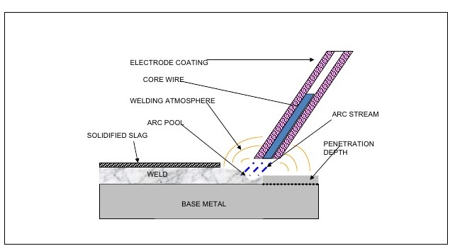
SMAW General View

Slide 23
SMAW Principles of Operation
Welding commences when an electric arc is struck between the tip of the electrode and the work. The intense heat of the arc melts the tip of the electrode and the surface of the work close to the arc. Tiny globules of molten metal rapidly form on the tip of the electrode, then transfer through the arc stream into the molten weld pool. In this manner, filler metal is deposited as the electrode is progressively consumed. The arc is moved over the work at an appropriate arc length and travel speed, melting and fusing a portion of the base metal and continuously adding filler metal. Since the arc is one of the hottest of the commercial sources of heat [temperatures above 9000 degrees F(5000 degrees C) have been measured at its centre], melting of the base metal takes place almost instantaneously upon arc initiation. If welds are made in either the flat or the horizontal position, metal transfer is induced by the force of gravity, gas expansion, electric and electromagnetic forces, and surface tension. For welds in other positions, gravity works against the other forces.

Slide 24
SMAW Principles of Operation
The sizes and types of electrodes for shielded metal arc welding define the arc voltage requirements (within the overall range of 16 to 40 V) and the amperage requirements (within the overall range of 20 to 550 A). The current may be either alternating or direct, depending upon the electrode being used, but the power source must be able to control the level of current within a reasonable range in order to respond to the complex variables of the welding process itself.
During welding the current remains constant, even if the arc distance and voltage change. The SMAW machines have static dropping characteristic.
The deposit rate is inferior to 1kg/h and the arc time is about 30%, due to the permanent need to change the consumable electrode.

Slide 25
SMAW Principles of Operation
DCSP (Direct Current Straight Polarity): Increases the weld penetration.
DCRN (Direct Current Reverse Polarity): Causes heat to build up in the electrode, increasing the electrode melting rate and decreasing the depth of the weld.
AC (Alternating Current): The resulting heat distribution provides a balance between the melting rate and penetration;

Slide 26
SMAW Covered Electrodes
In addition to establishing the arc and supplying filler metal for the weld deposit, the electrode introduces other materials into or around the arc, or both. Depending upon the type of electrode being used, the covering performs one or more of the following functions:
Provides a gas to shield the arc and prevent excessive atmospheric contamination of the molten filler metal.
Provides scavengers, deoxidizers, and fluxing agents to cleanse the weld and prevent excessive grain growth in the weld metal.
Establishes the electrical characteristics of the electrode.
Provides a slag blanket to protect the hot weld metal from the air and enhance the mechanical properties, bead shape, and surface cleanliness of the weld metal.
Provides a means of adding alloying elements to change the mechanical properties of the weld metal.

Slide 27
SMAW Covered Electrodes
In addition to improving the mechanical properties of the weld metal, electrode coverings can be designed for welding with alternating current (AC). With AC, the welding arc goes out and is re-established each time the current reverses its direction. For good arc stability, it is necessary to have a gas in the arc stream that will remain ionized during each reversal of the current. This ionized gas makes possible the reignition of the arc. Gases that readily ionize are available from a variety of compounds, including those that contain potassium. It is the incorporation of these compounds in the electrode covering that enables the electrode to operate on AC.
To increase the deposition rate, the coverings of some carbon and low alloy steel electrodes contain iron powder. The iron powder is another source of metal available for deposition, in addition to that obtained from the core of the electrode. The presence of iron powder in the covering also makes more efficient use of the arc energy. Metal powders other than iron are frequently used to alter the mechanical properties of the weld metal.

Slide 28
SMAW Arc Shielding
THE ARC SHIELDING action is essentially the same for all electrodes, but the specific method of shielding and the volume of slag produced vary from type to type. The bulk of the covering materials on some electrodes is converted to gas by the heat of the arc, and only a small amount of slag is produced. Weld metal from such electrodes can be identified by the incomplete or light layer of slag which covers the bead.
For electrodes at the other extreme, the bulk of the covering is converted to slag by the heat of the arc, and only a small volume of shielding gas is produced. The tiny globules of metal being transferred across the arc are entirely coated with a thin film of molten slag. This molten slag floats to the surface of the weld puddle because it is lighter than the metal. The slag solidifies after the weld metal has solidified. Welds made with these electrodes are identified by the heavy slag deposits that completely cover the weld beads. Between these extremes is a wide variety of electrode types, each with a different combination of gas and slag shielding.

Slide 29
SMAW Arc Shielding
Variations in the amount of slag and gas shielding also influence the welding characteristics of covered electrodes. Electrodes which produce a heavy slag can carry high amperage and provide high deposition rates, making them ideal for heavy weldments in the flat position. Electrodes which produce a light slag layer are used with lower amperage and provide lower deposition rates. These electrodes produce a smaller weld pool and are suitable for making welds in all positions.
Because of the differences in their welding characteristics, one type of covered electrode usually will be best suited for a given application.

Slide 30
SMAW Capabilities and Limitations
SHIELDED METAL ARC WELDING is one of the most widely used processes, particularly for short welds in production, maintenance and repair work, and for field construction.
Advantages:
The equipment is relatively simple, inexpensive, and portable.
The filler metal, and the means of protecting it and the weld metal from harmful oxidation during welding, are provided by the covered electrode.
Auxiliary gas shielding or granular flux is not required.
The process is less sensitive to wind than gas shielded arc welding processes.
It can be used in areas of limited access.
The process is suitable for most of the commonly used metals and alloys.
Disadvantages
Lower consumable efficiency (waste is produced)
Difficult to use on thin materials
High operator skill required

Slide 31
SMAW Capabilities and Limitation
SMAW electrodes are available to weld carbon and low alloy steels, stainless steels, cast irons, copper, and nickel and their alloys, and for some aluminium applications. Low melting metals, such as lead, tin, and zinc, and their alloys, are not welded with SMAW because the intense heat of the arc is too high for them. SMAW is not suitable for reactive metals such as titanium, zirconium, tantalum, and columbium because the shielding provided is inadequate to prevent oxygen contamination of the weld.
Covered electrodes are produced in lengths of 9 to 18 in. (230 to 460 mm). The amount of current that can be used is limited by the electrical resistance of the core wire. Excessive amperage overheats the electrode and breaks down the covering. This, in turn, changes the arc characteristics and the shielding that is obtained. Because of this limitation, deposition rates are generally lower than for a welding process such as GMAW(Gas Metal Arc Welding).

Slide 32
Gas Metal Arc Welding (GMAW) General
Gas Metal Arc Welding (GMAW), also known as Metal Inert Gas (MIG) welding, is a welding process in which a low-voltage (18-40V) and high current (60-500A) electric arc is formed between a consumable wire electrode and the workpiece metals, heating them and causing them to melt and join.
Along with the wire electrode, a shielding gas is fed through the welding gun, which shields the process from contaminated by the air.
A constant voltage, direct current power source is most commonly used by GMAW.
There are four primary methods of metal transfer in GMAW called: globular, dip or short-circuiting, spray and pulsed spray, each of which has advantages and limitations.

Slide 33
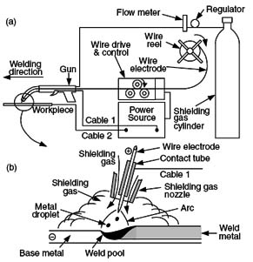
GMAW – General view

Slide 34
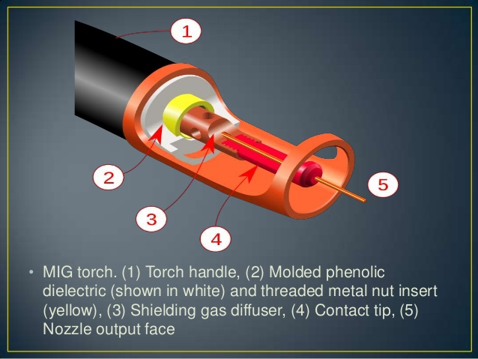
GMAW – Welding torches
The typical GMAW gun has a number of key parts as: a control switch, a contact tip, a power cable, a gas nozzle, an electrode conduit and liner and a gas pipe.
The control switch or trigger when pressed initiates the wire feed, the electric power and the shielding gas flow, causing an electric arc to be stuck.
The gas nozzle is used to evenly direct the shielding gas into the welding zone; if the flow is not appropriate, it may not provide adequate protection of the weld area.

Slide 35
GMAW – Modes of Metal Transfer
Globular Transfer
It is characterized by a drop size with a diameter greater than the electrode itself.
The droplet detach when its weight exceeds the surface tension of the molten metal that holds the drop to the electrode tip.
It takes place with a positive electrode (DCRP) when the current is relatively low regardless of the type of shielding gas.
The molten drop grows in size from its lowest value with increasing current.

Slide 36
GMAW – Modes of Metal Transfer
Spray Transfer
Either pure Argon or Argon rich with 0.5% to 5% oxygen shielding gas is used. With such gas mixture a true spatter free, axial spray transfer becomes possible with higher current.
The minimum welding current at which spray transfer occurs is called the transition current. This depends on the metal wire diameter and shielding gas.
Spray transfer mode can be used in any welding position, especially for welding plates, thick walled pipes and sections in the flat position.
The metal droplets being very small, short circuit does not occur and spatter is almost eliminated.
Using as shielding gas helium or a gas mixture with more than about 15% of CO₂ there is no transition from globular to spray transfer. Also, there is no transition by using straight polarity.

Slide 37
GMAW – Modes of Metal Transfer
Pulsed Transfer
Welding current switches automatically from a low level to a higher level in a periodic manner.
Lower level current, also known as background current is set below the transition point and higher level is set well above the transition point in spray transfer range.
Spray type metal transfer is achieved by applying pulses of higher level current, each pulse having a sufficient force to detach a droplet.
The power supply is specially designed to produce a continuous wave form and pulses of the wave current.

Slide 38
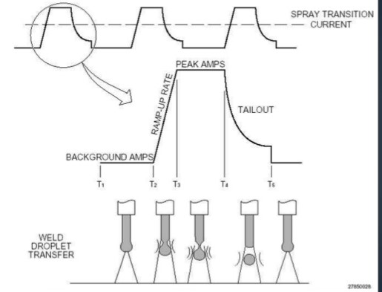
GMAW Pulsed Spray Transfer

Slide 39
GMAW – Modes of Metal Transfer
Short Circuit Transfer (Dip transfer)
It is used with low-current operation with lower electrode diameter.
The molten metal forming on the tip of the electrode wire is transferred by the wire dipping into the weld pool, thus causing a momentary short circuit.
In this way, metal is transferred only during the period when electrode tip is in contact with the weld pool.
This mode of transfer is preferred in vertical and overhead welding where the metal tends to run out of the joint under the action of gravity.

Slide 40
GMAW – Welding Current
Welding current depends upon welded metal thickness and metal transfer mode required, according to the parent metals properties.
Metal Thichness (mm) | Current (A)
<6 | 100-200
6-8 | 200-450
>8 | 450-700

Slide 41
GMAW – Polarity
In GMAW we mainly use reverse polarity (DCRP).
DCRP eliminates arc blow
For welding sheet metal heating effect is produced mainly on electrode

Slide 42
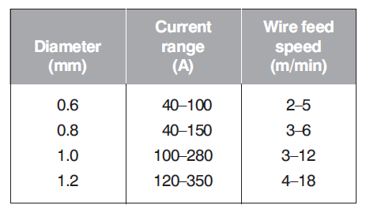
GMAW – Electrodes
In GMAW diameter of electrode normally ranges from 0.7 to 2.4 mm depending on welding current and metal thickness.
Electrode is made of the same metal as parent metal. In the case where an active shielding gas is used (mixture with O₂ or CO₂) electrode must be coated with deoxidizing agents such as copper.

Slide 43
GMAW – Flux-cored wires
Wires for GMAW welding are usually solid. For carbon, carbon manganese, high strength low alloy steels and stainless steels flux cored wires can be used. These offer the advantages of higher welding speeds and easier control of fillet weld profiles.

Slide 44
GMAW – Shielding Gas
According to the metal being welded we use:
Pure Argon
Argon mixed with small amounts of other gases
Helium or
Carbon dioxide
Pure argon is particularly effective for welding aluminium and its alloys. Also used for copper and nickel.
Mixtures of argon with carbon dioxide and other gases provide ideal arc conditions for spatter free welding of carbon, carbon-manganese and high strength low alloy steels in dip, spray and pulse transfer modes

Slide 45
GMAW – Gas Flow Rate
For different applications (modes of transfer) there are different flow rates:
For the spray and pulsed spray modes a flow rate of 10 l/min is suitable.
For globular mode a rate of 15 l/min is preferred.
For dip mode a good shielding environment is required so a flow rate between 20-25 l/min is used.

Slide 46
GMAW – Advantages and Disadvantages
Advantages | Disadvantages
Higher Electrode Efficiency (Less Waste) | Need external shielding gas
Lower Heat Inputs | Limited positions (no vertical or overhead)
Minimal weld clean up | High cost equipment
Reduced Welding Fumes | Cannot weld thick materials
Easiest to learn | Material must be free of rust and dirt

Slide 47
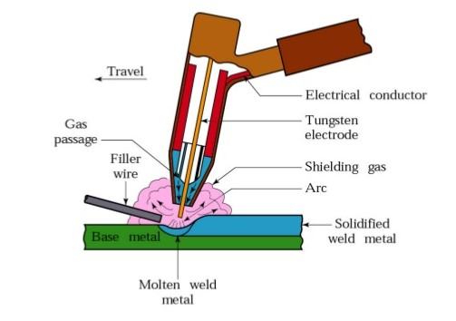
Gas Tungsten Arc Welding (GTAW) General
Gas Tungsten Arc Welding (GTAW), formerly known as Tungsten Inert Gas (TIG) Welding, is an electric-arc welding process that produces an arc between a non-consumable electrode and the work to be welded. The weld is shielded from the atmosphere by a shielding gas that forms an envelope around the weld area.

Slide 48
GTAW General
GTAW is versatile and can be used on ferrous and nonferrous metals and, depending on the base metal, in all welding positions. The process can be used to weld thin or thick materials with or without a filler metal. For thicker materials, an externally fed filler wire is generally used. The type of filler metal wire to be used is based on the chemical analysis of the base metal. The size of the filler metal wire depends on the thickness of the base metal, which usually dictates the welding current.
Welding variables are selected after the base metal, filler metal, and joint configuration have been selected. The fixed welding variables include the type of filler metal, electrode type and size, the type of current, and the type of shielding gas.
The primary adjustable variables for GTAW are welding current, arc length, and travel speed.

Slide 49
GTAW Tungsten Electrodes
The electrode material for GTAW is made from a tungsten alloy. Tungsten has one of the highest melting temperatures of any metal, about 6,170 degrees Fahrenheit (3,410 degrees Celsius).
The size of an electrode to be used is determined by the welding current required. Larger electrodes permit higher currents to be used. Smaller diameter electrodes may be used for welding thinner materials.
Tungsten alloy | Usage
Pure tungsten | On nonferrous metals, such as aluminium and magnesium, and is typically used with a balled-end preparation on alternating current
Thoriated tungsten | On carbon and stainless steel. It can be purchased with 1 or 2 per cent thorium. The thoriated tungsten starts readily and maintains a stable arc. It has a greater resistance to contamination and will maintain a sharp point and will not break down as readily as pure tungsten.
Zirconiated tungsten | welding with higher AC currents on nonferrous metals

Slide 50
GTAW Shielding Gases
Argon and helium are the two most commonly used shielding gases used for GTAW. Both gases are inert, causing an ionization effect in the welding arc. They protect the tungsten electrode and the molten weld pool from the atmosphere.
Argon is heavier than helium and may be supplied in liquid or gaseous form. Argon is suitable for welding similar and dissimilar metals and works well while welding in the vertical and overhead welding positions.
Helium is a lighter inert gas. It leaves the weld area faster than argon, and higher flow rates are necessary when using it. Helium produces a narrow but deep heat-affected zone (HAZ), which is good for welding on heavier metals. It is suitable for welding at high speeds and gives good coverage in vertical and overhead welding positions. It helps to increase the penetration. Helium is suitable for use on thicker nonferrous metals.
Argon and helium mixtures can be also used.
Argon and hydrogen mixtures are often used for welding of stainless steel. The typical mixture is a 95 per cent argon and 5 per cent hydrogen.

Slide 51
GTAW Welding Current
The current depends primarily on the type of metal to be welded, the current levels required, and the availability of the machine that produces that type of welding current.
Direct current electrode positive (DCRP) (reverse polarity) is sometimes used to weld very thin nonferrous metals. Direct current electrode negative (DCSP) (straight polarity) is used most commonly to weld stainless steel and ferrous metals.
AC current, with the addition of high frequency, is most commonly used for welding some nonferrous metals such as aluminium and magnesium. It provides good cleaning action and gives moderate penetration.

Slide 52
GTAW Applications
Originally developed for welding Aluminium and Magnesium.
The other metals are Stainless steel, High carbon steel, Copper, Brass, Bronze, Silver, Molybdenum etc.
This process is used for joining various combinations of dissimilar metals.
Pipe work required for high pressure steam lines, chemical and petroleum industries.
Welding of air craft frame, jet engine casing, rocket motor casing.

Slide 53
GTAW Advantages and Disadvantages
Advantages | Disadvantages
Clean, high quality welds | High operator skill required
Ability to weld very thin materials | High cost equipment
Wide range of alloys can be welded | Lower deposition rates
Spatter free welds | Need external shielding gas
Highly aesthetic weld beads | Material must be free of rust and dirt
Welds are stronger and ductile

Slide 54
Submerged Arc Welding (SAW) Principles
SAW involves formation of an arc between a continuously-fed bare wire electrode and the work piece. The process uses a flux to generate protective gases and slag, and to add alloying elements to the weld pool. A shielding gas is not required. Prior to welding, a thin layer of flux powder is placed on the work piece surface. The arc moves along the joint line and as it does so, excess flux is recycled via a hopper. Remaining fused slag layers can be easily removed after welding. As the arc is completely covered by the flux layer, heat loss is extremely low. This produces a thermal efficiency as high as 60% (compared with 25% for manual metal arc). There is no visible arc light, welding is spatter-free and there is no need for fume extraction.

Slide 55
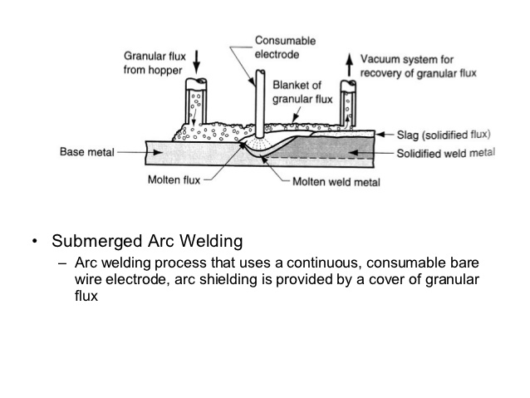
Submerged Arc Welding (SAW) Principles

Slide 56
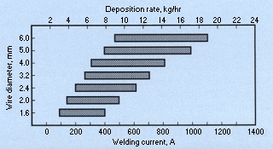
SAW Operating characteristics
SAW is usually operated as an automatic process, but it can be semi-automatic. Welding parameters: current, arc voltage and travel speed all affect bead shape, depth of penetration and chemical composition of the deposited weld metal. Because the operator cannot see the weld pool, greater reliance must be placed on parameter settings.

Slide 57
SAW Process Variants (Wire)
According to material thickness, joint type and size of component, varying the following can increase deposition rate and improve bead shape:
Wire
SAW is normally operated with a single wire on either AC or DC current. Common variants are:
twin wire
multiple wire (tandem or triple)
metal powder addition
tubular wire
All contribute to improved productivity through a marked increase in weld metal deposition rates and/or travel speeds.

Slide 58
SAW Process Variants (Flux)
Flux
Fluxes used in SAW are granular fusible minerals containing oxides of manganese, silicon, titanium, aluminium, calcium, zirconium, magnesium and other compounds such as calcium fluoride. The flux is specially formulated to be compatible with a given electrode wire type so that the combination of flux and wire yields desired mechanical properties. All fluxes react with the weld pool to produce the weld metal chemical composition and mechanical properties. It is common practice to refer to fluxes as 'active' if they add manganese and silicon to the weld, the amount of manganese and silicon added is influenced by the arc voltage and the welding current level.

Slide 59
SAW Process Variants (Flux)
The main types of flux for SAW are:
Bonded fluxes - produced by drying the ingredients, then bonding them with a low melting point compound such as a sodium silicate. Most bonded fluxes contain metallic deoxidisers which help to prevent weld porosity. These fluxes are effective over rust and mill scale.
Fused fluxes - produced by mixing the ingredients, then melting them in an electric furnace to form a chemically homogeneous product, cooled and ground to the required particle size. Smooth stable arcs, with welding currents up to 2000A and consistent weld metal properties, are the main attraction of these fluxes.

Slide 60
SAW Welding current
The SAW process uses either direct or alternating current for welding power. Direct current is used for most applications which use a single arc. Both direct current electrode positive (DCEP) and electrode negative (DCEN) are used.
The constant voltage type of direct current power is more popular for submerged arc welding with 1/8 in. (3.2 mm) and smaller diameter electrode wires.
The constant current power system is normally used for welding with 5/32 in. (4 mm) and larger-diameter electrode wires. The control circuit is more complex since it attempts to duplicate the actions of the welder to retain a specific arc length. The wire feed system must sense the voltage across the arc and feed the electrode wire into the arc to maintain this voltage. As conditions change, the wire feed must slow down or speed up to maintain the prefixed voltage across the arc. This adds complexity to the control system.

Slide 61
SAW Applications
SAW is ideally suited for longitudinal and circumferential butt and fillet welds. However, because of high fluidity of the weld pool, molten slag and loose flux layer, welding is generally carried out on butt joints in the flat position and fillet joints in both the flat and horizontal positions. For circumferential joints, the work piece is rotated under a fixed welding head with welding taking place in the flat position. Depending on material thickness, either single-pass, two-pass or multipass weld procedures can be carried out. There is virtually no restriction on the material thickness, provided a suitable joint preparation is adopted. Most commonly welded materials are carbon-manganese steels, low alloy and high-strength steels and stainless steels, although the process is capable of welding some non-ferrous materials with judicious choice of electrode filler wire and flux combinations.

Slide 62
SAW Applications
The submerged arc process is widely used in heavy steel plate fabrication work. This includes the welding of structural shapes, the longitudinal seam of larger diameter pipe, the manufacture of machine components for all types of heavy industry, and the manufacture of vessels and tanks for pressure and storage use. It is widely used in the shipbuilding industry for splicing and fabricating sub-assemblies, and by many other industries where steels are used in medium to heavy thicknesses. It is also used for surfacing and build-up work, maintenance, and repair.

Slide 63
SAW Advantages - Disadvantages
Advantages | Disadvantages
Practically, no edge preparation is necessary for materials under 12 mm in thickness | Since the operator cannot see the welding being carried out, he cannot judge the progress of welding accurately
The submerged process can be used for welding in exposed areas with relatively high wind | The progress is limited to welding in flat position and on the metal more than 4.8 mm thick. In small thicknesses burn through is likely to occur
high quality metal weld | The process requires accurate fit-up in the joint
Welding is carried out without sparks, smoke, flash or spatter | Flux is subjected to contamination that may cause weld
extremely high speed and deposition rate
easy automation for high-operator factor
normally, no involvement of manipulative skills
Because of high heat concentration and high welding speeds weld distortion is much

Slide 64
ElectroSlag Welding (ESW) (1)
Electroslag welding is a method where a primary arc is used at first to heat the slag and is then smothered by the conductive slag. The heat is then generated by the slag resisting the electricity passing between the consumed electrode and the work. It is usually used to weld steel in a vertical position and was used widely in the Soviet Union in the 1940's.
The thickness limit for this welding process reaches up to 30 cm. Extreme heat helps to gain this type of penetration, and multiple electrodes can be used to speed up this process. In the 1970's, electroslag welding became a popular choice for welding metals that were very thick. These applications include parts for bridges, buildings, ships, and pressure vessels.

Slide 65
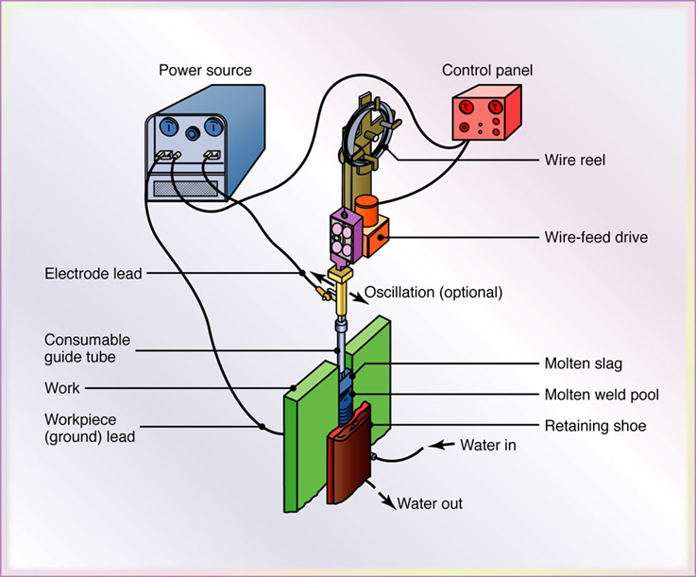
ESW (2)

Slide 66
ESW (3)
The positive side of electroslag welding is that very thick metals can be joined and multiple electrodes can be used to complete a weld in a single pass. The heat is held in the weld longer and gas bubbles are allowed to escape from the weld pool before it cools. The entire process is automatic and once it starts it does not stop until the weld is complete.
In shipbuilding, electroslag welding is the quickest way to join the large section modules of the ship together.
There is very little work that needs to be done to prepare the joints prior to welding and the distortion of the metal is relatively low. The drawbacks come from the fact that the system is very complicated and works mainly on vertical joints. Also some of the instruments used in this procedure have to be cooled with a constant water supply.

Slide 67
ElectroGas Welding (EGW)
Electrogas welding (EG) is characterised by a vertical groove which is bound by two water-cooled copper shoes. In the groove, a filler wire electrode which is fed through a copper nozzle, is melted by a shielded arc.
One or more electrodes are fed through a conduit and a continuous arc is maintained by flux-cored electrodes at up to 750 A or solid electrodes at 400 A.
Shielding is done by means of an inert gas, such as argon or helium depending on the type of material being welded. The gas may be provided either from an external source, from a flux-cored electrode or from both the sources. The equipment of electrogas welding is reliable and training an operator is easy. Weld thickness is between 12 mm to 75 mm on steels, titanium and aluminum alloys.

Slide 68
EGW (2)
Electrogas welding process is used in the construction of bridges, pressure vessels, thick-walled and large-diameter pipes, storage tanks, submarines and ships. If possible, any interruptions of the welding process should be avoided.
Suitable power sources are rectifiers with a slightly dropping static characteristic. The electrode has a positive polarity.
For a more wide-spread application of electrogas welding, the High-Speed Electrogas Welding Method has been developed . In this process, the gap cross-section is reduced and additional metal powder is added to increase the deposition rate. By the increase of the welding speed, the weld-adjacent regions remain above critical temperatures for a short time and thus the brittleness effects are significantly reduced.

Slide 69
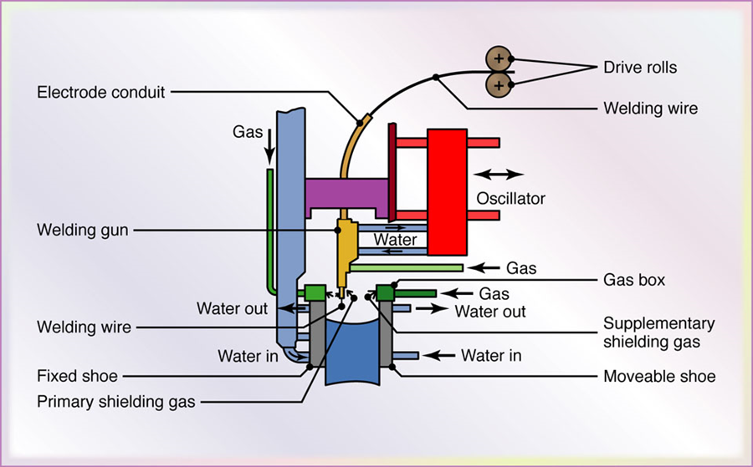
ElectroGas Welding

Slide 70
Comparison of Welding processes
 | SMAW | Gravity | GMAW | GTAW | SAW | ESW/WGW
Production rate | 5 | 3 | 4 | 6 | 2 | 1 (higher)
Installation Cost | 1 | 2 | 4 | 3 | 5 | 6 (higher)
Fracture toughness | 3 | 4 | 2 | 1 (higher) | 5 | 6
Welding positions | all | Flat horizontal | all | all | flat | vertical

Slide 71
Use of welding processes in shipbuilding
Stage | Structural Element | Joint type | Welding process
Sub-assembly | Interior elements | Butt | SAW
 |  | Tee | Gravity GMAW (CO₂)
Assembly | Flat plates | Butt | SAW
 | Curved plates | Butt | SAW GMAW (CO_{2,} CO₂+Ar)
 | Interior elements | Tee | Gravity GMAW (CO₂)
Final assembly | Outer plates | Butt (flat) | SAW GMAW (CO_{2,} CO₂+Ar)
 |  | Butt (vertical) | ESW GMAW (CO_{2,} CO₂+Ar)
 |  | Butt (horizontal) | SAW GMAW (CO_{2,} CO₂+Ar)
 | Interior plates | Butt (vertical) | ESW
 |  | Butt (flat) | SAW GMAW (CO₂)

Slide 72
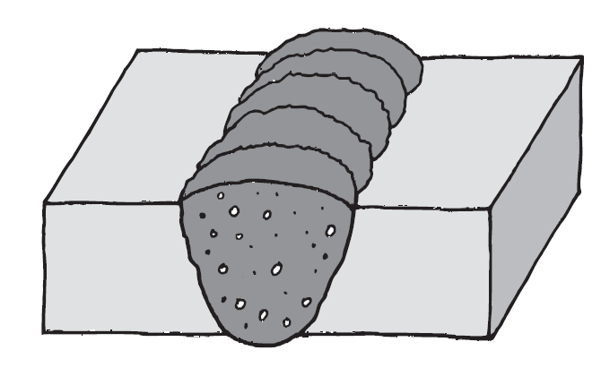
Defects in Welds
Defects in welds
1. Cavities
1.a Porosity
1.b Solid Inclusions
gas flow too high
blocked nozzle
draughty conditions
moisture on work or filler
paint or grease on surface
of metal

Slide 73
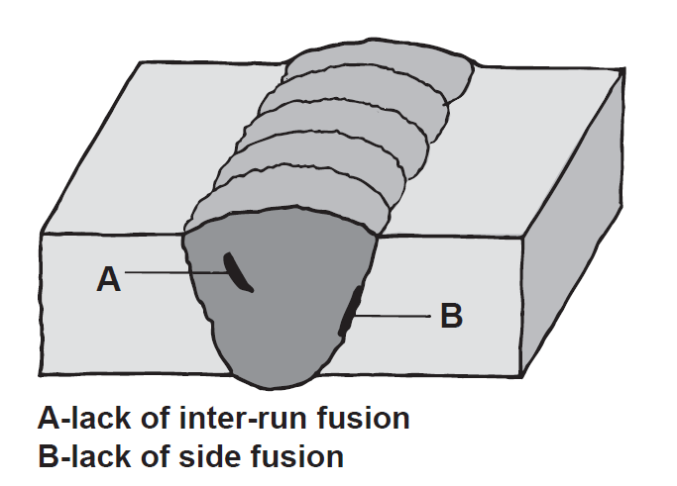
Defects in Welds
2. Lack of fusion
arc length too short
current too low
travel speed too slow
in GMAG welding
incorrect inductance
setting (GMAG)
Inadequate gas
shielding

Slide 74
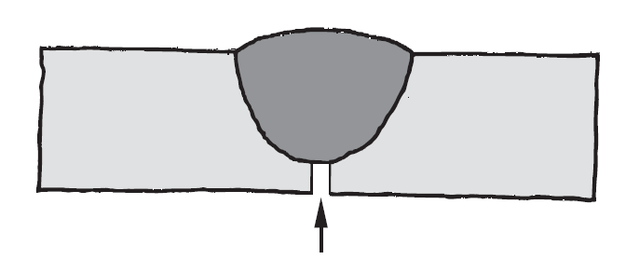
Defects in Welds
3. Lack of penetration
current too low
root gap too small
root face too thick
poor technique
misaligned joint

Slide 75
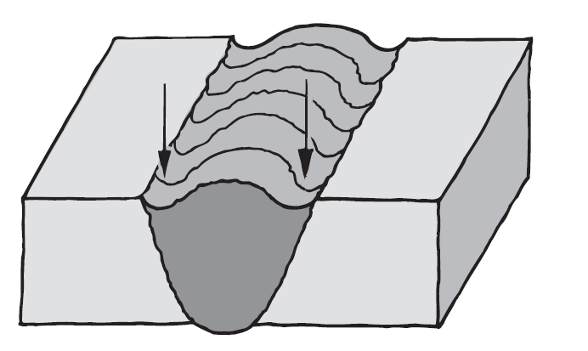
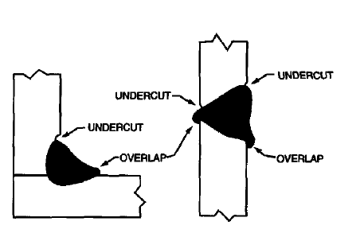
Defects in Welds
4. Undercut, Overlap
travel speed too high
current too high
poor technique
No proper choice
of welding materials
No proper preparation

Slide 76
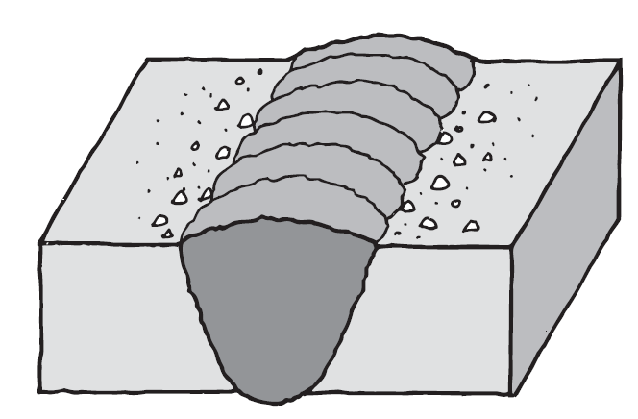
Defects in Welds
5. Spatter
insufficient inductance
short arc length
voltage too low
rusty plate

Slide 77
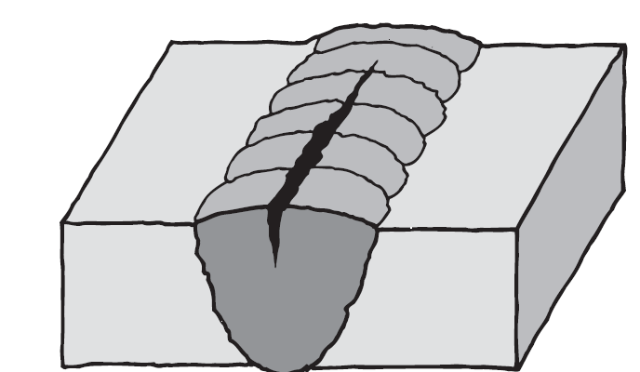
Defects in Welds
6. Cracks (in line, transverse, cratter)
Cracks on welding, base metal
Hot, Cold cracks
low voltage, high current
incorrect filler
(stainless steel and aluminium)
incorrect use of preheat
high restraint
Acceptance levels for defects are
given in Standards.
Check the Standards before you start to weld.

Slide 78
No.20: Non-destructive testing of ship hull steel welds
(IACS, 1988, Rev.1, Dec 2007)
REC_20_pdf717.pdf
6520_defects_overview_final3.pdf

Slide 79
Non-destructive tests (NDT)
Non-destructive tests (NDT)
Visual inspection.
Penetrant fluid.
Magnetic particles.
Radiographic examination (X-ray, Gamma-ray).
Ultrasonic.

Slide 80
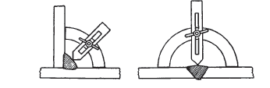
NDT- Visual inspection
Examination of a weld on completion will indicate many of the following points:
Has correct fusion been obtained between weld metal and parent metal?
Is there any indentation, denoting undercutting along the line where the weld joins the parent metal (line of fusion)?
Has penetration been obtained right through the joint, indicated by the weld metal appearing through the bottom of the V or U on a single V or U joint?
Has the joint been built up on its upper side (reinforced), or has the weld a concave side on its face, denoting lack of metal and thus weakness?
Does the metal is full of pinholes and burnt?
Has spatter occurred, indicating too high a current or too high a voltage across the arc or too long an arc?
Are the dimensions of the weld correct, tested, for example, by gauges

Slide 81
NDT – Penetrant fluid
The surface is cleaned and the dye penetrant fluid is painted or sprayed on the area to be examined. The fluid is allowed to penetrate into any defects such as cracks and the surplus is removed. A developer powder is sprayed on to the surface and soaks up the penetrant leaving a stain indicating the defect. The surface can also be viewed under ultraviolet light in darkened conditions, when the fluorescent penetrant glows, indicating the crack.
Surface scratches may mask the result and penetrant contamination of the crack occurs but the method is used as an addition to X-ray or gamma-ray inspection.

Slide 82
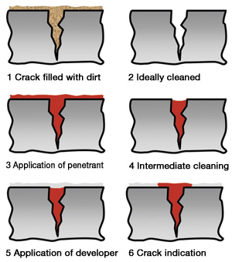
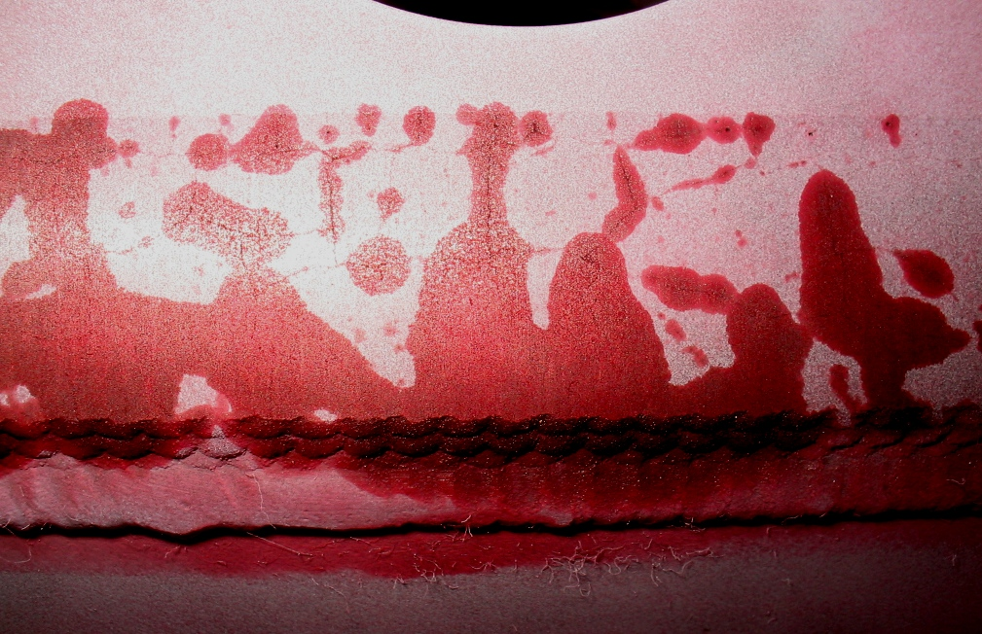
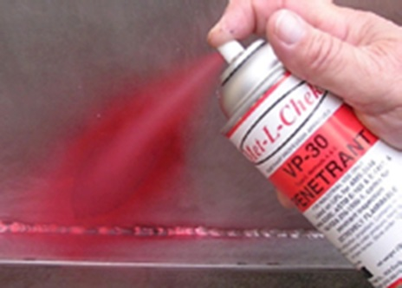
NDT – Penetrant fluid

Slide 83
NDT – Magnetic particles test
(Surface defects only)
The specimen under test is magnetized using a low voltage transformer and two probes for making contact with the specimen, and to enable the flux to be varied in the specimen. Iron filings in a finely divided or colloidal state are applied as an ink or as a powder and the flux is distorted at the crack or other fault with magnetic poles being formed. Probe positions will give a flux either with the weld or across it as shown in Figure. Examination can also be performed with ultraviolet light and fluorescent ink.

Slide 84
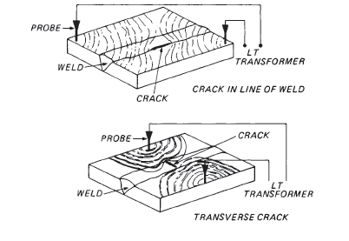
NDT – Magnetic Tests (2)

Slide 85
NDT – Radiographic Examination (1)
Radiography is a method of non-destructive examination that utilizes radiation to penetrate an object and (1) record images on a variety of recording devices such as film or photosensitive paper, (2) be viewed on a fluorescent screen, or (3) be monitored by various types of electronic radiation detectors.
When an object to be examined is exposed to penetrating radiation some radiation will be absorbed, some will be scattered and some radiation will be transmitted through the test object onto the recording device. Radiation will be differentially absorbed over various areas of the test object. Most weldment examinations performed by the radiographic method use electromagnetic radiation, such as x-rays and gamma rays.
The radiation emitted by these sources has an extremely short wavelength (about 1/10000 of the wavelength or less than that of visible light) that enables them to penetrate materials that absorb or reflect light. X-rays are produced by x-ray tubes; gamma rays are emitted from the disintegrating nuclei of radioactive elements.
Of the radioisotopes, the three in common use are cobalt 60, cesium 137, and iridium 192. These have been named in order of decreasing energy level (penetrating ability).

Slide 86
NDT – Radiographic Examination (2)
The radiographic process is dependent upon the differential absorption of radiation, as it penetrates the test object. It is the difference in absorption occurring during the exposure process that accounts for the difference in dark and light regions on the radiograph; i,e., the contrast. The key factors that determine the rate of absorption are: a) the mass of the object and b) the penetrating power, defined by the energy of the radiation source
Dark regions more easily penetrated parts
Light regions the more difficult to penetrate regions
Discontinuities parallel to the direction of radiation are most likely to create a discernible image, while discontinuities that are normal to (planar) the direction of radiation are least likely to create a discernible image. Thus, the welding inspector should realize that orientation of radiation to test object discontinuities is an important consideration. Radiographic exposure of the test object in multiple directions is therefore very common and often necessary. The inspector should realize there is a limit to the amount of differential absorption that is radiographically sensitive and that higher energy levels used for penetration produce lower sensitivity levels. Thus, the radiographer should select energy levels that will permit penetration of the object in a reasonable time period while still achieving adequate sensitivity and contrast for detection and interpretation of defects.

Slide 87
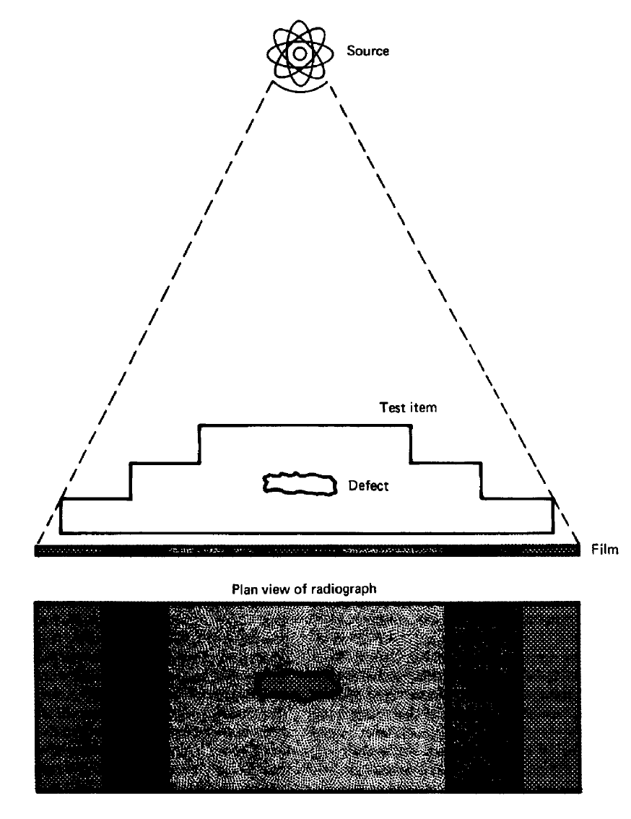
NDT – Radiographic Examination (3)

Slide 88
NDT – Radiographic Examination (4)
In general, the following rules apply to exposure geometry:
(1) The radiation source should be as small as possible. Sharpness in a radiograph is closely related to the physical size of the source of radiation.
(2)The distance from the source of radiation to the film should be as great as is practical.
(3) The film should be as close to the specimen as possible. Ideally the cassette or film holder should be in contact with the specimen.
(4)The primary source alignment axis of the radiation beam should be directed perpendicular to the film plane where possible. This will minimize distortion of the specimen and flaw images.
(5) The plane of maximum interest on the specimen should be parallel to the plane of the film.

Slide 89
NDT – Radiographic Examination (5)
Radiograph Interpretation – Welds
In addition to producing high quality radiographs, the radiographer must also be skilled in radiographic interpretation. Interpretation of radiographs takes place in three basic steps: (1) detection
(2) Interpretation
(3) evaluation.
All of these steps make use of the radiographer's visual acuity. Visual acuity is the ability to resolve a spatial pattern in an image. The ability of an individual to detect discontinuities in radiography is also affected by the lighting condition in the place of viewing, and the experience level for recognizing various features in the image

Slide 90
NDT – Radiographic Examination (6)
Discontinuities
Discontinuities are interruptions in the typical structure of a material. These interruptions may occur in the base metal, weld material or "heat affected" zones. Discontinuities, which do not meet the requirements of the codes or specifications used to invoke and control an inspection, are referred to as defects.

Slide 91
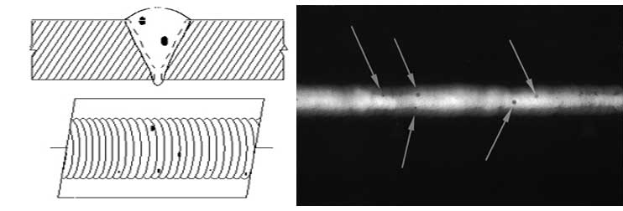
NDT – Radiographic Examination (7)
Porosity is the result of gas entrapment in the solidifying metal. Porosity can take many shapes on a radiograph but often appears as dark round or irregular spots or specks appearing singularly, in clusters, or in rows. Sometimes, porosity is elongated and may appear to have a tail. This is the result of gas attempting to escape while the metal is still in a liquid state and is called wormhole porosity. All porosity is a void in the material and it will have a higher radiographic density than the surrounding area.

Slide 92
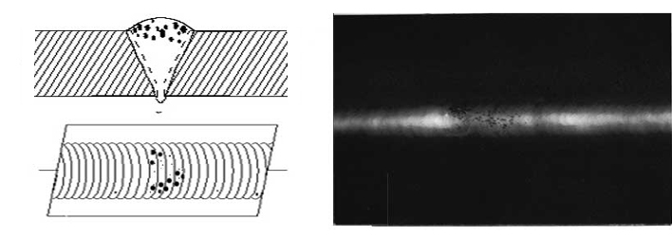
NDT – Radiographic Examination (8)
Cluster porosity is caused when flux coated electrodes are contaminated with moisture. The moisture turns into a gas when heated and becomes trapped in the weld during the welding process. Cluster porosity appear just like regular porosity in the radiograph but the indications will be grouped close together.

Slide 93
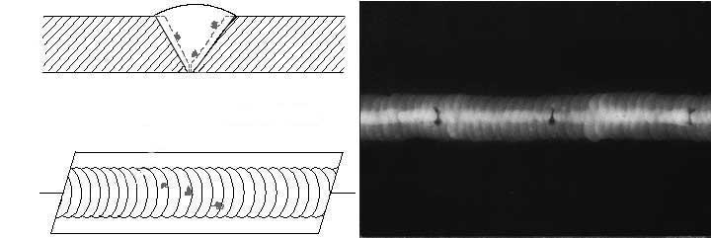
NDT – Radiographic Examination (9)
Slag inclusions are non-metallic solid material entrapped in weld metal or between weld and base metal. In a radiograph, dark, jagged asymmetrical shapes within the weld or along the weld joint areas are indicative of slag inclusions.

Slide 94
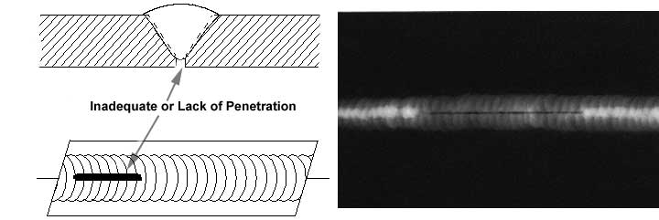
NDT – Radiographic Examination (10)
Incomplete penetration (IP) or lack of penetration (LOP) occurs when the weld metal fails to penetrate the joint. It is one of the most objectionable weld discontinuities. Lack of penetration allows a natural stress riser from which a crack may propagate. The appearance on a radiograph is a dark area with well-defined, straight edges that follows the land or root face down the centre of the weldment.

Slide 95
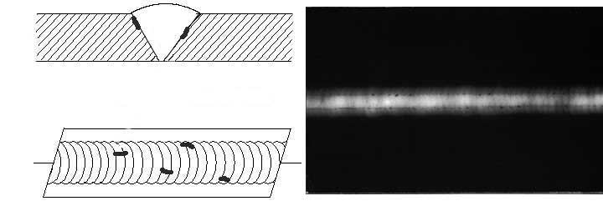
NDT – Radiographic Examination (11)
Incomplete fusion is a condition where the weld filler metal does not properly fuse with the base metal. Appearance on radiograph: usually appears as a dark line or lines oriented in the direction of the weld seam along the weld preparation or joining area.

Slide 96
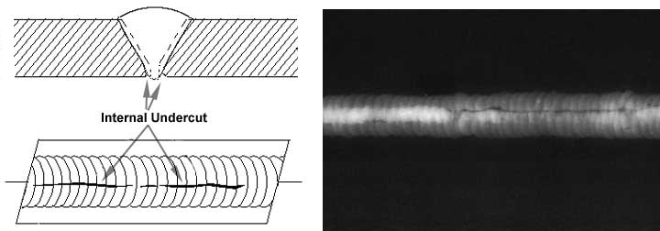
NDT – Radiographic Examination (12)
Internal or root undercut is an erosion of the base metal next to the root of the weld. In the radiographic image it appears as a dark irregular line offset from the centreline of the weldment. Undercutting is not as straight edged as LOP because it does not follow a ground edge.

Slide 97
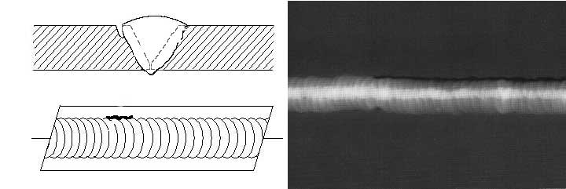
NDT – Radiographic Examination (13)
External or crown undercut is an erosion of the base metal next to the crown of the weld. In the radiograph, it appears as a dark irregular line along the outside edge of the weld area.

Slide 98
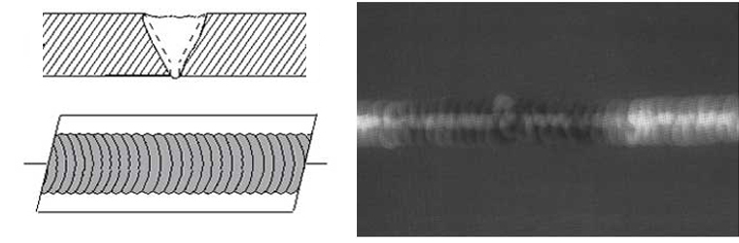
NDT – Radiographic Examination (14)
Inadequate weld reinforcement is an area of a weld where the thickness of weld metal deposited is less than the thickness of the base material. It is very easy to determine by radiograph if the weld has inadequate reinforcement, because the image density in the area of suspected inadequacy will be higher (darker) than the image density of the surrounding base material.

Slide 99
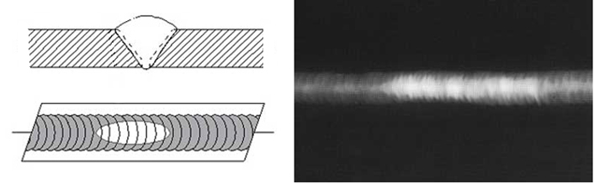
NDT – Radiographic Examination (15)
Excess weld reinforcement is an area of a weld that has weld metal added in excess of that specified by engineering drawings and codes. The appearance on a radiograph is a localized, lighter area in the weld. A visual inspection will easily determine if the weld reinforcement is in excess of that specified by the engineering requirements.

Slide 100

NDT – Radiographic Examination (16)
Cracks can be detected in a radiograph only when they are propagating in a direction that produces a change in thickness that is parallel to the x-ray beam. Cracks will appear as jagged and often very faint irregular lines. Cracks can sometimes appear as "tails" on inclusions or porosity.

Slide 101

NDT – Radiographic Examination (17)
Oxide inclusions are usually visible on the surface of material being welded (especially aluminum). Oxide inclusions are less dense than the surrounding material and, therefore, appear as dark irregularly shaped discontinuities in the radiograph.

Slide 102
NDT-Ultrasonic Testing (1)
Ultrasonic Testing (UT) uses high frequency sound energy to conduct examinations and make measurements. Ultrasonic inspection can be used for flaw detection/evaluation, dimensional measurements, material characterization, and more.
A typical UT inspection system consists of several functional units, such as the pulser/receiver, transducer, and display devices. A pulser/receiver is an electronic device that can produce high voltage electrical pulses. Driven by the pulser, the transducer generates high frequency ultrasonic energy. The sound energy is introduced and propagates through the materials in the form of waves. When there is a discontinuity (such as a crack) in the wave path, part of the energy will be reflected back from the flaw surface. The reflected wave signal is transformed into an electrical signal by the transducer and is displayed on a screen. Signal travel time can be directly related to the distance that the signal travelled. From the signal, information about the reflector location, size, orientation and other features can sometimes be gained.

Slide 103

NDT-Ultrasonic Testing (2)

Slide 104
NDT-Ultrasonic Testing (3)
Ultrasonic Inspection is a very useful and versatile NDT method. Some of the advantages of ultrasonic inspection include:
It is sensitive to both surface and subsurface discontinuities.
The depth of penetration for flaw detection or measurement is superior to other NDT methods.
Only single-sided access is needed when the pulse-echo technique is used.
It is highly accurate in determining reflector position and estimating size and shape.
Minimal part preparation is required.
Electronic equipment provides instantaneous results.
Detailed images can be produced with automated systems.
It has other uses, such as thickness measurement, in addition to flaw detection.

Slide 105
NDT-Ultrasonic Testing (4)
As with all NDT methods, ultrasonic inspection also has its limitations, which include:
Surface must be accessible to transmit ultrasound.
Skill and training is more extensive than with some other methods.
Materials that are rough, irregular in shape, very small, exceptionally thin or not homogeneous are difficult to inspect.
Cast iron and other coarse grained materials are difficult to inspect due to low sound transmission and high signal noise.
Linear defects oriented parallel to the sound beam may go undetected.
Reference standards are required for both equipment calibration and the characterization of flaws.

Slide 106

Non-Destructive Tests - Comparisons

Slide 107

Non-Destructive Tests

Slide 108

Weld Calculation

Slide 109

Weld Calculation

Slide 110


Weld Calculation

Slide 111

Weld calculation

Slide 112

Weld Calculation

Slide 113

Weld Calculation

Slide 114

Weld Calculation

Slide 115
Glossary
Arc Blow- Deviation of the direction of the welding arc caused by magnetic fields in the work piece when welding with direct current.
Straight Polarity- Welding condition when the electrode is connected to the negative terminal and the work is connected to the positive terminal of the welding power source.
Reverse Polarity- Welding condition when the electrode is connected to the positive terminal and the work is connected to the negative terminal of the welding power source.
Slag- The brittle mass that forms over the weld bead on welds made with coated electrodes, flux cored electrodes, submerged arc welding and other slag producing welding processes. Welds made with the gas metal arc and the gas tungsten arc welding processes are slag free.
Manual Arc Welding- Welding with a coated electrode where the operator's hand controls travel speed and the rate the electrode is fed into the arc.
Semi-Automatic Welding- Welding with a continuous solid wire or flux cored electrode where the wire feed speed, shielding gas flow rate, and voltage are pre-set on the equipment, and the operator guides the hand held welding gun along the joint to be welded.

Slide 116
Glossary
Slag Inclusion- A weld defect where slag is entrapped in the weld metal before it can float to the surface.
Root Pass- The initial pass in a multi-pass weld, usually requiring 100% penetration.
Gas Ions- Shielding gas atoms that, in the presence of an electrical current, lose one or more electrons and therefore, carry a positive electrical charge.
High Frequency- (as applied to gas-tungsten arc welding) An alternating current consisting of over 50,000 cycles per second at high voltage, low amperage that is superimposed on the welding circuit in GTAW power sources. It ionizes a path for non-touch arc starting and stabilizes the arc when welding with alternating current
.Inert Gases- Gases that are chemically inactive. They do not readily combine with other elements.

Slide 117
Glossary
Flux- In arc welding, fluxes are formulations that, when subjected to the arc, act as a cleaning agent by dissolving oxides, releasing trapped gases and slag and generally cleaning the weld metal by floating the impurities to the surface where they solidify in the slag covering. The flux also serves to reduce spatter and contributes to weld bead shape. The flux may be the coating on the electrode, inside the electrode as in flux cored types, or in a granular form as used in submerged arc welding.
Current Density- The amperes per square inch of cross-sectional area of an electrode. High current density results in high electrode melt-off rate and a concentrated, deep penetrating arc.
Slope or Slope Control- A necessary feature in welding power sources used for short circuiting arc welding. Slope Control reduces the short circuiting current each time the electrode touches the weld puddle
.Inductance- (as applies to short circuiting arc welding) A feature in welding power sources designed for short circuiting arc welding to retard the rate of current rise each time the electrode touches the weld puddle.

Slide 118
Glossary
Contact Tip- That part of a gas metal arc welding gun or flux cored arc welding gun that transfers the welding current to the welding wire immediately before the wire enters the arc.
Spray Transfer- Mode of metal transfer across the arc where the molten metal droplets are smaller than the electrode diameter and are axially directed to the weld puddle. Requires high voltage and amperage settings and a shielding gas of at least 80% argon.
Globular Transfer- Mode of metal transfer across the arc where a molten ball larger than the electrode diameter forms at the tip of the electrode. On detachment, it takes on an irregular shape and tumbles towards the weld puddle sometimes shorting between the electrode and work at irregular intervals. Occurs when using shielding gases other than those consisting of at least 80% argon and at medium current settings
.Pulse Transfer- Mode of metal transfer somewhat between spray and short circuiting. The specific power source has built into it two output levels: a steady background level, and a high output (peak) level. The later permits the transfer of metal across the arc. This peak output is controllable between high and low values up to several hundred cycles per second. The result of such a peak output produces a spray arc below the typical transition current.

Slide 119
Glossary
Short-circuiting Transfer- Mode of metal transfer in gas metal arc welding at low voltage and amperage. Transfer takes place each time the electrode touches or short-circuits to the weld puddle, extinguishing the arc. The short-circuiting current causes the electrode to neck down, melt off, and then repeats the cycle.
Trimix or Triple Mix- A shielding gas consisting of approximately 90% helium, 7-1/2% argon, and2-1/2% carbon dioxide used primarily for short-circuiting arc welding of stainless steels. Maintains corrosion resistance of the stainless steel and produces good wetting and excellent weld bead shape.

