Slide 1
CT - ABDOMEN

Slide 2
Bile ducts

Slide 3
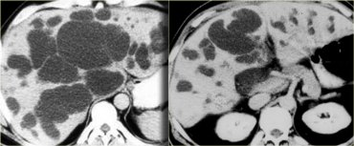
Caroli disease
Congenital
Dysplasia with focal dialatations

Slide 4
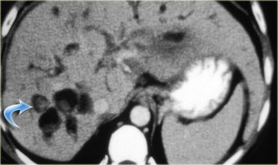
Stones in dilated bile ducts

Slide 5
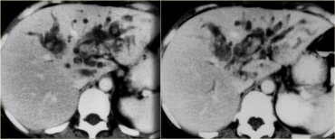
Pyogenic cholangitis

Slide 6
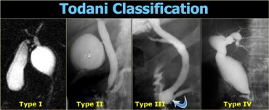
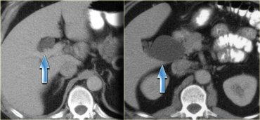
Choledochal cysts

Slide 7
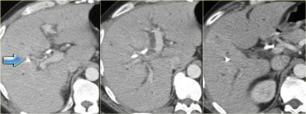
Bile duct dilatation
Usual type

Slide 8
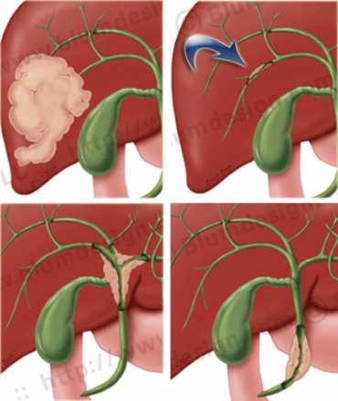
Cholangiocarcinoma

Slide 9
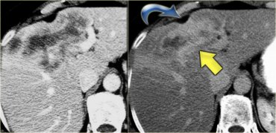
Delayed enhancement (15΄)

Slide 10
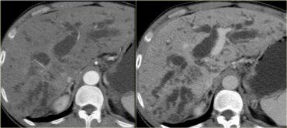
Klatskin’ tumor
Hilar tumor

Slide 11
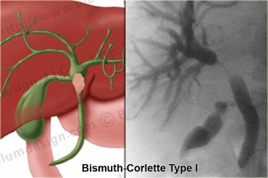
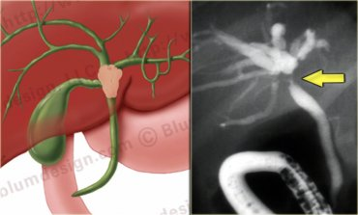
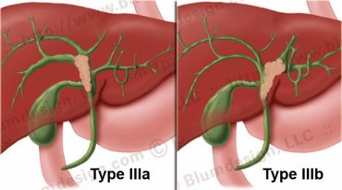
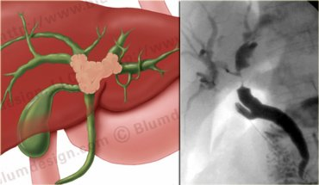

Slide 12
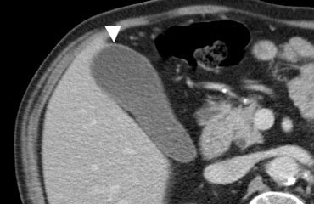
Normal gall bladder

Slide 13
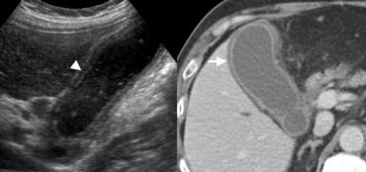

Slide 14
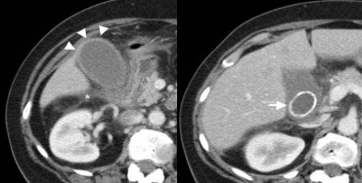

Slide 15
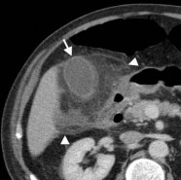
Fat infiltration

Slide 16
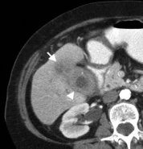
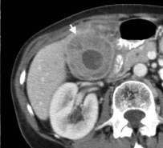
Which one is the carcinoma?

Slide 17
Pancreas
Use water for bowel prep
Scan before IV CM for calcifications
120 - 150 ml
Rate 3-5 ml/s.
Thickness 2-3 mm
Early arterial 20 sec for vascular assessment pre-op
Early portal phase 40-50 sec the most important phase for the best opacification of the pancreas parenchyma
Late portal or hepatic phase for liver etc

Slide 18

Ca pancreas

Slide 19
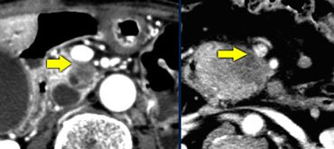
Ca pancreas - staging
Assessment of operability

Slide 20
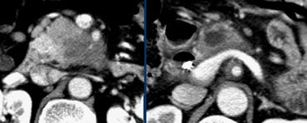

Slide 21
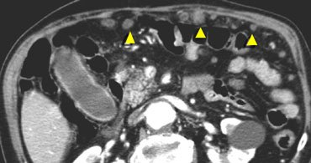
Peritoneal seeding

Slide 22
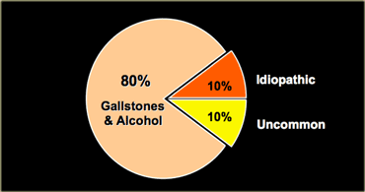
Pancreatitis

Slide 23
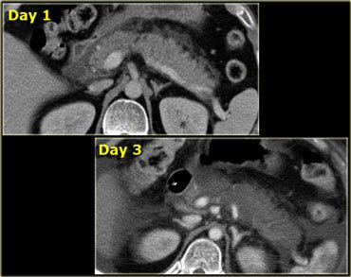

Slide 24
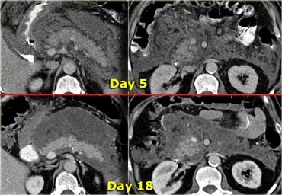

Slide 25
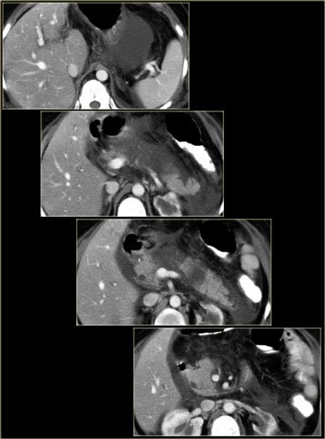
Necrotizing pancreatitis

Slide 26
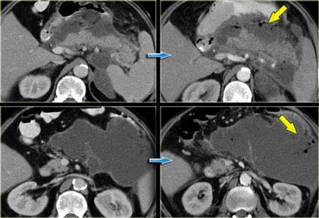

Slide 27
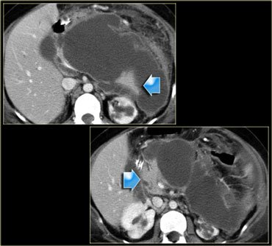

Slide 28
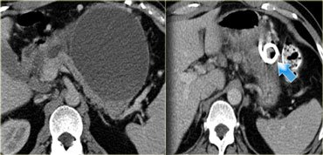
Pseudocyst

Slide 29
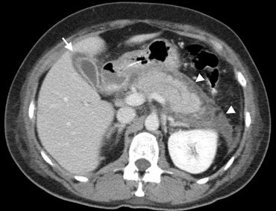
Pancreatitis

Slide 30
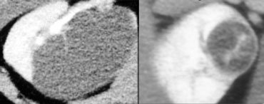
Kidneys

Slide 31
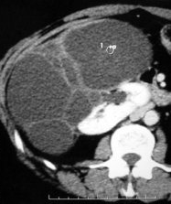
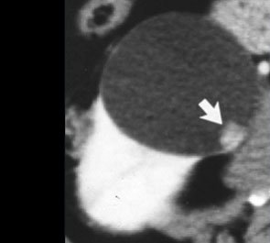

Slide 32
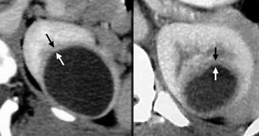

Slide 33
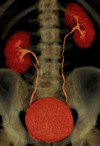
CT urography
Mainly haematuria

Slide 34
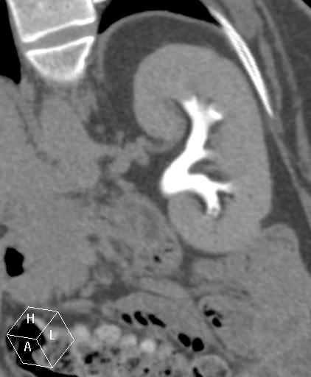
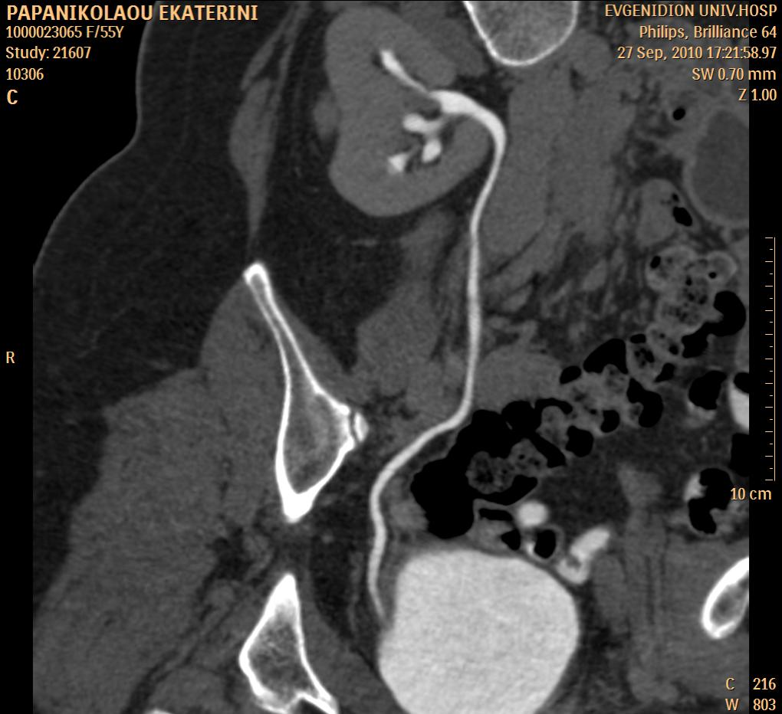
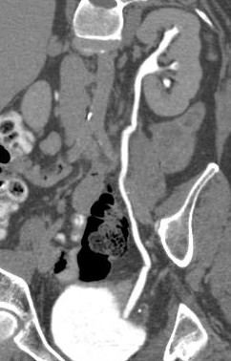

Slide 35
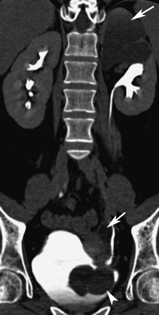
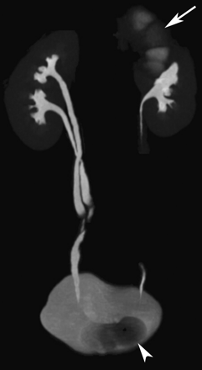

Slide 36
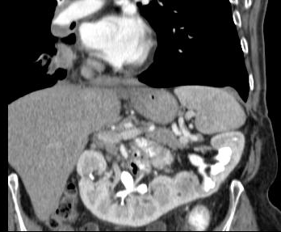

Slide 37
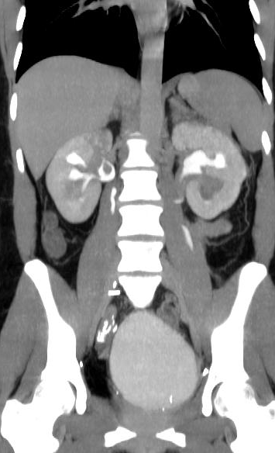
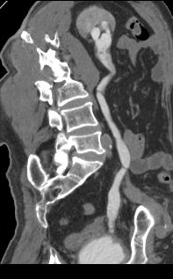

Slide 38
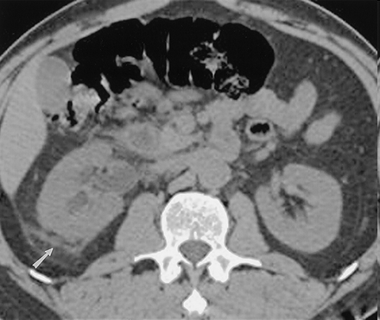
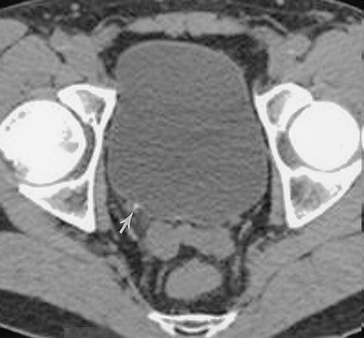

Slide 39
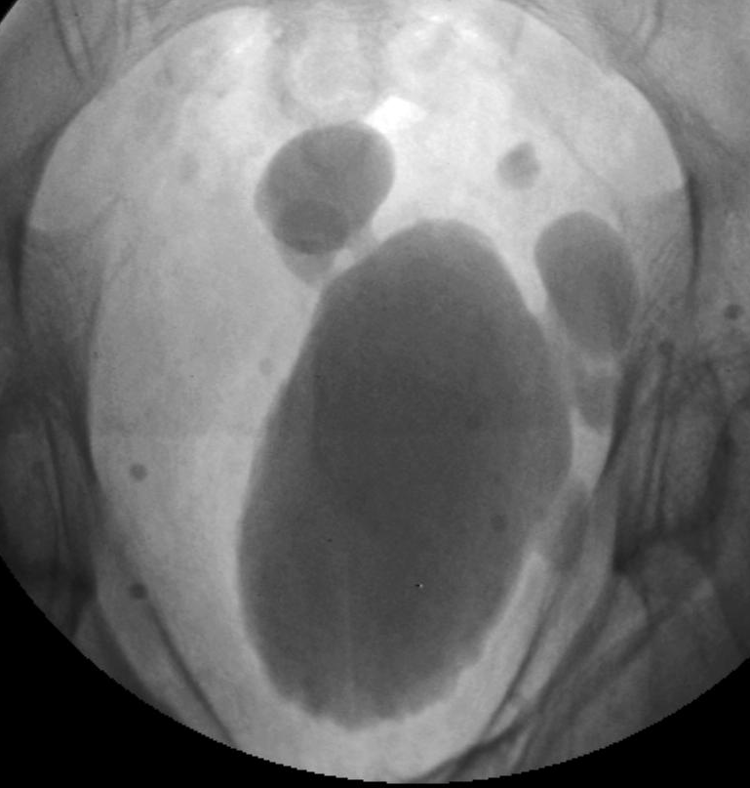
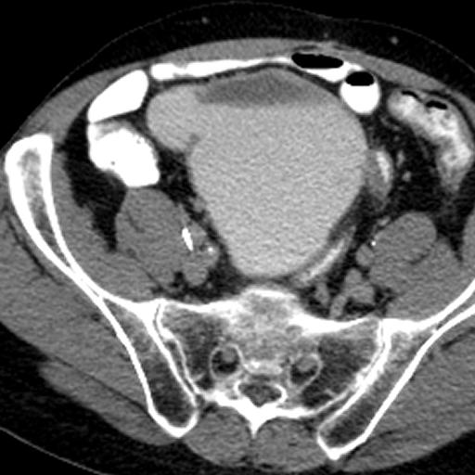
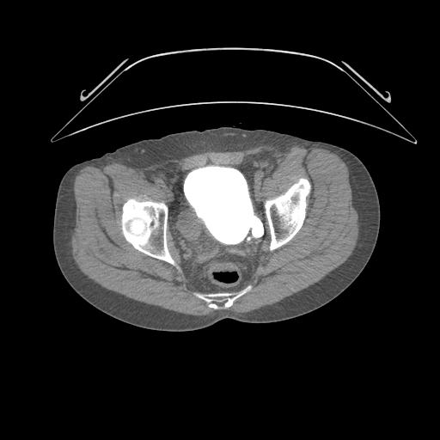

Slide 40
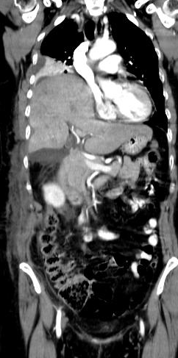
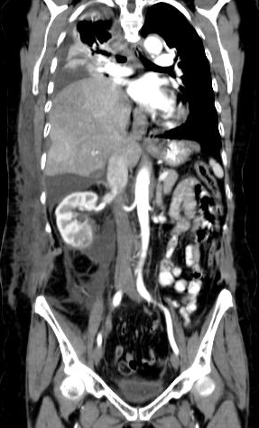


Slide 41


Slide 42


http://radiology.rsna.org/content/236/2/441

Slide 43

http://radiology.rsna.org/content/236/2/441

Slide 44

http://radiology.rsna.org/content/236/2/441

Slide 45



Adrenals
Measure HU before IV CM
Parenchymal phase – delayed phase
Assessment of enhancement and washout at 15 mins

Slide 46

Patient with lung cancer
-19HU
22HU

Slide 47

On the left a dedicated adrenal protocol in a patient with an adrenal mass.
On the unenhanced CT there is a small homogeneous mass that is well defined. The density is 9 HU, which is characteristic of a lipid-rich adenoma.
Although the protocol should have stopped at that moment, i.v. contrast was given to determine the washout.
The enhancement washout = (43 - 22) : (22 - 9) = 62% indicating a fast washout characteristic of an adenoma.
The lower the density on the unenhanced CT and the faster the washout the more confident you can be in making the diagnosis of an adenoma..

Slide 48

Adenoma - metastasis

Slide 49

Index of malignancy in cancer patients

Slide 50



Slide 51


Adrenal cancer - primary
Large inhomogeneous mass with central calcification typical of an adrenal carcinoma.

Slide 52

Metastatic disease

Slide 53

What do you see?

Slide 54
Trauma
Blunt trauma
  Portal phase
  Urographic phase
  No oral contrast to look for extravasation
Penetrating injuries
  Danger of bowel trauma
  Oral or rectal contrast preferred

Slide 55

Splenic rupture

Slide 56


Active extravasation

Slide 57


Slide 58

Liver trauma

Slide 59


Slide 60

Renal trauma

Slide 61


Slide 62
Urinary bladder
Instillation of contrast in the bladder after the initial scan with IV CM

Slide 63



Slide 64


Slide 65

Multiple trauma

Slide 66


Diaphragmatic rupture

Slide 67

Aortic aneurysm

Slide 68

Aortic rupture pre CM

Slide 69



Slide 70



Slide 71
Acute abdomen

Slide 72


Appendicitis

Slide 73


Diverticulitis

Slide 74

Cholecystitis

Slide 75

Fat inflammation

Slide 76

Mechanical bowel obstruction

Slide 77


Slide 78

Free air

Slide 79

Aneurysm rupture

Slide 80

Acute Pancreatitis

