Slide 1
CT lung

Slide 2
Technique
Depends on the indication
  Routine protocol
  High resolution protocol

Slide 3
Positioning
  Supine arms up
Scan length
  From the base of the neck to
    The diaphragm
    The adrenals in cancer patients

Slide 4
Breathing
  Full inspiration
Instruction
  Make sure there is adequate understanding
  Rehearse
  4-5 deep breaths before start
  3-4 sec before scan
  Scan outwards

Slide 5
IV CM (routine)
  90 mls
  2ml/sec
  25 (20-30) secs scan delay
IV CM angiography
  90-110 mls CM + 40-50 mls normal saline
  3ml/sec
  20sec delay or bolus tracking
Oral prep
  oesophagus
  Tumor invasion
  Just before scan

Slide 6
Section thickness
  Thin originals
  Thicker for viewing
Filters (raw data)
  Standard (lungs mediastinum)
  Bone HR lung parenhyma
  Optical filters
WW/L
  lungs: 1500 / -600
  mediastinum: 400 / 50

Slide 7
Exposure factors
  120kV
  150 mAs
  CTDIvol 5 - 10mGy
Due to high intrinsic contrast we can afford lower SNR and use lower exposure factors
The beam starvation artifacts in the shoulders and abdomen may be reduced by dose modulation techniques.

Slide 8
High Resolution CT (HRCT)
Thin sections < 2mms
Bone filter
Deep inspiration
Expiration - End expiration
    Air trapping
    DD air trapping – ground glass
    Wall invasion by Cancer
Prone - inspiration
  Only the suspicious areas usually lung bases
  5 mins before scan
  Avoid the need by scanning immediately after the patient lies flat
ΜΙΡ - minIP in different levels

Slide 9
CT low dose
Repeat scan for lung parenchyma assessment
Dose CTDIvol = 2-6mGy
Less sharp algorithm to manage noise
Higher kV (140)
Noise filtration

Slide 10
CT low dose – lung cancer screening
Thin sections (2-3mm)
Thicker reprocessing
No IV CM
CAD

Slide 11
Virtual bronchoscopy
3D technique
No measurements

Slide 12
Diseases of the lung

Slide 13
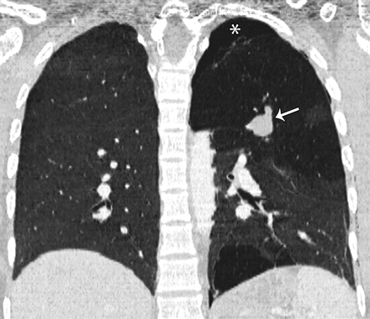
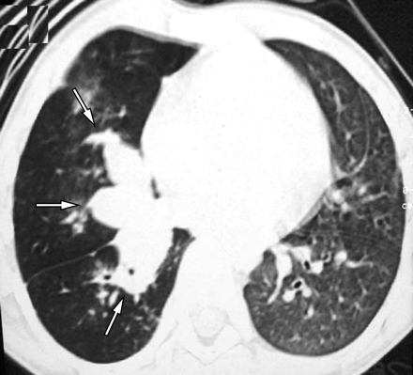
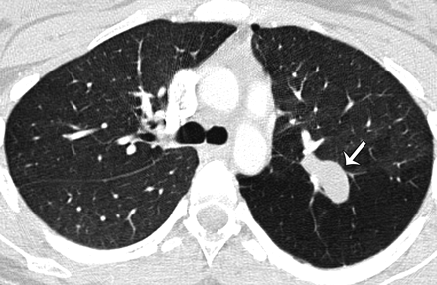
Congenital diseases
atresia
http://radiographics.rsna.org/content/29/5/1531 και 1497

Slide 14
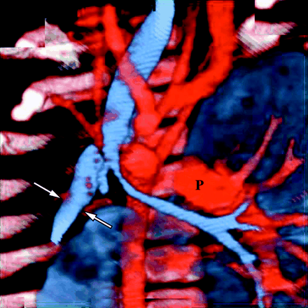
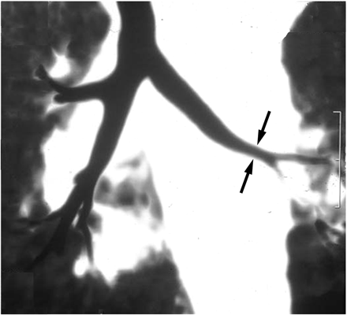
Agenesis, hypoplasia
http://www.ajronline.org/content/183/5/1497

Slide 15
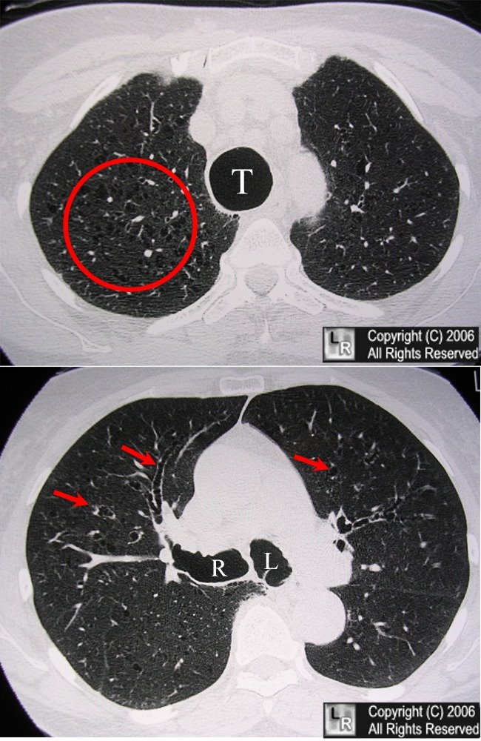
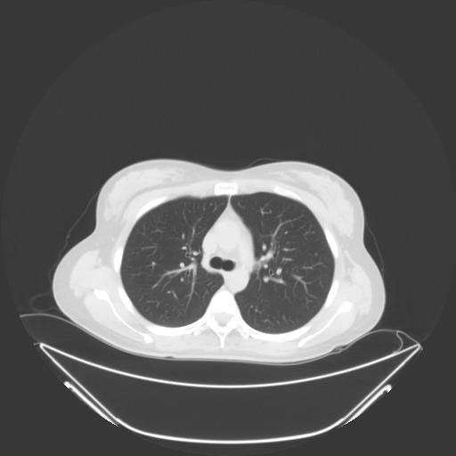
tracheobronchomegaly
http://www.learningradiology.com/archives06/COW%20230-Mounier-Kuhn/mounierkuhncorrect.html

Slide 16
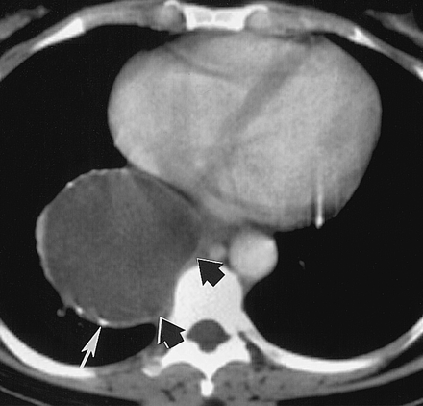
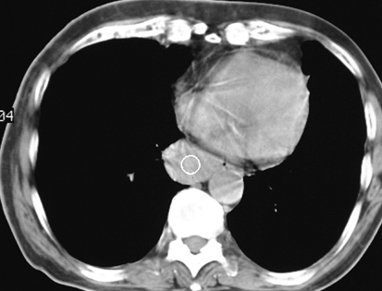
Bronchogenic cyst
Lung sequestration
http://radiology.rsna.org/content/217/2/441.long
http://emedicine.medscape.com/article/412554-overview#a20

Slide 17
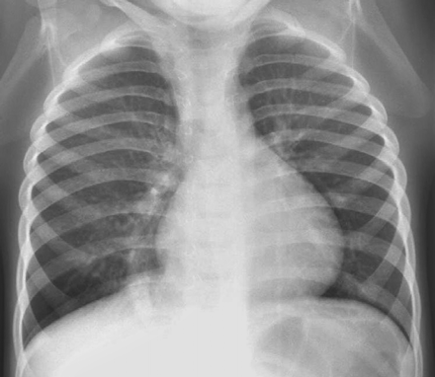
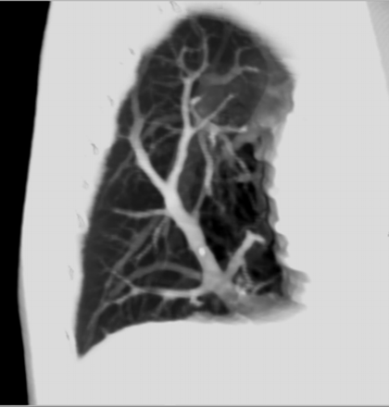
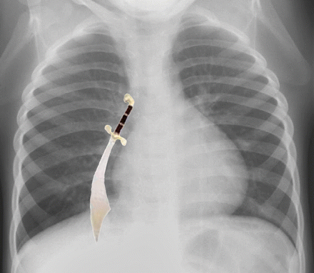
Scimitar syndrome
http://radiographics.rsna.org/content/27/5/1323.full
http://www.ajronline.org/content/183/5/1497

Slide 18
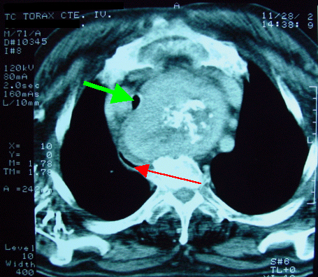
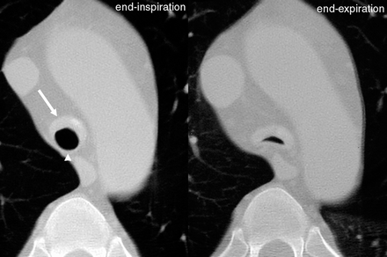
Diseases of the airways
Stenosis tracheal
Use WL=-700 και WW>1000
Movement may create double wall
http://radiographics.rsna.org/content/22/suppl_1/S215

Slide 19
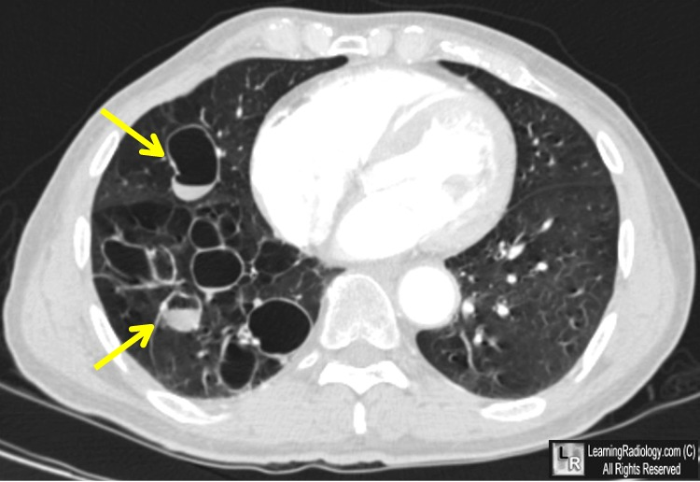
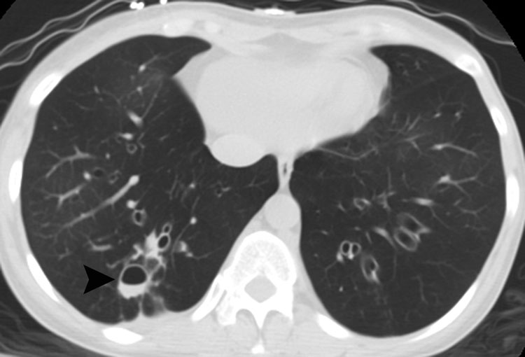
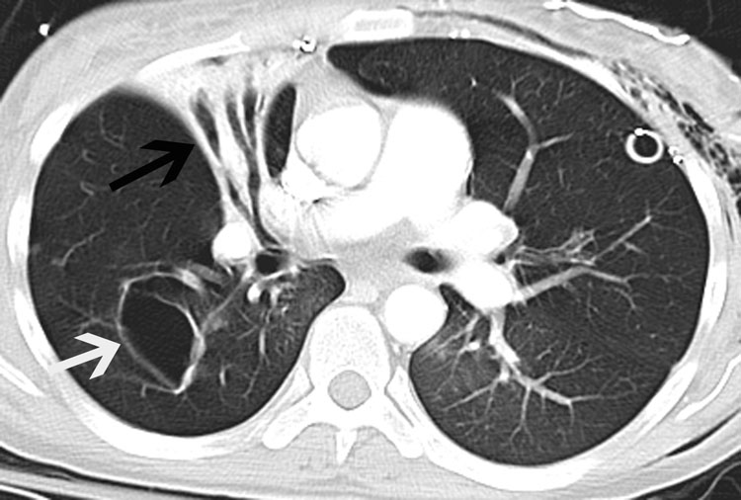
Bronchiectasis
http://www.learningradiology.com/archives2011/COW 468-Cystic Bronchiectasis
http://radiology.casereports.net/index.php/rcr/article/viewArticle/137/383

Slide 20
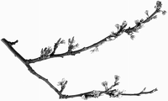
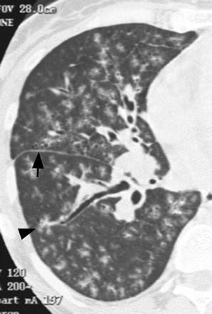
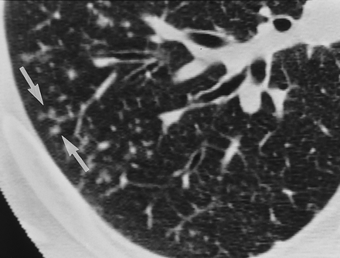
Bronchiolitis
Aspergillosis
http://www.ajronline.org/content/185/2/354/F15
http://radiology.rsna.org/content/222/3/771

Slide 21
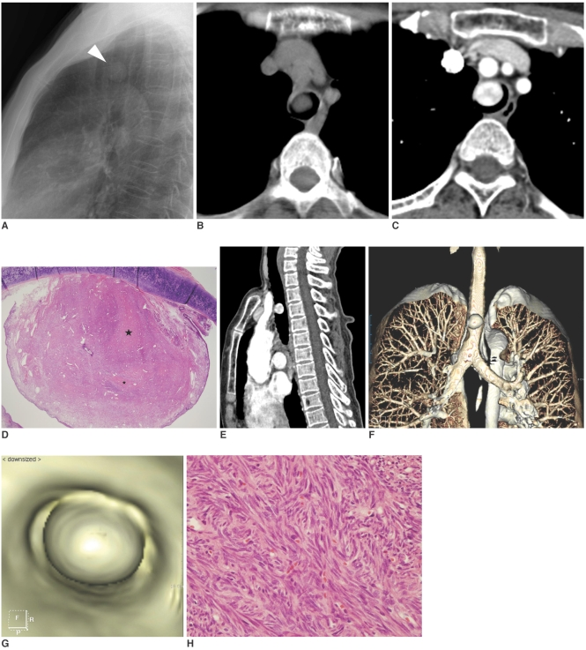
Tumors
  pappiloma –
  pappilomatosisΘηλωμάτωση
  carcinoid
http://www.ncbi.nlm.nih.gov/pmc/articles/PMC2627258/

Slide 22
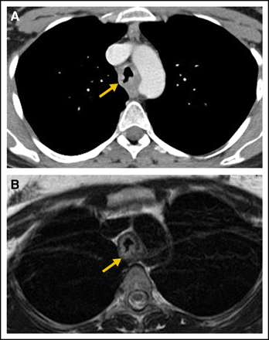
  Bronchial carcinoma
http://jco.ascopubs.org/content/25/34/5521.full

Slide 23
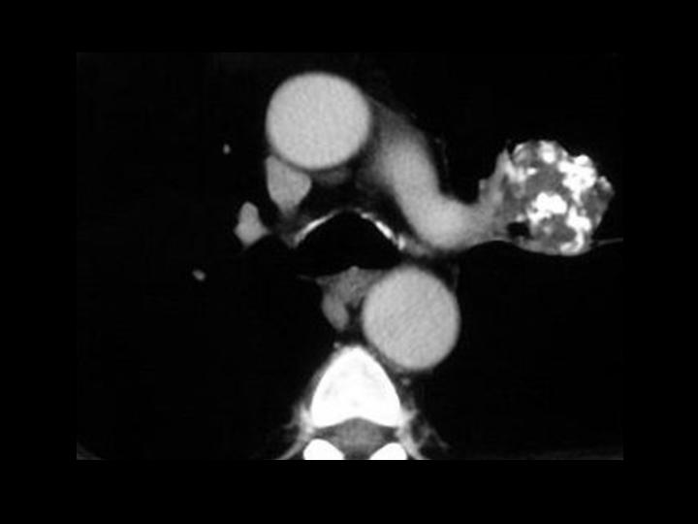
Lung nodules
Granuloma
Benign tumors
  Hamartoma, chondroma
http://emedicine.medscape.com/article/356271

Slide 24
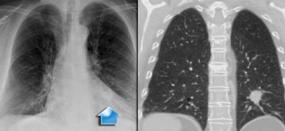
Malignant tumors
  Bronchogenic, alveolar cell, metastatic, carcinoid, kaposi sarcoma
http://www.radiologyassistant.nl/en/42459cff38f02

Slide 25
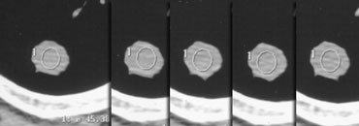
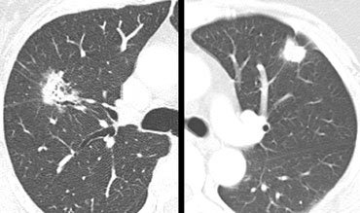
Lung nodule
Benign vs malignant
http://www.radiologyassistant.nl/en/460f9fcd50637

Slide 26
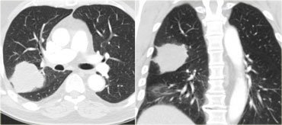
http://www.radiologyassistant.nl/en/42459cff38f02

Slide 27
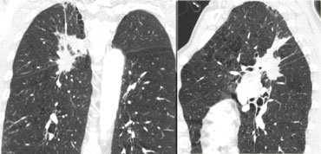
http://www.radiologyassistant.nl/en/42459cff38f02

Slide 28
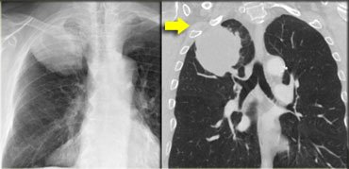
http://www.radiologyassistant.nl/en/42459cff38f02

Slide 29
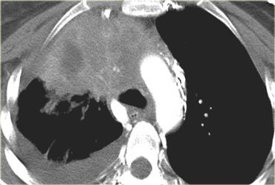
http://www.radiologyassistant.nl/en/42459cff38f02

Slide 30
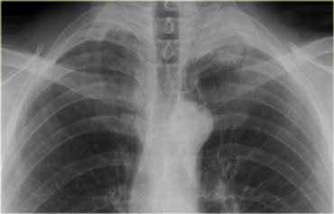
Pancoast tumor
http://www.radiologyassistant.nl/en/42459cff38f02

Slide 31
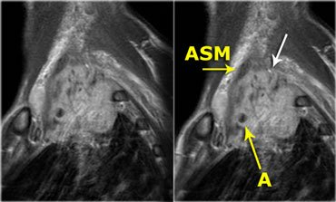
Pancoast tumor
http://www.radiologyassistant.nl/en/42459cff38f02

Slide 32
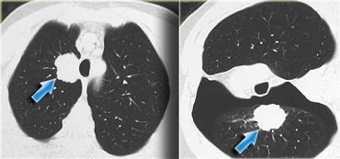
http://www.radiologyassistant.nl/en/42459cff38f02

Slide 33
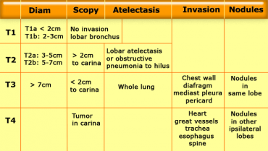
Staging – ΤΝΜ – Τ
http://www.radiologyassistant.nl/en/42459cff38f02

Slide 34
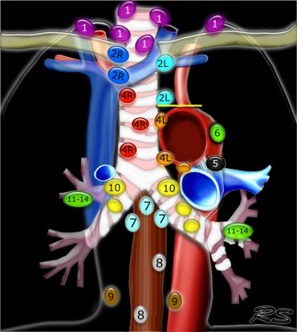
Staging
ΤΝΜ – Ν
http://www.radiologyassistant.nl/en/42459cff38f02

Slide 35
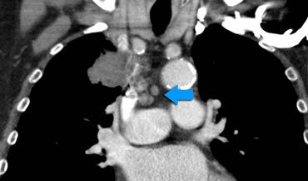
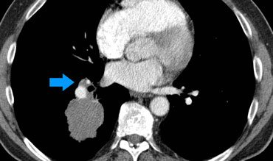
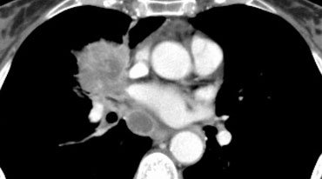
http://www.radiologyassistant.nl/en/42459cff38f02

Slide 36
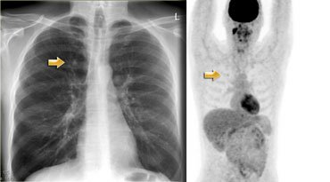
http://www.radiologyassistant.nl/en/42459cff38f02

Slide 37
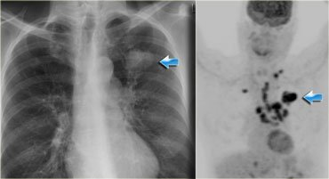
http://www.radiologyassistant.nl/en/42459cff38f02

Slide 38
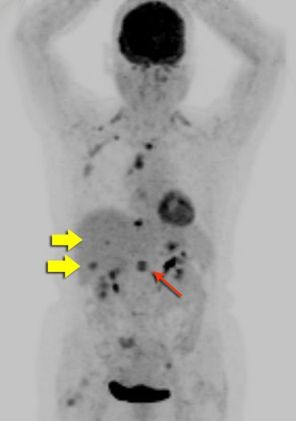
http://www.radiologyassistant.nl/en/42459cff38f02

Slide 39
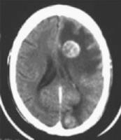
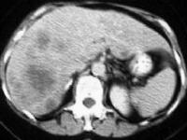
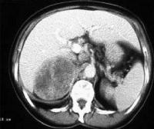
Staging
ΤΝΜ - Μ
  Brain
  Liver
  Adrenals

Slide 40
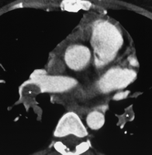
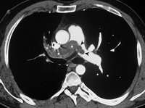
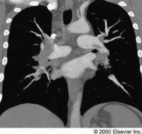
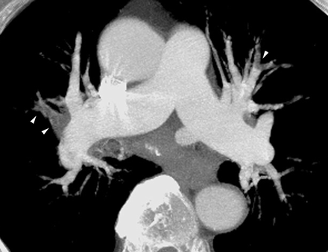
Embolism
http://imaging.consult.com/image/case

Slide 41
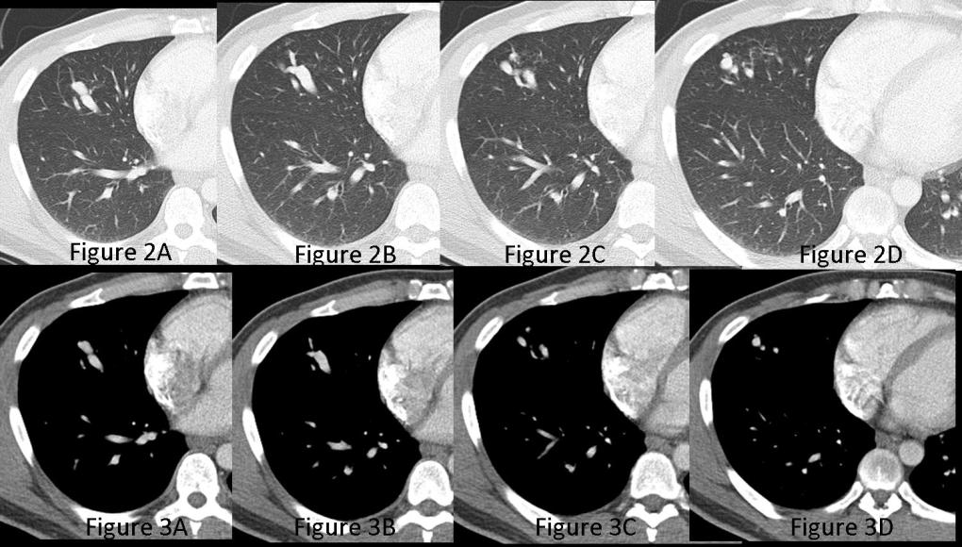
AV malformations
http://www.vcuthoracicimaging.com/Historyanswer.aspx?qid=71&fid=1

Slide 42
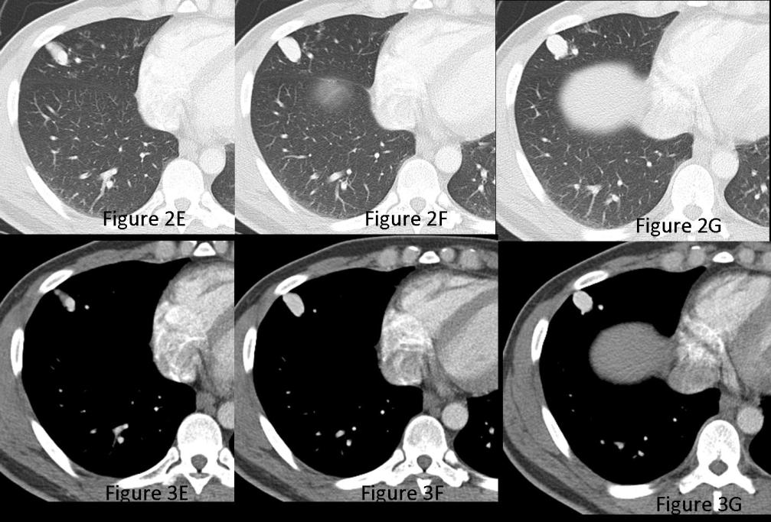
http://www.vcuthoracicimaging.com/Historyanswer.aspx?qid=71&fid=1

Slide 43

http://www.vcuthoracicimaging.com/Historyanswer.aspx?qid=71&fid=1

Slide 44

Intrapulmonary lymphnodes
Round atelectasis
http://www.learningradiology.com/notes/chestnotes/roundatelectasispage.htm

Slide 45
Infection
Bacterial pneumonia
Atypical pneymonia
Viral pneumonia
Tuberculosis
Pneumonia in the immunocompromised patient
  Bacterial
  Viral and pneumocystis Carinii, opportunistic or fungal

Slide 46


Bacterial

Slide 47


http://www.springerlink.com/content/hjnk528djcwwe8et
Atypical - viral

Slide 48

Pneumocystis Carinii Pneumonia (PCP) immunocompromised
http://www.springerlink.com/content/hjnk528djcwwe8et

Slide 49

Tuberculosis
TB – primary
  consolidation
  lymphadenopathy
  milliary
  effusion
http://radiographics.rsna.org/content/27/5/1255/F4

Slide 50


TB - secondary
  consolidation
  cavities
  fibrosis
  bronchiectasis
  empyema
http://radiographics.rsna.org/content/27/5/1255/F4

Slide 51

Before and after treatment
http://www.sciencedirect.com/science/article/pii/S0720048X07003658

Slide 52

Before and
after treatment
http://www.sciencedirect.com/science/article/pii/S0720048X07003658

Slide 53


Sarcoidosis
Hilar lymphnodes
Lymphnodes + lung involvement
Lung involvement
Fibrosis

Slide 54


Interstitial lung disease
centrilobular
Interlobar septa

Slide 55
Diffuse lung diseases
Linear and branching pattern
Interstitial pneumonitis
Pulmonary oedema
Diseases that cause multiple nodules
  Lymphangitis carcinomatosa
  Sarcoidosis
  Occupational diseases

Slide 56

Interstitial fibrosis
http://www.radiologyassistant.nl/en/42d94cd0c326b

Slide 57

Pulmonary oedema
http://www.radiologyassistant.nl/en/42d94cd0c326b

Slide 58

carcinomatosis
http://www.radiologyassistant.nl/en/42d94cd0c326b

Slide 59
Diffuse lung diseases
Increased lung density
Allergic alveolitis
Alveolar proteinosis
Lipoid pneumonia
Eosinophilic pneumonia
Drug induced lung disease

Slide 60

Alveolar proteinosis

Slide 61


Diffuse lung disease
Emphysema
Swyer-James symdrome
http://www.learningradiology.com/archives06/COW%20206-Bullous%20dz/bullouscorrect.htm

Slide 62


Diffuse lung disease
Cystic diseases
Histiocytosis – Χ, Langherhans
Pulmonary lympangioliomyomatosis
http://www.radiologyassistant.nl/en/42d94cd0c326b

Slide 63


Vascular diseases
Thromboembolic disease
Veno occlusive disease
http://radiographics.rsna.org/content/27/4/957
http://www.radiologyassistant.nl/en/42d94cd0c326b

Slide 64
Trauma
trauma
ARDS
Pneymonectomy-lobectomy
Tranplantation
  Acute rejection
  Chronic rejection
  Complications from the airways

Slide 65



Trauma

Slide 66

In vascular injuries the mediastinal fat becomes blurred

Slide 67

Pneumothorax
Air in the pleural cavity

Slide 68

Pleural effusion
Fluid in the pleural cavity
The clinical history points to the cause
Fresh blood may be hyperdense

Slide 69

ARDS (adult respiratory distress syndrome)
http://www.radiologyassistant.nl/en/46b480a6e4bdc

Slide 70

ARDS
http://www.radiologyassistant.nl/en/46b480a6e4bdc

Slide 71


Pneumonectomy - lobectomy
http://radiographics.rsna.org/content/26/5/1449

Slide 72



Transplantation lung
  acute
  Chronic rejection
  Airways
http://radiographics.rsna.org/content/27/4/957

