Slide 1
CT MEDIASTINUM

Slide 2
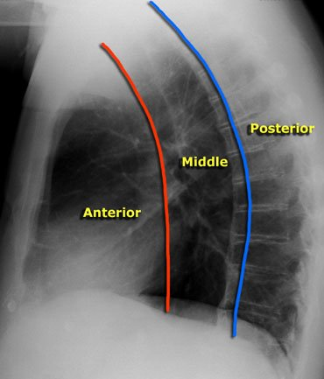
COMPARTMENTS
Anterior (thymus, thyroid)
Middle (heart vessels, airways, hila)
Posterior (descending aorta, oesophagus, thoracic duct azygos hemiazygos)
http://www.radiologyassistant.nl/en/4620a193b679d

Slide 3
Technique
Routine chest protocol
Thin overlapping sections
IV CM useful (pre contrast in hemorrhage or masses)
Oral CM in oesophageal
ECG gating in cardiac and ascending aorta studies. Data collection with least movement

Slide 4
IV CM
Just for separating vessels lymphnodes –
90 mls at 2ml/sec
Invasion or infection –
120ml scan delay 30-50 secs
Evaluation of vessels and tumor vascularity 150mls at 3-4mls/sec
In patients with thyroid cancer due for radioisotope treatment no IV CM is given

Slide 5
Image reprocessing
coronal
Oblique along the trachea
ΤΤΡ - minIP
ΜΙΡ - VRT for vascular pathology

Slide 6
Pathologic Conditions
Knowing the anatomic structures in each compartment will help us to suggest the possible cause of an abnormality

Slide 7
Anterior mediastinum - thymus
Large up to 20yrs of age
Like an arrowhead
Occasionally two lobes
Involutes and is replaced by fat in older ages

Slide 8
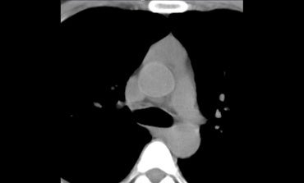
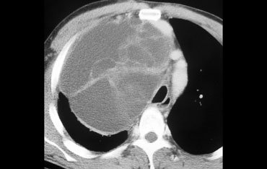
Hyperplasia
Thymoma -thymolipoma
Carcinoma
Genital cell tumors
teratoma
dermoid
seminoma
Chorionic carcinoma
www.radiologyassistant.nl/en/4620a193b679d

Slide 9
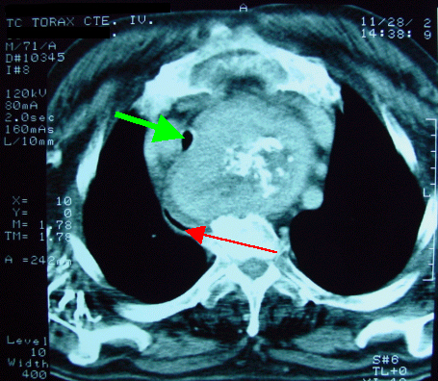
Anterior mediastinum –descending goitre
Low extension of the thyroid
Connection to the thyroid may not be obvious
May descend posteriorly
May displace and narrow the trachea
http://radiographics.rsna.org/content/22/suppl_1/S215

Slide 10
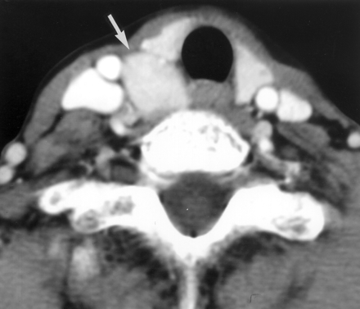
Anterior mediastinum parathyroid glands
Behind the upper and lower poles of the thyroid
Ectopic position
MR better
Take up CM
http://www.ajronline.org/content/179/2/495/F8

Slide 11
Anterior mediastinum lymphoma
Hodgkin’s disease
Anterior mediastinum
Non-Hodgkin (NHL)
immunocompromised, transplants, collagen diseases
Multiple independent blocks
Residual glands post treatment do not mean active disease, ΡΕΤ can show disease activity better than CT or MRI

Slide 12
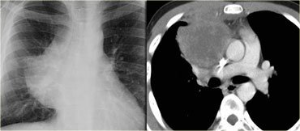
www.radiologyassistant.nl/en/4620a193b679d

Slide 13
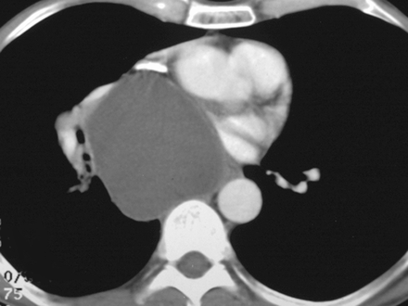
Middle mediastinum
Lymphoma
Airways
Bronchogenic cyst
Pericardial cyst
paragaggliomas –
Non-functioning– chemodectoma
functioning - phaechromocytoma
http://radiographics.rsna.org/content/22/suppl_1/S79

Slide 14
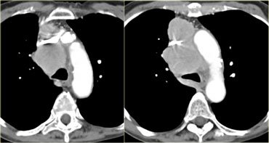
www.radiologyassistant.nl/en/4620a193b679d

Slide 15
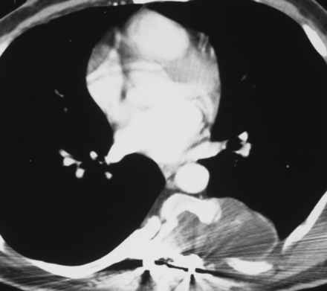
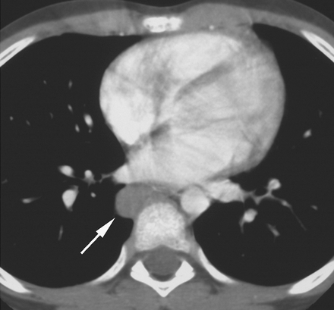
Posterior mediastnum
Neurogenic tumors
Extramedullary hemopoiesis
Oesophageal tumors
Meningoceles
http://radiographics.rsna.org/content/22/suppl_1/S79

Slide 16
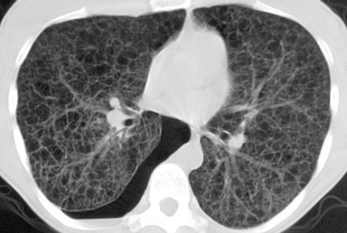
Pleural diseases
tumors
Metastasis
Mesothelioma
Lymphoma
Collections
blood
lymph
Pus
Fibrosis, exposure to asbestos
Pneumothorax
Emphysema
http://radiographics.rsna.org/content/25/3/803/F31

Slide 17
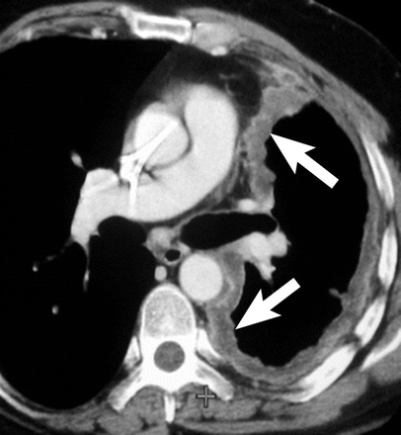
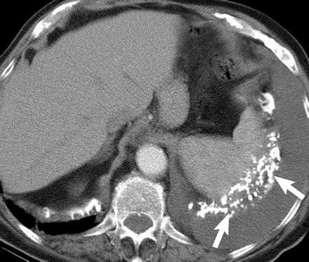
Mesothelioma
Malignant disease of the pleura
Seen in patients with asbestos disease
http://radiographics.rsna.org/content/24/1/105/F4

Slide 18
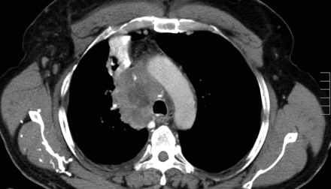
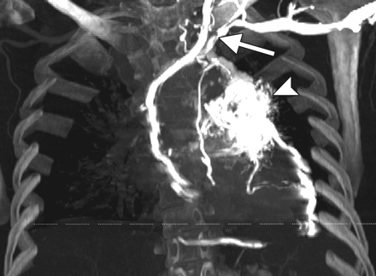
SVC occlusion
Intra- or extraluminal
Malignant disease
Fibrosis
Collateral circulation
Azygos intercostal superficial veins
http://www.ajronline.org/content/192/6/W344/F1
http://radiographics.rsna.org/content/30/1/67/F9

