Slide 1
CT aRTifacts

Slide 2
Learning objectives
a) the mechanisms by which artifacts are generated,
(b) the methods employed by CT equipment manufacturers to suppress them, and
(c) techniques of artifact avoidance available to the operator.

Slide 3
In computed tomography (CT), the term artifact is applied to any systematic discrepancy between the CT numbers in the reconstructed image and the true attenuation coefficients of the object.
CT images are prone to artefacts due to the vast amount of independent measurements needing processing for the image to be produced

Slide 4
Types of artifacts - appearance
(a) streaking, generally due to an inconsistency in a single measurement;
(b) shading, due to a group of channels or views deviating gradually from the true measurement;
(c) rings, due to errors in an individual detector calibration; and
(d) distortion, due to helical reconstruction.

Slide 5
Types of artifacts - causes
(a) physics-based artifacts, result from the physical processes involved in the acquisition of CT data;
(b) patient-based artifacts, caused by such factors as patient movement or the presence of metallic materials in or on the patient;
(c) scanner- based artifacts, result from imperfections in scanner function; and
(d) helical and multisection artifacts, produced by the image reconstruction process.

Slide 6
Physics-based Artifacts - Beam Hardening
An X-ray beam is composed of individual photons with a range of energies.
As the beam passes through an object, it becomes “harder,”
that is to say its mean energy increases, because the lower energy photons are absorbed more rapidly than the higher-energy photons.
Two types of artifact can result from this effect:
cupping artifacts and
dark bands or streaks between dense objects in the image.

Slide 7
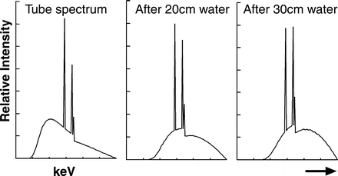
Changing energy spectrum of an x-ray beam as it passes through water. The mean energy increases with depth.

Slide 8
Physics-based Artifacts - Beam Hardening
Cupping Artifacts.
X-rays passing through the middle portion of a uniform cylindrical phantom are hardened more than those passing though the edges because they are passing though more material.
As the beam becomes harder, the rate at which it is attenuated decreases, so the beam is more intense when it reaches the detectors than would be expected if it had not been hardened.
Therefore, the resultant attenuation profile differs from the ideal profile that would be obtained without beam hardening . A profile of the CT numbers across the phantom displays a characteristic cupped shape.

Slide 9
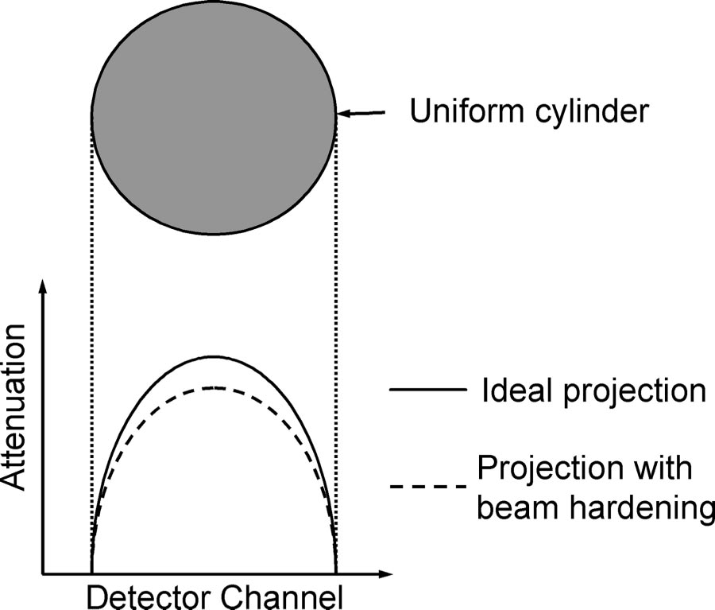
Attenuation profiles obtained with and without beam hardening for an x-ray beam passing through a uniform cylindrical phantom.

Slide 10
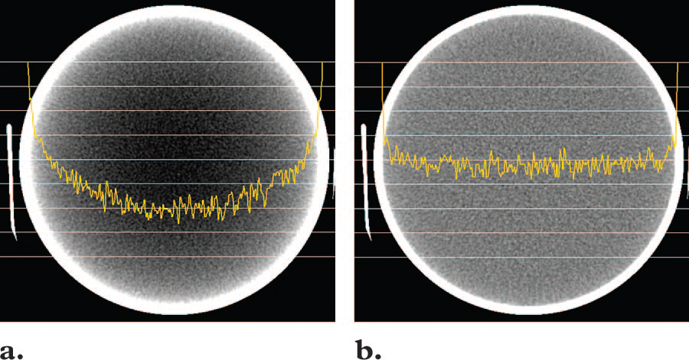
CT number profiles obtained across the center of a uniform water phantom without calibration correction (a) and with calibration correction (b).

Slide 11
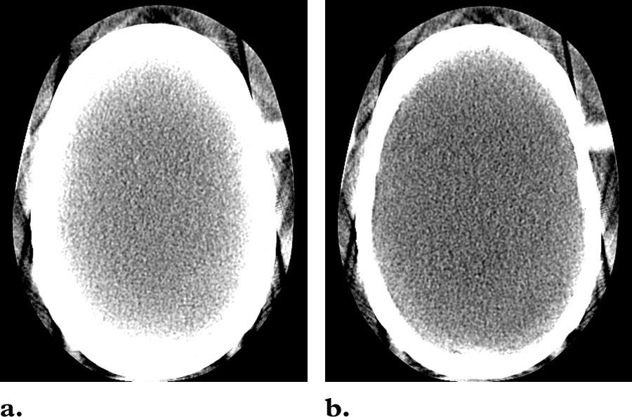
Can you tell which image has been corrected for beam hardening?

Slide 12
Physics-based Artifacts - Beam Hardening
Streaks and Dark Bands.
In very heterogeneous cross sections, dark bands or streaks can appear between two dense objects in an image.
They occur because the portion of the beam that passes through one of the objects at certain tube positions is hardened less than when it passes through both objects at other tube positions.

Slide 13
Can you think of two occasions when this artifact may occur in everyday practice?

Slide 14
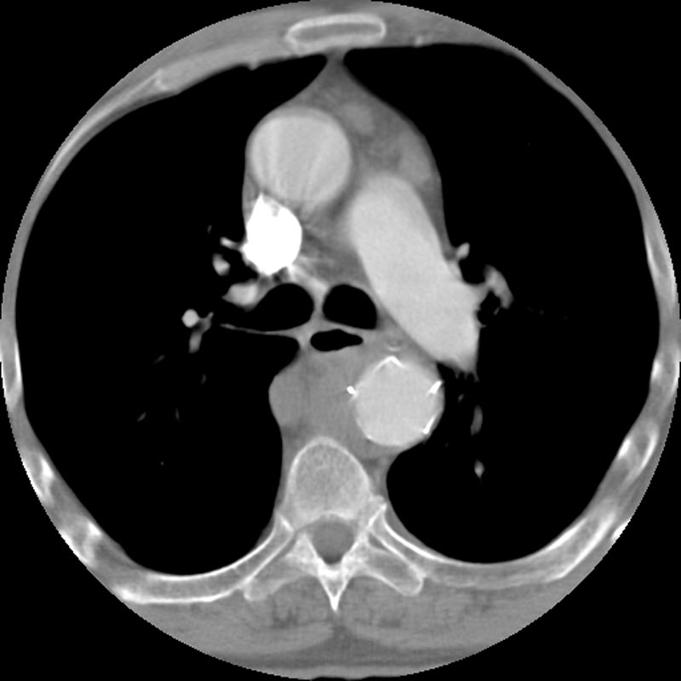
Can you think of two occasions when this artifact may occur?

Slide 15
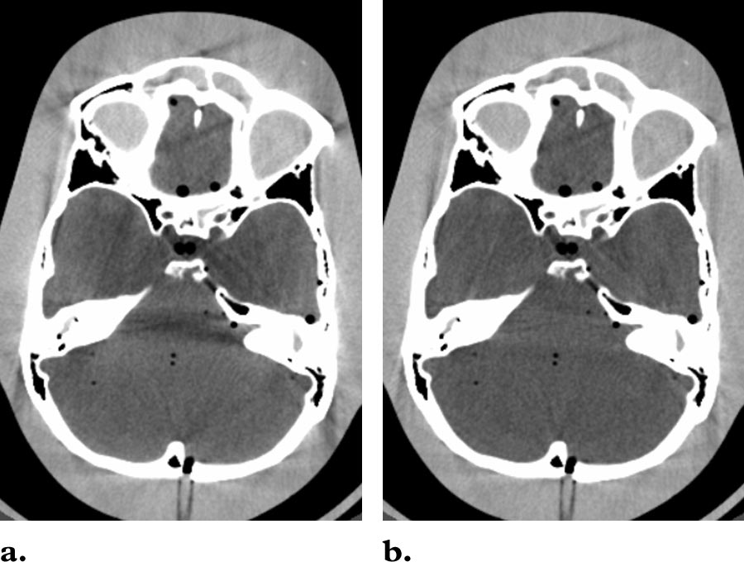

Slide 16
Minimizing Beam Hardening — Manufacturers
Filtration: A flat piece of attenuating, usually metallic material is used to “pre-harden” the beam by filtering out the lower-energy components before it passes through the patient. A “bowtie” filter further hardens the edges of the beam, which will pass through the thinner parts of the patient.
Calibration correction: Manufacturers calibrate their scanners using phantoms in a range of sizes. This allows the detectors to be calibrated with compensation tailored for the beam hardening effects of different parts of the patient
Beam hardening correction software: An iterative correction algorithm may be applied when images of bony regions are being reconstructed. This helps minimize blurring of the bone–soft tissue interface in brain scans and also reduces the appearance of dark bands in nonhomogeneous cross sections.

Slide 17
Avoidance of Beam Hardening - Operator
It is sometimes possible to avoid scanning bony regions, either by means of patient positioning or by tilting the gantry.
It is important to select the appropriate scan field of view to ensure that the scanner uses the correct calibration and beam hardening correction data and, on some systems, the appropriate bowtie filter.

Slide 18
Partial Volume Effect - 1
These artifacts are a separate problem from partial volume averaging, which yields a CT number representative of the average attenuation of the materials within a voxel.
Occurs when a dense object lying off-center protrudes partway into the width of the x-ray beam. As a result the object is not seen by the detectors throughout the whole of the data collection time, ie from all points of the detector rotation.

Slide 19
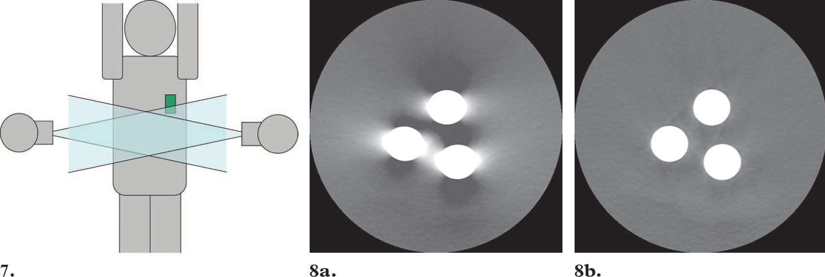
Partial Volume Effect - 2
Look at the green object (metal). The beam does not “see” it in all positions. The inconsistencies between the views cause shading artifacts to appear in the image

Slide 20
Partial Volume Effect - 3
Can best be avoided by using a thin acquisition section width. This is necessary when imaging any part of the body where the anatomy is changing rapidly in the Z-axis, as in the posterior fossa.
To limit image noise, thicker sections can be generated by adding together several thin sections.

Slide 21
Partial Volume Averaging - 1
CT is a quantitative method
The CT number in each pixel is proportional to the average μ in the corresponding voxel. For voxels containing all one tissue type (e.g., all bone, all liver), μ is representative of that tissue. Some voxels in the image, however, contain a mixture of different tissue types. When this occurs, for example with bone and soft tissue, the μ is not representative of either tissue but instead is a weighted average of the two different μ values.
Partial volume averaging is most pronounced for softly rounded structures that are almost parallel to the CT slice. The most evident example is near the top of the head, where the cranium shares a substantial number of voxels with brain tissue, causing details of the brain parenchyma to be lost because the large μ of bone dominates.

Slide 22
Partial Volume Averaging - 2
This situation is easily recognizable and therefore seldom leads to misdiagnosis.
Partial volume artifacts can lead to misdiagnosis when the presence of adjacent anatomic structures is not suspected.
It may interfere with quantitave CT measurements
Less pronounced with thin sections
Partly overcome by interleaved reconstructions (5mm thick at 2.5mm intervals)

Slide 23
Photon Starvation
A potential source of serious streaking artifacts is photon starvation, which can occur in highly attenuating areas such as the shoulders
When the x-ray beam is traveling horizontally, the attenuation is greatest and insufficient photons reach the detector
The result is that very noisy projections are produced at these tube angulations.

Slide 24
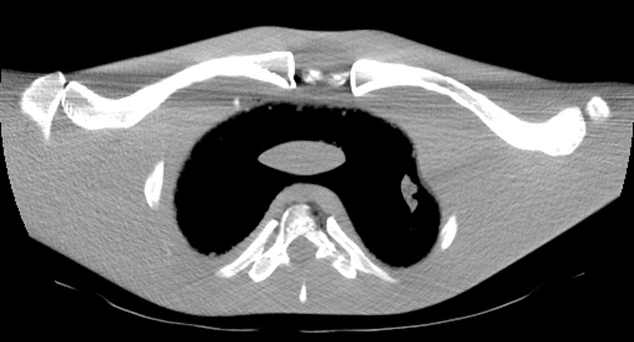
The reconstruction process has the effect of greatly magnifying the noise, resulting in horizontal streaks in the image.

Slide 25
How can this be corrected?

Slide 26
How can this be corrected?
If the tube current is increased for the duration of the scan, the problem of photon starvation will be overcome, but the patient will receive an unnecessary dose when the beam is passing through less attenuating parts.
Therefore, manufacturers have developed techniques for minimizing photon starvation

Slide 27
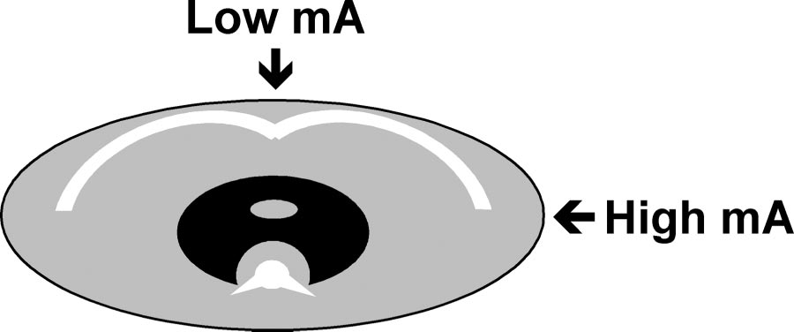
Photon Starvation Dose modulation techniques - 1
Automatic Tube Current Modulation
The tube current is automatically varied during the course of each rotation, a process known as milliamperage modulation.
This allows sufficient photons to pass through the widest parts of the patient without unnecessary dose to the narrower parts.

Slide 28
Photon Starvation Dose modulation techniques - 2
Adaptive Filtration (software correction tools)
Smooths the attenuation profile in areas of high attenuation before the image is reconstructed.
Multidimensional adaptive filtration technique for use on multisection scanners.
For the small proportion of projection data that exceed a selected attenuation threshold, smoothing is carried out between adjacent in-plane detectors and between successive projection angles.
The Z- filter used in helical reconstruction is broadened for high-attenuation projection angles to allow more photons to contribute to image formation

Slide 29
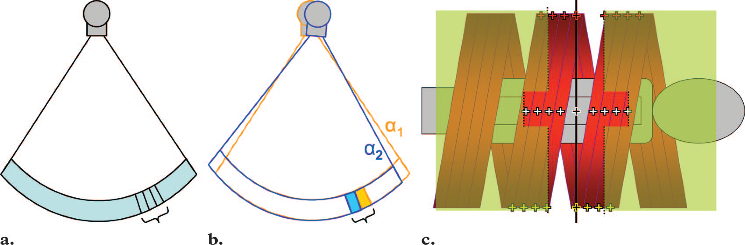
Adaptive Filtration

Slide 30
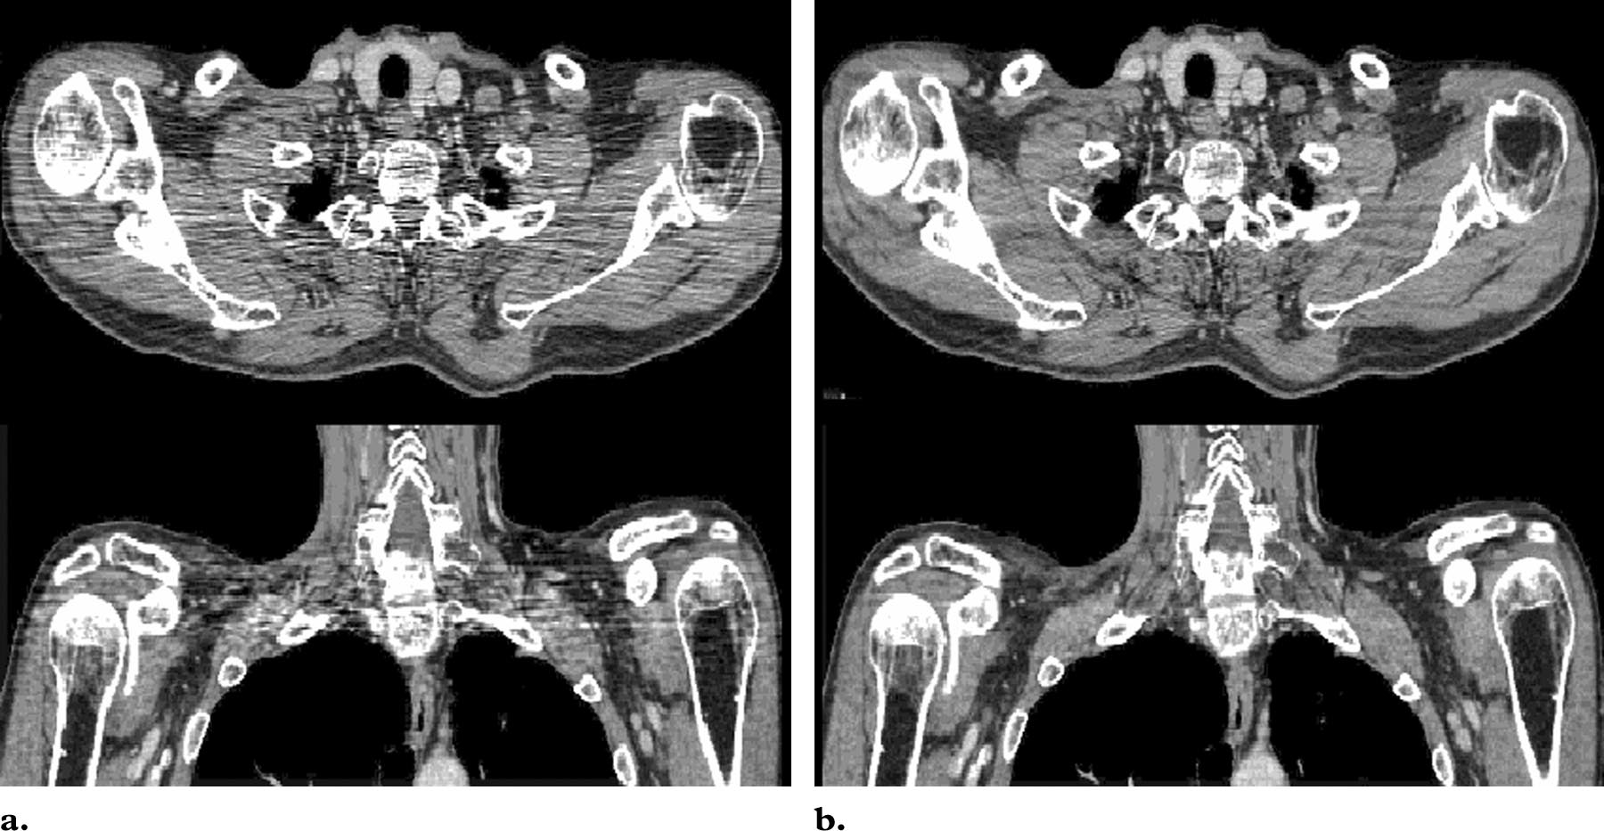
Multidimensional adaptive filtration (b)

Slide 31
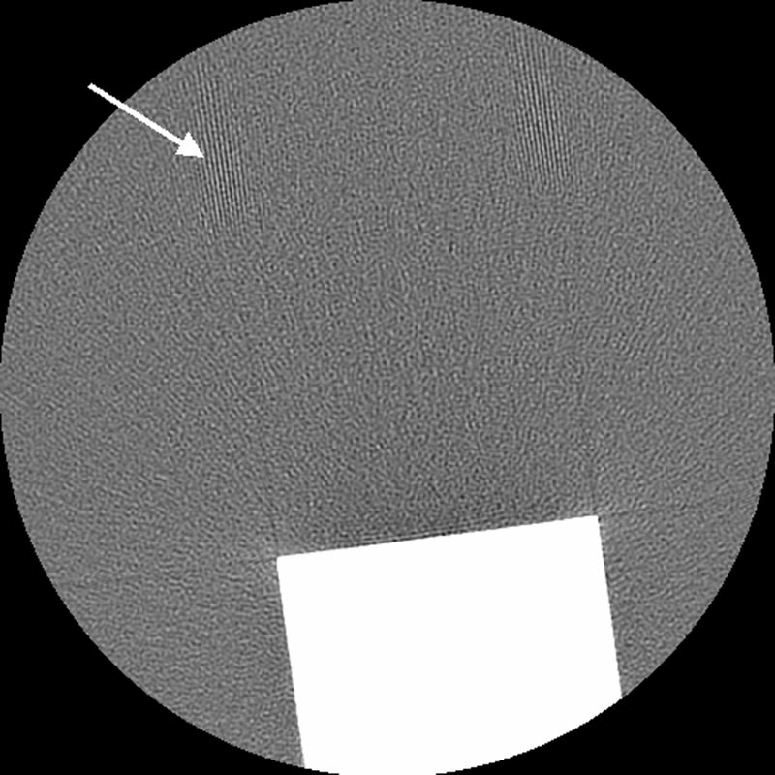
Undersampling
The number of projections used to reconstruct a CT image is one of the determining factors in image quality. Too large an interval between projections (undersampling) can result in misregistration by the computer of information relating to sharp edges and small objects.
This leads to an effect known as view aliasing, where fine stripes appear to be radiating from the edge of, but at a distance from, a dense structure. Stripes appearing close to the structure are more likely to be caused by undersampling within a projection, which is known as ray aliasing.

Slide 32
Aliasing may not have too serious an effect on the diagnostic quality of an image, since the evenly spaced lines do not normally mimic any anatomic structures.
Where resolution of fine detail is important, undersampling artifacts need to be avoided as far as possible.
View aliasing can be minimized by acquiring the largest possible number of projections per rotation.
slower rotation speed,
independent of rotation speed.
Ray aliasing can be reduced by using specialized high-resolution techniques
quarter-detector shift or
flying focal spot.

Slide 33
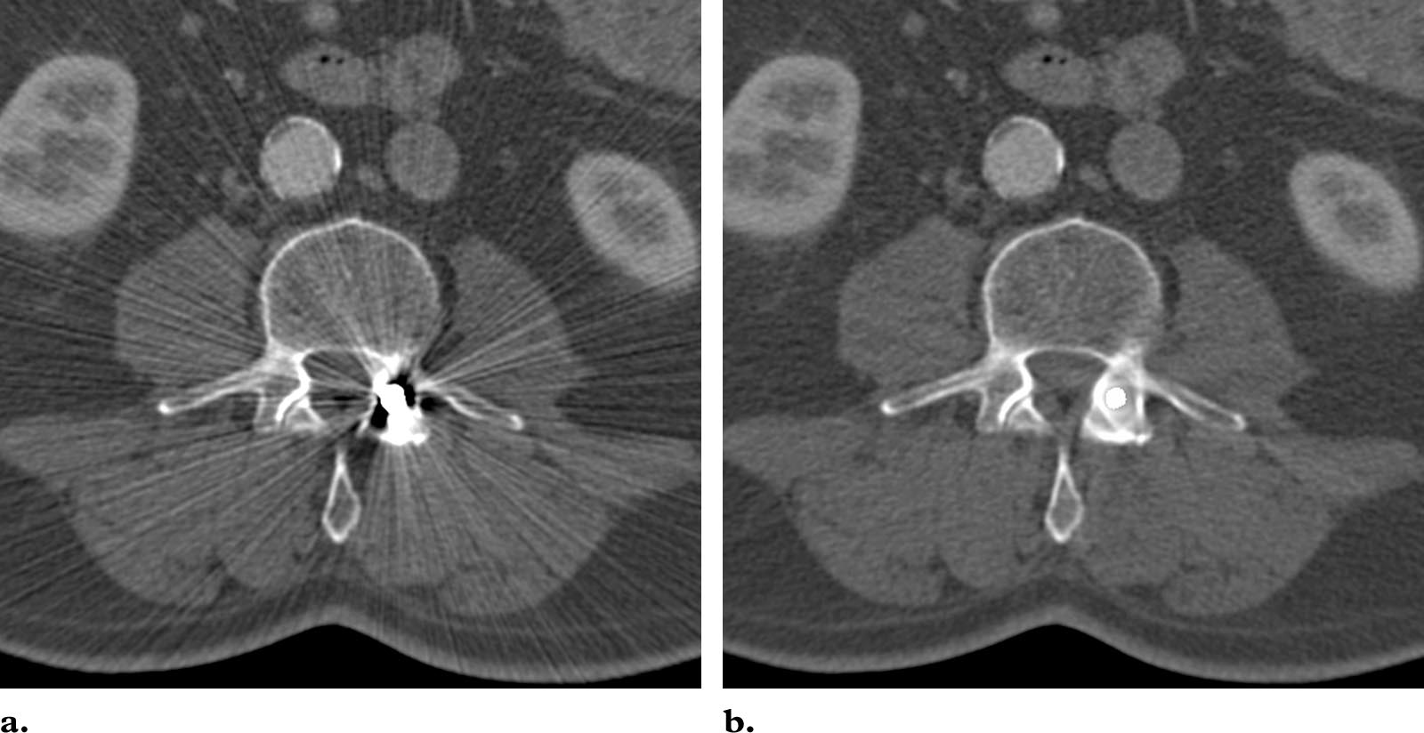
Patient-based Artifacts - Metallic Materials
The presence of metal objects in the scan field can lead to severe streaking artifacts.
They occur because the density of the metal is beyond the normal range that can be handled by the computer, resulting in incomplete attenuation profiles.
Additional artifacts due to beam hardening, partial volume, and aliasing are likely to compound the problem when scanning very dense objects.

Slide 34
Patient-based Artifacts - Metallic Materials
Avoidance of Metal Artifacts by the Operator.
Take off removable metal objects such as jewelry before scanning commences.
For nonremovable items (dental fillings, prosthetic devices, and surgical clips) -use gantry angulation when possible.
When this is impossible - increase especially kVp, use thin sections.
Software Corrections for Metal Artifacts.
Streaking caused by overranging can be greatly reduced by means of special software corrections.
Limited usefulness of metal particularly away from metal object
Use with beam hardening correction software

Slide 36
Patient-based Artifacts - Patient Motion
Can cause misregistration artifacts, which appear as shading or streaking in the reconstructed image.
Avoidance of Motion Artifacts by the Operator
Positioning aids is sufficient to prevent voluntary movement in most patients.
Immobilizing by means of sedation (eg, pediatric patients).
Use as short a scan time as possible
Breathholding
The sensitivity of the image to motion artifacts depends on the orientation of the motion.
Specifying body scan mode, as opposed to head scan mode, may automatically incorporate some motion artifact reduction in the reconstruction.

Slide 37
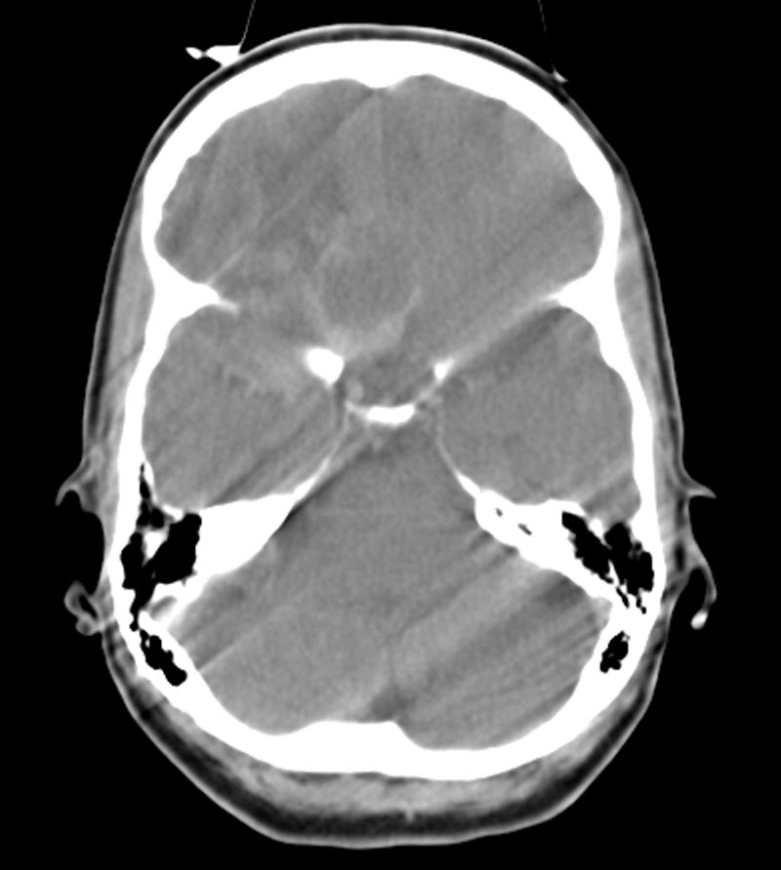

Slide 38
Patient-based Artifacts - Patient Motion
Built-in Features for Minimizing Motion Artifacts
Overscan and underscan modes: The maximum discrepancy in detector readings occurs between views obtained toward the beginning and end of a 360° scan. Adding an extra 10% or so to the standard 360° helps reduce the severity of motion artifacts.
The use of partial scan mode (underscan) can also reduce motion artifacts, but this may be at the expense of poorer resolution.
Software correction: application of reduced weighting to the beginning and end views to suppress their contribution to the final image. This may increase noise in the vertical direction
Specialized motion correction is available on some scanners.

Slide 39
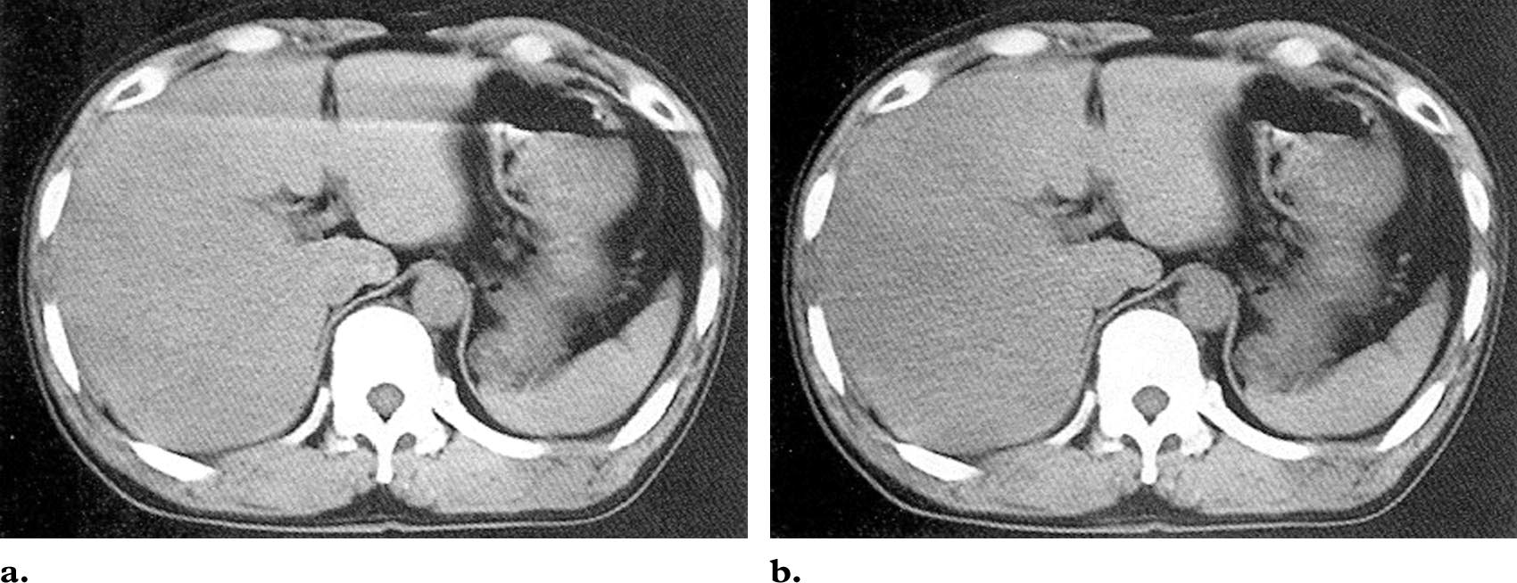

Slide 40
Patient-based Artifacts - Patient Motion
Cardiac gating
The rapid motion of the heart can lead to severe artifacts in images of the heart and to artifacts that can mimic disease in associated structures, (eg. dissected aorta).
using data from just a fraction of the cardiac cycle, when there is least cardiac motion.
combining ectrocardiographic gating techniques with specialized methods of image reconstruction

Slide 41
Patient-based Artifacts – Incomplete Projections
The computer will have incomplete information relating to any portion of the patient outside the scan field of view.
The part outside the scan field of view is not seen in the images but streaking or shading artifacts are likely to be generated
Blocking the reference channels at the sides of the detector array may also interfere with data normalization and cause streaking artifacts.
To avoid artifacts due to incomplete projections, it is essential to position the patient so that no parts lie outside the scan field.

Slide 42
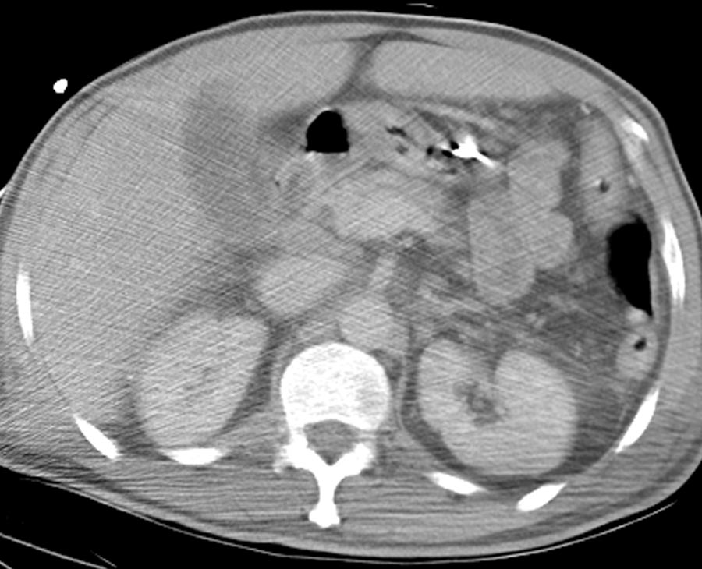

Slide 43
Patient-based Artifacts – Incomplete Projections
Scanners designed for radiation therapy planning have wider bores and larger scan fields of view also allowing scanning of exceptionally large patients.
Some manufacturers monitor the reference data channels for inconsistencies and avoid using reference data that appear suspicious.
As an alternative, the CT system may be designed with reference detectors on the tube side or with ray paths within the gantry to eliminate possible interference with reference data.

Slide 44
Scanner-based Artifacts Ring Artifacts
If one of the detectors is out of calibration on a third-generation (rotating x-ray tube and detector assembly) scanner, the detector will give a consistently erroneous reading at each angular position, resulting in a circular artifact.
A scanner with solid-state detectors, where all the detectors are separate entities, is in principle more susceptible to ring artifacts than a scanner with gas detectors, in which the detector array consists of a single xenon-filled chamber subdivided by electrodes.

Slide 45
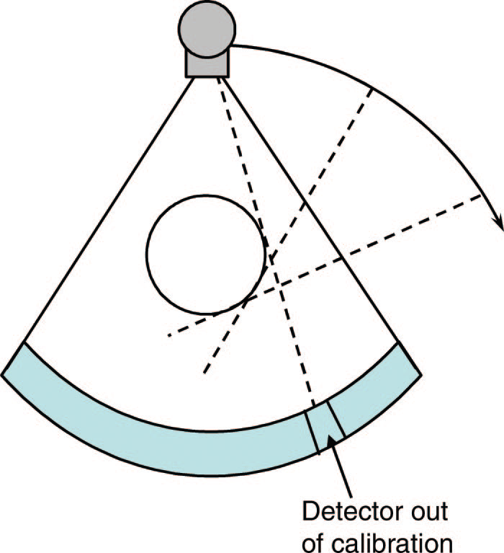
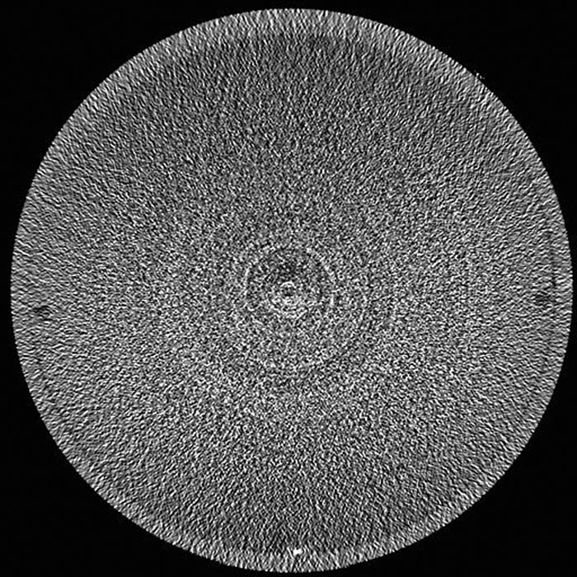
Rings might not be visible on a clinical image if a wide window is used.
When visible, they would rarely be confused with disease, but
They can impair the diagnostic quality of an image, particularly when central detectors are affected, creating a dark smudge at the center of the image.

Slide 46
Scanner-based Artifacts Ring Artifacts
Avoidance and Software Corrections
The presence of circular artifacts in an image is an indication that the detector gain needs recalibration or repair.
Selecting the correct scan field of view may reduce the artifact by using calibration data that fit more closely to the patient anatomy.
All modern scanners use solid-state detectors, but their potential for ring artifacts is reduced by software that characterizes and corrects detector variations.

Slide 47
Helical and MDCT Artifacts Helical Artifacts in the Axial Plane Single-Section Scanning
There are additional artifacts that can occur in helical scanning due to the helical interpolation and reconstruction process.
Occur when anatomic structures change rapidly in the Z- direction (eg, at the top of the skull) and are worse for higher pitches.
If a helical scan is performed of a cone-shaped phantom lying along the z axis of the scanner, the resultant axial images are distorted because of the weighting function used in the helical interpolation algorithm

Slide 48
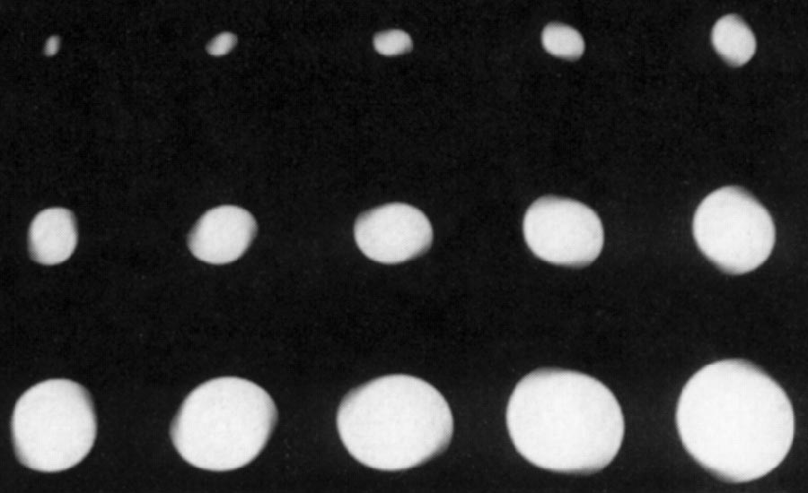

Slide 49
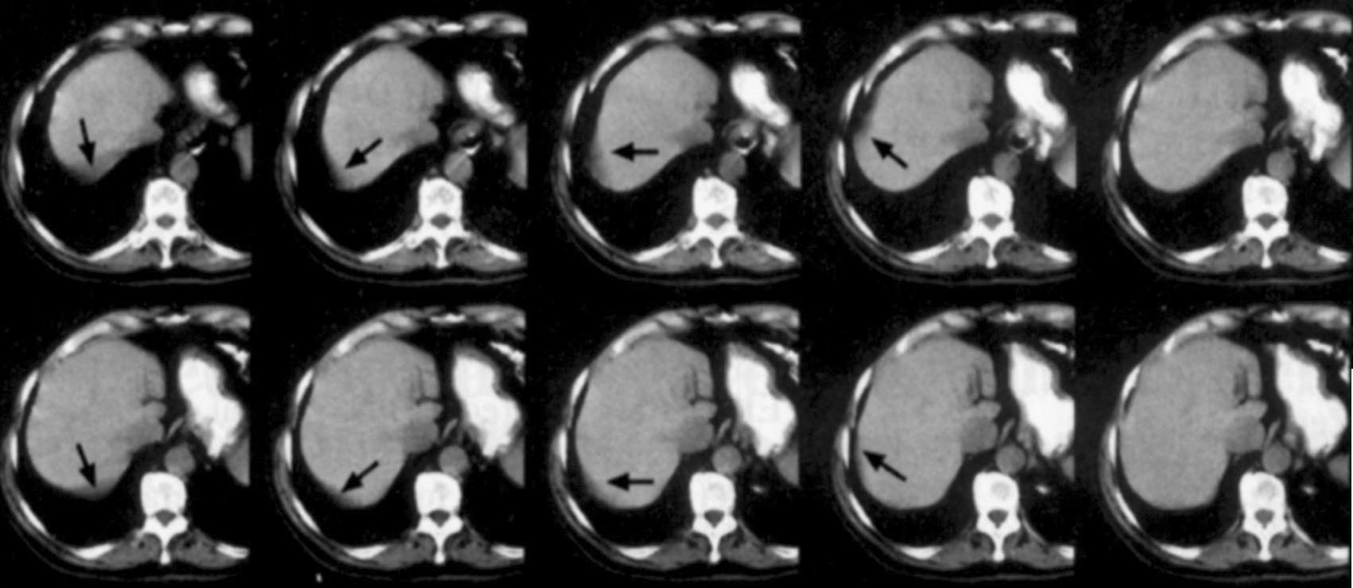

Slide 50
To reduce the effects of variation along the Z- axis:
use a low pitch,
a 180° rather than 360° helical interpolator
thin acquisition sections rather than thick
Sometimes, it is still preferable to use axial rather than helical imaging to avoid helical artifacts (eg, in brain scanning).

Slide 51
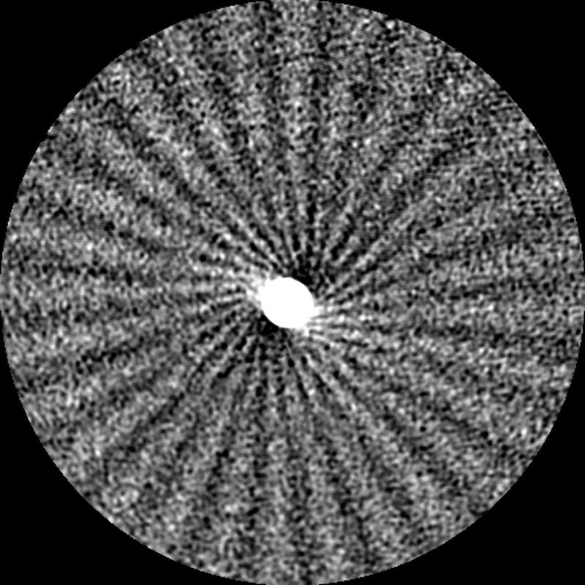
Helical and MDCT Artifacts Helical Artifacts in the Axial Plane Multi-Section Scanning
More complicated helical interpolation more image distortion.
The typical windmill-like artifact is due to the fact that several rows of detectors intersect the plane of reconstruction during the course of each rotation.
Increasing the pitch, increases the number of detector rows intersecting the image plane per rotation and the number of “vanes” in the windmill artifact increases.

Slide 52
Z-filter helical interpolators reduce the severity of windmill artifacts, especially when the image reconstruction width is wider than the detector acquisition width.
Artifacts may also be slightly reduced by using noninteger pitch values relative to detector acquisition width. This is because Z-axis sampling density is optimized for noninteger pitches.

Slide 53
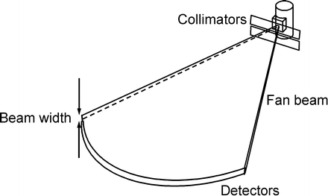
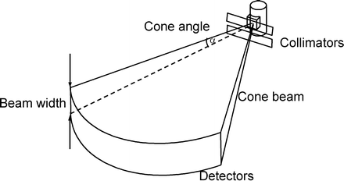
MDCT Artifacts - Cone Beam Effect
As the number of sections acquired per rotation increases, a wider collimation is required and the x-ray beam becomes cone-shaped rather than fanshaped

Slide 54
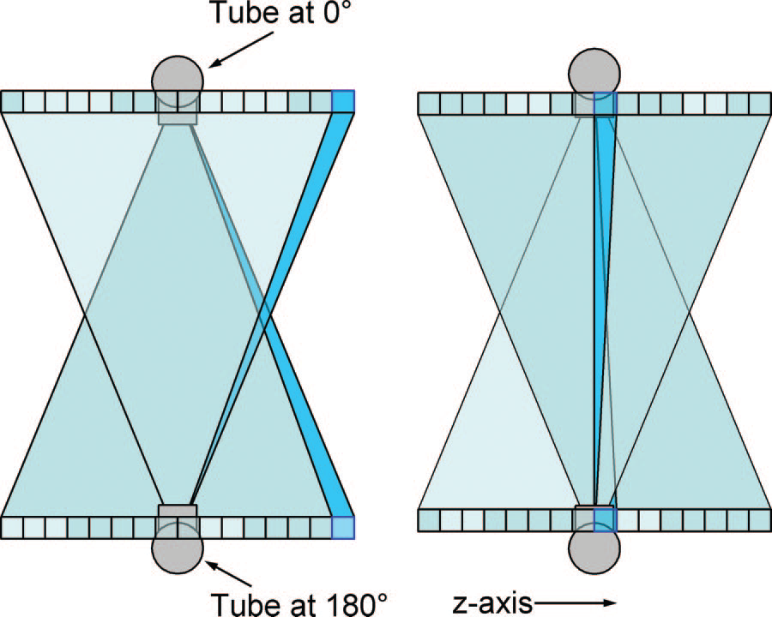
As the tube and detectors rotate around the patient, the data collected by each detector correspond to a volume contained between two cones, instead of the ideal flat plane.
Artifacts similar to those of partial volume for off-axis objects.
More pronounced for the outer detector rows than for the inner ones, where the data collected correspond more closely to a plane.

Slide 56
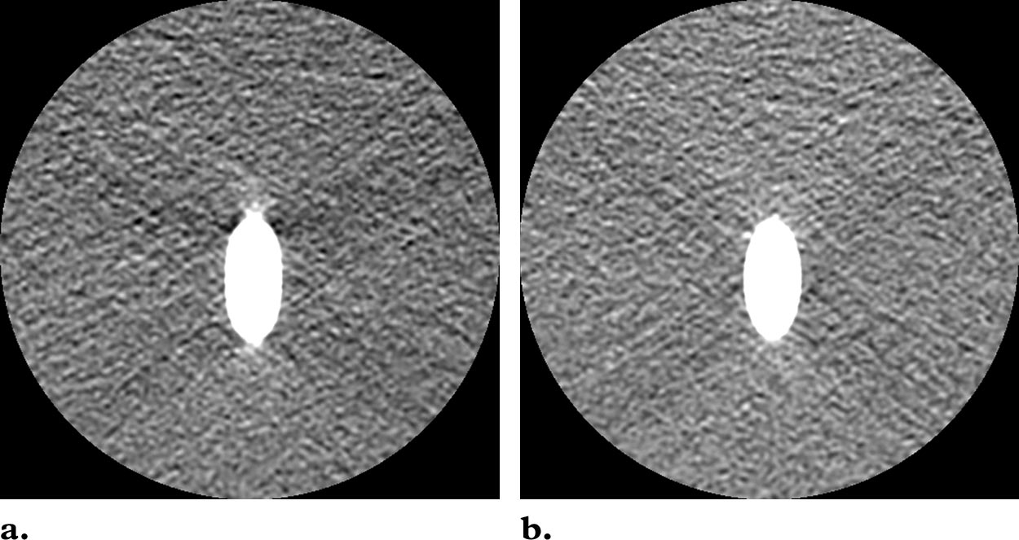
Which image has been made by central detector data?

Slide 57
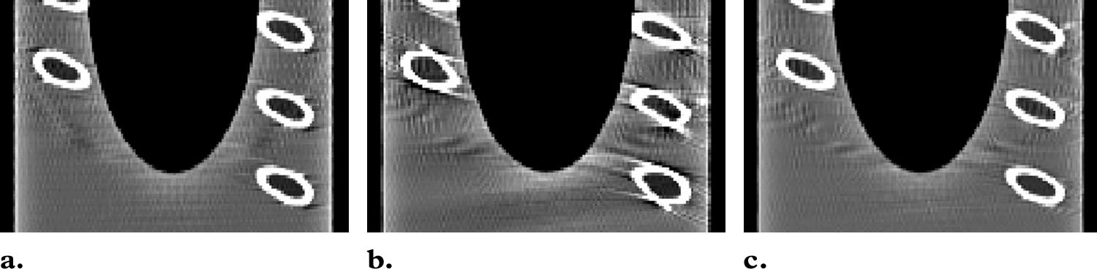
As the artifact gets worse by increasing detector rows manufacturers employ cone beam reconstruction techniques instead of the standard ones.
4-rows
16-rows without
16-rows with

Slide 58
Multiplanar and 3-dimensional Reformation
Major improvements in multiplanar and 3-D reformation have come about with helical and MDCT.
The faster speed reduces the effect of patient motion
The narrower acquisition sections and overlapping reconstructed sections lead to sharper edge definition on reformatted images.

Slide 59
Multiplanar and 3-D Reformation Stair Step Artifacts
around the edges of structures of reformatted images when wide collimations and non-overlapping reconstruction intervals are used.
less severe with helical scanning, which permits reconstruction of overlapping sections than with overlapping axial scans (>patient dose)
Virtually eliminated from thin-section data (isotropic imaging)

Slide 60
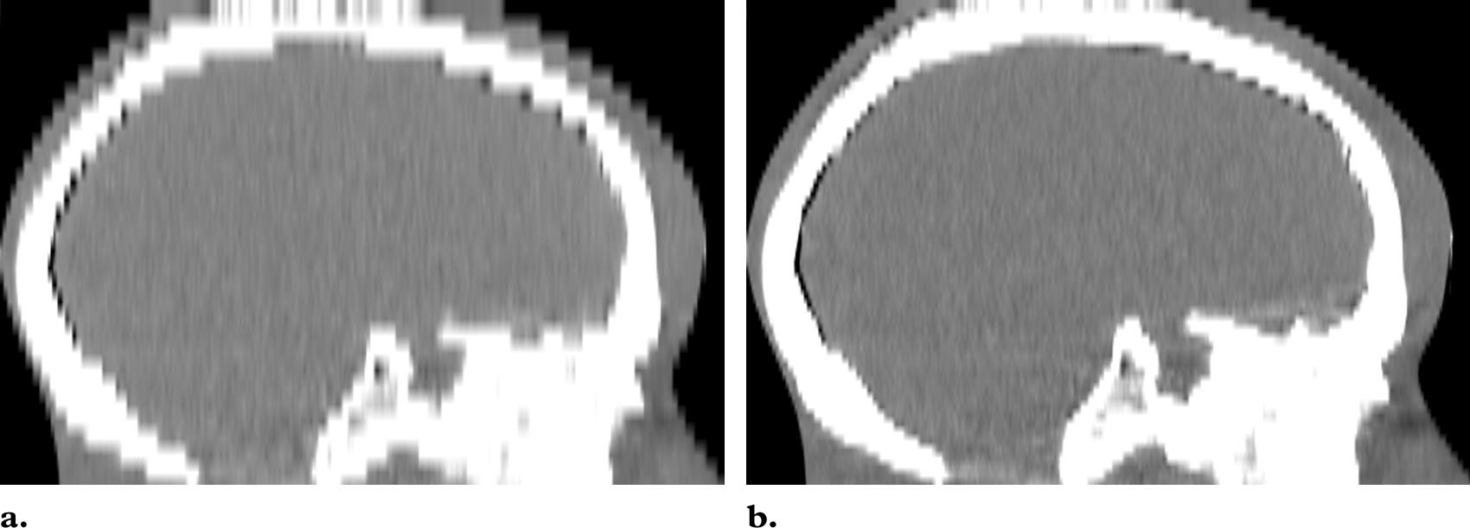
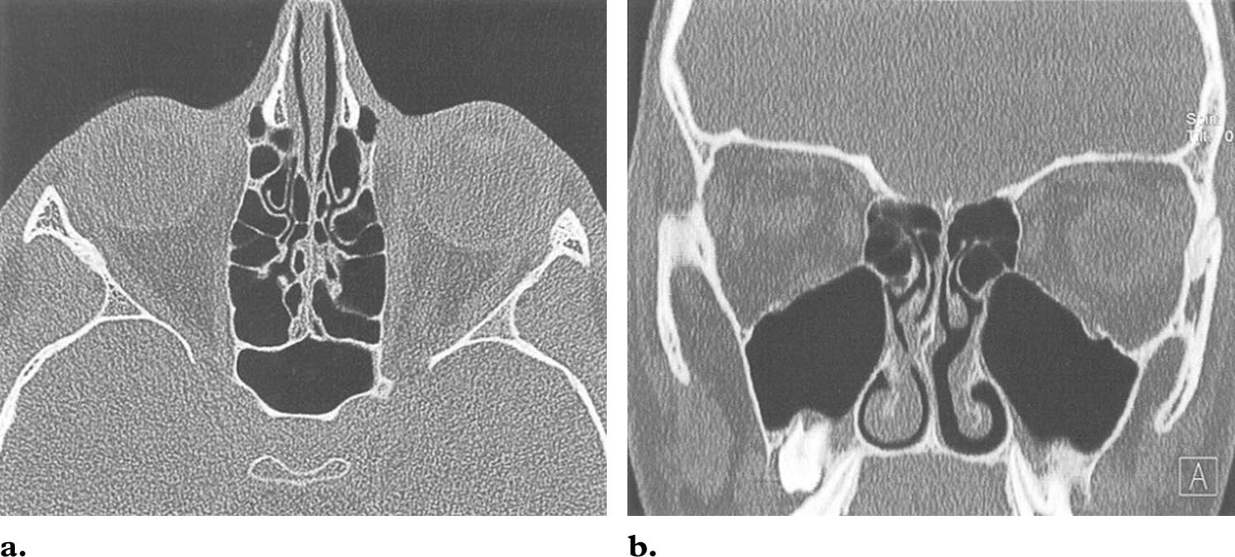

Slide 61
Multiplanar and 3-D Reformation Zebra Artifacts
Faint stripes in multiplanar and 3-D reformatted images from helical data because the helical interpolation process gives rise to a degree of noise inhomogeneity along the Z-axis.
more pronounced away from the axis of rotation because the noise inhomogeneity is worse off-axis.

Slide 62
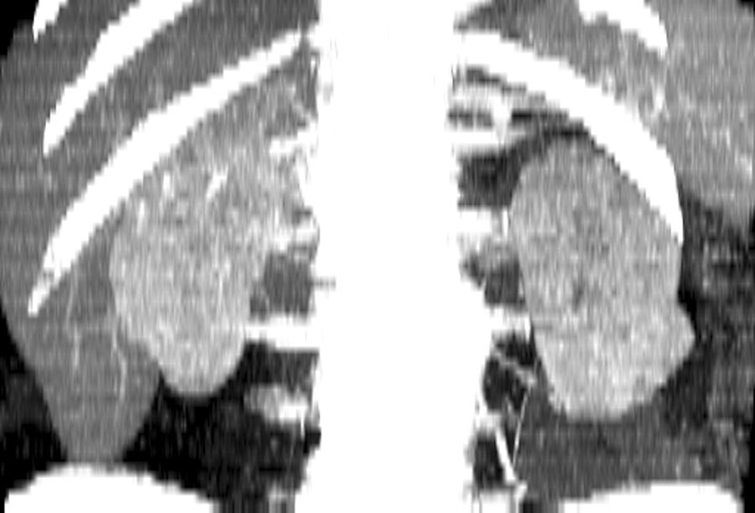

Slide 63
Artifacts originate from a range of sources and can degrade the quality of a CT image to varying degrees.
Design features incorporated into modern scanners minimize some types of artifact, and some can be partially corrected by the scanner software.
However, there are many instances where careful patient positioning and the optimum selection of scan parameters are the most important factors in avoiding image artifacts

Slide 64


Slide 65
Artifacts in CT: Recognition and Avoidance Julia F. Barrett, MSc ● Nicholas Keat, MSc RadioGraphics 2004; 24:1679–1691

