Slide 1
Ct image quality

Slide 2
ACR CT Accreditation Dose Pass/Fail Criteria and Reference Levels
Examination | Pass/Fail Criteria CTDIvol (mGy) | Reference Levels CTDIvol (mGy)
Adult Head | 80 | 75
Adult Abdomen | 30 | 25
Pediatric Abdomen (5 year old) | 25 | 20

Slide 3
CT examination quality parameters
A. Technique Parameters
B. Anatomic Coverage/Display
C. Filming Technique (for hard copy film submissions only)
D. Artifacts
E. Examination Identification: Missing Information
F. Examination Protocols

Slide 4
A. Technique Parameters
B. Anatomic Coverage/Display
are examination specific and follow the examination protocols

Slide 5
C. Filming Technique (Hard copy submission only)
Images must be photographed large enough to be evaluated.
Films must be formatted at no more than 20 on 1 for a 14 x 17 film. (For high resolution chest CT and pulmonary embolism and all cardiac examinations formats no greater than 12 on 1 should be used.)
Each image should be numbered sequentially and photographed in anatomic order.

Slide 6
C. Filming Technique (Hard copy submission only)
The films may also be numbered sequentially with a grease pencil or stick-on label, but this is not a requirement.
There should be no missing images or images photographed out of numerical sequence.
If applicable, non-contrast scans should be photographed in sequence separate from contrast-enhanced scans.
Delayed scans should also be photographed in a separate series in anatomic order.

Slide 7
C. Filming Technique (Hard copy submission only)
The overall film density should be appropriate to display anatomic structures.
Gaps in the alphanumeric information may suggest that the density is set too low, while loss of definition or blooming may suggest density is set too high.
The film should not exhibit variation in density across it or between individual films.
There should be no areas of the film where the images or alphanumerics appear blurry.

Slide 8
C. Filming Technique (Hard copy submission only)
Two digital scout (topogram, etc.) images must be included for each study: one of which should be annotated.
The digital scout radiograph should be displayed either as an image the same size as the axial images or in a larger format.
It may be on the same film as the axial images or on a separate film. The scan locations (as indicated by an image number or location) should be displayed on the scout radiograph.
The films should be free of fog, roller marks or other artifacts.

Slide 9
D: Artifacts
The images should be free of artifacts that would hinder interpretation. If such artifacts are present, images should be repeated.
The repeated images may be inserted in the sequence of images either after the images containing artifacts or at the end of the series.
Motion artifacts that result in indistinct or "double" contours to organs should be repeated if they significantly degrade the exam quality on multiple sections.

Slide 10
D: Artifacts
Misregistration is more difficult to quantitate, but if it appears to result in more than a 2-cm gap in anatomic coverage, images should be repeated in the area of the gap.
The image should not appear visually grainy; if graininess is present it may be a function of insufficient exposure or the combination of exposure, window width/level, and film density.
Streak artifacts that compromise diagnostic quality with sections not repeated would be a deficiency. If streak artifacts are present, the images should have been repeated after attempting to eliminate the cause of the artifact (such as overlying lines or metallic devices).
In some cases, internal metallic surgical clips are responsible for the streak artifact; if so, the images should not be considered deficient.

Slide 11
E: Exam Identification
All labels should be easily readable and placed so they do not overlap with the relevant anatomy on the image.
Film submission: The exam information should be printed on films. If all of the information is not available on the filmed images, you must include a screen print or demographics page on the films you submit.
Electronic submission: If you are submitting your images electronically, the information should be on the images, or readily assessable by the reviewer.

Slide 12
E: Exam Identification
Patient name (First and last)
Patient age (or date of birth)
Patient identification number
Gender of patient, date of exam
Time of exam (this refers to the time of the first axial image acquired in helical or non-helical
mode), and institution name
The technologist's name, initials, or other means of identifying the technologist who performed the study should be indicated at least once on the study
Left/right labeling

Slide 13
E: Exam Identification
mA
kVp
Pitch or rate of table feed
Scan time (duration)
Image number (numbered consecutively based on anatomic location)
Series number (if applicable)
Size (distance) scale as scored lines indicating centimeters
Slice thickness or slice width
Table position (scan location)
Window width and level
Presence or absence of contrast
Field of view
Reconstruction algorithm

Slide 14
F: Examination Protocol
A typical protocol should at least include the following elements:
Indication
Scanner settings (routine kVp, mA, rotation time, etc.)
Phase of respiration
Slice thickness
Table speed (pitch)
Reconstruction algorithm
Reconstruction interval
Cranio-caudal extent
IV contrast (with injection rate and scan delay)
Necessity for preliminary non-contrast scans

Slide 15
F: Examination Protocol
It is important that scanning protocols be designed specifically to optimize visualization of pathologic processes and take full advantage of the capabilities of the scanner in use.
Protocols will vary from site to site but still share common attributes, e.g., the need to scan prior to contrast equilibration when evaluating the liver.
It should contain clear instructions for the technologist which describe how to perform that type of examination.
Refer to the exam-specific technique parameters section for specific protocol requirements and recommendations.
All protocols should stress the importance of keeping radiation doses as low as reasonably achievable (ALARA).

Slide 16
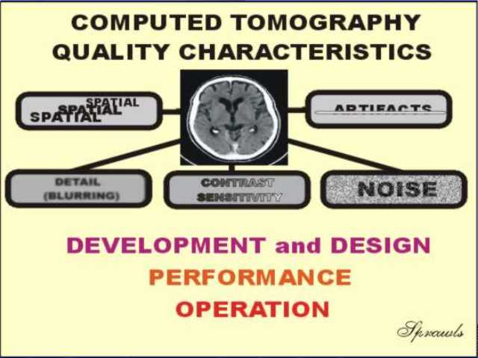
CT – image quality

Slide 17
CT – image quality
Optimizing image quality is the process of achieving a balance among the various characteristics (such as detail and noise) and adjusting the image quality to appropriate levels in order to manage the radiation dose to the patient.
The clinical utility of any modality lies in its spatial and contrast resolution.
There is a compromise between spatial resolution and contrast resolution.

Slide 18
CT - spatial resolution
The MTF, the fundamental measurement of spatial resolution
For a typical CT scanner; MTF is approximately 1 Iine pair per millimeter (lp/mm)
compared with the typical MTF for digital radiography which is 5 Ip/mm.

Slide 19
CT – contrast resolution
CT has by far, the best contrast resolution of any clinical x-ray modality.
Contrast resolution refers to the ability of an imaging procedure to reliably depict very subtle differences in contrast.
CT demonstrates contrast resolution of about 0.5%.

Slide 20
CT – contrast resolution
A classic clinical example in which the contrast resolution capability of CT excels is distinguishing subtle soft tissue tumors
The difference in CT number between the tumor and the surrounding tissue may be small (e.g., 20 CT numbers), but
because the noise in the CT numbers is smaller (e.g., 3 CT numbers), the tumor is visible on the display to the trained human observer.

Slide 21
CT – contrast resolution
Contrast resolution is fundamentally tied to SNR.
SNR is also very much related to the number of x-ray quanta used per pixel in the image.
If one attempts to reduce the pixel size (and thereby increase spatial resolution) and the dose levels are kept the same, the number of x-rays per pixel is reduced.
For example, for the same FOV and dose, changing to a 1,024 X 1,024 CT image from a 512 X 512 image would result in fewer x-ray photons passing through each voxel, and therefore the SNR per pixel would drop.

Slide 22
In CT there is a well-established relationship among:
SNR,
pixel dimensions (Δ),
slice thickness (T), and
radiation dose (D)
SNR²
D∝
Δ³T

Slide 23
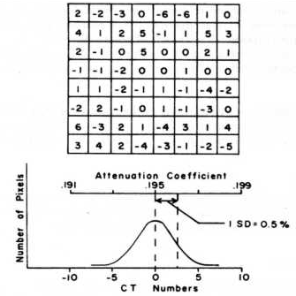
Random Distribution of CT Numbers for a Region in an Image of Water
This represents an area (Region of Interest, ROI) within an image of water.
Here we see that all of the pixels do not have a CT number value of zero, as might be expected. This variation in the CT number values is what we see in the image as noise.

Slide 24
The amount of variation, or spread, can be calculated and expressed by the statistical parameter, Standard Deviation (SD).
All CT machines are programmed to calculate the SD within a ROI setup by the operator.
This makes it easy to measure the level of noise in CT images.

Slide 25
Factors Affecting Spatial Resolution
Detector pitch: the center-to-center spacing of the detectors along the array. For third-generation scanners, the detector pitch determines the ray spacing; for fourth-generation scanners, the detector pitch influences the view sampling.
Detector aperture: the width of the active element of one detector. The use of smaller detectors increases the cutoff (Nyquist) frequency of the image, and it improves spatial resolution at all frequencies.

Slide 26
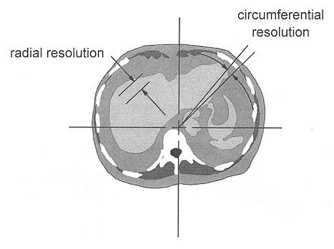
Rays and views
1st and 2nd generation scanners used 28,800 and 324,000 data points
State-of-the-art scanner may acquire about 800,000 data points
Modern 512 x 512 circular CT image contains about 205,000 image pixels
Number of rays affects the radial component of spatial resolution; number of views affects the circumferential component of the resolution

Slide 27
Factors Affecting Spatial Resolution
The sinogram
Display of raw data acquired for one CT slice before reconstruction
Rays are plotted horizontally and views are shown on the vertical axis
Objects close to the edge of the FOV produce a sinusoid of high amplitude
Bad detector in a 3rd generation scanner would show up as a vertical line on the sinogram

Slide 28
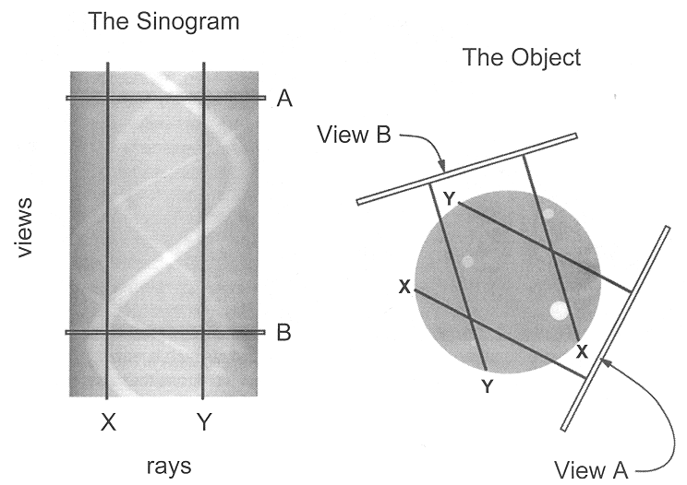

Slide 29
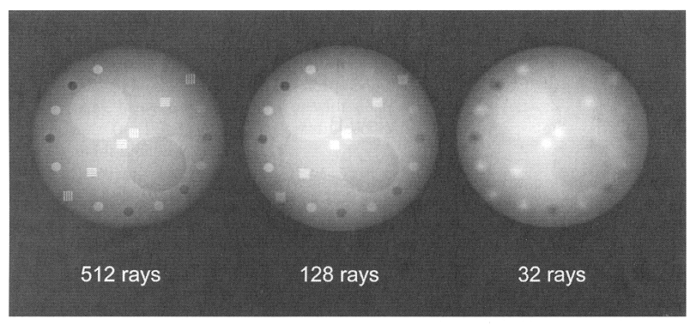
Number of rays
Number of rays: over the same FOV has a strong influence on spatial resolution. For a fixed FOV; the number of rays increases as the detector pitch decreases.
CT images of a simulated object reconstructed with differing numbers of rays show that reducing the ray sampling results in low-resolution, blurred images

Slide 30
Number of views: influence the ability of the CT image to convey the higher spatial frequencies in the image without artifacts. Use of too few views results in view aliasing, which is most noticeable toward the periphery of the image.
CT images of the simulated object reconstructed with differing numbers of views show the effect of using too few angular views (view aliasing)
Sharp edges (high spatial frequencies) produce radiating artifacts that become more apparent near the periphery of the image

Slide 31
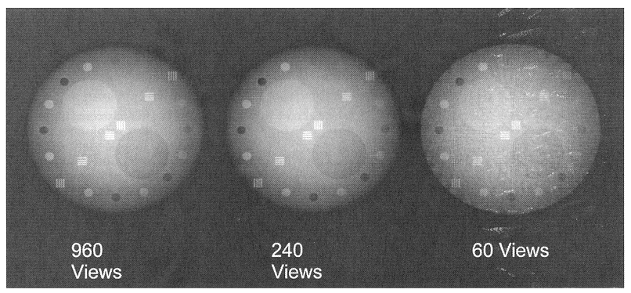

Slide 32
Factors Affecting Spatial Resolution
Focal spot size: larger focal spots cause more geometric unsharpness in the detected image and reduce spatial resolution. The influence of focal spot size is very much related to the magnification of an object to be resolved.
Object magnification: amplifies the blurring of the focal spot. Because of the need to scan completely around the patient in a fixed diameter gantry, the magnification factors experienced in CT are higher than in radiography. Magnification factors of 2.0 are common, and they can reach 2.7 for the entrant surfaces of large patients.

Slide 33
Factors Affecting Spatial Resolution
Slice thickness: detector aperture in the cranial-caudal axis. Large slice thicknesses clearly reduce spatial resolution in the cranial-caudal axis, but they also reduce sharpness of the edges of structures in the transaxial image. If a linear, high-contrast object such as a contrast-filled vessel runs perfectly perpendicular to the trans axial plane, it will exhibit sharp edges regardless of slice thickness. However, if it traverses through the patient at an angle, its edges will be increasingly blurred with increased slice thickness.

Slide 34
Slice thickness: multiple detector array scanners
In axial scanning (i.e., with no table movement) where, for example, four detector arrays are used, the width of the two center detector arrays almost completely dictates the thickness of the slices
For the two slices at the edges of the scan, the inner side of the slice is determined by the edge of the detector, but the outer edge is determined either by the outer edge of the detector or by the collimator penumbra, depending on collimator adjustment

Slide 35
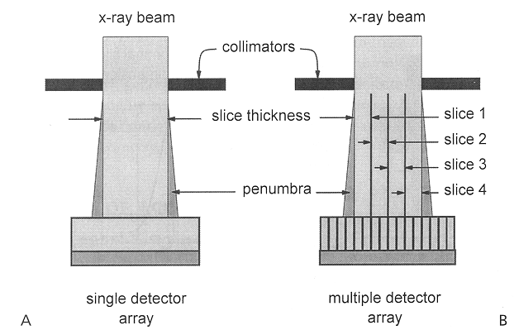

Slide 36
Slice sensitivity profile: is literally the line spread function in the cranial-caudal axis of the patient. The slice sensitivity profile is a more accurate descriptor of the slice thickness.
For single detector array scanners, the shape of the slice sensitivity profile is a consequence of:
Finite width of the x-ray focal spot
Penumbra of the collimator
The fact that the image is computed from a number of projection angles encircling the patient
Other minor factors
Helical scans have a slightly broader slice sensitivity profile due to translation of the patient during the scan

Slide 37
Factors Affecting Spatial Resolution
Helical pitch: greater pitches reduce spatial resolution. A larger pitch increases the width of the slice sensitivity profile.
Reconstruction kernel: its shape has a direct bearing on spatial resolution. Bone filters have the best spatial resolution, and soft tissue filters have lower spatial resolution.
CT reconstruction algorithms assume that the x-ray source has negotiated a circular, not helical, path around the patient
Before the actual CT reconstruction, the helical data set is interpolated into a series of planar image sets
With helical scanning, CT images can be reconstructed at any position along the length of the scan

Slide 38
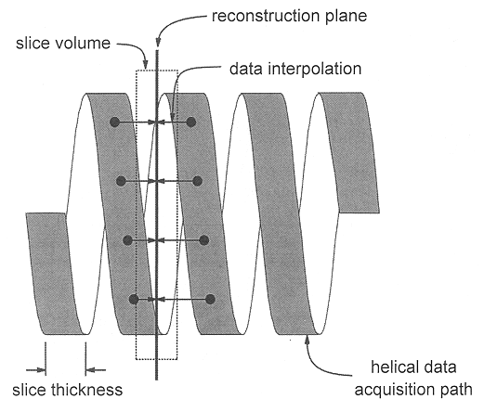

Slide 39
Factors Affecting Spatial Resolution
Pixel matrix: has a direct influence (for a fixed FaY) on spatial resolution; however no CT manufacturer compromises on this parameter in a way that reduces resolution. In some instances the pixel matrix may be reduced. For example, some vendors reconstruct to a 256 X 256 pixel matrix for CT fluoroscopy to achieve real-time performance.
Also, in soft copy viewing, if the number of CT images displayed on a monitor exceeds the pixel resolution of the display hardware, the software downscans the CT images, reducing the spatial resolution. For example, a 1,024 X 1,024 pixel workstation can display only four 512 X 512 CT images at full resolution.

Slide 40
Factors Affecting Spatial Resolution
Patient motion: involuntary motion (e.g., heart) or motion resulting from patient noncompliance (e.g., respiratory), causes blurring proportional to the distance of the motion during the scan.
Field of view: FOV influences the physical dimensions of each pixel. A 10- cm FOV in a 512 X 512 matrix results in pixel dimensions of approximately 0.2 mm, and a 35-cm FOV produces pixel widths of about 0.7 mm.

Slide 41
Factors Affecting Contrast Resolution
mAs: directly influence the number of x-ray photons used to produce the CT image, thereby affecting the SNR and the contrast resolution. Doubling of the mAs of the study increases the SNR by v2 or 41 %, and the contrast resolution consequently improves. Dose: increases linearly with mAs per scan.
Pixel size (FOV): If patient size and all other scan parameters are fixed, as FOV increases, pixel dimensions increase, and the number of x-rays passing through each pixel increases.
Slice thickness: has a strong (linear) influence on the number of photons used to produce the image. Thicker slices use more photons and have better SNR. For example, doubling of the slice thickness doubles the number of photons used (at the same kV and mAs), and increases the SNR by √2, or 41 %.

Slide 42
Factors Affecting Contrast Resolution
Reconstruction filter: Bone filters produce lower contrast resolution, and soft tissue filters improve contrast resolution.
Patient size: For the same x-ray technique, larger patients attenuate more xrays, resulting in detection of fewer x-rays. This reduces the SNR and therefore the contrast resolution.
Gantry rotation speed: Most CT systems have an upper limit on mA, and for a fixed pitch and a fixed mA, faster gantry rotations (e.g., 1 second compared with 0.5 second) result in reduced mAs used to produce each CT image, reducing contrast resolution.

Slide 43
Blurring which effects image detail occurs both in the scanning and image reconstruction phases.
The amount of blurring is determined by a variety of factors, some are fixed by the design of the equipment, but many are adjustable protocol factors.
During the scanning phase the focal spot size and the detector dimensions determine the size of each ray within the x-ray beam. Small rays produce scan data with "better detail". Increasing the pitch has the effect of reducing the data detail in the direction of patient motion.
All anatomical detail within each voxel is "Blurred together" and represented by one CT number value. Therefore, small voxels produce images with less blurring and better detail.
Some of the filter algorithms (like used to reduce noise) blur the image.

Slide 44
http://faculty.etsu.edu/blanton/16_-_Computed_Tomography_II.ppt

