Slide 1
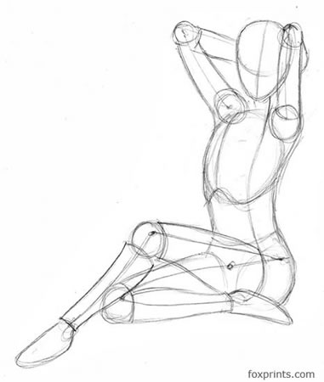
CT LIVER

Slide 2
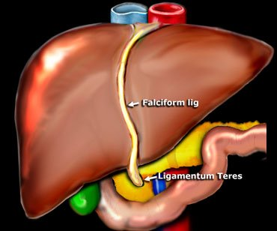
Anatomy
Macroscopic anatomy
External view
The quadrate lobe belongs anatomically to the right lobe and functionally to the left
http://www.radiologyassistant.nl/en/4375bb8dc241d

Slide 3
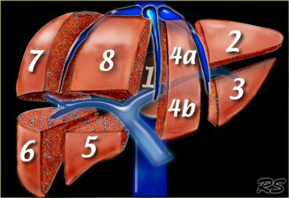
Segmental anatomy Couinaud
Functional anatomy
Depends on blood vessels and bile ducts
Right, middle and left hepatic veins
Portal vein and main branches
http://www.radiologyassistant.nl/en/4375bb8dc241d

Slide 4
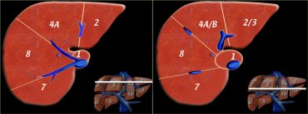
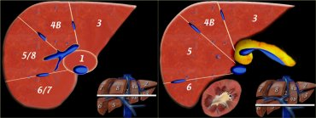
http://www.radiologyassistant.nl/en/4375bb8dc241d

Slide 5
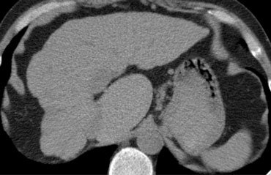
Segment Ι – quadrate lobe
posterior
Direct communication with IVC via own hepatic veins unrelated to the main ones
May be supplied by the right and left portal veins
In cirrhosis it retains its size or hyertrophies
http://www.radiologyassistant.nl/en/4375bb8dc241d

Slide 6
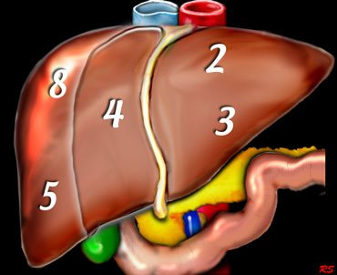
Segments I, VI, VII are posterior
http://www.radiologyassistant.nl/en/4375bb8dc241d

Slide 7
Volumetric studies (CT, MRΙ) for non interventional assessment of the anatomy
Establish the relationship of tumors for surgery planning
http://www.radiologyassistant.nl/en/4375bb8dc241d

Slide 8
Dynamic studies
Patients examined for the first time usually subjected to 3-phase scan
Before IV CM
Arterial phase (usually late arterial)
Portal phase
Depending on findings delayed phase
http://www.radiologyassistant.nl/en/446f010d8f420

Slide 9
Depiction of a lesion depends on difference in density
Some tumors do not show before CM because of low contrast
CM improves lesion depiction
Liver has double blood supply 80% portal and 20% hepatic artery
Maximum density in portal phase
Tumors are 100% supplied by hepatic artery so display maximum density in arterial phase
http://www.radiologyassistant.nl/en/446f010d8f420

Slide 10
Dynamic studies
Arterial phase in vascular tumors results in intense enhancement while the liver is of relatively low density. A hyperdense lesion in hypodense liver
In portal phase the increase in liver density may “hide” these lesions.
In the portal phase the tumors that show up are those with poor vascularity. These tumors show up as hypodense lesion in hyperdense liver
In the delayed phase (equilibrium) tumors that show up are those washing out before the liver (hypodense) or those retaining CM longer than the liver (hyperdense)
http://www.radiologyassistant.nl/en/446f010d8f420

Slide 11
Dynamic studies
Lesions may be:
Vascular
Non vascular
http://www.radiologyassistant.nl/en/446f010d8f420

Slide 12
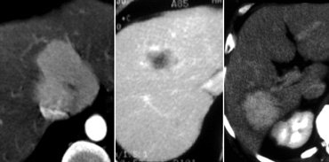
Arterial phase - hyperdense FNH
Portal phase – hypodense metastasis
Equilibrium phase – hyperdense cholangiocarcinoma
http://www.radiologyassistant.nl/en/446f010d8f420

Slide 13
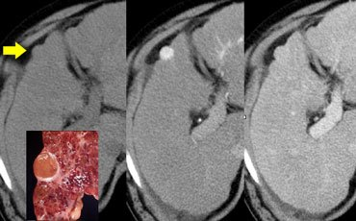
Hepatocellular carcinoma
What would you call this lesion?
http://www.radiologyassistant.nl/en/446f010d8f420

Slide 14
Dynamic liver imaging
Hypervascularised tumors take up CM best approximately 35secs post injection start (delayed arterial phase)
In the delayed arterial phase there is early opacification of the portal vein
The early arterial phase is needed in angiography (20 secs scan delay
http://www.radiologyassistant.nl/en/446f010d8f420

Slide 15
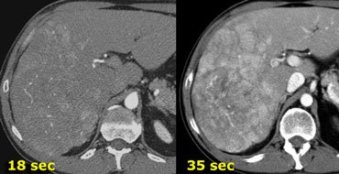
Early arterial – late arterial phase
Look at the CM in the portal vein
http://www.radiologyassistant.nl/en/446f010d8f420

Slide 16
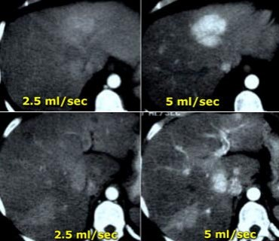
Rate of injection is important
Ideally = 5ml/sec
Total volume =140-150 mls
http://www.radiologyassistant.nl/en/446f010d8f420

Slide 17
Arterial phase is important when we need:
To characterize a focal lesion
To look for HCC in pts with elevated a-FP
Investigate cirrhotic patients
To look for metastasis from hypervascular primaries
http://www.radiologyassistant.nl/en/446f010d8f420

Slide 18
Hypervascular tumors
Benign
FNH
Adenoma
Haemangioma
Malignant
HCC
Metastases
Breast
Sarcoma
Neuroendocrine tumors
Hypernephroma
Melanoma

Slide 19
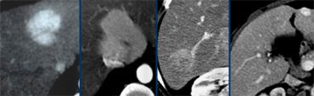
adenoma, FNH, HCC, haemangioma
Hypervascular tumors look similar in arterial phase
But different in the portal and late phases
http://www.radiologyassistant.nl/en/446f010d8f420

Slide 20
Dynamic liver study portal phase
Hyperdense liver, hypodense tumor
Ideally delay around 75 seconds
Hepatic phase because hepatic veins are also opacified
Looking for hypovascular metastases it is important to inject a high total volume of CM the rate is not that important
http://www.radiologyassistant.nl/en/446f010d8f420

Slide 21
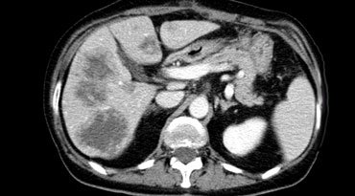
Dynamic liver study portal phase
Hypodense in the portal phase are usually metastases
http://www.radiologyassistant.nl/en/446f010d8f420

Slide 22
Dynamic liver study equilibrium phase
Reduced liver density due to CM wash out
3-4 minutes post injection
Best 10 mins
In tumor with high nascularity HCC
In tumors with CM retention (hemangioma)
Late opacification of fibrous tissue in the tumor capsule or the central scar
http://www.radiologyassistant.nl/en/446f010d8f420

Slide 23
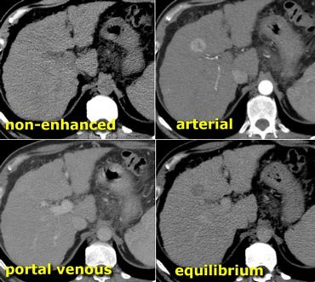
http://www.radiologyassistant.nl/en/446f010d8f420

Slide 24
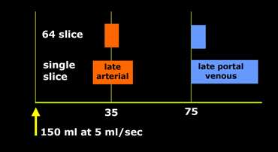
Arterial phase = middle of scan at 35 secs
Scan time 4-MDCT = 20 secs, start at 25 secs
Scan time 64-MDCT = 4 secs, start at 33 secs
Timing in the portal phase is less critical
http://www.radiologyassistant.nl/en/446f010d8f420

Slide 25
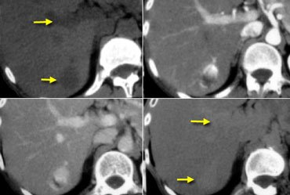
Hemangioma
Similar density to vessels at all phases
http://www.radiologyassistant.nl/en/446f010d8f420

Slide 26
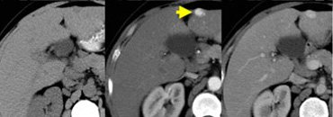
Hemangioma
The commonest benign lesion
Multiple small vessels
Fills from outside to the center
Density same as vessels in all phases
http://www.radiologyassistant.nl/en/448eef3083354

Slide 27
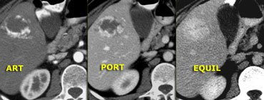
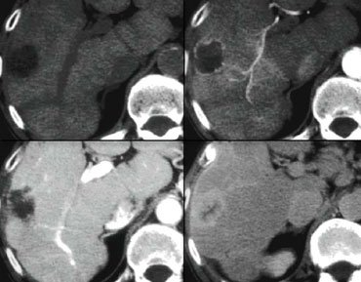
Hemangioma
Gradual filling-in
http://www.radiologyassistant.nl/en/448eef3083354

Slide 28
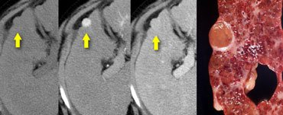
Hepatocellular carcinoma, HCC
The commonest malignant tumor
85% in liver cirrhosis and hepatitis Β/C
Early diagnosis with arterial phase scanning
http://www.radiologyassistant.nl/en/448eef3083354

Slide 29
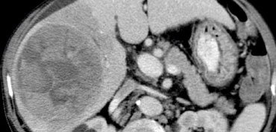
HCC
Big HCCs display early wash out in portal phase
There may be thrombus in the portal vein (tumor or blood thrombus)
http://www.radiologyassistant.nl/en/448eef3083354

Slide 30
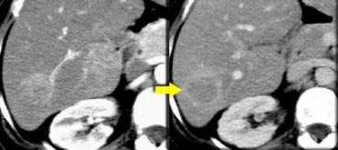
Adenoma
Benign tumor
Women on contraceptives or men on anabolic steroids
Arterial enhancement that remains
http://www.radiologyassistant.nl/en/448eef3083354

Slide 31
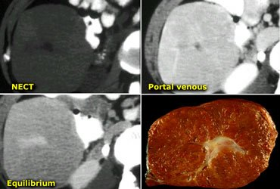
Focal nodular hyperplasia - FNH
Benign tumor with central scar taking up at delayed phase
Intense arterial enhancement, isodense in portal and the delayed phases
http://www.radiologyassistant.nl/en/448eef3083354

Slide 32
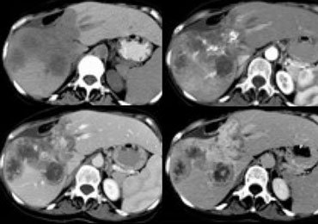
Cholangiocarcinoma
Usually big
Delayed enhancement
http://www.radiologyassistant.nl/en/448eef3083354

Slide 33
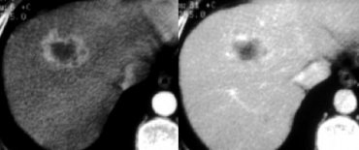
Metastases
Hypovascular
Digestive tract, lung, breast head, neck
Hypodense in portal phase
Peripheral enhancement-active tumor
Central necrosis-no enhancement
hypervascular
Less common kidney, insulinoma, carcinoid, sarcoma, malanoma, breast
Hyperdense arterial phase
Calcifications
Large bowel, stomach, breast, pancreas endocrine, leiomyosarcoma, osteo- , melanoma
Cystic
Mucin producing ovarian tumor, large bowel, sarcoma, melanoma, lung, carcinoid
http://www.radiologyassistant.nl/en/448eef3083354

Slide 34
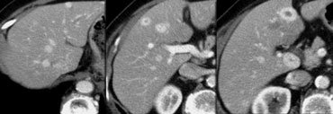

Slide 35
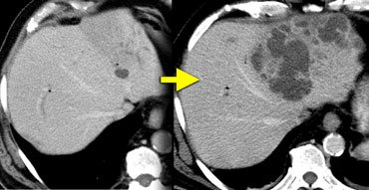
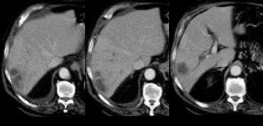
Liver abscess
Bacteria via bile duct portal vein or hepatic artery or by contiguous spread
http://www.radiologyassistant.nl/en/448eef3083354

Slide 36
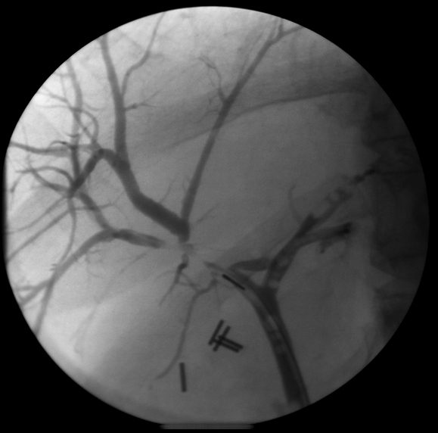

Slide 37
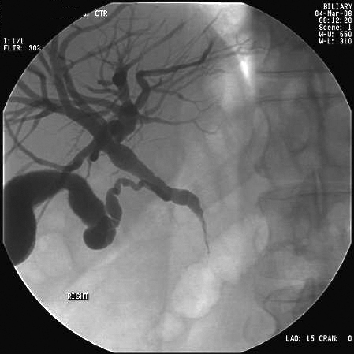

Slide 38
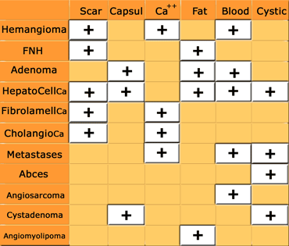

Slide 39
http://www.info-radiologie.ch/entero-irm-anatomie/fullsize/irm-abdominal-coronal.0030_fs.jpg
http://www.radiologyassistant.nl/en/448eef3083354
http://www.radiologyassistant.nl/en/446f010d8f420
http://www.radiologyassistant.nl/en/4375bb8dc241d

