Slide 1
Contrast media in MDCT

Slide 2
Learning objectives
Today you will be presented with
fundamentals of arterial and parenchymal CM enhancement,
user-selectable parameters (injection flow rate, injection volume, and injection duration) and
the way they affect the respective time attenuation responses
practical examples of injection strategies

Slide 3
Multislice or multidetector-row CT (MDCT) is a rapidly evolving technology.
The development of more powerful and sophisticated x-ray tubes, advances in detector design with increasing numbers of detector rows mounted on ever-faster rotating gantry systems, and sophisticated reconstruction algorithms have led to substantial gains in spatial and temporal resolution, volume coverage, and acquisition speed.
Although these developments offer new opportunities in cardiovascular and body CT imaging, protocol design and contrast medium (CM) delivery become more difficult and less forgiving at the same time.

Slide 4
The relationship between the total volume of CM injected and the degree of opacification of the normal liver parenchyma will not change in the foreseeable future,
because this relationship is controlled by pharmacokinetics—the respective volumes of distribution of a radiographic contrast agent in the extracellular space.
scan timing is also not critical for imaging of the liver in a portal venous phase, even with the fastest scanner

Slide 5
Substantially more sophistication is needed, however, when modern CT technology is used to take advantage of rapid changes of CM opacification because of differences in organ perfusion, for example in imaging of hypervascular liver lesions, the pancreas, or perfusion itself, and for imaging of the cardiovascular system.
Understanding the early CM dynamics is a prerequisite for the design of scanning and injection protocols in all these instances, and correct scan timing is critical.

Slide 6
All currently used angiographic x-ray CM are water- soluble derivates of symmetrically iodinated benzene (triiodobenzene).
All angiographic x-ray CM are extracellular fluid markers. After intravenous administration they are rapidly distributed between the intravascular and extravascular interstitial spaces.
Traditional pharmacokinetic studies on CM have concentrated on the phase of elimination rather than on the early phase of CM distribution.
For the time frame relevant to modern CT, however, it is this particularly complex phase of early CM distribution and redistribution that determines vascular enhancement and enhancement of well-perfused organs.

Slide 7
Vascular vs parenchymal opacification
Vascular enhancement and parenchymal organ enhancement are dominated by different kinetics.
For nonvascular CT (eg, imaging of the liver during a parenchymal phase) the degree of organ opacification correlates closely with the volume of CM (iodine) administered and is inversely related to a patient’s body weight (a surrogate parameter for extracellular space)
Arterial enhancement, on the other hand, is not immediately related to CM volume.

Slide 8
Key rules of early arterial CM dynamics and their consequences
Rule 1: Arterial enhancement is proportional to the iodine administration rate. Arterial opacification can be increased by:
increasing the injection flow rate and/or
increasing the iodine concentration of the contrast medium
Rule 2: Arterial enhancement increases cumulatively with the injection duration
longer CM injections increase arterial enhancement
a minimum injection duration of approximately 10s is always needed
Rule 3: Individual enhancement is controlled by cardiac output
cardiac output is inversely proportional to arterial opacification
increasing or decreasing both the injection rate and the injection volumes to body weight reduces the interindividual variability of arterial enhancement

Slide 9
RULE 1 Arterial enhancement is proportional to the iodine administration rate
Arterial enhancement is controlled by two key rules
the amount of iodinated CM delivered per unit of time, which, for a given iodine concentration, is the injection flow rate (mL/s), and
the injection duration, in seconds.
For example 5 mL/s for 20 seconds, corresponds to an intravenous CM injection of 100 mL at 5 mL/s which is the usual way of dictating CM dose
so
CM volume does indirectly play a role, notably because most power injectors require that a CM injection is keyed into the injector interface as CM volume and flow rate.

Slide 10
Use of contrast medium with high iodine concentration is an alternative approach to using a high injection rate as a means to increase iodine delivery rate.

Slide 11
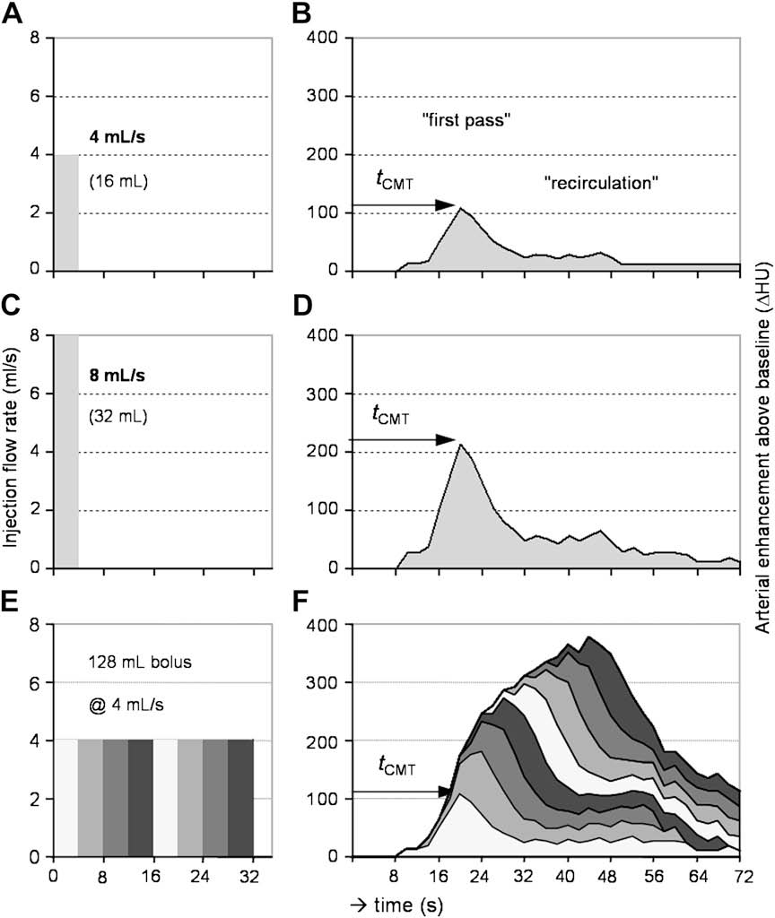
CM kinetics
CM transit time (tCMT): the time needed for CM to reach the vessel of interest
first pass
recirculation – bolus broadening

Slide 12
the degree of arterial enhancement is directly proportional to the iodine administration rate.
when the injection rate is doubled the corresponding enhancement response is twice as strong.
changing the iodine concentration of the contrast agent has the same proportional effect
For fast multidetector CT, a high iodine delivery rate is desirable to maximize arterial enhancement at CT angiography and to depict hypervascular tumors.

Slide 14
Maximum flow rate
There are physiologic and practical limitations to increasing the injection flow rates
Injection flow rates > of 8 mL/s do not increase max. enhancement due to pooling in the central venous system with reflux into the inferior vena cava
High injection flow rates are also limited by the size of the intravenous cannula, most of which would not allow injection rates > 6 mL/s (18 G) even if warmed CM are used

Slide 15
RULE 2 Arterial enhancement increases cumulatively with the injection duration
The effect of increasing (or shortening) the injection duration is more difficult to understand than the direct relationship of the iodine administration rate, but it is equally important
CM Injection may be understood as the sum up of smaller boluses
the recirculation effects of the earlier test boluses overlap (and thus sum up) with the first-pass effects of later test boluses, resulting in the typical continuous increase of arterial enhancement over time

Slide 18
RULE 3 Individual enhancement is controlled by cardiac output
The degree of arterial enhancement is highly variable between individuals. Even in normal cardiac output, mid aortic enhancement may range from 140 HU to 440 HU (a factor of three) between patients.
Body weight taken into account, the average aortic enhancement ranges from 92 to 196 HU/mL/kg (a factor of two). Adjusting the CM injection rates (and volumes) to body weight therefore reduces interindividual differences of arterial enhancement, but it does not completely eliminate them.

Slide 19
The most important patient-related factor affecting the magnitude of vascular and parenchymal contrast enhancement is body weight
To maintain a consistent level of contrast enhancement in larger patients, one should consider increasing the overall iodine dose delivery by increasing contrast medium volume and/or concentration.
Iodine dose is commonly adjusted for body size on the basis of the 1:1 linear proportionality to body weight.

Slide 20
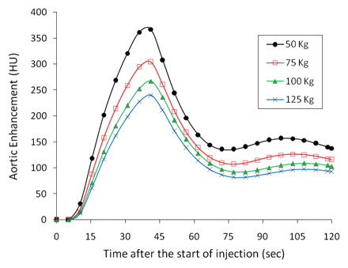
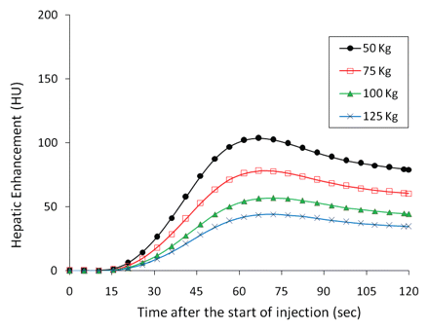
Body-weight adjustment of injections is recommended, at least for patients who have small (<60 kg) and large (>90 kg) body size
This approach is a practical compromise that allows individualization of CM delivery while avoiding the need for a calculator
http://radiology.rsna.org/content/256/1/32

Slide 21
Arterial enhancement
The fundamental physiologic parameter affecting arterial enhancement is cardiac output
Cardiac output is inversely related to the degree of arterial enhancement, particularly in first-pass dynamics
Arterial enhancement is therefore lower in patients who have high cardiac output, but it is stronger in patients who have low cardiac output (despite the delayed t_{CMT})

Slide 22
Timing contrast enhancement
The most important patient-related factor affecting the timing of contrast enhancement is cardiac output and cardiovascular circulation.
When cardiac output decreases, contrast material bolus arrives slowly and clears slowly, resulting in delayed contrast material bolus arrival and delayed but stronger peak arterial and parenchymal enhancement.
When scan timing is critical, CT scan delay should be individualized by using a test-bolus or a bolus-tracking technique to account for circulatory variations among patients.

Slide 23
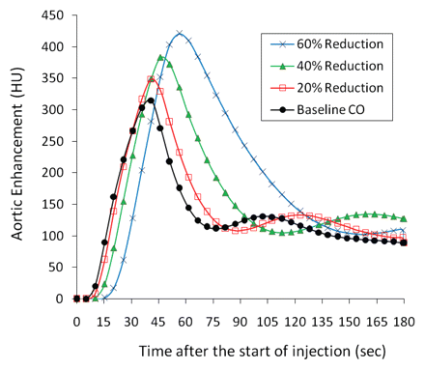
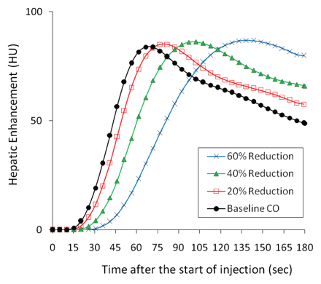
Cardiac output and enhancement
http://radiology.rsna.org/content/256/1/32

Slide 24
Parenchymal enhancement - liver
Parenchymal enhancement results less from the opacification of blood vessels and more from CM distribution into the extravascular interstitial space of an organ or tissue.
The dynamics of hepatic CM enhancement are also influenced by the dual blood supply of the liver, with most hepatic blood flow (approximately 80%) derived from the portal venous system, where any CM bolus is substantially broadened (and delayed) within the splachnic vasculature.
The enhancement of normal liver parenchyma is much lower than vascular enhancement, and also occurs much later than arterial enhancement (approximately 40 or 50 seconds after aortic enhancement).

Slide 25
Scan timing for parenchymal (portal venous phase) liver imaging can also be chosen empirically, approximately 70 seconds or later after start of an injection.
The portal phase is also comparably long, and the contrast to low- attenuation liver lesions remains adequate for as long as CM has not diffused into the interstitial spaces of low-attenuation solid liver lesions, making them potentially isodense to surrounding normal liver parenchyma

Slide 26
Certain liver lesions, notably well differentiated as hepatocellular carcinomas, remain or become hypoattenuating even later, in the so-called ‘‘delayed’’ or equilibrium/post-equilibrium phase, which occurs approximately 3 to 5 minutes after contrast delivery. Delayed-phase imaging may improve the sensitivity of hepatocellular carcinoma (HCC) in cirrhotic livers.
Even later imaging (10–15 minutes or more) depicts CM retention in fibrous components of neoplasms, such as tumor capsules and cholangiocellular carcinomas.

Slide 27
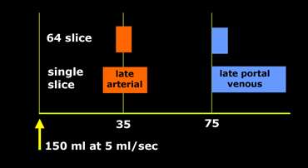

Slide 28
Enhancement of normal liver parenchyma—and thus the contrast to low-attenuation liver lesions—is independent of the injection flow rate, but is directly proportional to the total amount of CM (iodine) delivered.

Slide 29
The main physiologic parameter affecting the strength of CM enhancement of normal liver parenchyma is body weight.
Although body weight may not be the best surrogate marker for extracellular fluid space, it is more readily available than lean body weight.
500 to 600mg of iodine per kilogram of bodyweight achieves adequate hepatic parenchymal enhancement.
Adjustment of CM volume to body size is recommended

Slide 30
Liver and pancreas CT 64-channel injection protocol
High Concentration CM (370 mg I/mL)
Injection (~1.6 mL/kg BodyWeight) in 30 s
Body Weight Injection Volume @ Flow Rate
<55 kg 90 mL @ 3.0 mL/s
<65 kg 100 mL @ 3.5 mL/s
75 kg 120 mL @ 4.0 mL/s
>85 kg 135 mL @ 4.5 mL/s
>95 kg 150 mL @ 5.0 mL/s

Slide 31
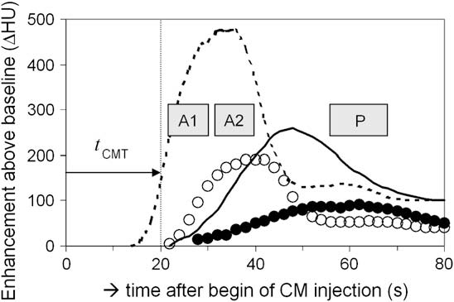
Enhancement of Hypervascular Liver Lesions
http://radiology.rsna.org/content/256/1/32

Slide 32
Such lesions are characterized by their systemic arterial rather than portal venous blood supply, and therefore demonstrate an earlier enhancement than surrounding normal liver parenchyma, somewhat comparable to the enhancement of the spleen

Slide 33
Hypervascular liver lesion opacification increases slightly later than opacification of the supplying artery, it is best to image such lesions as late as possible, yet before the surrounding liver parenchyma has a chance to increase the background attenuation from portal venous CM.
late arterial phase occurs approximately 10 to 15 seconds after CM arrival in the aorta
Note that at that time the portal vein branches (but not the parenchyma or hepatic veins) will be slightly opacified, hence the alternative term ‘‘portal venous inflow phase’

Slide 34
The enhancement of hypervascular liver lesions can be controlled by the same parameters that affect arterial enhancement:
Fast injection flow rates and
high-concentration CM
Scan timing is critical, obviously, and should be chosen relative to the arrival of CM (tCMT) in the abdominal aorta.

Slide 35
Enhancement of pancreas
The enhancement kinetics of other solid organs, such as the normal pancreas, also follow arterial dynamics
There is a longer delay necessary to increase the opacification of the interstitial spaces of the organ of interest
Approximately 20 to 25 seconds after CM arrival in the aorta (for injection durations of 30 seconds, and scan times of approximately 5 seconds)
The superior mesenteric vein is often not well opacified in this phase so perform a portal phase
For hyper vascular lesions start arterial phase a little earlier 15secs post arrival

Slide 36
A fixed, empiric scanning delay remains adequate for many routine CT applications.
For example, for routine CM-enhanced thoracic CT, small to moderate amounts of CM suffice to delineate the hilar vessels.
A fixed scanning delay of approximately 40 to 50 seconds also allows opacification of tumors or pleural enhancement.
With fast scanners, the thorax can be scanned within a few seconds (3–6 seconds), and the data acquisition should be initiated approximately 10 seconds after the entire bolus has been injected to avoid artifacts from unopacified contrast in the great thoracic veins.
As an example, we inject 1 mL/kg body weight within 30 seconds, and use a fixed delay of 40 seconds in this instance.
For routine chest-abdomen-pelvis CT we inject 1.6 mL/kg body weight in 40 seconds, and scan after a fixed delay of 70 seconds

Slide 37
Fixed, empiric scanning delays cannot be recommended for cardiac or vascular CT, (and also dedicated phase-sensitive scans for liver and pancreas imaging) because the arterial tCMT is prohibitively variable between individual patients, ranging from as short as 8 to as long as 40 seconds in patients who have cardiovascular diseases.
The scanning delay (the time interval between the beginning of a CM injection and the initiation of CT data acquisition) needs to be timed relative to the tCMT of the vascular territory of interest.
With fast MDCT acquisitions the tCMT itself does not necessarily serve as the scanning delay, as was the case with slower single-detector CT systems, but the tCMT rather serves as a landmark relative to which the scanning delay can be individualized.

Slide 38
Depending on the vessels of interest an additional delay relative to the tCMT can be selected.
In CTA, this additional delay may be as short as 2 seconds (tCMT + 2s), but often slightly longer delays of 5 or 8 seconds are used (tCMT + 8s).
The notation ‘‘tCMT + 8s’’ means that the scan is initiated 8 seconds after the CM has arrived in the target vasculature.
Even longer relative delays are used for early-arterial or late arterial phases of the liver and for pancreatic imaging.
Transit times can be easily determined using either a test-bolus injection or an automatic bolus triggering technique.

Slide 39
Test Bolus
The injection of a small test bolus (15–20 mL) while acquiring a low-dose dynamic (non-incremental) CT acquisition is a reliable means to determine the tCMT from the intravenous injection site to the arterial territory of interest
The tCMT equals the time-to-peak enhancement interval measured in a region of interest (ROI) placed within a reference vessel

Slide 40
Automatic bolus triggering
For automated bolus triggering, a circular ROI is placed into the target vessel on a non-enhanced image.
While CM is injected, a series of low dose non-incremental scans are obtained and the attenuation within the ROI is monitored.
The tCMT equals the time when a predefined enhancement threshold (trigger level) is reached (eg, 100 HU)

Slide 41
Contrast material arrival time can be estimated either by using a test-bolus or bolus-tracking method.
Contrast material arrival time should not be simply assumed to serve as the scan delay, particularly for fast multidetector CT. It should be used as a means of individualizing the scan delay
Scan delay = contrast material arrival time + post-trigger delay
Some MDCT applications may require long post-trigger delays that prevent the diagnostic acquisition from starting quickly during the appropriate early contrast enhancement.
The magnitude of post-trigger delay depends on the injection duration, scan duration, and location of target organ.

Slide 42
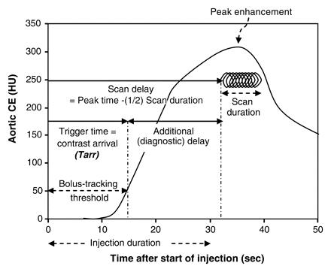

Slide 43
For technical reasons, the CT acquisition cannot begin immediately and automated bolus triggering causes a slight delay relative to the tCMT.
This inherent delay depends on the scanner model and on the longitudinal distance between the monitoring series and the starting position of the scan
Α prerecorded breath-holding command is programmed into the CT acquisition, this increases the minimal delay before a scan can be initiated
The minimal trigger delay is approximately 2secs

Slide 44
If a longer trigger delay is necessary (eg, 8 seconds, tCMT + 8s), the injection duration needs to be increased accordingly to guarantee a long enough enhancement phase within the vascular territory of interest.
Bolus triggering is a robust and practical technique for routine use and has the advantage of not requiring an additional test bolus injection, thus decreasing the total contrast used.
It also eliminates unwanted organ enhancement (eg, renal collecting system) in the subsequent full bolus study.

Slide 45
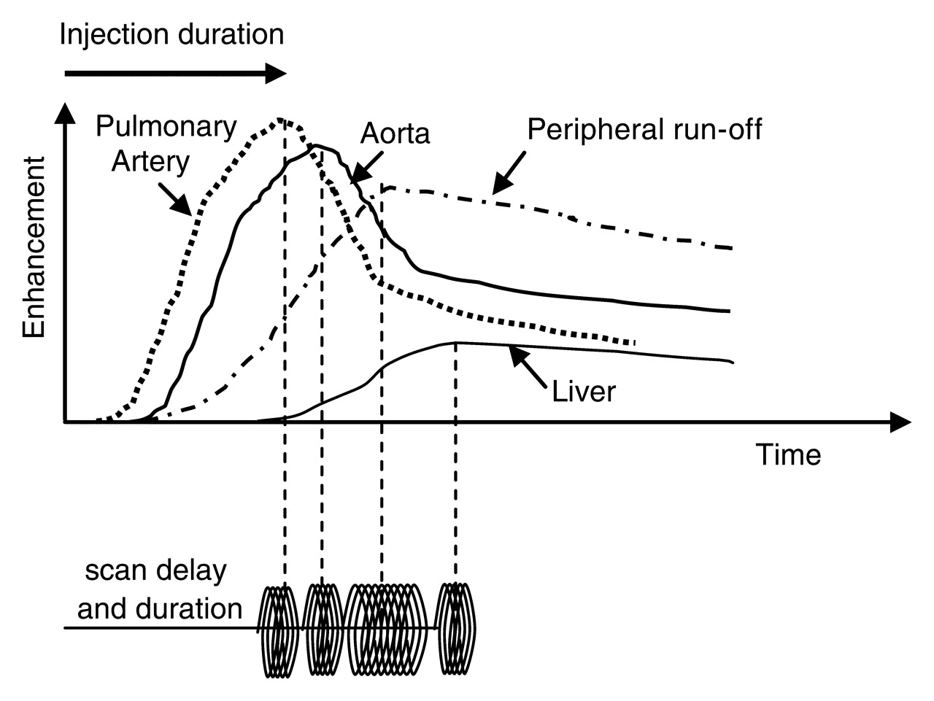

Slide 46
 |  |  | spiral
 |  | Post threshold delay
 | tracker
Post injection delay
Threshold (50-150 HU)
Injection start

Slide 47
Time of arrival
Wrist | Elbow | Central line
t + (2-4) secs | t | t - (4-6) secs

Slide 48
Scanning and injection protocol design
The sequence of acquisitions (digital radiograph for selecting the scanning range, precontrast, postcontrast, and delayed acquisitions, and so forth) with their respective technical acquisition and reconstruction parameters (kVp, mAs, detector configuration, pitch, rotation time, slice thickness/interval, reconstruction kernel, and so forth) are preprogrammed into the scanner menu.
Injection parameters are kept as a separate paper or electronic file; however, this may change in the future and injection protocols may be stored in the memory of a power injector or on the scanner console

Slide 49
Dose modulation techniques
Modern CT scanners are equipped with powerful x-ray tubes
There is a complex relationship between tube power, gantry rotation time, pitch, and image noise make
This makes manual selection of exposure parameters unintuitive and may result in unnecessarily high radiation exposure (notably in slim individuals) or suboptimal image quality with excessive noise (typically in very obese patients).

Slide 50
Automated tube current modulation is available on all modern CT scanners and should be used in all protocols, with a few exceptions (head, and ECG gated scans)
the user selects a desired/acceptable image quality (quality reference mAs) or image noise (noise index) rather than selecting a particular tube current

Slide 51
Advantages and Disadvantages of Fast CT Acquisitions
Shorter scan times allow for easier breath-holding and are the prerequisite for imaging during dedicated phases of organ enhancement.
Fast gantry rotations are also fundamental for cardiac imaging because the gantry rotation time directly translates into temporal resolution.
In the setting of cardiovascular CT applications, shorter scan times also allow for the use of less total CM volumes and larger anatomic coverage

Slide 52
Fast scan times also come with potential disadvantages.
They usually need faster CM injections, and the traditional strategy of selecting the injection duration equal to the scan time is no longer adequate.
Fast data acquisitions may in fact be too fast in situations in which vascular opacification is delayed because of pathologic conditions.
Opacification of large aneurysms may take several seconds because of slow mixing of opacified blood with non-opacified blood, and
filling of arteries distal to significantly diseased vessels may also substantially delay the propagation of an intravenously injected bolus downstream

Slide 53
The fastest possible table speed is not necessarily the best choice with modern CT equipment.
Deliberately scanning at a moderate table speed, or allowing the bolus a head start, is a more appropriate and reliable strategy.
Another benefit of not using the fastest possible acquisition speed is that slower scans (with submaximal gantry rotation speed and submaximal pitch) provide a considerable cushion of tube power, which may be needed in large and obese patients to maintain acceptable image noise.

Slide 54
Contrast Medium Injection Strategies for Cardiovascular CT
As opposed to the previous strategies, wherein the injection duration was chosen to match the scan time (plus increased delay), the technical capabilities of modern 64-channel scanners allow a reversal of the traditional paradigm:
we no longer select the injection duration based on the scan time, but we select the scan time based on an injection protocol that allows good opacification with reasonable injection flow rates for a wide range of patients.
The average injection flow rate is a moderate 5 mL/s, which allows down-regulating (4 mL/s) and up-regulating (6 mL/s) the flow rates according to patients’ physiology.

Slide 55
Slow down the CT acquisition and use the same scan time for a given vascular territory for every patient (the pitch thus varies between patients and tube output is controlled by automated tube current modulation).
When the same scan time is used for all patients, one can always use the same injection duration also, which simplifies individualizing the flow rates (and volumes) for different patient physiology.
For example, use a fixed scan time of 10 seconds for abdominal CTA, with an injection duration of 18 seconds, and a scanning delay of tCMT + 8 seconds, as determined by bolus triggering
This strategy allows breath-holding for virtually all patients. It results in reliably strong arterial enhancement because of high iodine flux and increased scanning delay relative to the tCMT, while avoiding excessive injection flow rates.
Image noise is constant within and across individuals by using automated tube current modulation

Slide 56
In cardiac CT, the scan time cannot be predetermined, because gantry rotation time and pitch have to be adapted to the heart rate
Instead of flushing the veins with saline alone, it is advantageous to flush the veins with diluted contrast (70%–80% saline, 20%–30% CM) to maintain right ventricular opacification

Slide 57
Lower extremity CTA benefits from deliberately slowing down the acquisition even more.
Because of the potentially slow propagation of a CM bolus within a diseased lower extremity arterial tree, use a scan time of 40 seconds.
The injection duration is always 35 seconds; this is possible because the data acquisition follows the bolus down the arterial tree and the injection duration can therefore be shorter than the scan time

Slide 58
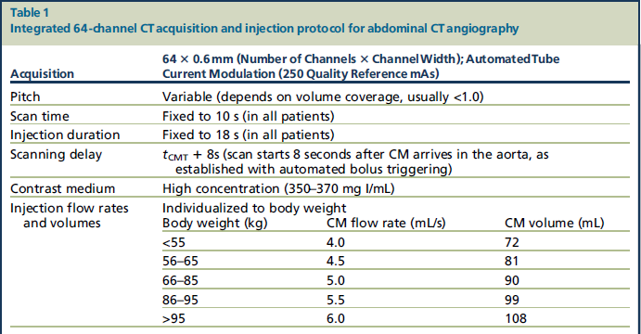

Slide 59
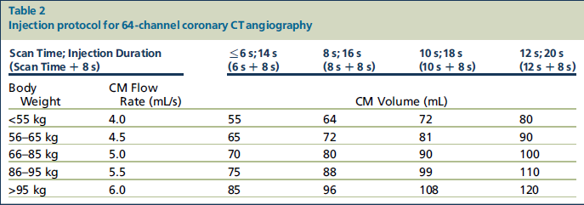

Slide 60
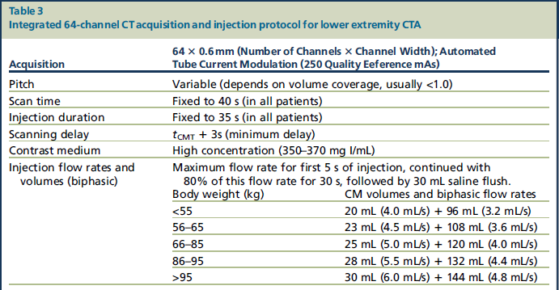

Slide 61
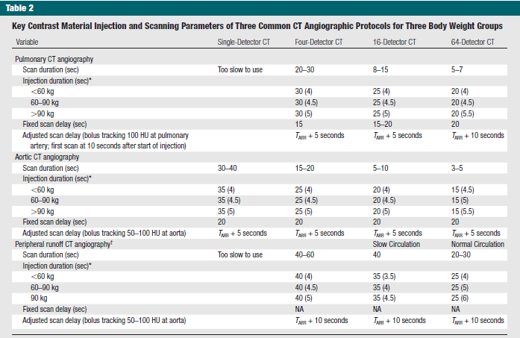

Slide 62
Saline flush
A saline flush pushes the tail of the injected contrast medium bolus into the central blood volume and makes use of contrast medium that would otherwise remain unused in the injection tubing and peripheral veins. It therefore increases both the efficiency of contrast medium utilization and the level of contrast enhancement.
improved bolus geometry due to reduced intravascular contrast medium dispersion,
reduced streak artifact from dense contrast medium in the brachiocephalic vein and superior vena cava on thoracic CT
increased hydration to reduce contrast-induced nephrotoxicity,
elimination of the need for injecting a small amount of saline at the end of CT scan to wash out any residual contrast medium which is highly viscous and may clog the vascular access catheter.

Slide 63
saline flush is particularly beneficial when a small volume of contrast medium is used
practical requirement of a double-barrel power injector
Uniform prolonged arterial enhancement may be achieved with either an individually customized biphasic injection or with the exponentially decelerated multiphasic injection method.

Slide 64
Direction of scan
Scan duration information is crucial for the calculation of the injection duration and scan timing. For a long scan, an extended injection is likely required.
While clinical contrast-enhanced CT is performed with the scan direction commensurate with the direction of contrast material bolus propagation,
exception is caudocranial scanning at pulmonary CT angiography for the detection of pulmonary emboli

Slide 65
Intravenous Contrast Medium Administration and Scan Timing at CT: Considerations and Approaches. Kyongtae T. Bae, MD, PhD. Radiology July 2010 vol. 256 no. 1 32-61

