Slide 1
Harmonic Analysis and the Prediction of Tides
Dr. Russell Herman
Mathematic and Statistics
UNCW
“THE SUBJECT on which I have to speak this evening is the tides, and at the outset I feel in a curiously difficult position. If I were asked to tell what I mean by the Tides I should feel it exceedingly difficult to answer the question. The tides have something to do with motion of the sea.”
Lord Kelvin, 1882

Slide 2
Outline
What Are Tides?
Tidal Constituents
Fourier Analysis
Harmonic Analysis
Ellipse Parameters
Abstract
In this talk we will describe classical tidal harmonic analysis. We begin with the history of the prediction of tides. We then describe spectral analysis and its relation to harmonic analysis. We end by describing current ellipses.

Slide 3
The Importance of Tides
Important for commerce and science for thousands of years
Tides produce strong currents
Tidal currents have speeds up to 5m/s in coastal waters
Tidal currents generate internal waves over various topographies.
The Earth's crust “bends” under tidal forces.
Tides influence the orbits of satellites.
Tidal forces are important in solar and galactic dynamics.

Slide 4
Tidal Analysis – Long History
Mariners know tides are related to the moon’s phases
The exact relationship is complicated
Many contributors:
  Galileo, Descartes, Kepler, Newton, Euler, Bernoulli, Kant, Laplace, Airy, Lord Kelvin, Jeffreys, Munk and many others
Some of the first computers were developed to predict tides.
Tide-predicting machines were developed and used to predict tidal constituents.

Slide 5
“Rise and fall of the sea is sometimes called a tide; … Now, we find there a good ten feet rise and fall, and yet we are authoritatively told there is very little tide.”
“The truth is, the word "tide" as used by sailors at sea means horizontal motion of the water; but when used by landsmen or sailors in port, it means vertical motion of the water.”
“One of the most interesting points of tidal theory is the determination of the currents by which the rise and fall is produced, and so far the sailor's idea of what is most noteworthy as to tidal motion is correct: because before there can be a rise and fall of the water anywhere it must come from some other place, and the water cannot pass from place to place without moving horizontally, or nearly horizontally, through a great distance. Thus the primary phenomenon of the tides is after all the tidal current; …”
The Tides, Sir William Thomson (Lord Kelvin) – 1882,
Evening Lecture To The British Association

Slide 6
Tidal Analysis – Hard Problem!
Important questions remained:
  What is the amplitude and phase of the tides?
  What is the speed and direction of currents?
  What is the shape of the tides?
First, accurate, global maps of deep-sea tides were published in 1994.
Predicting tides along coasts and at ports is much simpler.

Slide 7
Tidal Potential
Tides - found from the hydrodynamic equations for a self-gravitating ocean on a rotating, elastic Earth.
The driving force - small change in gravity due to relative motion of the moon and sun.
Main Forces:
Centripetal acceleration at Earth's surface drives water toward the side of Earth opposite the moon.
Gravitational attraction causes water to be attracted toward the moon.
If the Earth were an ocean planet with deep oceans:
  There would be two bulges of water on Earth,
  one on the side facing the moon, one on the opposite side.

Slide 8
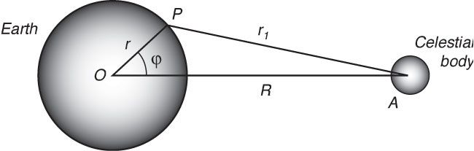
Gravitational Potential
Terms: Force = gradient of potential
1. No force
2. Constant Force – orbital motion
3. Tidal Potential

Slide 9
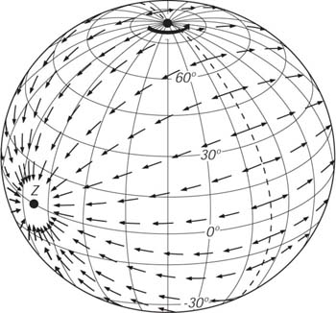
Tidal Buldges
The tidal potential is symmetric about the Earth-moon line, and it produces symmetric bulges. vertical forces produces very small changes in the weight of the oceans. It is very small compared to gravity, and it can be ignored.

Slide 10
High Tides
Allow the Earth to rotate,
An observer in space sees two bulges fixed relative to the Earth-moon line as Earth rotates.
An observer on Earth sees the two tidal bulges rotate around Earth as moon moves one cycle per day.
The moon produces high tides every 12 hours and 25.23 minutes on the equator if it is above the equator.
High tides are not exactly twice per day
  the moon rotates around Earth.
  the moon is above the equator only twice per lunar month, complicating the simple picture of the tides on an ideal ocean-covered Earth.
  the moon's distance from Earth varies since the moon's orbit is elliptical and changing

Slide 11
Lunar and Solar Tidal Forces
Solar tidal forces are similar
Horizontal Components – K_{S}/K_{M} = 0.46051
Thus, need to know relative positions of sun and moon!

Slide 12
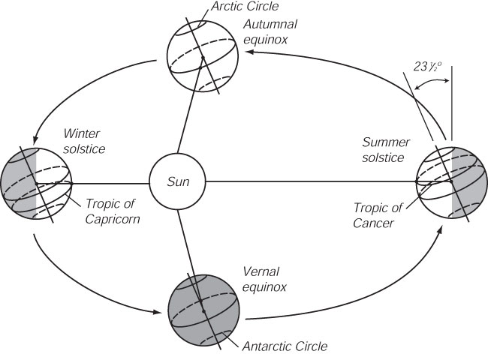
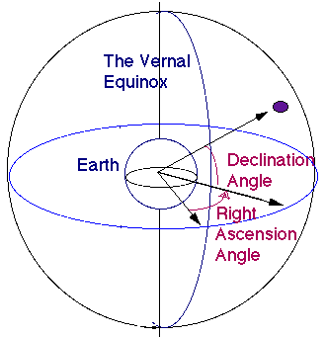
Locating the Sun and the Moon
Terminology – Celestial Mechanics
Declination
Vernal Equinox
Right Ascension

Slide 13
Tidal Frequencies
ϕ_{p} is latitude at which the tidal potential is calculated,
δ is declination of moon (or sun) north of the equator,
τ is the hour angle of moon (or sun).

Slide 14
Solar Motion
The periods of hour angle:
solar day of 24hr 0min or lunar day of 24hr 50.47min.
Earth's axis of rotation is inclined 23.45° with respect to the plane of Earth's orbit about the sun.
Sun’s declination varies between δ = ± 23.45° with a period of one solar year.
Earth's rotation axis precesses with period of 26,000 yrs.
The rotation of the ecliptic plane causes δ and the vernal equinox to change slowly
Earth's orbit about the sun is elliptical causing perigee to rotate with a period of 20,900 years.
Therefore R_{S} varies with this period.

Slide 15
Lunar Motion
The moon's orbit lies in a plane inclined at a mean angle of 5.15° relative to the plane of the ecliptic. The lunar declination varies between δ = 23.45 ± 5.15° with a period of one tropical month of 27.32 solar days.
The inclination of moon's orbit: 4.97° to 5.32°.
The perigee rotates with a period of 8.85 years. The eccentricity has a mean value of 0.0549, and it varies between 0.044 and 0.067.
The plane of moon's orbit rotates around Earth's axis of with a period of 17.613 years.
These processes cause variations in R_{M}

Slide 16
Tidal Potential Periods
Lunar Tidal Potential - periods near 14 days, 24 hours, and 12 hours
Solar Tidal Potential - periods near 180 days, 24 hours, and 12 hours
Doodson (1922) - Fourier Series Expansion using 6 frequencies

Slide 17
Doodson’s Frequencies
 | Frequency (°/hour) |  | Period | Source
f₁ | 14.49205211 | 1 | lunar day | Local mean lunar time
f₂ | 0.54901653 | 1 | month | Moon's mean longitude
f₃ | 0.04106864 | 1 | year | Sun's mean longitude
f₄ | >0.00464184 | 8.847 | years | Longitude of Moon's perigee
f₅ | -0.00220641 | 18.613 | years | Longitude of Moon's ascending node
f₆ | 0.00000196 | 20,940 | years | Longitude of sun's perigee

Slide 18
The Tidal Constituents
Tidal Species | Name | n₁ | n₂ | n₃ | n₄ | n₅ | Equilibrium Amplitude* (m) | Period (hr)
Semidiurnal | n₁ = 2
Principal lunar | M₂ | 2 | 0 | 0 | 0 | 0 | 0.242334 | 12.4206
Principal solar | S₂ | 2 | 2 | -2 | 0 | 0 | 0.112841 | 12.0000
Lunar elliptic | N₂ | 2 | -1 | 0 | 1 | 0 | 0.046398 | 12.6584
Lunisolar | K₂ | 2 | 2 | 0 | 0 | 0 | 0.030704 | 11.9673
Diurnal | n₁ =1
Lunisolar | K₁ | 1 | 1 | 0 | 0 | 0 | 0.141565 | 23.9344
Principal lunar | O₁ | 1 | -1 | 0 | 0 | 0 | 0.100514 | 25.8194
Principal solar | P₁ | 1 | 1 | -2 | 0 | 0 | 0.046843 | 24.0659
Elliptic lunar | >Q₁ | 1 | -2 | 0 | 1 | 0 | 0.019256 | 26.8684
Long Period | n₁ = 0
Fortnightly | M_{f} | 0 | 2 | 0 | 0 | 0 | 0.041742 | 327.85
Monthly | M_{m} | 0 | 1 | 0 | -1 | 0 | 0.022026 | 661.31
Semiannual | S_{sa} | 0 | 0 | 2 | 0 | 0 | 0.019446 | 4383.05

Slide 19
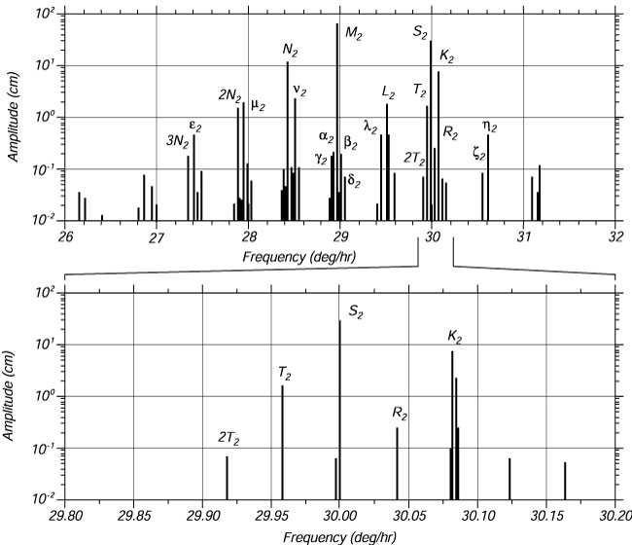
Constituent Splitting
Doodson's expansion:399 constituents,
100 are long period, 160 are daily, 115 are twice per day,
and 14 are thrice per day. Most have very small amplitudes.
Sir George Darwin named the largest tides.

Slide 20
How to Obtain Constituents
Fourier (Spectral) Analysis
Harmonic Analysis

Slide 21
Fourier Analysis … In the beginning …
1742 – d’Alembert – solved wave equation
1749 – Leonhard Euler – plucked string
1753 – Daniel Bernoulli – solutions are superpositions of harmonics
1807 - Joseph Fourier solved heat equation
Problems – lead to modern analysis!

Slide 22
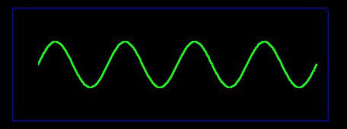
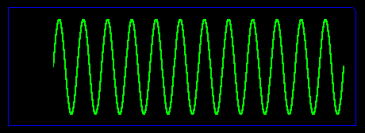
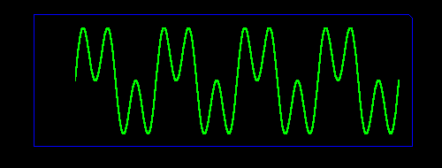
Adding Sine Waves

Slide 23
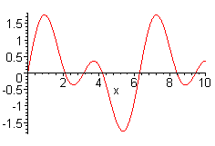
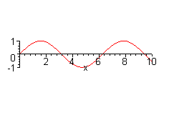
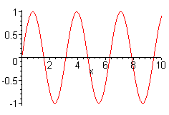
Spectral Theory
Fourier Series
  Sum of Sinusoidal Functions
Fourier Analysis
  Spectrum Analysis
  Harmonic Analysis
+
=

Slide 24
Fourier Series

Slide 25
Reconstruction
Fourier Expansion:
Power Spectrum
Comparison
between
f(x) and F(x)

Slide 26
Analog Signals
Analog Signals
  Continuous in time and frequency
  Infinite time and frequency domains
  Described by Fourier Transform
Real Signals
  Sampled at discrete times
  Finite length records
  Leads to discrete frequencies on finite interval
  Described by Discrete Fourier Transform

Slide 27
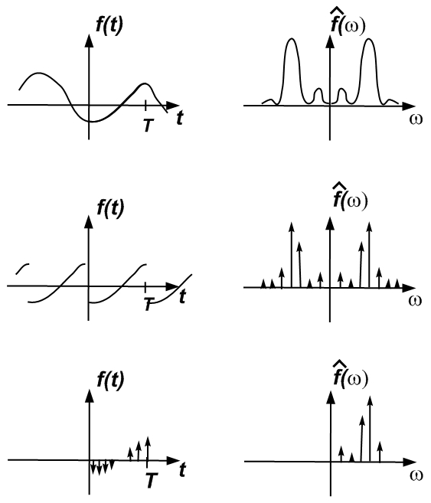
Analog to Discrete

Slide 28
DFT – Discrete Fourier Transform
Sampled Signal:
and

Slide 29
DFT – Discrete Fourier Transform

Slide 30
Matlab Implementation
y=[7.6 7.4 8.2 9.2 10.2 11.5 12.4 13.4 13.7 11.8 10.1 ...
9.0 8.9 9.5 10.6 11.4 12.9 12.7 13.9 14.2 13.5 11.4 10.9 8.1];
N=length(y);
% Compute the matrices of trigonometric functions
p=1:N/2+1;
n=1:N;
C=cos(2*pi*n'*(p-1)/N);
S=sin(2*pi*n'*(p-1)/N);
% Compute Fourier Coefficients
A=2/N*y*C;
B=2/N*y*S;
A(N/2+1)=A(N/2+1)/2;
% Reconstruct Signal - pmax is number of frequencies used in increasing order
pmax=13;
ynew=A(1)/2+C(:,2:pmax)*A(2:pmax)'+S(:,2:pmax)*B(2:pmax)';
% Plot Data
plot(y,'o')
% Plot reconstruction over data
hold on
plot(ynew,'r')
hold off

Slide 31
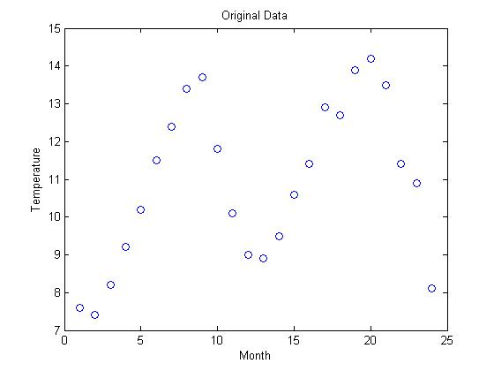
DFT Example
Monthly mean surface temperature (ºC) on the west coast of Canada January 1982-December 1983 (Emery and Thompson)

Slide 32
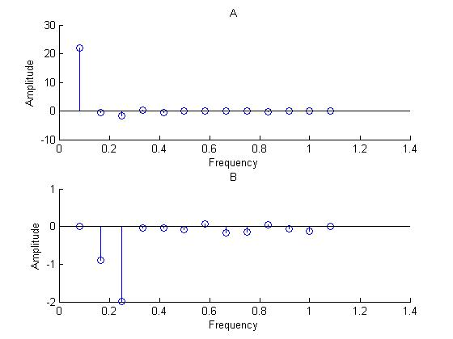
Fourier Coefficients

Slide 33
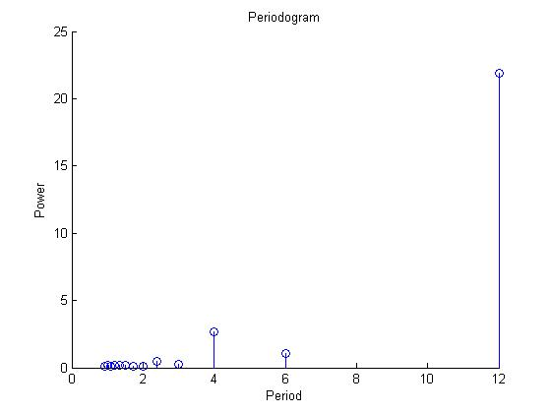
Periodogram – Power Spectrum

Slide 34
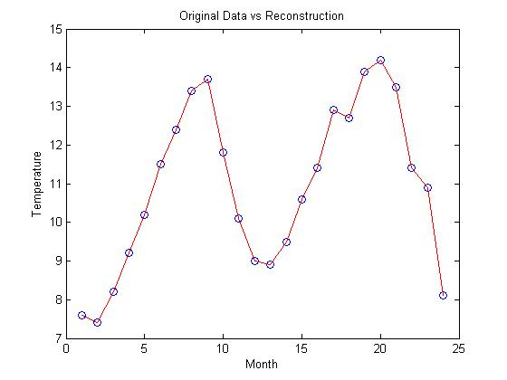
Reconstruction

Slide 35
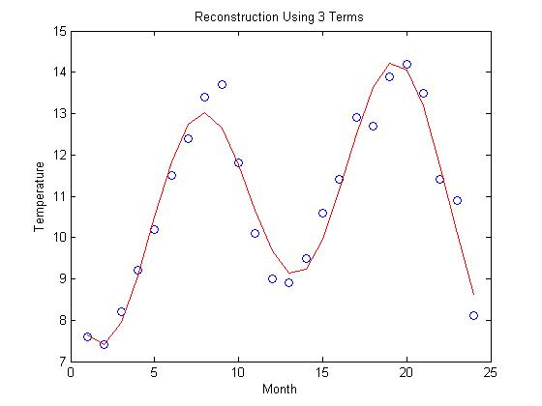
Reconstruction with 3 Frequencies

Slide 36
Harmonic Analysis
Consider a set of data consisting of N values at equally spaced times,
We seek the best approximation using M given frequencies.
The unknown parameters in this case are the A’s and B’s.

Slide 37
Linear Regression
Minimize
Normal Equations

Slide 38
System of Equations – DZ=Y

Slide 39
Matlab Implementation – DZ=Y
y=[7.6 7.4 8.2 9.2 10.2 11.5 12.4 13.4 13.7 11.8 10.1 ...
9.0 8.9 9.5 10.6 11.4 12.9 12.7 13.9 14.2 13.5 11.4 10.9 8.1];
N=length(y);
% Number of Harmonics Desired and frequency dt
M=2; f=1/12*(1:M); T=24; alpha=f*T;
% Compute the matrices of trigonometric functions
n=1:N;
C=cos(2*pi*alpha'*n/N); S=sin(2*pi*alpha'*n/N);
c_row=ones(1,N)*C'; s_row=ones(1,N)*S';
D(1,1)=N;
D(1,2:M+1)=c_row;
D(1,M+2:2*M+1)=s_row;
D(2:M+1,1)=c_row';
D(M+2:2*M+1,1)=s_row';
D(2:M+1,2:M+1)=C*C';
D(M+2:2*M+1,2:M+1)=S*C';
D(2:M+1,M+2:2*M+1)=C*S';
D(M+2:2*M+1,M+2:2*M+1)=S*S';
yy(1,1)=sum(y);
yy(2:M+1)=y*C';
yy(M+2:2*M+1)=y*S';
z=D^(-1)*yy';

Slide 40
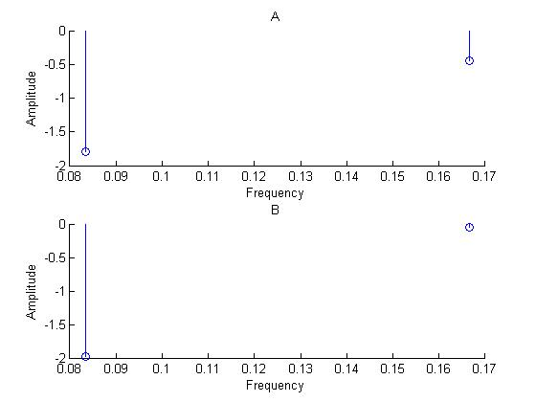
Harmonic Analysis Example
Frequencies 0.0183 cpmo, 0.167 cpmo

Slide 41
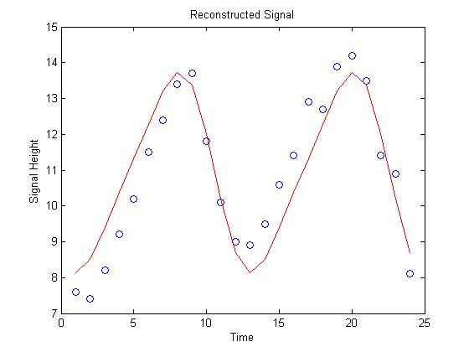
Reconstruction

Slide 42
Example 2
data = DLMREAD('tidedat1.txt');
N=length(data);
t=data(1:N,1); % time
r=data(1:N,2); % height
ymean=mean(r); % calculate average
ynorm=r-ymean; % subtract out average
y=ynorm'; % height'
dt=t(2)-t(1);
T=t(N);
% Number of Harmonics Desired and frequency dt
M=8;
TideNames=['M2','N2','K1','S2','O1','P1','K2','Q1'];
TidePeriods=[12.42 12.66 23.93 12 25.82 24.07 11.97 26.87];
f=1./TidePeriods;

Slide 43
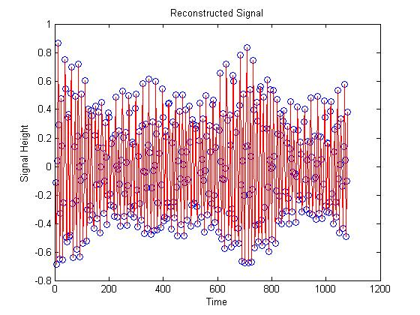
Data

Slide 44
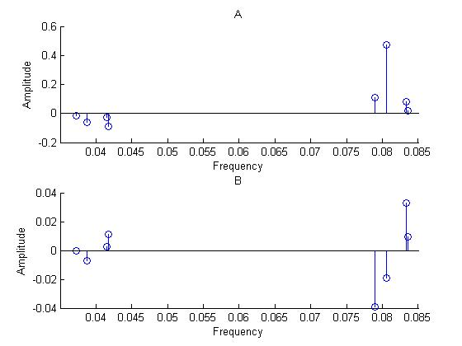
Harmonic Amplitudes

Slide 45
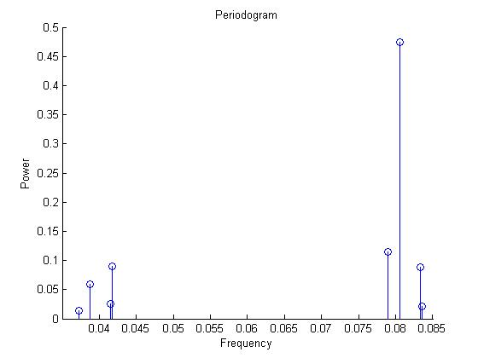
Power Spectrum – Frequency

Slide 46
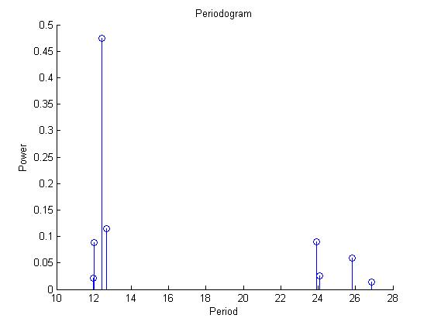
Periodogram - Period
Names =['M2', 'N2', 'K1', 'S2', 'O1', 'P1', 'K2', 'Q1'];
Periods=[12.42 12.66 23.93 12 25.82 24.07 11.97 26.87];

Slide 47
Current Analysis
Horizontal Currents are two dimensional
One performs the harmonic analysis on vectors
The results for each constituent are combined and reported using ellipse parameters

Slide 48
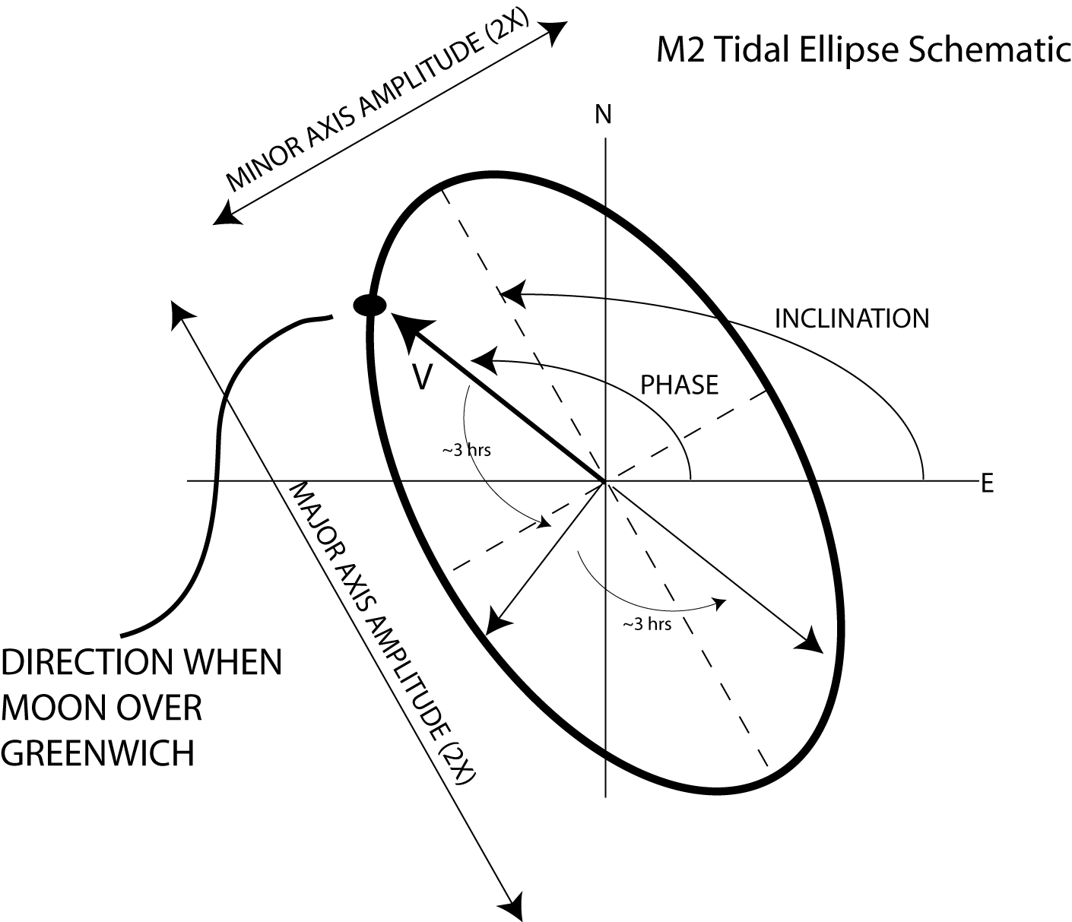
F. Bingham, 2005

Slide 49
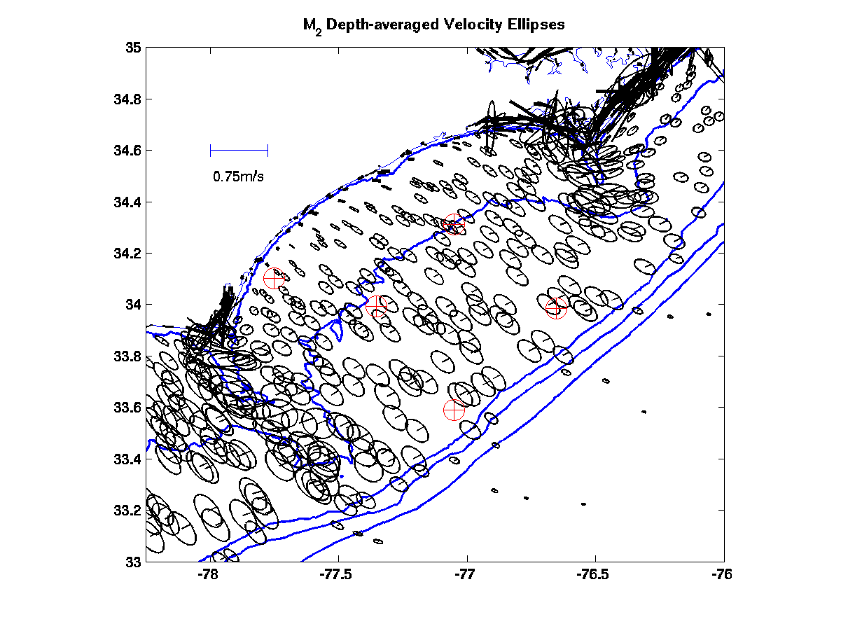
C. Canady, 2005

Slide 50
General Conic

Slide 51
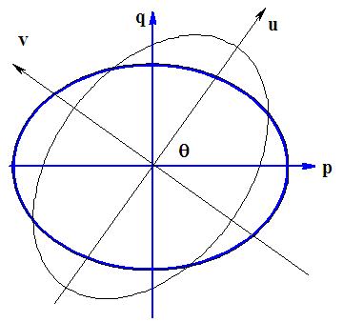
Coordinate Transformation

Slide 52
Goals
Maximum Current Velocity – Semi-major axis
Eccentricity – Ratio of semi-minor axis to semimajor axis
Inclination – Angle semi-major axis makes to East
Phase Angle – Time of maximum velocity with respect to Greenwich time

Slide 53
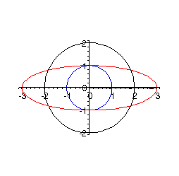
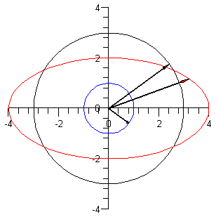
Ellipses and Phasors
Any ellipse centered at the origin can be found from the sum of two counter rotating phasors.

Slide 54
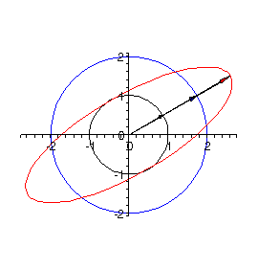
Rotated Ellipse

Slide 55
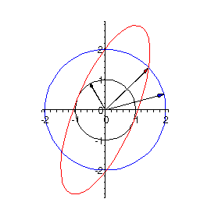
Changing the Initial Phasors

Slide 56
Relation to Current Ellipses

Slide 57
Rotated Ellipse

Slide 58
Summary
History of Tides
Fourier Analysis – DFT
Harmonic Analysis – Wave Heights
Harmonic Analysis – Currents
Ellipse Parameters

Slide 59
Bibliography
W.J. Emery and R.E. Thompson, Data Analysis Methods in Physical Oceanography, 2001.
G. Godin, The Analysis of Tides, 1972.
R. H. Stewart, Introduction to Physical Oceanography, 1997, Open Source Textbook
R. L. Herman, Fourier and Complex Analysis, Course Notes, 2005.
W.H. Munk and D.E. Cartwright, Tidal Spectroscopy and Prediction, Transactions of the Royal Society of London, A 259, 533-581.
R. Paulowicz, B. Beardsley, and S. Lentz, Classical Tidal Harmonic Analysis Including Error Estimates in MATLAB Using T_TIDE, Computers and Geosciences, 2002.
Sir William Thomson, The Tides, 1882.
Z. Xu, Ellipse Parameters Conversion and Vertical Velocity Profiles for Tidal Currents, 2000.

Slide 60
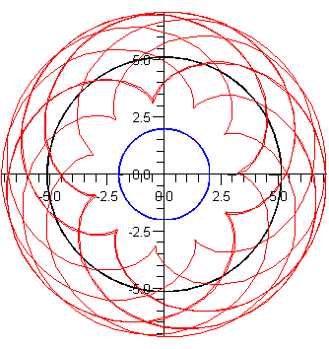
Epicycloid

