Slide 1




¹Department of Geodesy and Surveying of the Aristotle University of Thessaloniki
²Department of Surveying Engineering of the Technological Educational Institute of Athens
³School of Rural and Surveying Engineering of the National Technical University of Athens
First Validation of the Hellenic Vertical Datum as a Prerequisite for the Efficient Disaster and Resource Management:
The “ELEVATION” Project
D. ANASTASIOU³, D. GAIFILLIA², A. KATSADOUROU¹, E. KOLYVAKI¹,
X. PAPANIKOLAOU³, M. GIANNIOU², G. S. VERGOS¹ and V. PAGOUNIS²
Presented at the
FIG Commission 3 Workshop 2012
Spatial Information, Informal Development, Property and Housing

Slide 2
Importance of horizontal and vertical networks
Technical Projects are based on well established horizontal and vertical reference networks:
confrontation of a natural disaster
determination of crustal deformations
calculation of small distortions of a construction
Precise knowledge of the location
successful crisis management
Horizontal control networks: determination with high precision (GPS/GNSS applications)
Vertical control networks: difficulties due to the effect of the earth's gravity field
exploitation of surface water and underground resources
construction of large technical infrastructures
confrontation of environmental issues
Main objective: Evaluation of the Hellenic Vertical Reference System (VRS)
In the frame of the pan-European effort for the establishment of a common European Vertical Network
FIG 2012 Athens, 10-14/12 Anastasiou et al.

Slide 3
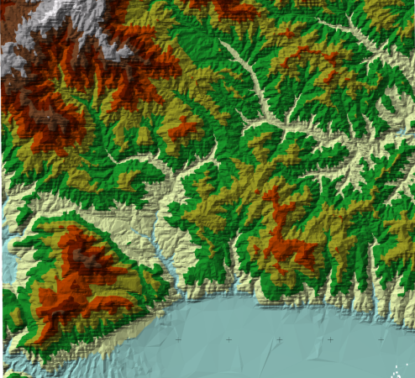
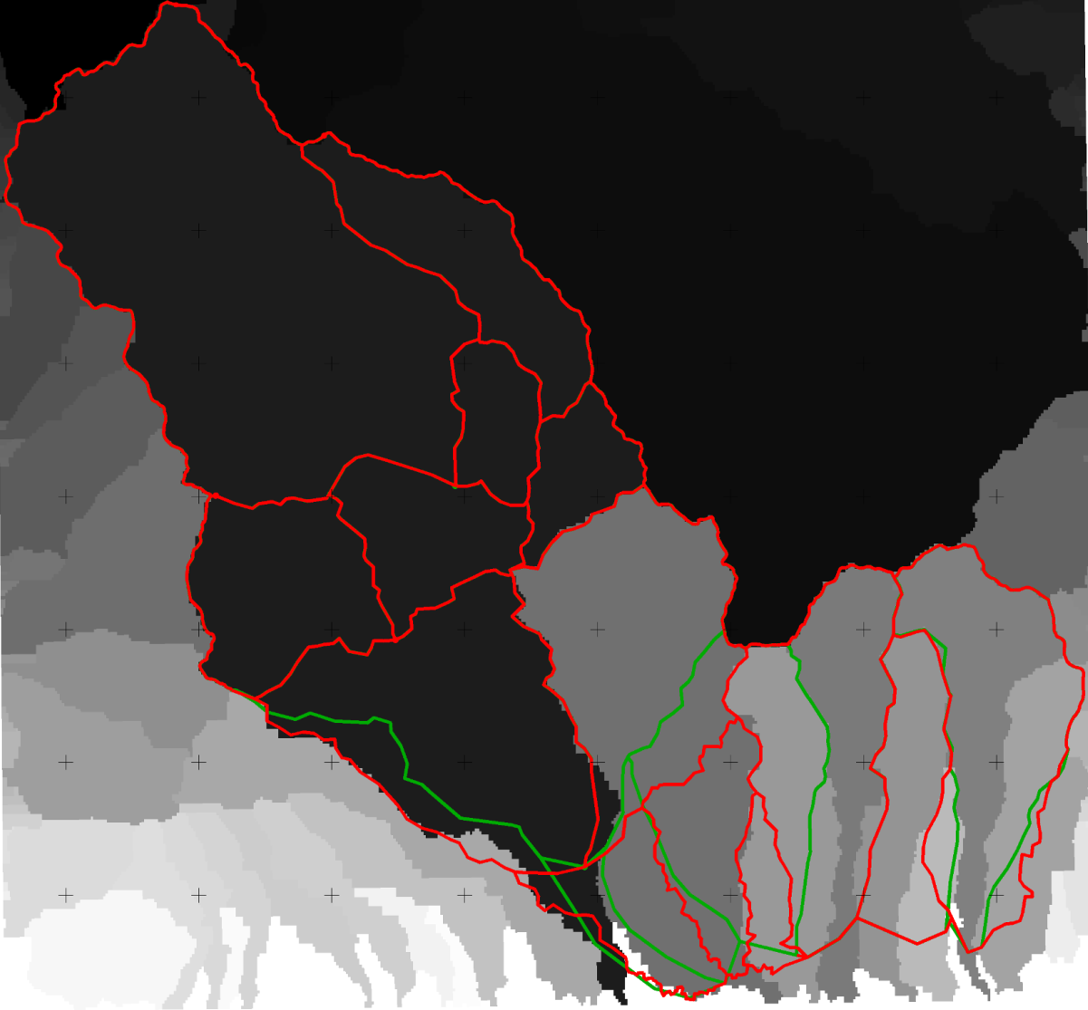
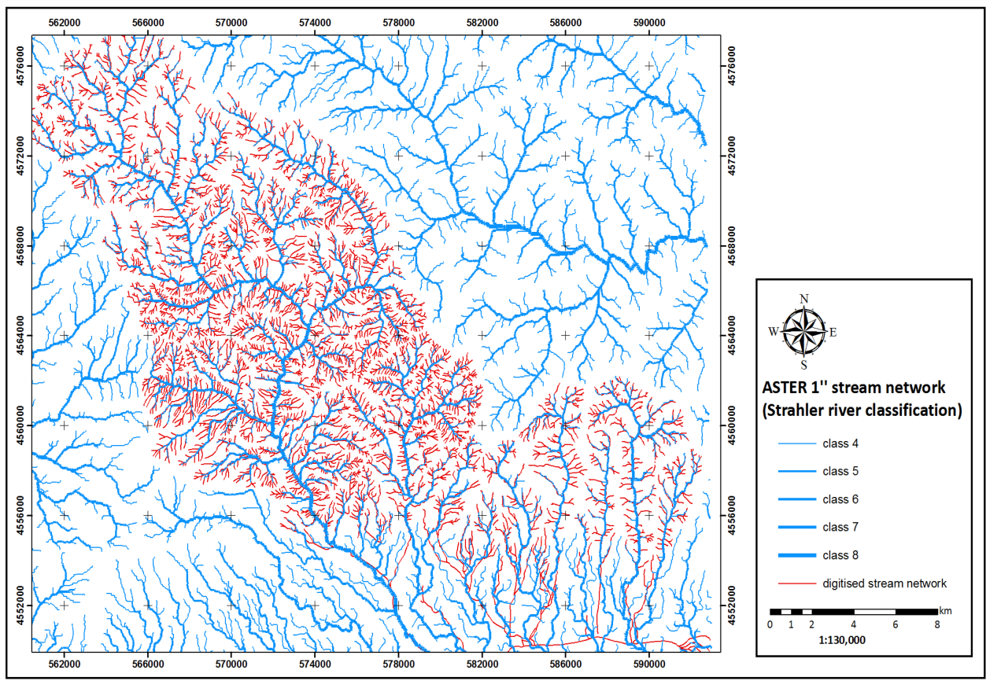
Vertical networks for surface water
Tzanou and Vergos 2012
FIG 2012 Athens, 10-14/12 Anastasiou et al.

Slide 4
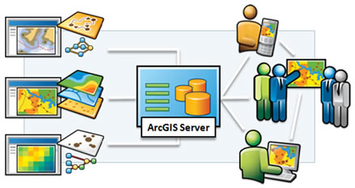
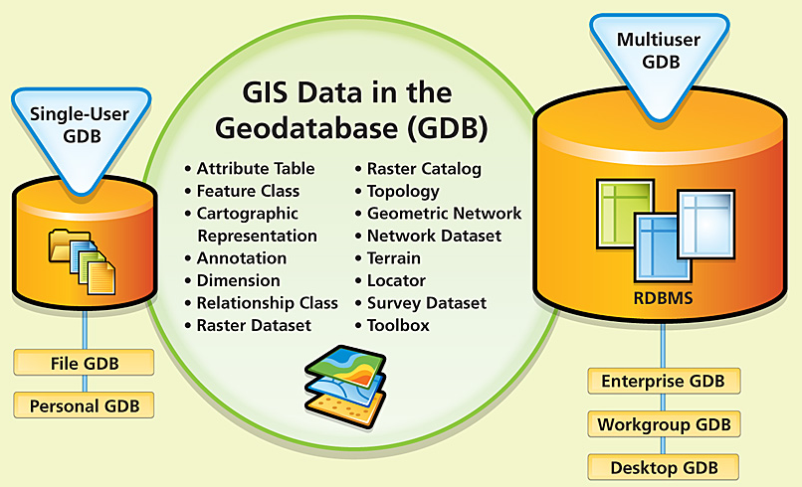
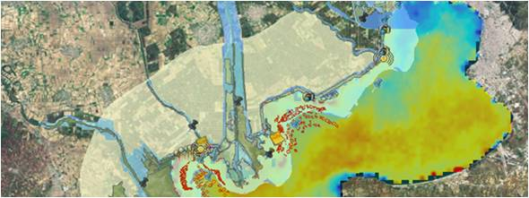
Vertical networks for spatial planning
Environmental and Geo Data
Remote Sensing Data
Height Data
Basic Cartographic Background
Savvaidis et al. 2012
Geo-database & Spatial Planning
FIG 2012 Athens, 10-14/12 Anastasiou et al.

Slide 5
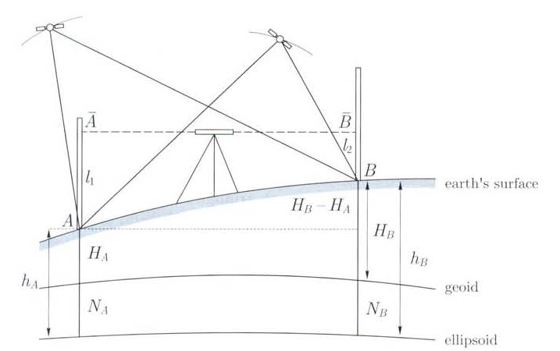
Theoretical Background
Orthometric Height: the distance along the plump line from Earths’ surface to the geoid
Ellipsoid Height:
the distance along the vertical from Earths’ surface to the reference ellipsoid
Geoid Height:
the distance along the vertical from the geoid to the reference ellipsoid
Geoid: is an equipotential surface of the Earth’s gravity field that is approached by the MSL at a global scale, provided that the effects of tides and currents are removed
Ellipsoid: is not a physical surface and is used only as a (mathematical) model of the Earth’s surface for horizontal positioning, due to its simplicity. The ellipsoid is the reference surface utilized by the geodetic satellite missions
FIG 2012 Athens, 10-14/12 Anastasiou et al.

Slide 6
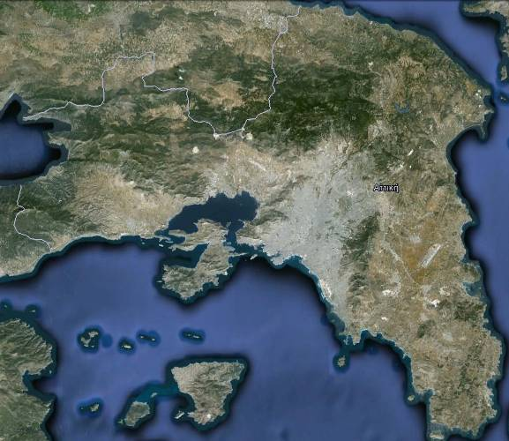
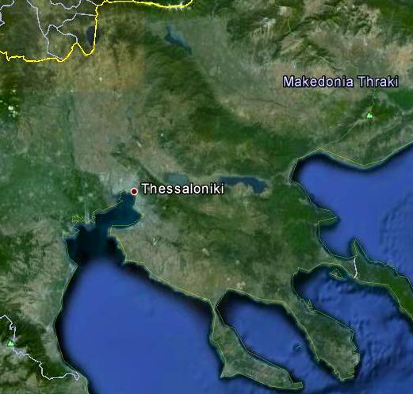
Description of the project
Areas under study
Height benchmarks of the national trigonometric and leveling networks
Attica
Thessaloniki
Assessment of internal accuracy of the two networks:
Geoid heights from local gravimetric models and global geopotential models
Satellite and conventional geodetic measurements for the determination of ellipsoidal and Helmert-type orthometric heights respectively :
Static GPS observations
Classical spirit leveling
Special Trigonometric leveling
Due to earlier work, all three types of height information are available for some benchmarks in both areas. Therefore the work carried out referred to additional measurements in order to fill-in the areas under study.
FIG 2012 Athens, 10-14/12 Anastasiou et al.

Slide 7
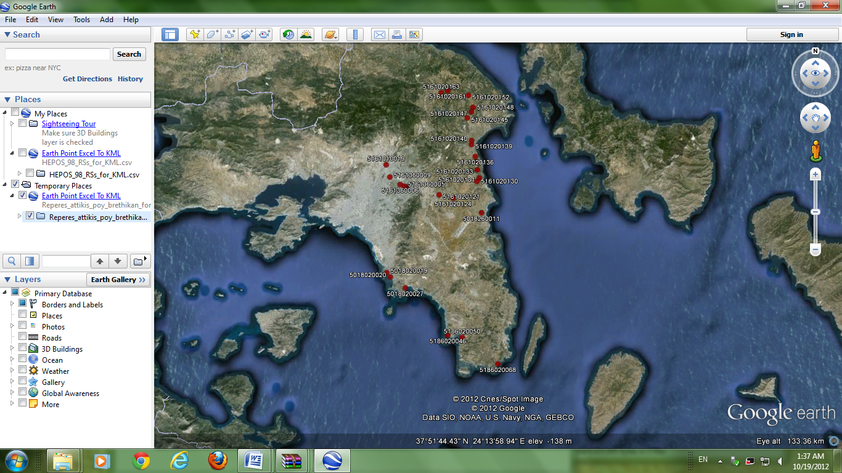
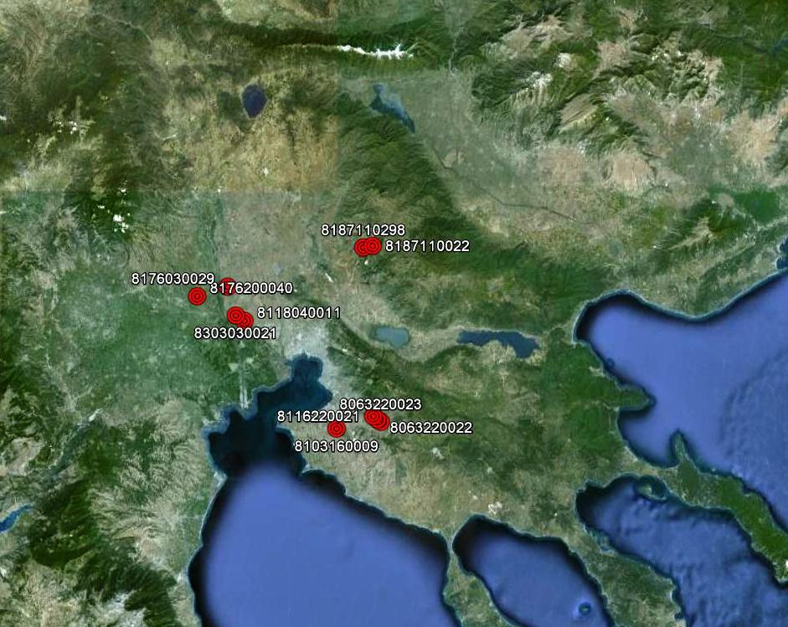
Leveling data identification
Measurement at benchmarks (BMs) selected from the National Trigonometric and Leveling Network, established by the Hellenic Military Geographic Service (HMGS) during 1963 – 1986
In order to guarantee the connection to the national horizontal and vertical networks
(Many benchmarks have been totally destroyed or they are not in a good condition)
Identification in Attica
157 height BMs were searched
27 height BMs were found
Identification in Thessaloniki
28 height BMs were searched
10 height BMs were found
FIG 2012 Athens, 10-14/12 Anastasiou et al.

Slide 8
Leveling measurements
Part of the leveling BMs found were chosen due to accessibility and reliability factors
Since GPS measurements cannot be performed directly on height BMs, collocated BMs were established at short distances in order to measure both orthometric and ellipsoidal heights
Two types of techniques were applied:
The two techniques were applied between height BMs and also between BMs and height BMs
10 height differences were measured in Attica and 12 in Thessaloniki
classical spirit leveling
special trigonometric leveling
Investigation Area | Equipment | Technique
Attica | Topcon DL-101C | classical spirit leveling
 | Leica TCR 1202 | special trigonometric leveling
Thessaloniki | Leica Sprider 150 | classical spirit leveling
 | Topcon GTS212 | special trigonometric leveling
FIG 2012 Athens, 10-14/12 Anastasiou et al.

Slide 9
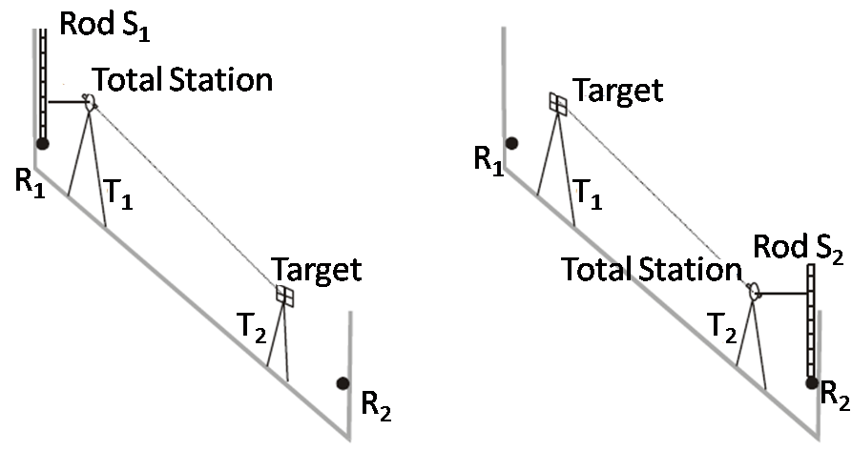
Special Trigonometric Leveling
Starting
point
Ending
point
The tripod T₁ together with the total station is placed close to R₁. The leveling rod S₁ is placed over R₁. The total station is used like a leveling instrument as it scopes the rod horizontally in direct and inverted scope positions.
The tripod T₂ together with the target is placed next to R₂. The total station measures the vertical angle and the slope distance from T₁ to T₂.
The total station changes position with the target and we measure the vertical angle and the slope distance from T₂ to T₁. Finally we use the total station as leveling instrument and we scope the rod S₂.
(If the distance R₁R₂ is long, it is suggested that the observations be repeated several times to conclude in an average value)
FIG 2012 Athens, 10-14/12 Anastasiou et al.

Slide 10
Leveling Results
ATTICA
Leveling Process No | Region | Starting Point ID | Ending Point ID | S* (km) | Technique* | Orthometric Height Difference*
1 | Ano Souli | 5161020148 | 5161020147 | 1.13 | CSL | -48.752
2 | Rafina | 5161020130 | 161017 | 0.60 | CSL | 3.754
3 | Rafina | 5161020130 | 5161020131 | 0.95 | STL | -22.105
4 | Nea Makri | 5161020135 | 5161020136 | 1.23 | STL | -22.638
5 | Grammatiko | 5161020152 | 161105 | 0.40 | STL | 8.206
6 | Kapandriti | 5161020163 | 5161020161 | 3.47 | STL | 27.751
?
THESSALONIKI
Leveling Process No | Region | Starting Point ID | Ending Point ID | S* (km) | DH_{CSL} (m) | DH_{STL} (m) | DH_{CSL}-DH_{STL} (m)
1 | Peristera | 63067 | 8063220022 | 0.32 | 4.817 | 4.785 | 0.032
2 | Epanomi | 8116220021 | 8116220021_101gg | 0.06 | 0.399 | 0.395 | 0.004
3 | Peristera | 8063220023 | 8063220023_103gg | 0.106 | 0.796 | 0.806 | -0.010
4 | Peristera | 8063220022 | 8063220022 _102gg | 0.032 | 0.123 | 0.125 | -0.002
5 | Kardia | 8103160009 | 8103160009_100gg | 0.04 | 0.233 | 0.231 | 0.002
6 | Ag. Athan. | 8118040011 | 8118040011_106gg | 0.077 | -0.562 | -0.562 | -0.000
7 | Gefira | 8303030021 | 8303030021_107gg | 0.055 | -0.447 | -0.446 | -0.001
8 | Proxoma | 8176030029 | 8176030029_109gg | 0.071 | -2.064 | -2.066 | 0.002
9 | Proxoma | 8176030029 | 176021 | 0.3 | 10.536 | 10.548 | -0.012
10 | Dorkada | 8187110022 | 8187110022 _105gg | 0.091 | -2.222 | -2.201 | -0.021
11 | Koufalia | 8176200040 | 8176200040 _108gg | 0.02 | 0.556 | 0.549 | 0.007
12 | Kartere | 8187110298 | 8187110298_104gg | 0.028 | 0.728 | 0.737 | -0.009
*S: Distance CSL : Classical Spirit Leveling STL: Special Trigonometric Leveling
FIG 2012 Athens, 10-14/12 Anastasiou et al.

Slide 11
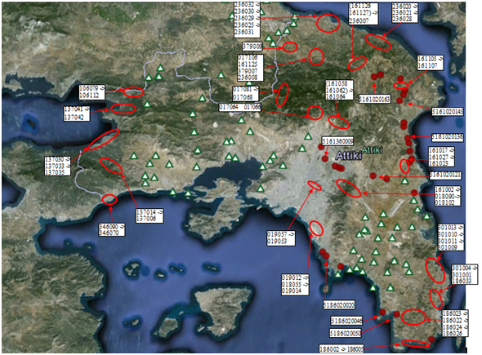
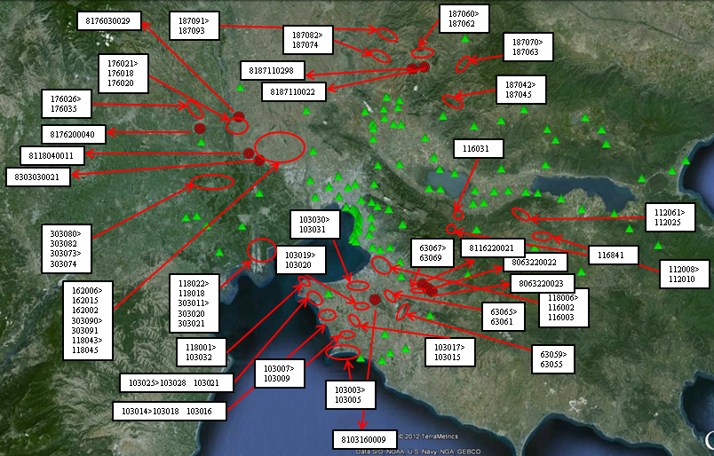
GPS data identification
Trigonometric BMs
Newly established reference points located in a short distance from the height BMs
FIG 2012 Athens, 10-14/12 Anastasiou et al.

Slide 12
GPS measurements
Static measurements with dual frequency receivers to reduce the influence of ionosphere
HEPOS stations near Attica and Thessaloniki were used as reference stations
Investigation Area | Receiver Type | Antenna Type | Accuracy
Attica | TOPCON HiperPro | TOPCON HiperPro | 3 mm + 0.5 ppm (horizontally) 5 mm + 0.5ppm (vertically)
Thessaloniki | LEICA SR520 | LEICA AT502 | 3 mm + 0.5 ppm (static survey)
Measurement Parameters:
Occupation time of at least 60 minutes
Logging rate 15 s
Elevation mask 10º
Antenna height measurements are characterized by an accuracy of ±1 mm
The reference point is at the top of the benchmark
The uniform equipment and procedure for the antenna height measurements provide homogeneity and high accuracy, with variations of the order of 2-3 cm
The errors in reading or typing the antenna height, which are a common source of errors in GPS measurements, can be avoided
FIG 2012 Athens, 10-14/12 Anastasiou et al.

Slide 13
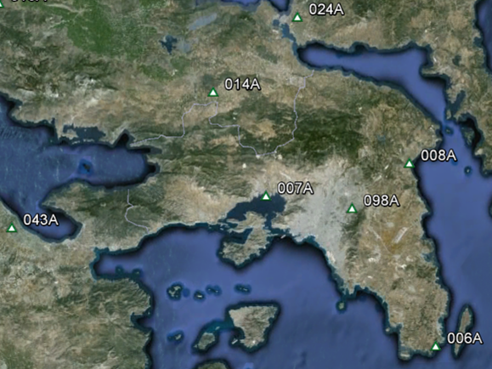
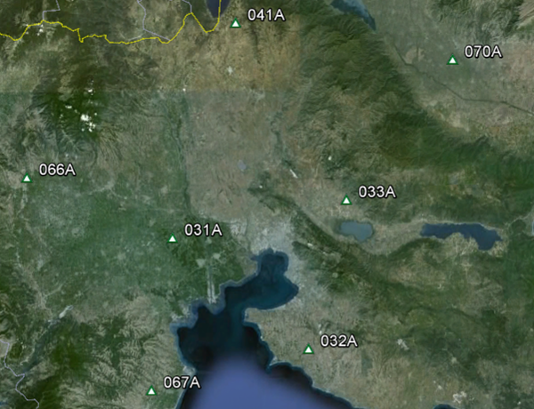
HEPOS permanent stations
Calculation of the coordinates of the BMs in the HTRS07 datum
High accuracy and homogeneity
Smaller baseline lengths (<25 km) compared to using the EUREF Permanent Network
Dense network all over Greece and especially in Attica and Thessaloniki
Data available at any observation rate unlike the EPN data (observation rate = 30 s)
Stations near Attica
Stations near Thessaloniki
FIG 2012 Athens, 10-14/12 Anastasiou et al.

Slide 14
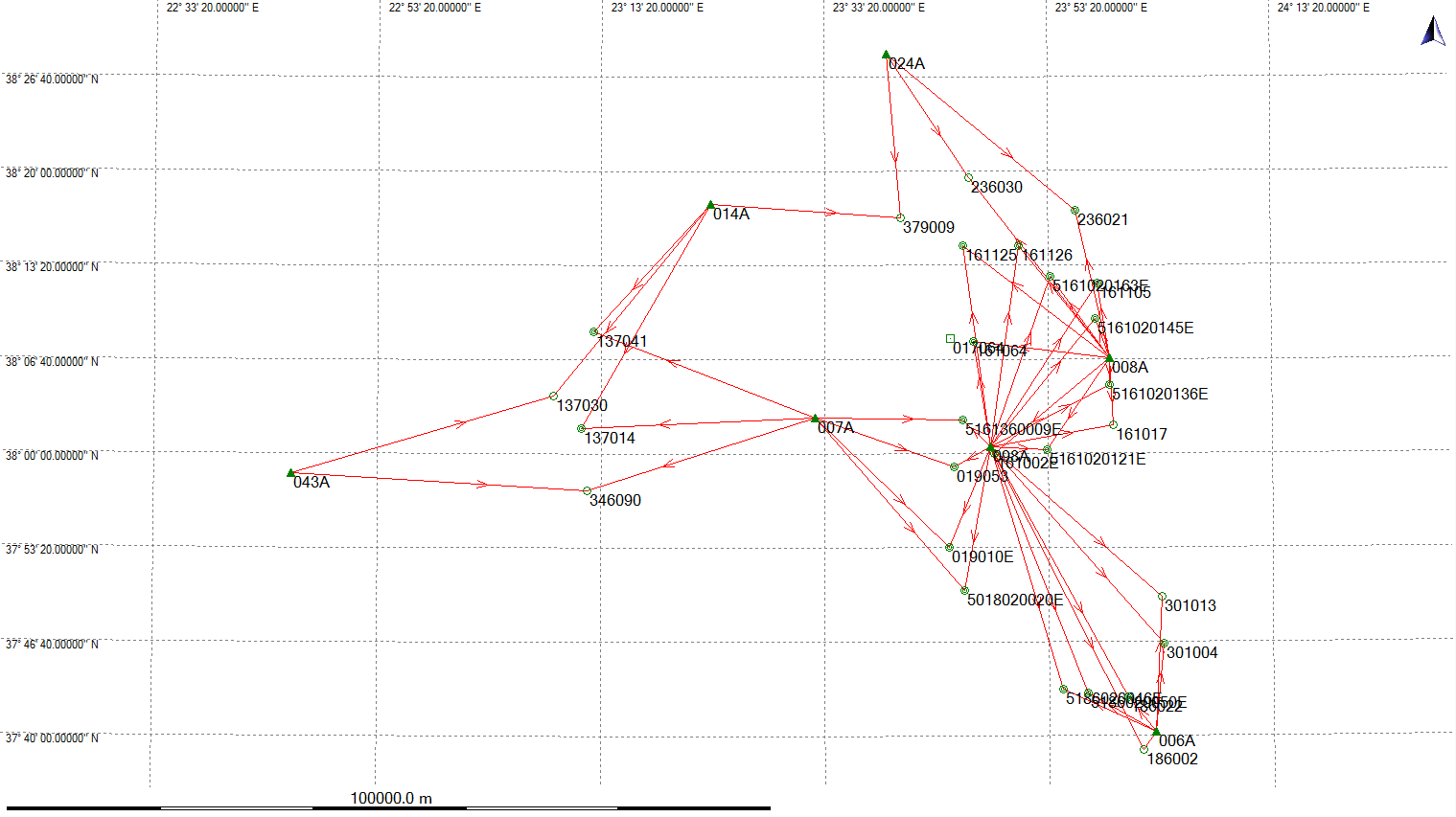
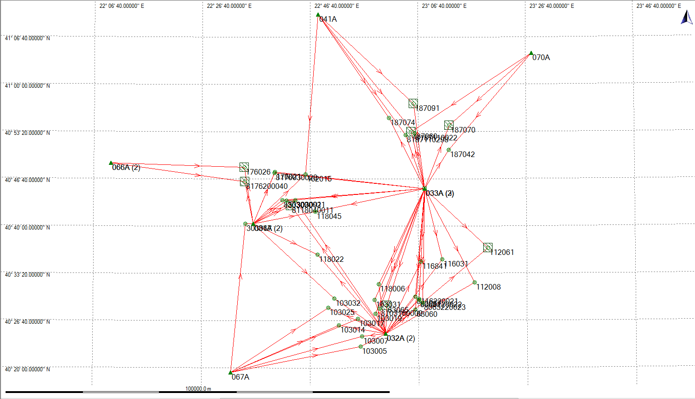
GPS processing approaches
GPS processing software package: Leica Geo Office (LGO)
The points are solved from the nearest HEPOS reference station
The points are solved from the next nearest HEPOS reference station
A least squares adjustment is computed for each point using the two baselines connecting the point to the HEPOS stations
Baselines (short and long) in Attica
Baselines (short and long) in Thessaloniki
FIG 2012 Athens, 10-14/12 Anastasiou et al.

Slide 15
GPS results for both the shortest and the longest baselines
Geodetic coordinates in HTRS07 and standard deviations for Attica
Geodetic coordinates in HTRS07 and standard deviations for Thessaloniki
Point Id | X (m) | Y (m) | Z (m) | std(X) (m) | std(Y) (m) | std(Z) (m)
103005 | 4480666.0949 | 1895782.9751 | 4110619.2829 | 0.0062 | 0.0089 | 0.0051
103007 | 4478991.1303 | 1895435.8957 | 4112635.9879 | 0.0072 | 0.0168 | 0.0011
103014 | 4479612.5713 | 1889120.4670 | 4114772.6982 | 0.0105 | 0.0227 | 0.0047
103017 | 4476709.8245 | 1893380.9070 | 4116115.5248 | 0.0060 | 0.0045 | 0.0055
103019 | 4474196.8246 | 1897206.0092 | 4117252.7451 | 0.0053 | 0.0035 | 0.0056
103025 | 4477908.8600 | 1885456.4768 | 4118343.8225 | 0.0080 | 0.0070 | 0.0087
103031 | 4472091.0924 | 1896051.6572 | 4119857.2543 | 0.0088 | 0.0040 | 0.0107
103032 | 4475930.0026 | 1886301.1065 | 4120124.2848 | 0.0150 | 0.0181 | 0.0137
112008 | 4459560.7816 | 1919082.2449 | 4123644.9935 | 0.0186 | 0.0167 | 0.0168
112061 (033A) | 4452624.1769 | 1920013.1342 | 4130364.2539 | 0.0031 | 0.0016 | 0.0022
116031 | 4459072.8908 | 1909753.7084 | 4128127.1158 | 0.0219 | 0.0103 | 0.0244
116841 | 4462126.5674 | 1904951.1834 | 4128207.4375 | 0.0093 | 0.0127 | 0.0081
118006 | 4469107.6152 | 1896050.6803 | 4122971.3521 | 0.0167 | 0.0095 | 0.0158
118022 | 4470682.3808 | 1879348.7361 | 4128840.1563 | 0.0184 | 0.0082 | 0.0204
118045 | 4464238.6666 | 1875971.6023 | 4137321.9046 | 0.0102 | 0.0125 | 0.0110
162015 | 4459475.8444 | 1871330.0809 | 4144860.2808 | 0.0075 | 0.0053 | 0.0091
176021 | 4462120.7138 | 1863710.4955 | 4145221.6803 | 0.0066 | 0.0049 | 0.0061
176026 (031A) | 4464363.8174 | 1856104.3600 | 4146148.7320 | 0.0010 | 0.0006 | 0.0011
187042 | 4441500.8104 | 1904100.2864 | 4149974.3977 | 0.0041 | 0.0041 | 0.0046
187060 (033A) | 4442363.9366 | 1893855.9793 | 4153530.6041 | 0.0023 | 0.0010 | 0.0013
187070 (033A) | 4437527.7375 | 1902564.9604 | 4154731.9948 | 0.0008 | 0.0006 | 0.0009
187074 | 4442289.2703 | 1887645.5560 | 4156175.6318 | 0.0194 | 0.0118 | 0.0238
187091 (041A) | 4437706.7257 | 1892654.8102 | 4159146.9497 | 0.0017 | 0.0008 | 0.0019
303067 | 4473122.9709 | 1860044.5646 | 4134906.4635 | 0.0057 | 0.0026 | 0.0068
303090 | 4465346.0160 | 1868379.1500 | 4139556.9686 | 0.0158 | 0.0069 | 0.0148
303091 | 4464374.2639 | 1870519.5410 | 4139676.3865 | 0.0094 | 0.0042 | 0.0102
63060 | 4469475.5286 | 1906438.7224 | 4117985.9686 | 0.0211 | 0.0090 | 0.0241
63065 (032A) | 4471702.9712 | 1899377.8031 | 4118859.6266 | 0.0008 | 0.0005 | 0.0007
63067 | 4467325.5952 | 1906701.8451 | 4120072.9194 | 0.0041 | 0.0019 | 0.0039
Point Id | X (m) | Y (m) | Z (m) | std(X) (m) | std(Y) (m) | std(Z) (m)
17064 | 0 | 0 | 0 | 0.0000 | 0.0000 | 0.0000
019010E | 4613547.0539 | 2029159.6199 | 3895771.1204 | 0.0190 | 0.0086 | 0.0163
19053 | 4607522.5128 | 2027123.8561 | 3904262.2811 | 0.0114 | 0.0051 | 0.0105
137014 | 4624209.4675 | 1981217.3049 | 3908357.9147 | 0.0163 | 0.0074 | 0.0180
137030 (014A) | 4622964.6992 | 1976765.5018 | 3911403.3561 | 0.0016 | 0.0007 | 0.0014
137041 | 4616154.9471 | 1979488.8528 | 3918081.4371 | 0.0127 | 0.0109 | 0.0118
161002E | 4604412.8482 | 2031604.7214 | 3905583.0883 | 0.0020 | 0.0034 | 0.0013
161017 (008A) | 4595913.4895 | 2044840.0840 | 3908391.8324 | 0.0008 | 0.0005 | 0.0009
161064 | 4597228.7009 | 2025478.8403 | 3917234.4837 | 0.0237 | 0.0115 | 0.0203
161105 | 4586413.9092 | 2038335.9746 | 3923156.6757 | 0.0085 | 0.0071 | 0.0069
161125 | 4590576.0486 | 2021108.4579 | 3927088.1604 | 0.0071 | 0.0109 | 0.0060
161126 | 4587973.3529 | 2027855.3390 | 3927308.2137 | 0.0113 | 0.0054 | 0.0097
186002 (006A) | 4618223.0634 | 2058827.9960 | 3874789.1905 | 0.0006 | 0.0003 | 0.0004
186022 | 4615211.4360 | 2055422.3103 | 3880355.0791 | 0.0075 | 0.0034 | 0.0095
236021 | 4581915.2099 | 2033374.5249 | 3930571.9198 | 0.0246 | 0.0148 | 0.0225
236030 (008A) | 4585143.1414 | 2019476.6059 | 3933839.0248 | 0.0022 | 0.0014 | 0.0021
301004 | 4609355.4433 | 2057853.8783 | 3885916.1798 | 0.0171 | 0.0076 | 0.0197
301013 (006A) | 4605929.0987 | 2056182.1690 | 3890738.5004 | 0.0013 | 0.0007 | 0.0009
346090 (007A) | 4628184.1549 | 1983816.4342 | 3901654.3515 | 0.0016 | 0.0009 | 0.0013
379009 (014A) | 4591750.5756 | 2012634.0687 | 3929840.4948 | 0.0015 | 0.0007 | 0.0011
5018020020E | 4615857.6783 | 2032320.5692 | 3891353.1940 | 0.0204 | 0.0108 | 0.0171
5161020121E | 4601281.1458 | 2037784.4608 | 3905935.6226 | 0.0165 | 0.0077 | 0.0141
5161020136E | 4593049.6215 | 2043003.0354 | 3912569.4115 | 0.0095 | 0.0042 | 0.0083
5161020145E | 4588934.6792 | 2039212.7396 | 3919371.4087 | 0.0213 | 0.0098 | 0.0183
5161020163E | 4588360.5715 | 2032567.5184 | 3923889.1101 | 0.0164 | 0.0100 | 0.0158
5161360009E | 4603436.9788 | 2026684.6893 | 3909049.5178 | 0.0042 | 0.0045 | 0.0049
5186020046E | 4617943.1065 | 2047301.4261 | 3881105.3377 | 0.0228 | 0.0116 | 0.0200
5186020050E | 4616939.0250 | 2050325.4874 | 3880683.3359 | 0.0125 | 0.0073 | 0.0173
Some points (outlined with red) were not solved from both stations because the averaging limit was exceeded
limited satellite visibility due to obstacles
disrupted L2 measurements due to electromagnetic interferences in the areas of the BMs
FIG 2012 Athens, 10-14/12 Anastasiou et al.

Slide 16
Closing and Relative error
THESSALONIKI
Loop | Closing error (cm) | Length (km) | Relative error (ppm)
103005-32-67 | 3.51 | 83.39 | 0.4209
103007-32-67 | 21.81 | 83.24 | 2.6203
103014-32-67 | 3.02 | 84.67 | 0.3567
103017-32-67 | 21.55 | 85.71 | 2.5143
103019-32-33 | 14.44 | 80.17 | 1.8011
103025-32-67 | 0.88 | 88.53 | 0.0994
103031-32-33 | 1.56 | 80.38 | 0.1941
103032-31-32 | 1.22 | 89.85 | 0.1358
112008-32-33 | 3.38 | 93.76 | 0.3605
116031-32-33 | 2.12 | 82.67 | 0.2565
116841-32-33 | 1.9 | 79.31 | 0.2396
118006-32-33 | 0.44 | 79.93 | 0.0551
118022-31-32 | 0.42 | 90.66 | 0.0463
118045-31-33 | 2.59 | 91.08 | 0.2844
162015-31-41 | 9.16 | 117.89 | 0.7770
176021-31-33 | 2.63 | 99.35 | 0.2647
187042-33-70 | 2.47 | 90.18 | 0.2739
187074-33-41 | 4.61 | 106.75 | 0.4318
303067-31-67 | 0.45 | 80.36 | 0.0560
303090-31-33 | 1.68 | 92.18 | 0.1823
303091-31-32 | 0.31 | 99.53 | 0.0311
63060-32-33 | 1.95 | 80.84 | 0.2412
63067-32-33 | 3.57 | 80.67 | 0.4425
8176030029-31-33 | 0.82 | 99.24 | 0.0826
8063220022-32-33 | 0.92 | 80.72 | 0.1140
8063220023-32-33 | 1.08 | 81.60 | 0.1323
8103160009-32-33 | 0.4 | 79.39 | 0.0504
8116220021-32-33 | 1.32 | 79.92 | 0.1652
8187110022-33-41 | 4.32 | 107.93 | 0.4003
8187110298-33-41 | 10.74 | 107.08 | 1.0030
ATTICA
Loop | Closing error (cm) | Length (km) | Relative error (ppm)
019010E-007A-098A | 0.34 | 62.03 | 0.0548
019053-007A-098A | 9.03 | 48.08 | 1.8781
137014-007A-014A | 0.75 | 95.75 | 0.0783
137030-014A-043A | 3.99 | 133.50 | 0.2989
137041-014A-007A | 6.48 | 85.03 | 0.7621
161002-098A-008A | 1.39 | 40.18 | 0.3459
161064-098A-008A | 2.62 | 51.49 | 0.5088
161105-008A-098A | 0.41 | 54.90 | 0.0747
161125-008A-098A | 7.09 | 70.36 | 1.0077
161126-098A-008A | 0.28 | 65.12 | 0.0430
161017-098A-008A | 0.54 | 44.63 | 0.1210
186022-098A-006A | 6.82 | 86.11 | 0.7920
236021-008A-024A | 22.63 | 101.16 | 2.2371
236030-008A-024A | 24.28 | 98.62 | 2.4620
301004-006A-098A | 0.18 | 88.77 | 0.0203
301013-006A-098A | 33.6 | 90.43 | 3.7156
346090-007A-043A | 24.97 | 138.98 | 1.7967
379009-014A-024A | 1.34 | 76.45 | 0.1753
5018020020E-098A-007A | 2.56 | 72.23 | 0.3544
5161020136E-008A-098A | 0.86 | 40.52 | 0.2122
5161020145E-098A-008A | 1.71 | 46.61 | 0.3669
5161020163E-008A-098A | 4.08 | 56.34 | 0.7242
5161360009E-098A-007A | 1.19 | 47.82 | 0.2488
5186020046E-098A-006A | 17.52 | 89.41 | 1.9595
5186020050E-098A-006A | 1.36 | 87.87 | 0.1548
Closing error:
depends on the loop length
Relative error:
ranges between 0.04 - 3.71 ppm
indicates the quality of the
GPS data
FIG 2012 Athens, 10-14/12 Anastasiou et al.

Slide 17
Conclusions
Height information of high accuracy and reliability in a common reference system is essential
Given the pan-European effort for the establishment of a common European Vertical Network, the validation of the Hellenic VRS seems an one-way road decision
The validation of the national vertical reference network and the establishment of its connection to the European VRS will aid cross-border transport, infrastructure, planning and environmental management
Vertical networks as geodetic infrastructures, provide accurate information about fundamental properties of the Earth as they change over time and have led to many scientific, civil, military, and commercial application
Height information is an indispensible component of engineering works, spatial planning and protection/conservation of the natural and built environment
Future Plans
Development of a geographical information system combining height and property information
This system will be used to monitor and record changes in order to prevent illegal constructions, so it will give a new quality level for managing the documents of real estate cadastre
Natural hazards confrontation, via more equitable decisions in crisis situation, can be done using an accurate representation of the physical environment and its interdependency with the human activities
FIG 2012 Athens, 10-14/12 Anastasiou et al.

Slide 18
Thank you for
your attention
Acknowledgements
The present work was carried out in the frame of
“Archimedes III – Funding of research groups in T.E.I.”,
co-financed by the E.U. and national funds under the Operational Program
“Education and Lifelong Learning 2007-2013”

