Slide 1


AUT1 as an IHRS station
Establishing an IHRS reference station
G.S. Vergos and I.N. Tziavos
GravLab, DGS, AUTH
IAG-IASPEI 2017
Session G2.6
Kobe, Japan
July 30 – August 5, 2017

Slide 2
OUTLINE
IHRS/IHRF Why AUT1?
Methodology/Theory
Data availability
Processing
Results
Conclusions

Slide 3
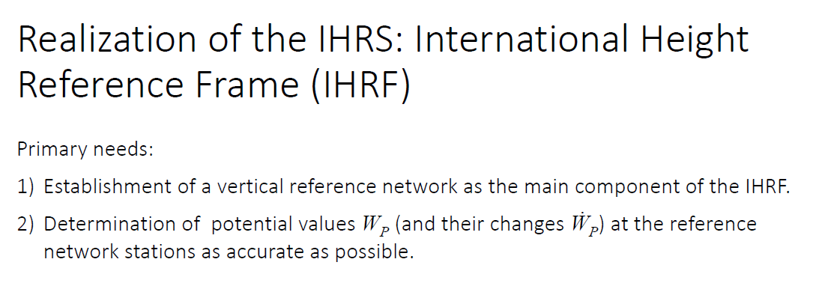
IHRF/IHRS Why AUT1?
IHRF as a realization of IHRS
Splinter Meeting IAG JWG0.1.2 GGHS2016 Thessaloniki, Greece (© Sánchez, 2016)

Slide 4
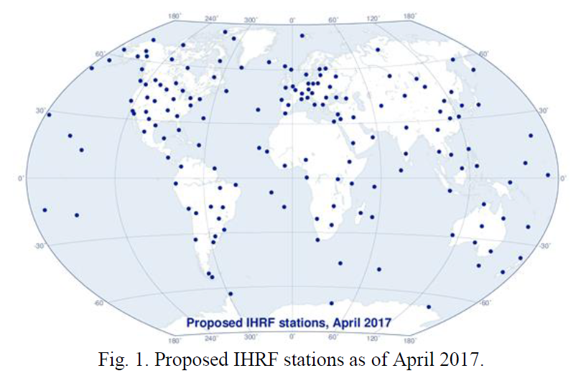
IHRF/IHRS Why AUT1?
IHRF as a realization of IHRS
Why AUT1?
SWG0.1.2 Report of the IAG Vol. 40 ─ Travaux de l’AIG 2015-2017 (© Sánchez, 2017)

Slide 5
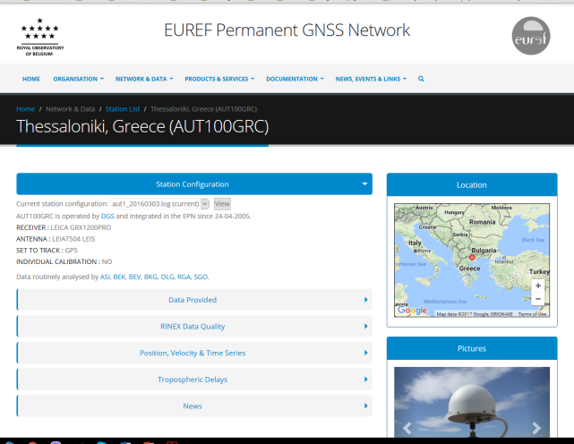
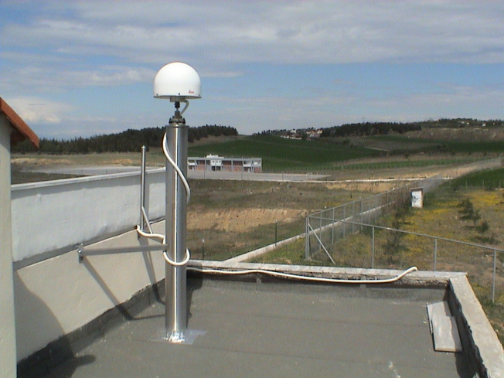
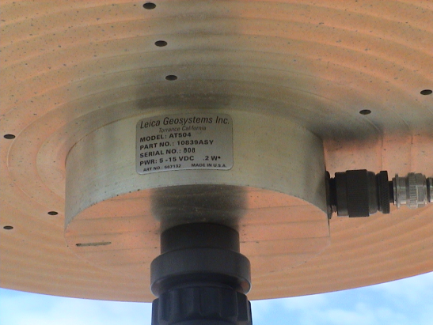
IHRF/IHRS Why AUT1?
IHRF as a realization of IHRS
Why AUT1?
EUREF Station (Class A Station)
The AUT1 EUREF Class A station (© EUREF)

Slide 6
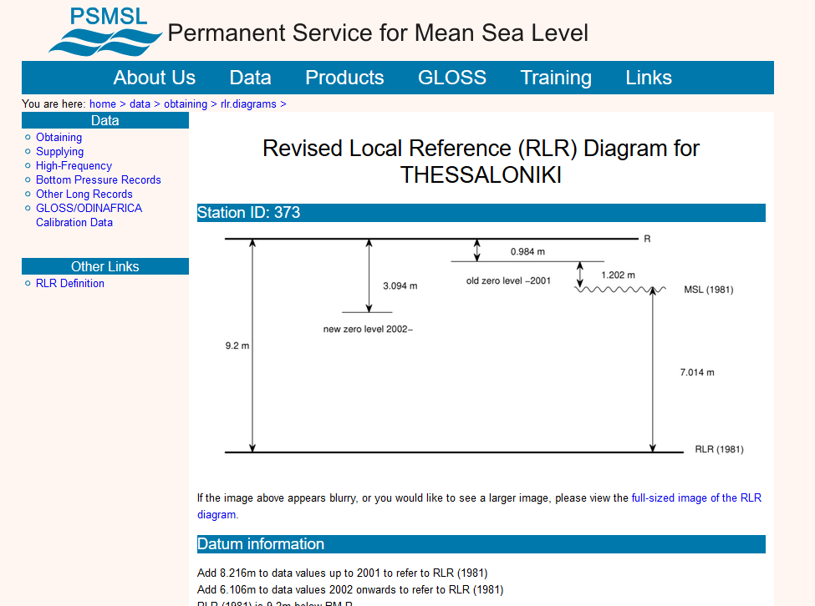
IHRF/IHRS Why AUT1?
IHRF as a realization of IHRS
Why AUT1?
EUREF Station (Class A Station)
HNHS TG station in proximity (9.2 km)
Thessaloniki SONEL TG station (© PSMSL)

Slide 7
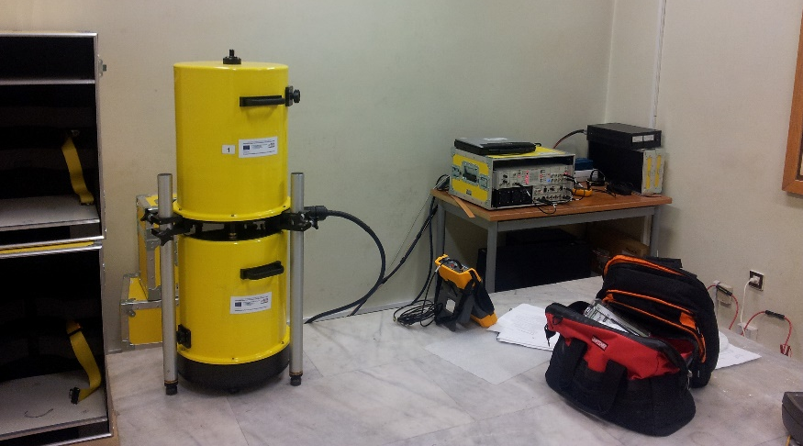
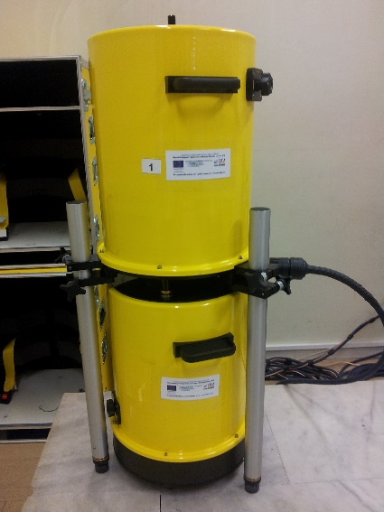
IHRF/IHRS Why AUT1?
IHRF as a realization of IHRS
Why AUT1?
EUREF Station (Class A Station)
HNHS TG station in proximity (9.2 km)
GravLab A10(#027) station in proximity (8 km)
GravLab A10 (#027) (© GravLab)

Slide 8
IHRF/IHRS Why AUT1?
IHRF as a realization of IHRS
Why AUT1?
EUREF Station (Class A Station)
HNHS TG station in proximity (9.2 km)
GravLab A10(#027) station in proximity (8 km)
Abundance of local gravity data (25208 pts. with S<210km)

Slide 9
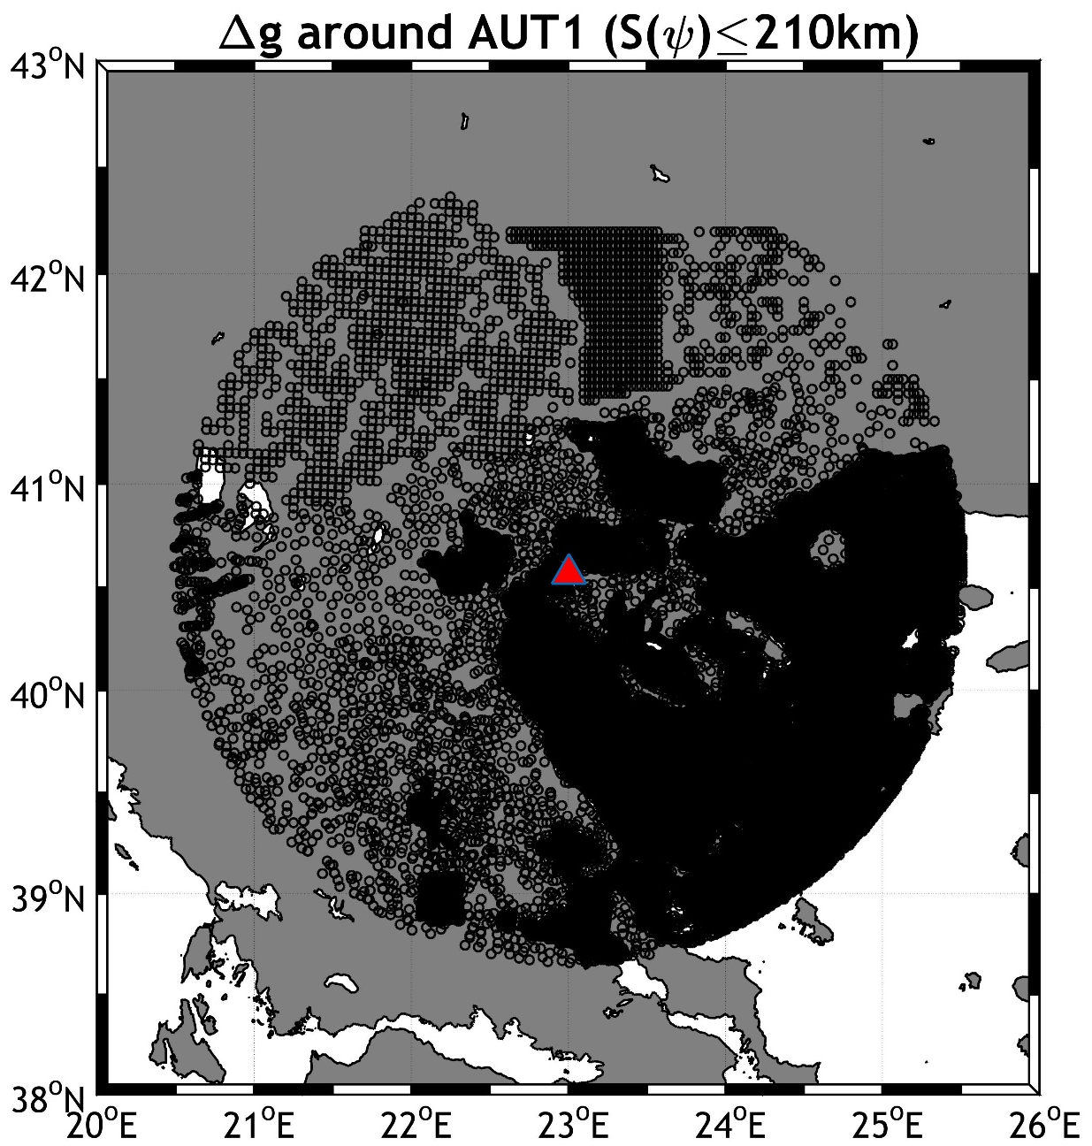
IHRF/IHRS Why AUT1?
Distribution of available local gravity anomalies around AUT1

Slide 10
IHRF/IHRS Why AUT1?
IHRF as a realization of IHRS
Why AUT1?
EUREF Station (Class A Station)
HNHS TG station in proximity (9.2 km)
GravLab A10(#027) station in proximity (8 km)
Abundance of local gravity data (25208 pts. with S<210km)
Levelling connection with the Hellenic VRF through dedicated 1st order spirit leveling

Slide 11



Methodology
Estimate the potential @ AUT1 employing ellipsoidal, orthometric and geoid heights (synthesis of GOCE GGM + local data through RCR)
$${\hat{W}}_{AUT1}^{}= W_{o}^{CVD}−{ΔC}_{AUT1}^{CVD/LVD}$$
$$\left(h_{AUT1}−H_{AUT1}−N_{AUT1}\right){\overline{g}}_{i}=∆C_{AUT1}^{CVD/LVD}$$
$${\overline{g}}_{AUT1}=g_{AUT1}+0.0424H_{AUT1}$$
From EUREF (088/2005)
1st order leveling
Dedicated relative gravity campaign

Slide 12
Methodology
Determine $N_{AUT1}$ using an RCR concept as:
$$N_{AUT1}=N_{0}+N_{GOCE}|_{2}^{n_{1}}+N_{RTM}|_{n_{1+1}}^{216,000}+N_{res}|_{216,000}^{∞}$$

Slide 13

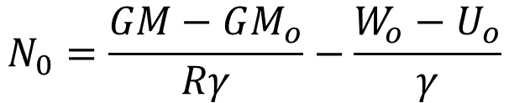



Methodology
Determine $N_{AUT1}$ using an RCR concept as:
$$N_{AUT1}=N_{0}+N_{GOCE}|_{2}^{n_{1}}+N_{RTM}|_{n_{1+1}}^{216,000}+N_{res}|_{216,000}^{∞}$$
$$N_{0}=\frac{GM−GM_{o}}{Rγ}−\frac{W_{o}−U_{o}}{γ}$$
$$N_{GOCE}|_{2}^{n_{1}}$$
GOCO05s to d/o 220
$$N_{RTM}|_{n_{1+1}}^{216,000}$$
SRTM3″ DTM for the wider Hellenic area
$$N_{res}|_{216,000}^{∞}$$
From ${Δg}_{res}$ employing numerical integration, LSC, FFT, Stokes modifications (WG), radial spherical basis functions

Slide 14
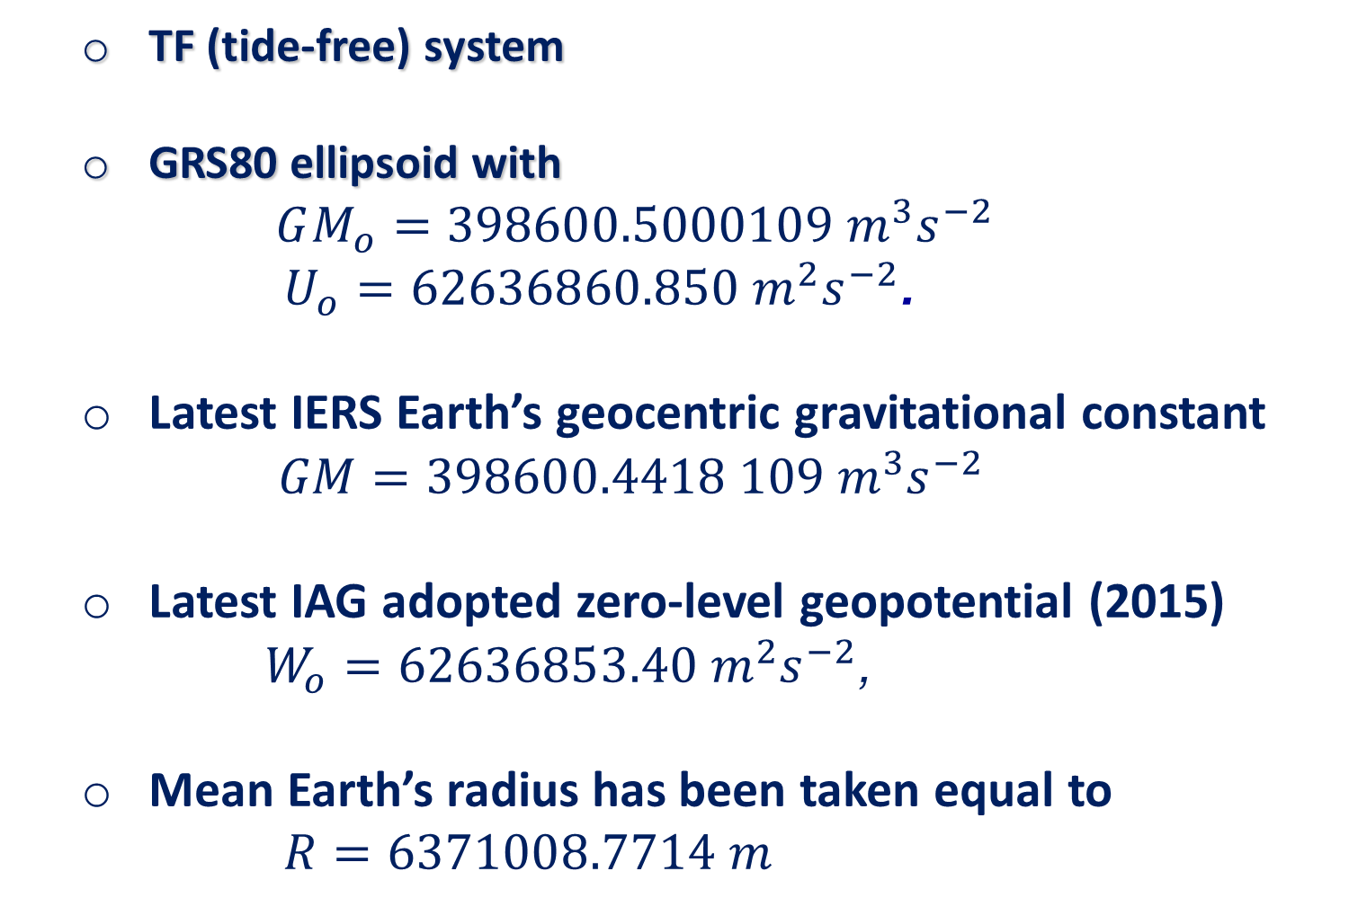
Methodology – Conventions
  TF (tide-free) system
  GRS80 ellipsoid with
  $$GM_{o}=398600.5000109 m^{3}s^{−2}$$
  $U_{o}=62636860.850 m^{2}s^{−2}$.
  Latest IERS Earth’s geocentric gravitational constant
  $GM=398600.4418 109 m^{3}s^{−2}$
  Latest IAG adopted zero-level geopotential (2015)
  $W_{o}=62636853.40 m^{2}s^{−2}$,
  Mean Earth’s radius has been taken equal to
  $R=6371008.7714 m$

Slide 15
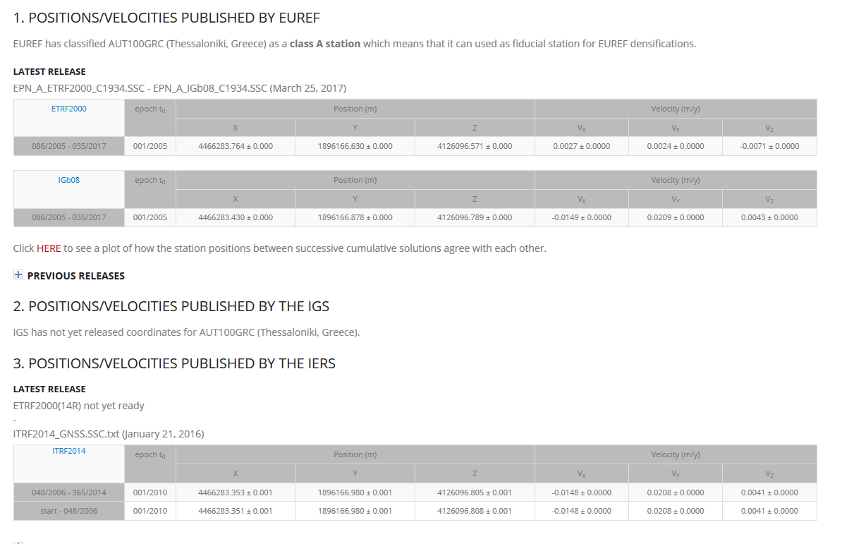

Data availability
$h_{AUT1}$=150.0785±0.0020 m
AUT1 ellipsoidal height from DGS/AUTH

Slide 16
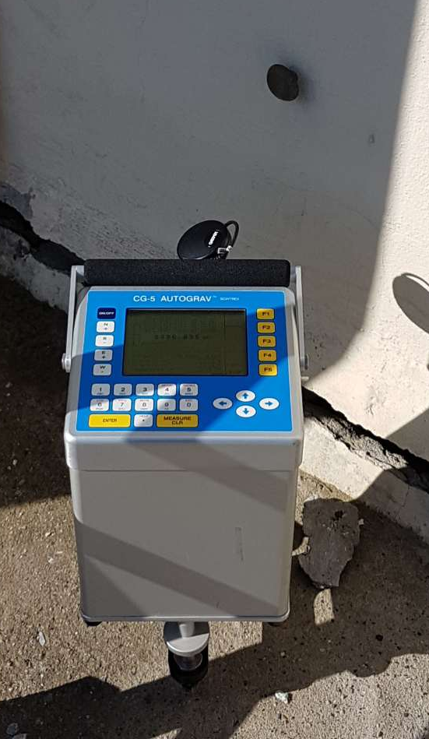
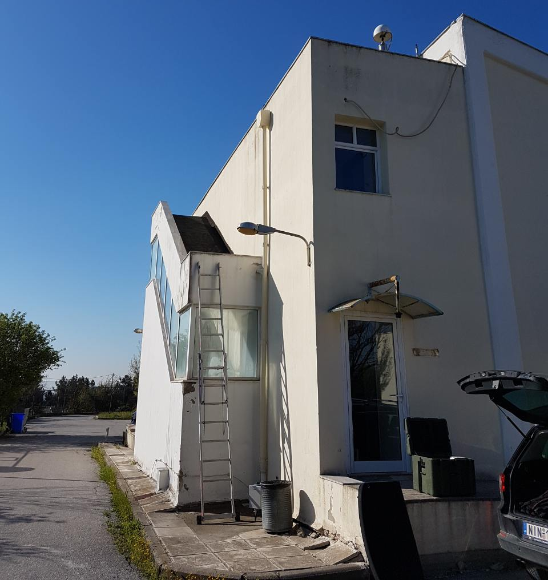
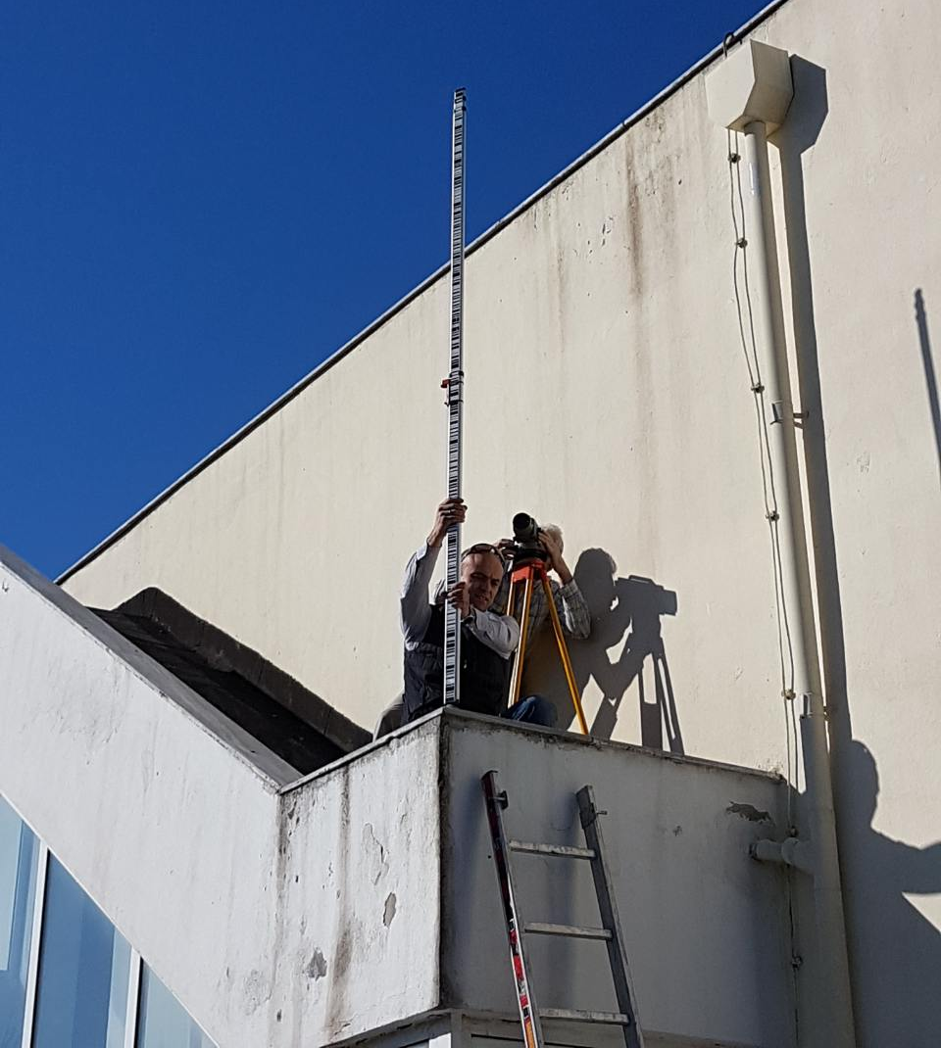

Data availability
$h_{AUT1}$=150.0785±0.0020 m
$H_{AUT1}$=108.8291±0.0021 m
AUT1 dedicated spirit leveling from AUT1 leveling BM to the ARP

Slide 17
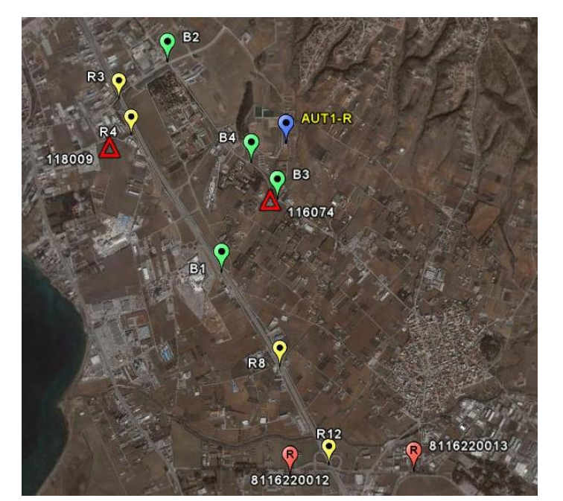
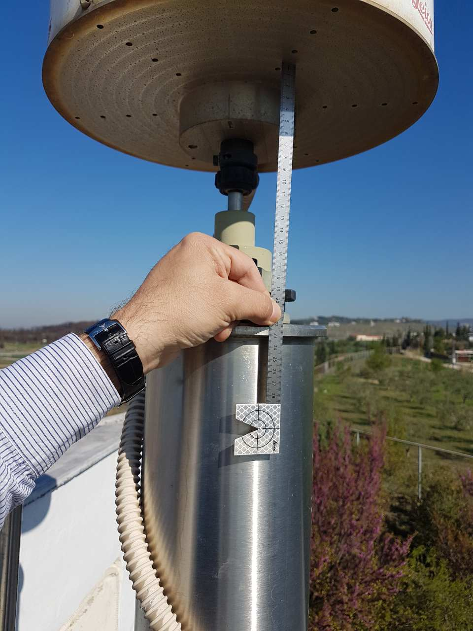
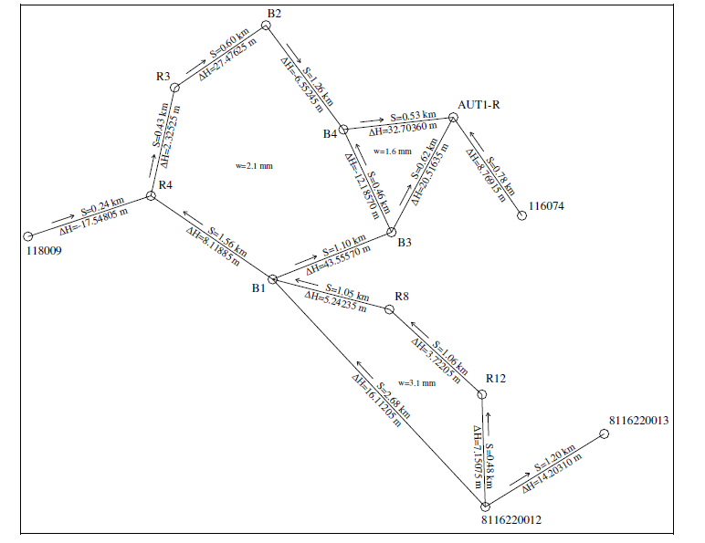
Data availability
$h_{AUT1}$=150.0785±0.0020 m
$H_{AUT1}$=108.8291±0.0021 m
AUT1 1st order spirit leveling to connect to HVRF (Vlachakis et al. 2005)
AUT1 dedicated spirit leveling

Slide 18
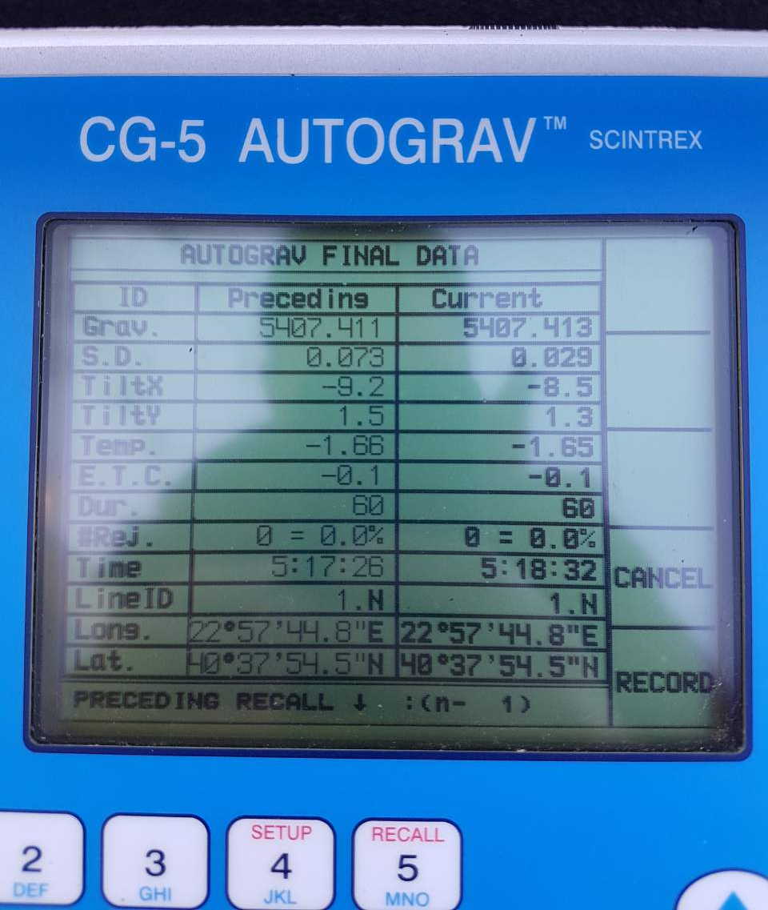
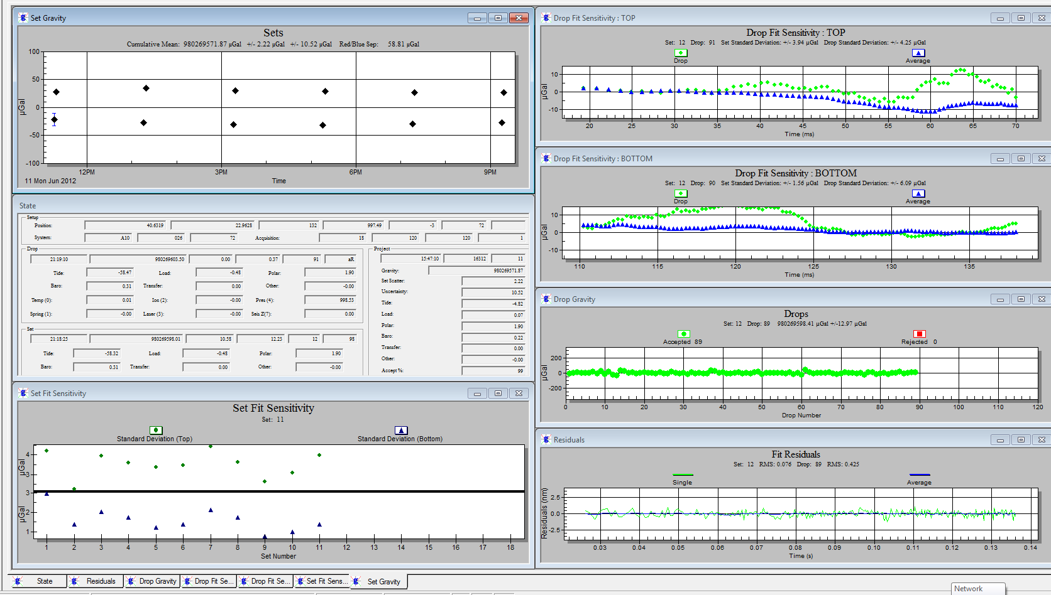

Data availability
$h_{AUT1}$=150.0785±0.0020 m
$H_{AUT1}$=108.8291±0.0021 m
$g_{AUT1}$=980234905.23±19.98 μGal
GravLab dedicated gravity survey connecting A10(#027) with AUT1

Slide 19
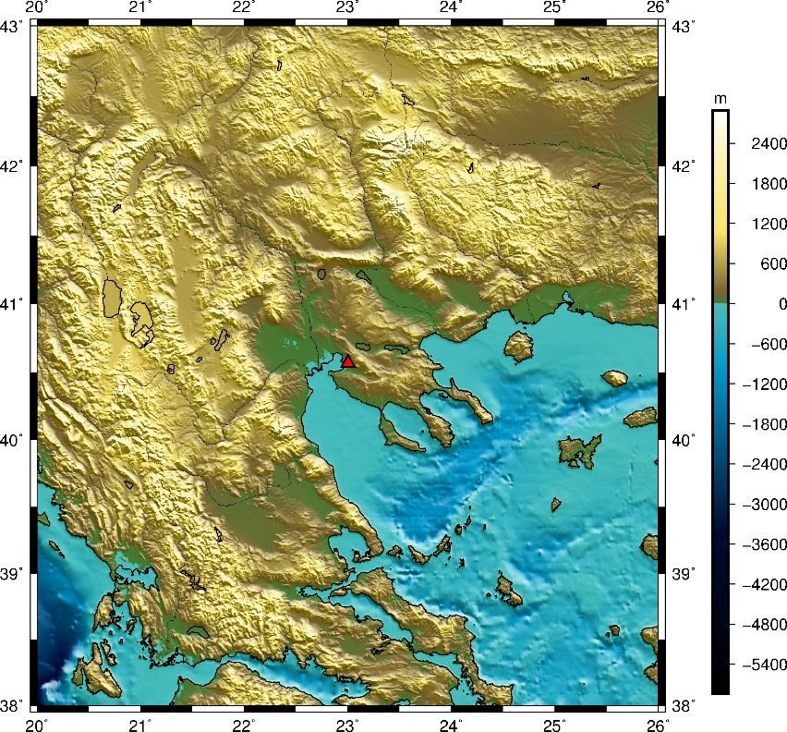

Data availability
$$N_{RTM}|_{n_{1+1}}^{216,000}$$
SRTM3″ DTM for the wider Hellenic area
 | max | min | mean | std
DTM/DBM | 3041.7 | -5250.00 | -768.10 | 1478.99
The generated SRTM3″ DTM/DBM around AUT1 for the evaluation of RTM

Slide 20
Data availability
Select local gravity data based on the JWG0.1.2 concept
Statistics of the available local free-air gravity anomalies around AUT1. Unit: [mGal]
 | nr. pts. | max | min | mean | std
S∈[0,10] | 460 | 137.739 | 11.111 | 58.057 | 17.929
S∈(10,50] | 2209 | 180.365 | -20.643 | 31.579 | 37.364
S∈(50,110] | 6319 | 192.130 | -44.743 | 13.411 | 28.892
S∈(110,210] | 16221 | 258.979 | -107.127 | 23.252 | 32.643
all S∈[0,210] | 25205 | 258.979 | -107.127 | 22.150 | 32.775

Slide 21
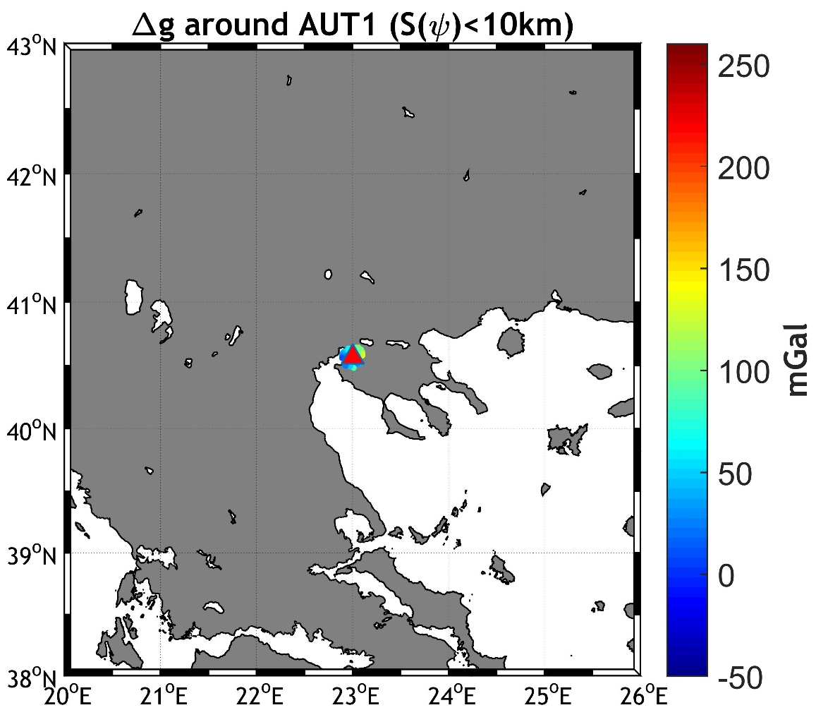
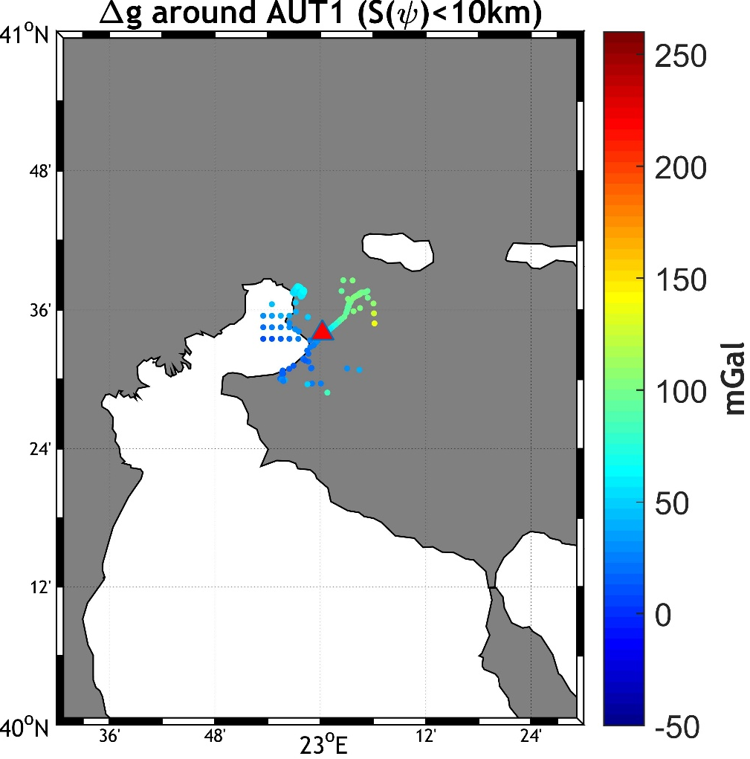
Data availability
Distribution of local gravity data around AUT1

Slide 22
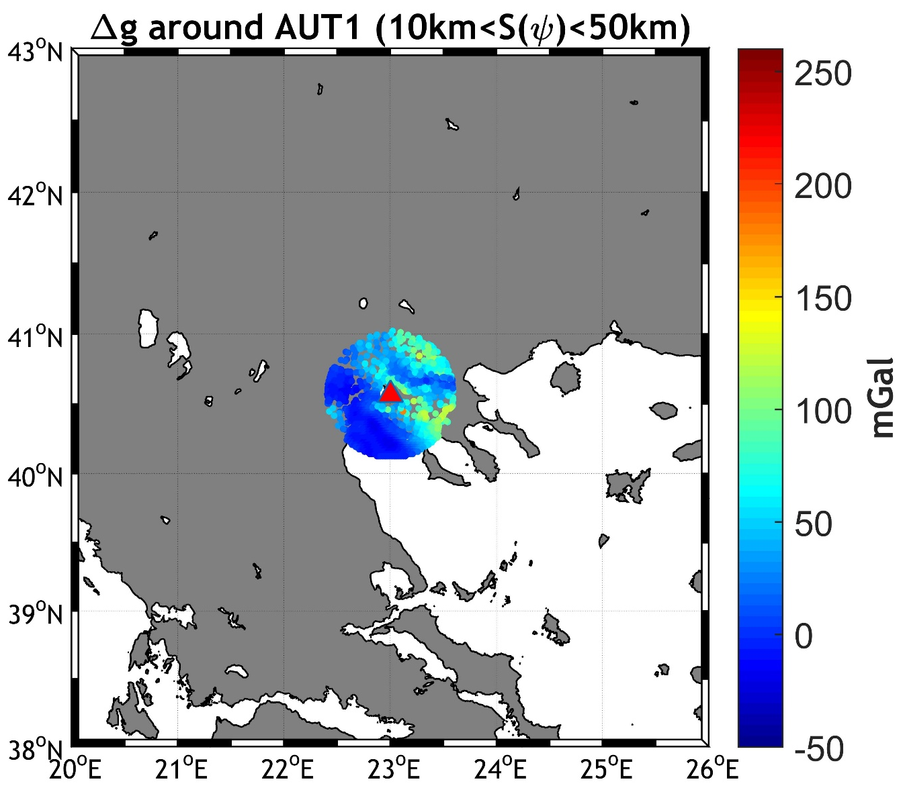
Data availability
Distribution of local gravity data around AUT1

Slide 23
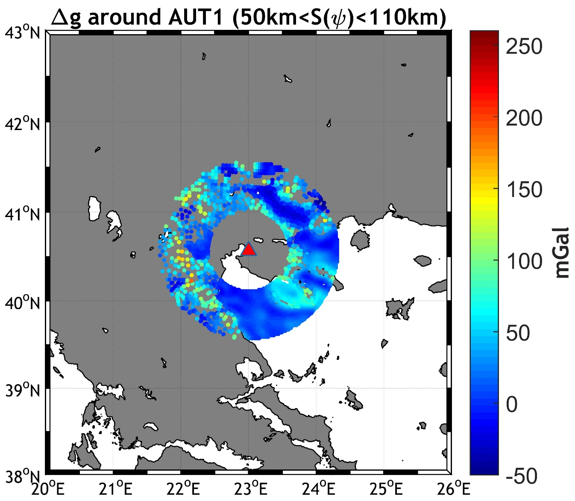
Data availability
Distribution of local gravity data around AUT1

Slide 24
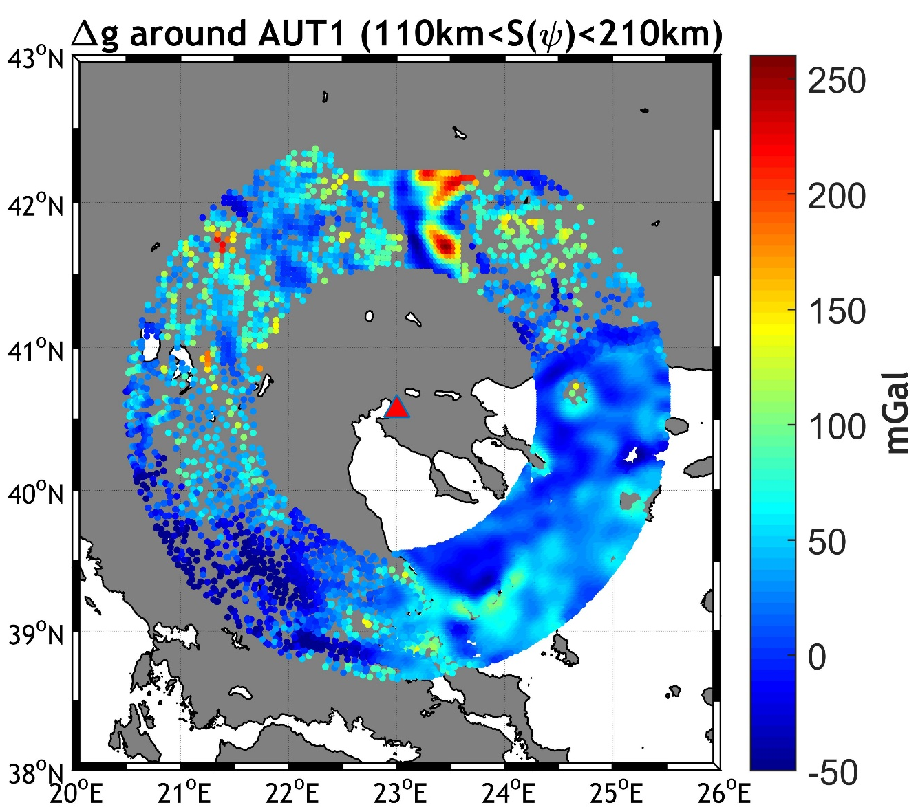
Data availability
Distribution of local gravity data around AUT1

Slide 25
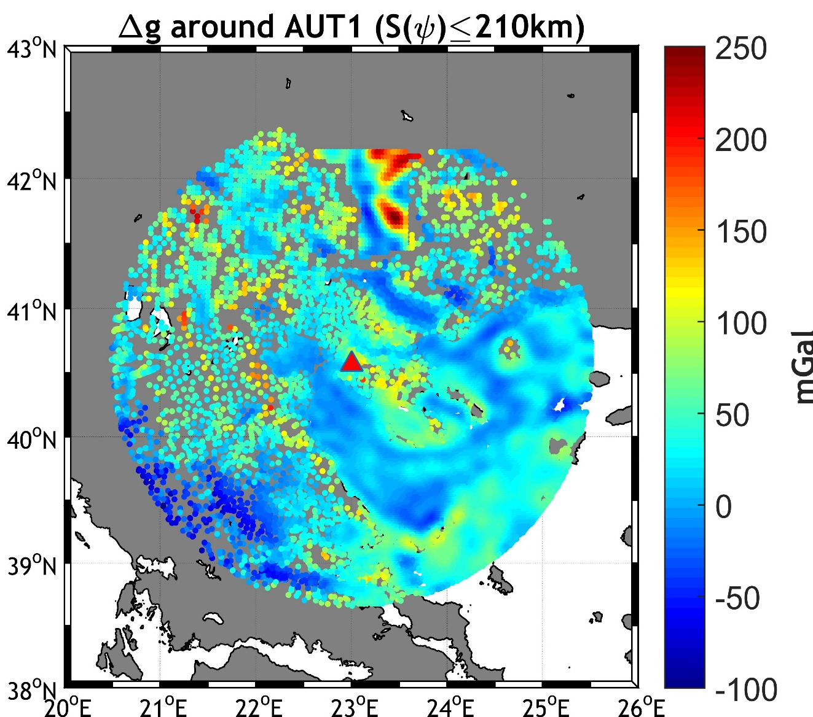
Data availability
Distribution of local gravity data around AUT1

Slide 26
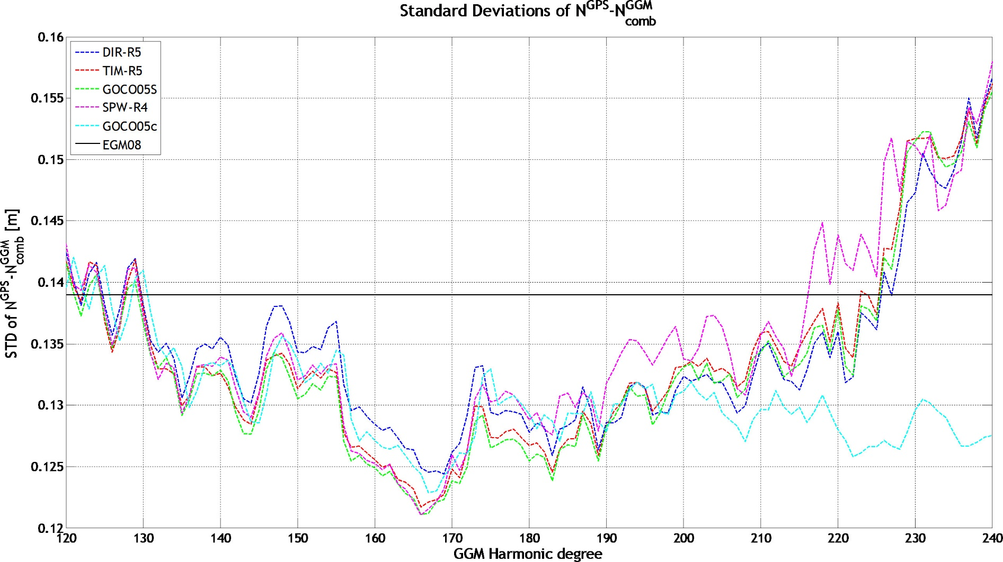
Data pre-processing
Reduction to GOCO05s (n_{max}=183, 200, 220)
GOCE GGM evaluation over Greece

Slide 27
Data availability
Reduction to GOCO05s (n_{max}=183, 200, 220)
Statistics of the original and reduced free-air gravity anomalies. Unit: [mGal]
 | max | min | mean | std
Δg_{f} | 258.979 | -107.127 | 22.150 | 32.775
Δg_{red} (d/o 183) | 200.782 | -107.907 | -10.068 | 32.971
Δg_{red} (d/o 200) | 195.579 | -110.758 | -9.798 | 32.475
Δg_{red} (d/o 220) | 201.558 | -111.594 | -10.459 | 30.699

Slide 28
Data pre-processing
Compute RTM effects on gravity the usual way (terrain effects relative to a smooth but varying surface generated from the fine-detail DTM)
Statistics of the original and reduced free-air gravity anomalies. Unit: [mGal]
 | max | min | mean | std
Δg_{f} | 258.979 | -107.127 | 22.150 | 32.775
Δg_{red} (d/o 183) | 200.782 | -107.907 | -10.068 | 32.971
Δg_{res} (d/o 183) | 141.590 | -90.568 | 6.562 | 21.604
Δg_{red} (d/o 200) | 195.579 | -110.758 | -9.798 | 32.475
Δg_{res} (d/o 200) | 138.192 | -89.915 | 5.804 | 20.279
Δg_{red} (d/o 220) | 201.558 | -111.594 | -10.459 | 30.699
Δg_{res} (d/o 220) | 121.683 | -88.945 | 4.151 | 18.328

Slide 29
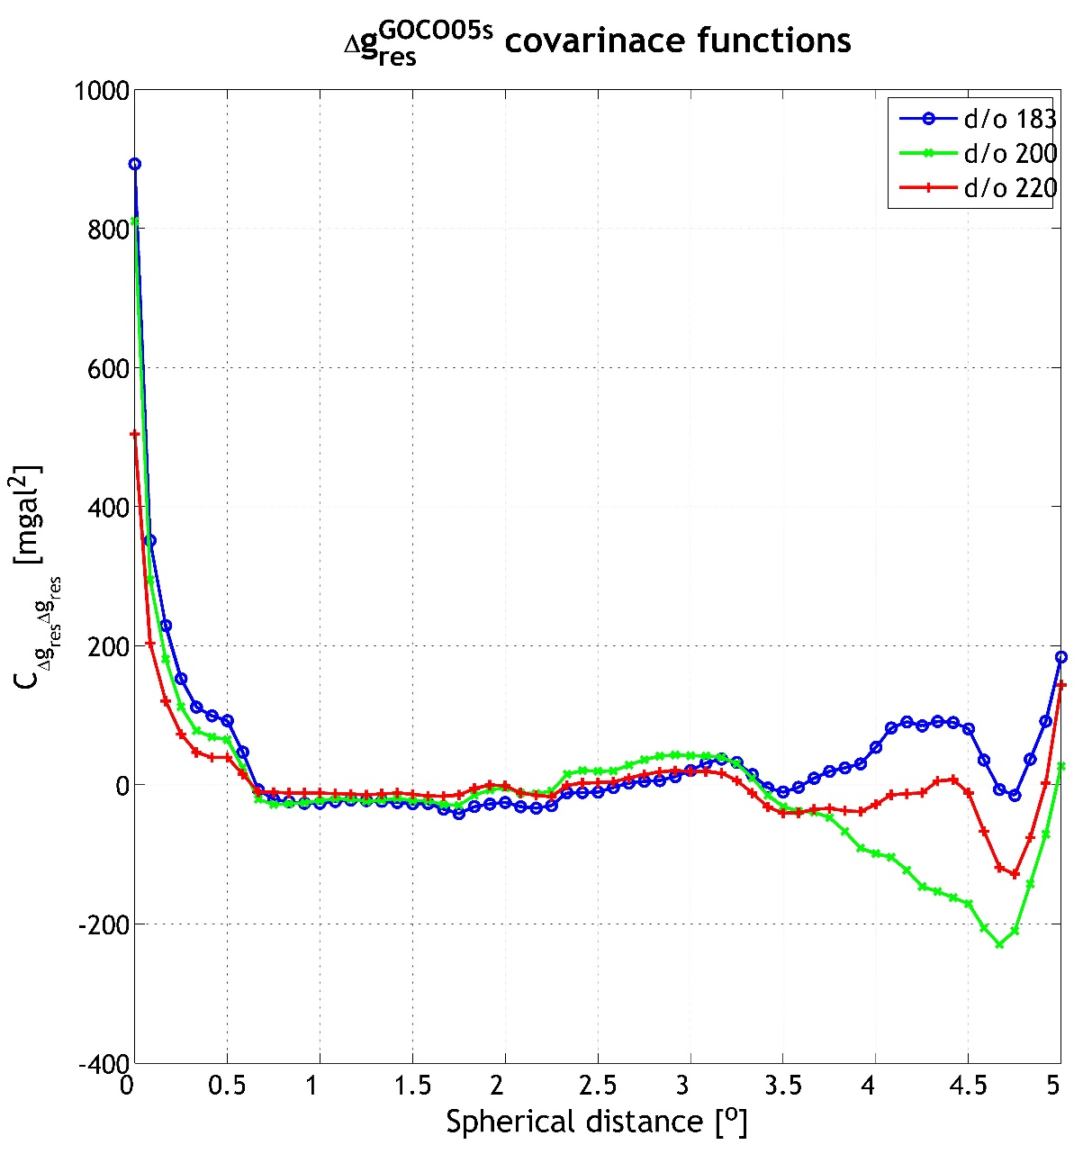
Data pre-processing
Δg_{res} empirical covariance functions

Slide 30
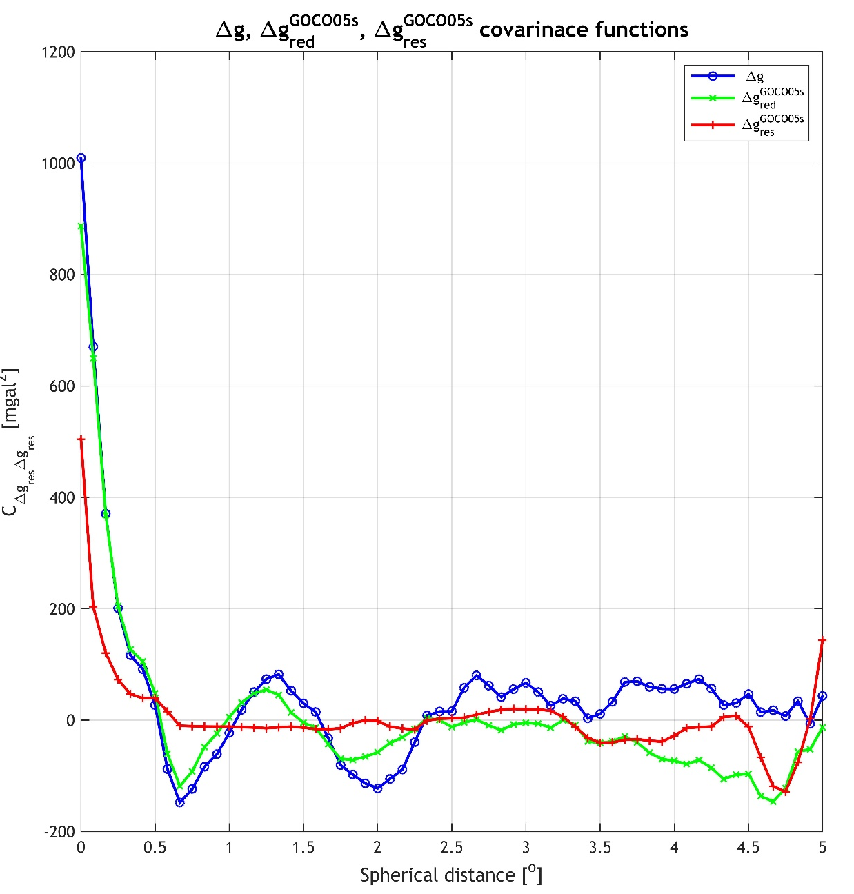
Data pre-processing
Δg, Δg_{red} and Δg_{res} empirical covariance functions

Slide 31
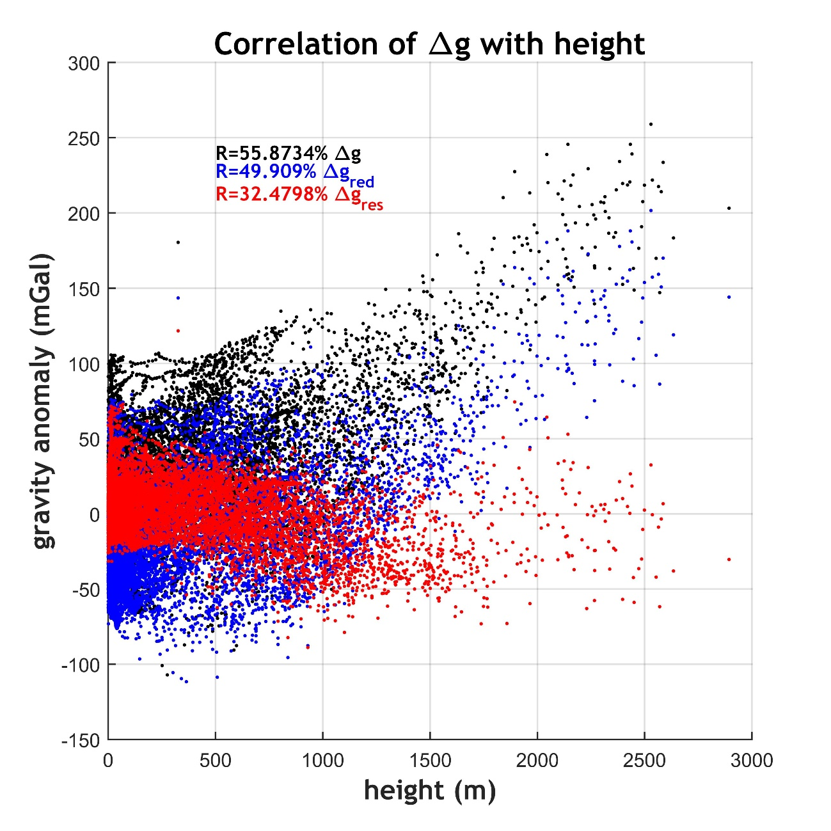
Data pre-processing

Slide 32
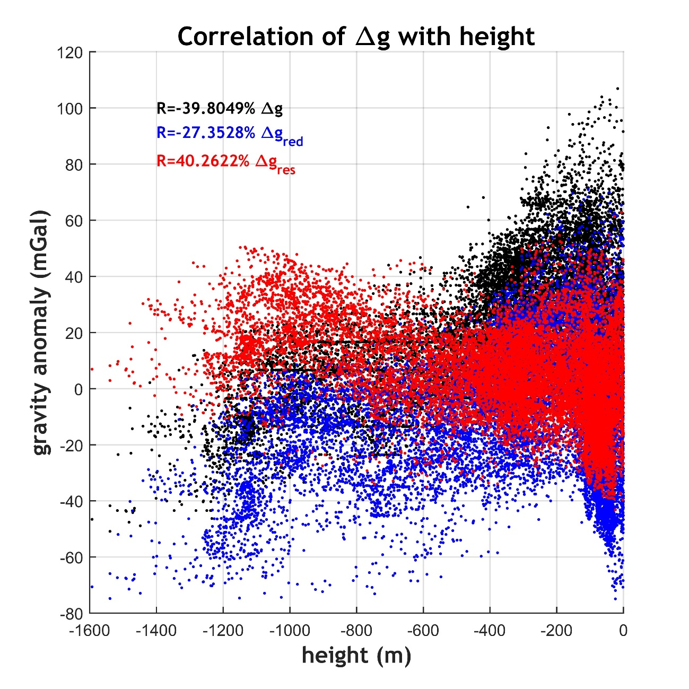
Data pre-processing
✗ RTM does not work well over marine areas due to the limited resolution/accuracy of current bathymetry models

Slide 33
Data pre-processing
Compute RTM effects as a synthesis of dv_ell2014 (d/o 221 to 2160) and ERTM2160 (Hirt et al. 2016) (from d/o 2160 to 99,000)
Statistics of the original and residual free-air gravity anomalies. Unit: [mGal]
 | max | min | mean | std
Δg_{f} | 258.979 | -107.127 | 22.150 | 32.775
Δg_{red} (d/o 220) | 201.558 | -111.594 | -10.459 | 30.699
Δg_{res} (d/o 220) | 121.683 | -88.945 | 4.151 | 18.328
Δg_{res} (dv_ell&ERTM) | 114.401 | -66.380 | 0.354 | 15.846

Slide 34
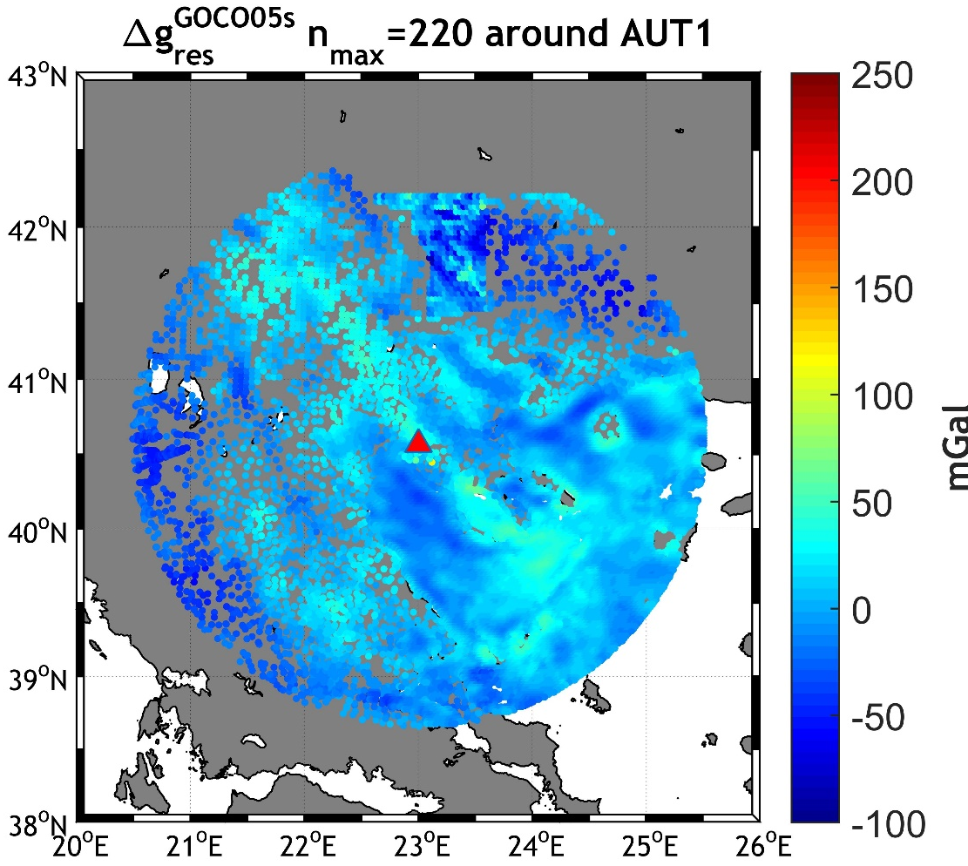
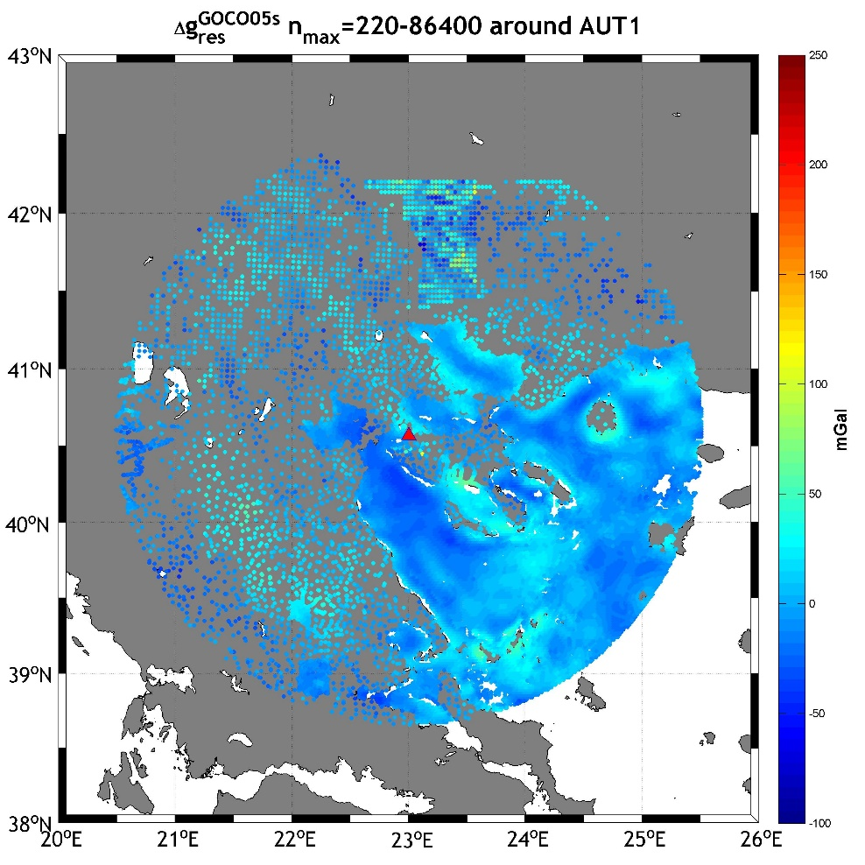
Data pre-processing
Δg_{res} with the classical (left) and dv_ell&ERTM approach (right)

Slide 35
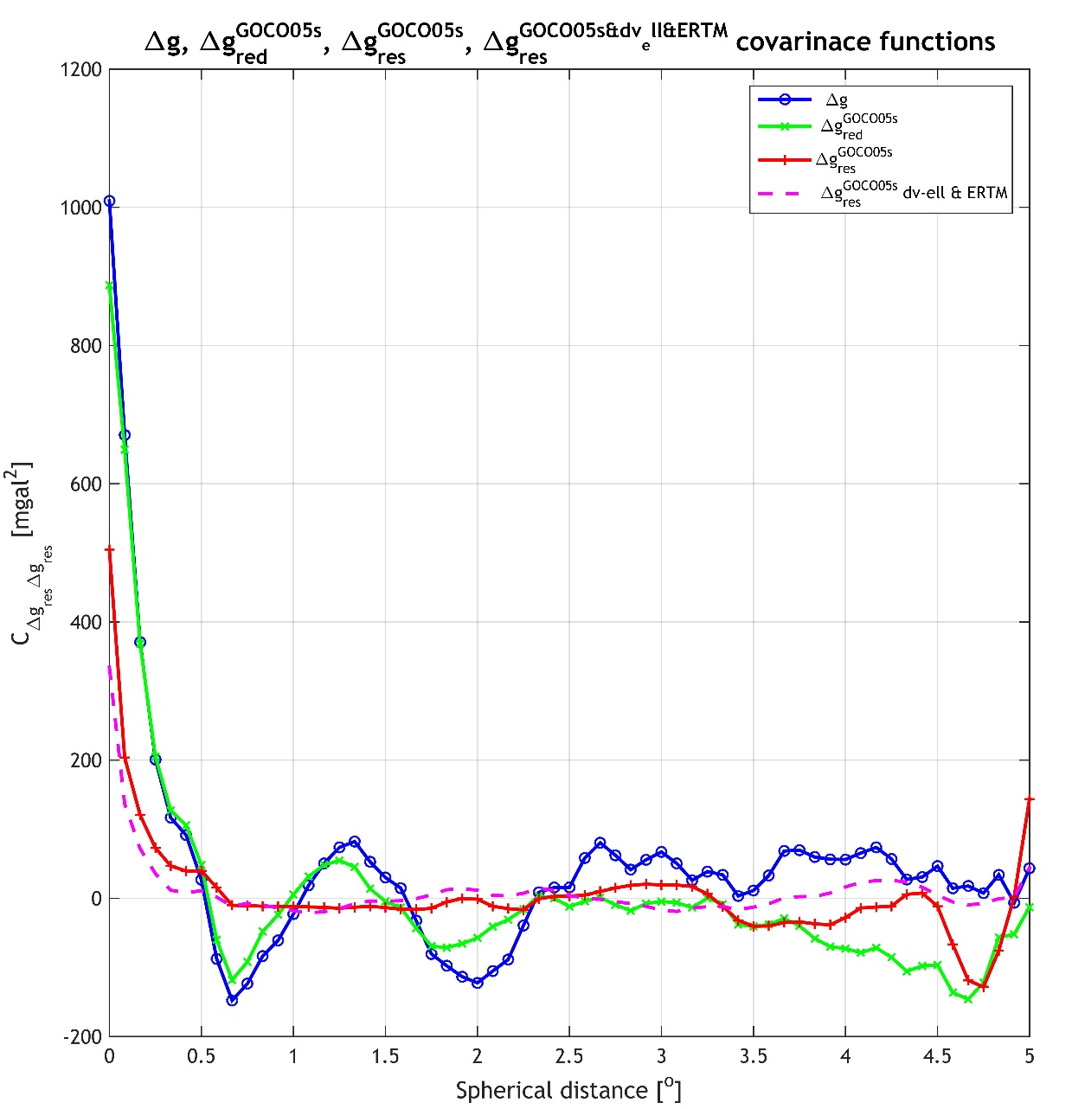
Data pre-processing

Slide 36
Data pre-processing
Reduction to XGM2016 (n_{max}=719)
Compute RTM effects on gravity the usual way
Statistics of the original and residual free-air gravity anomalies. Unit: [mGal]
 | max | min | mean | std
Δg_{f} | 258.979 | -107.127 | 22.150 | 32.775
Δg_{red} (d/o 220) | 201.558 | -111.594 | -10.459 | 30.699
Δg_{res} (d/o 220) | 121.683 | -88.945 | 4.151 | 18.328
Δg_{res} (dv_ell&ERTM) | 114.401 | -66.380 | 0.354 | 15.846
Δg_{red} (d/o 719) | 200.017 | -120.424 | -5.468 | 23.876
Δg_{res} (d/o 719) | 101.551 | -64.925 | 3.118 | 14.854

Slide 37
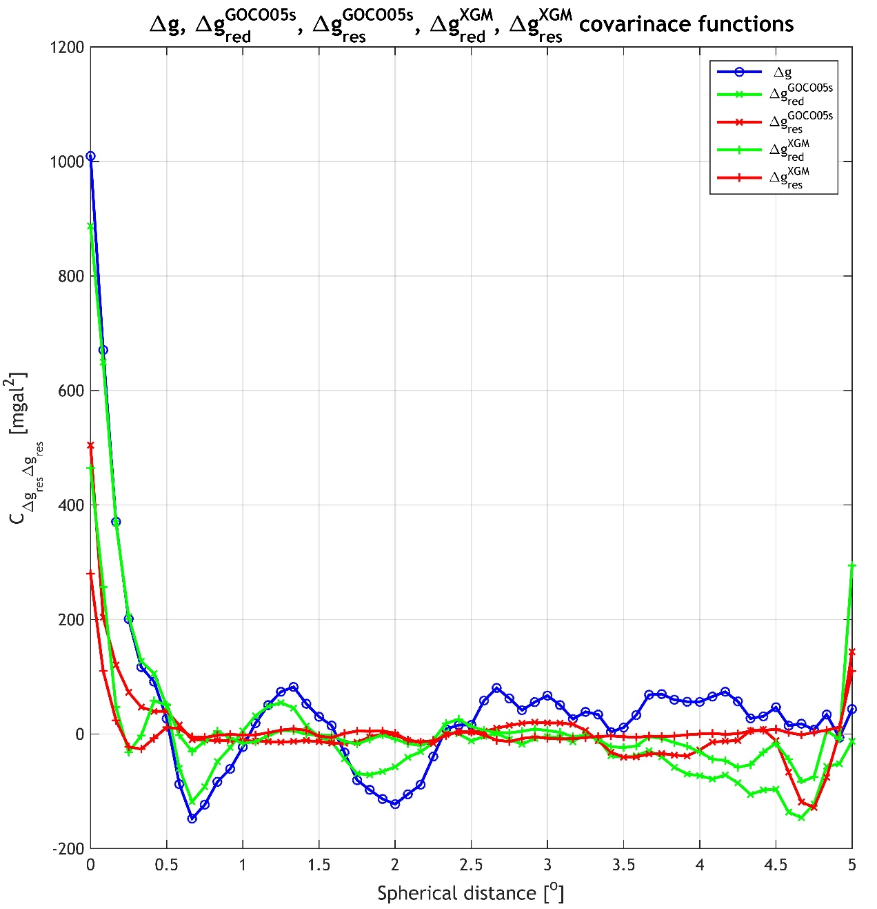
Data pre-processing

Slide 38

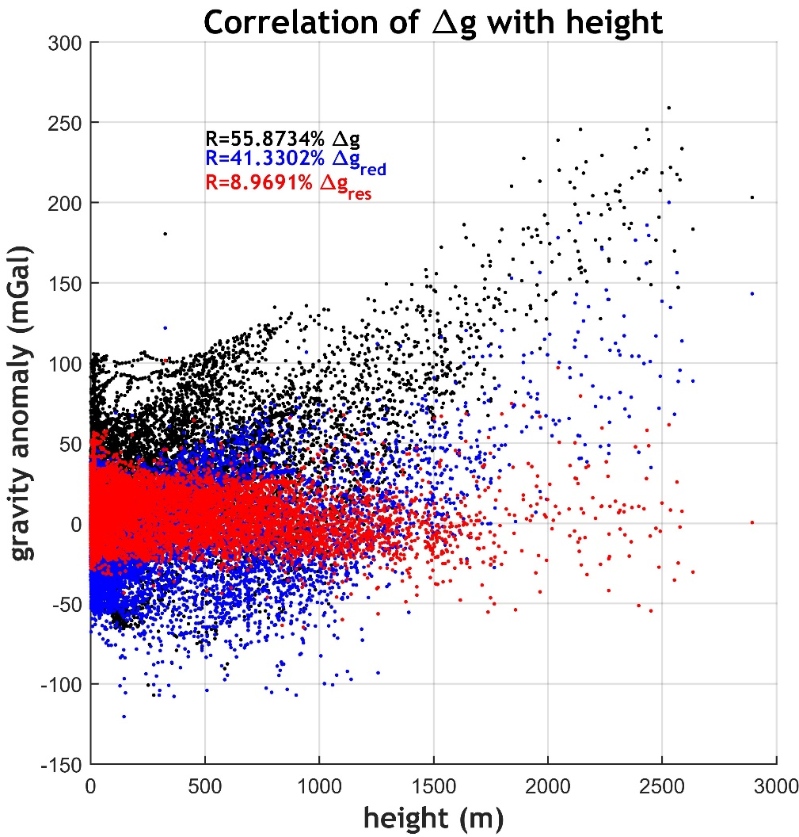
Data pre-processing
Δg_{res} relative to GOCO (left) and relative to XGM2016 (right)

Slide 39

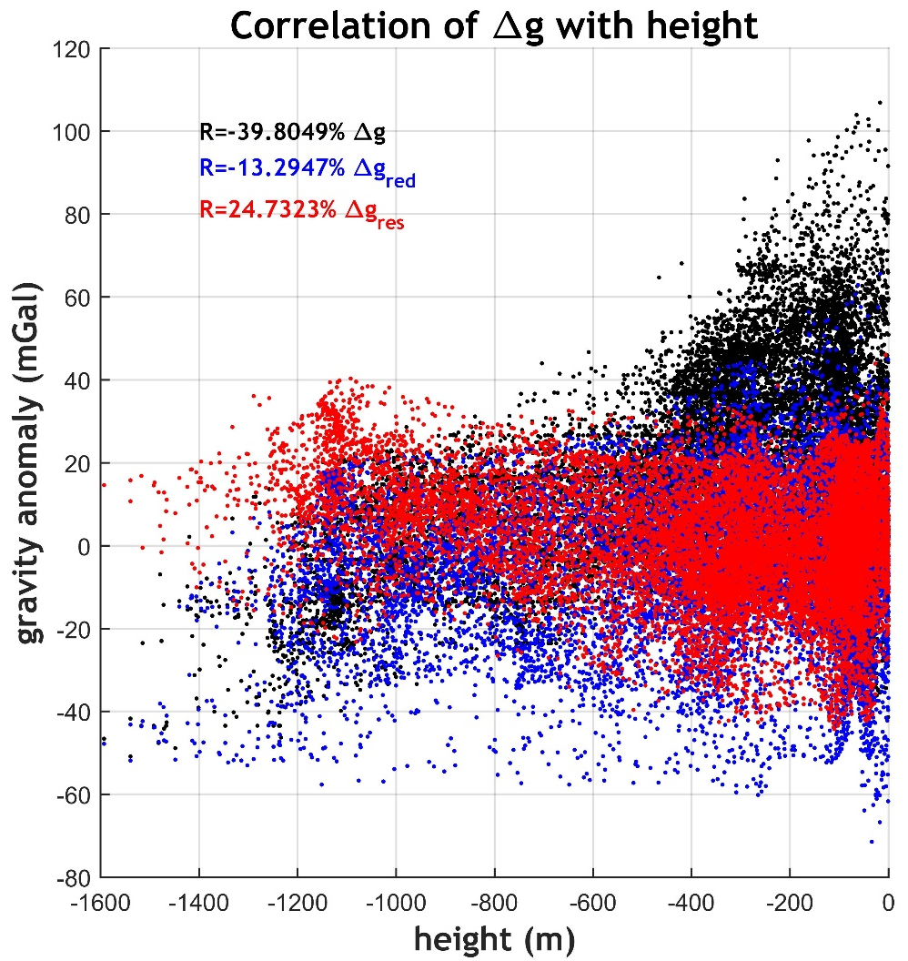
Data pre-processing
Δg_{res} relative to GOCO (left) and relative to XGM2016 (right)

Slide 40
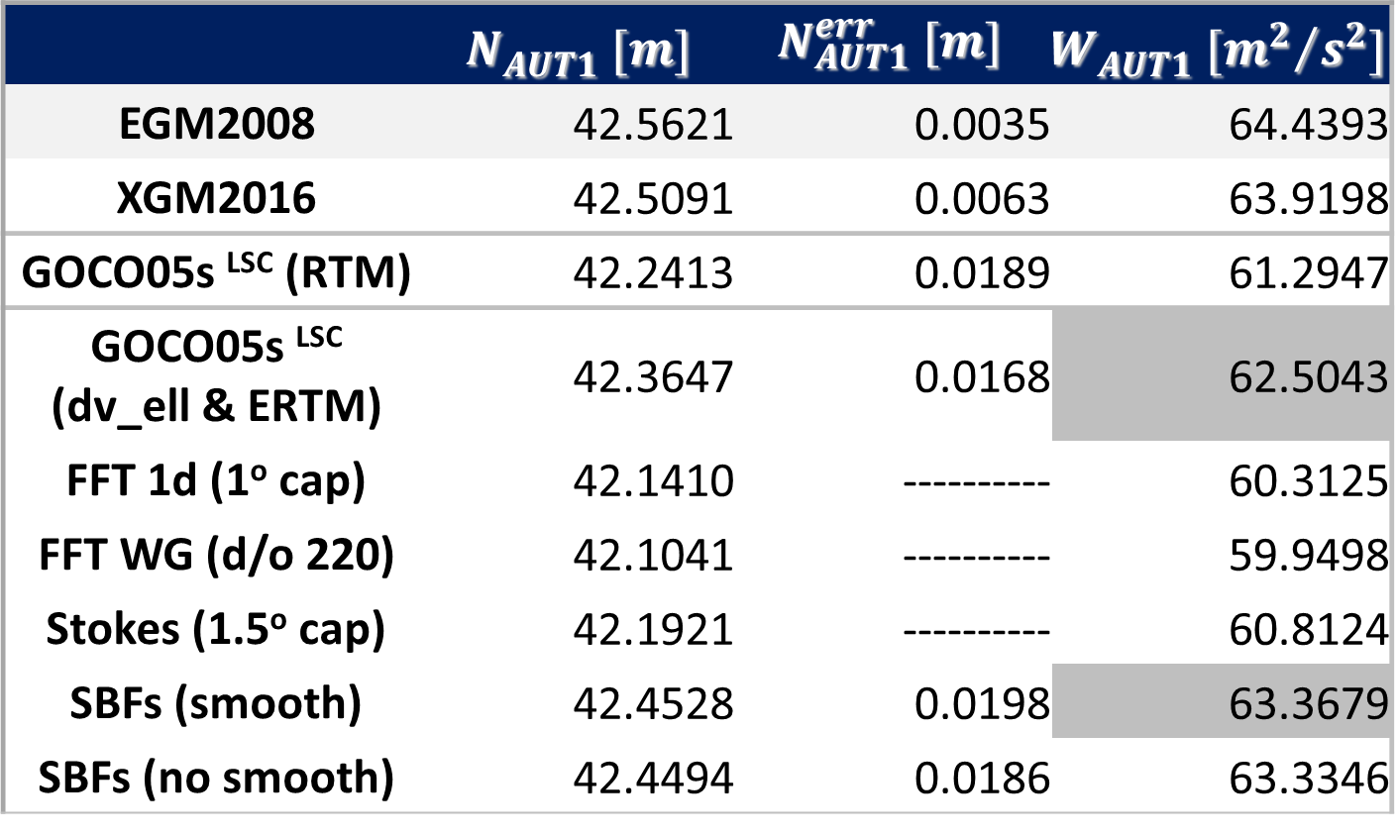
$N_{AUT1}^{}$ & $W_{AUT1}^{}$ modeling
Effect of estimation method
Statistics of the estimated geoid and potential at AUT1
 | $$N_{AUT1}^{} [m]$$ | $$N_{AUT1}^{err} [m]$$ | $$W_{AUT1}^{} [{m^{2}}/{s^{2}}]$$
EGM2008 | 42.5621 | 0.0035 | 64.4393
XGM2016 | 42.5091 | 0.0063 | 63.9198
GOCO05s ^{LSC} (RTM) | 42.2413 | 0.0189 | 61.2947
GOCO05s ^{LSC} (dv_ell & ERTM) | 42.3647 | 0.0168 | 62.5043
FFT 1d (1º cap) | 42.1410 | ---------- | 60.3125
FFT WG (d/o 220) | 42.1041 | ---------- | 59.9498
Stokes (1.5º cap) | 42.1921 | ---------- | 60.8124
SBFs (smooth) | 42.4528 | 0.0198 | 63.3679
SBFs (no smooth) | 42.4494 | 0.0186 | 63.3346

Slide 41
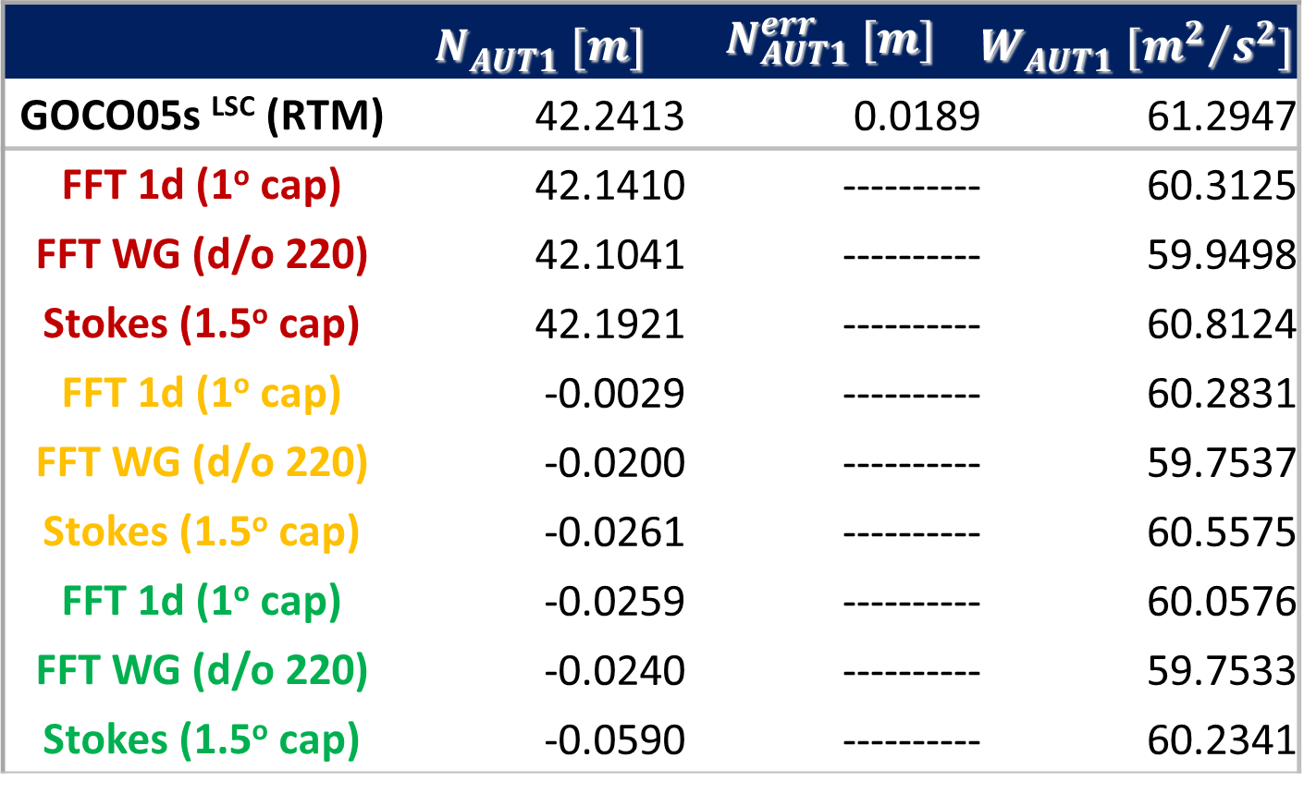
$N_{AUT1}^{}$ & $W_{AUT1}^{}$ modeling
Effect of gridding (splines, krigging, bilinear)
Statistics of the estimated geoid and potential at AUT1
 | $$N_{AUT1}^{} [m]$$ | $$N_{AUT1}^{err} [m]$$ | $$W_{AUT1}^{} [{m^{2}}/{s^{2}}]$$
GOCO05s ^{LSC} (RTM) | 42.2413 | 0.0189 | 61.2947
FFT 1d (1º cap) | 42.1410 | ---------- | 60.3125
FFT WG (d/o 220) | 42.1041 | ---------- | 59.9498
Stokes (1.5º cap) | 42.1921 | ---------- | 60.8124
FFT 1d (1º cap) | -0.0029 | ---------- | 60.2831
FFT WG (d/o 220) | -0.0200 | ---------- | 59.7537
Stokes (1.5º cap) | -0.0261 | ---------- | 60.5575
FFT 1d (1º cap) | -0.0259 | ---------- | 60.0576
FFT WG (d/o 220) | -0.0240 | ---------- | 59.7533
Stokes (1.5º cap) | -0.0590 | ---------- | 60.2341

Slide 42
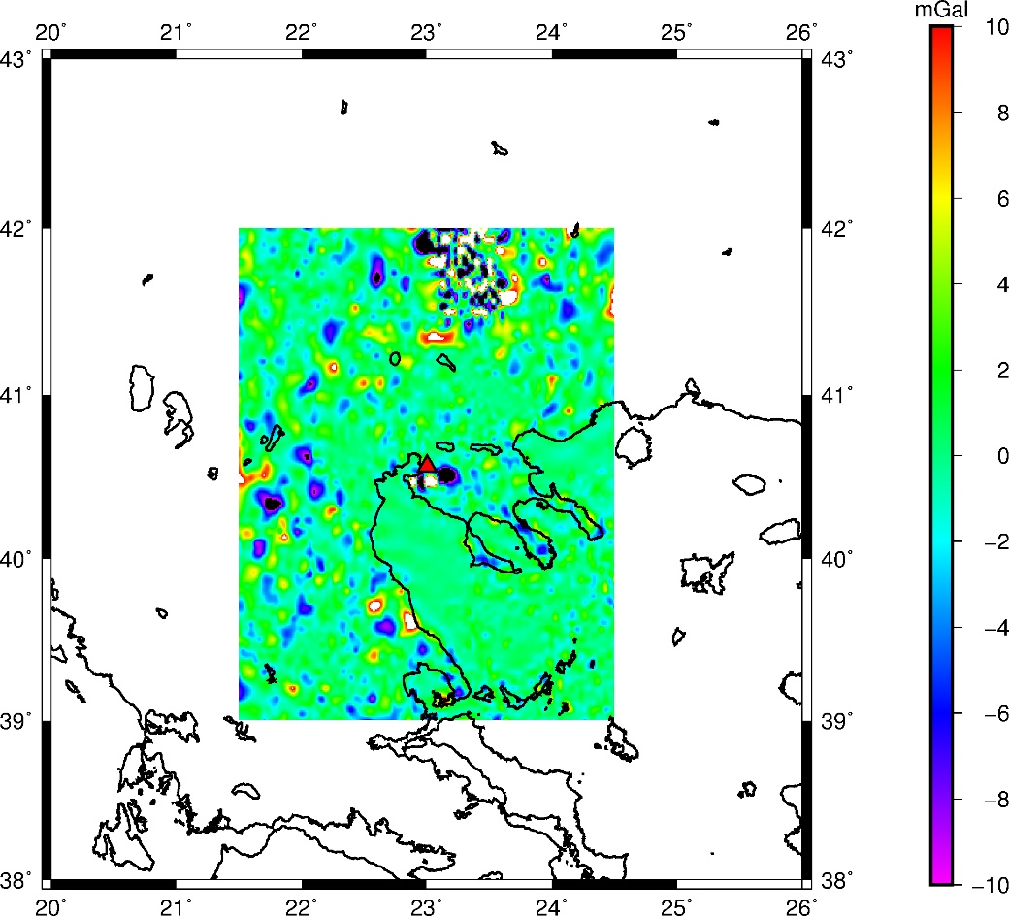
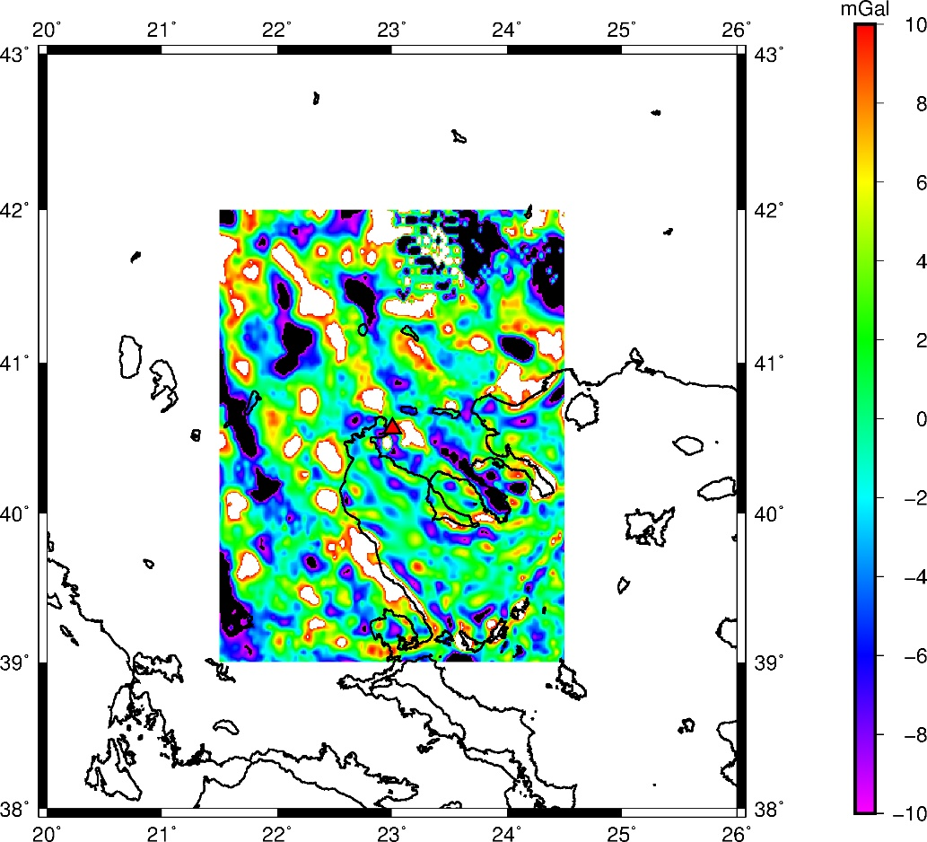
$N_{AUT1}^{}$ & $W_{AUT1}^{}$ modeling
Effect of gridding (splines, krigging, bilinear)
Gravity residuals differences between spline/kringging (left) and spline/bilinear (right). σ_{dif}=1.5 mGal and 8.5 mGal respectively

Slide 43
$N_{AUT1}^{}$ & $W_{AUT1}^{}$ modeling
Effect of data distribution and density
Use the GOCO5s LSC-based solution employing all data as reference and then evaluate the impact of data distribution and sampling

Slide 44
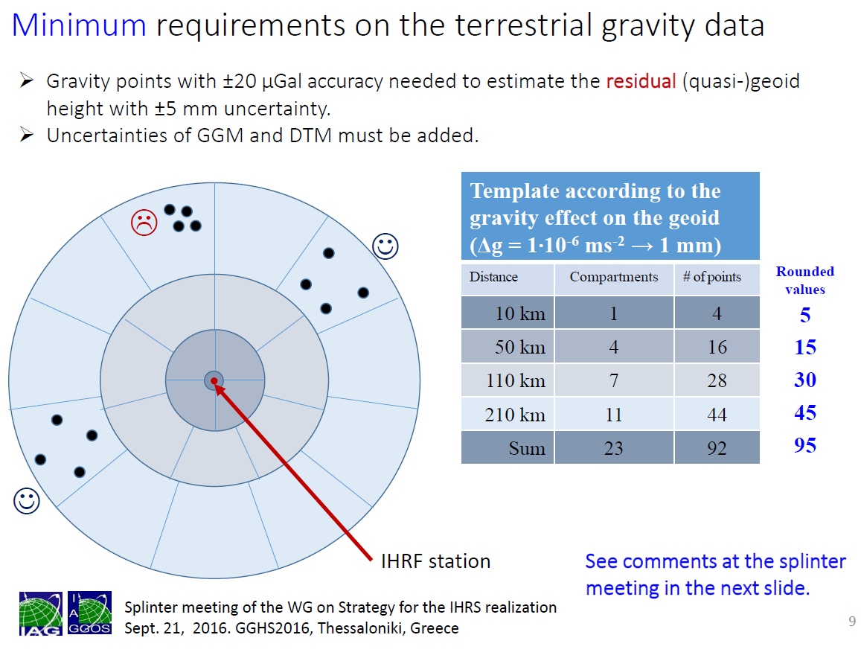
$N_{AUT1}^{}$ & $W_{AUT1}^{}$ modeling
Splinter Meeting IAG JWG0.1.2 GGHS2016 Thessaloniki, Greece (© Sánchez, 2016)

Slide 45
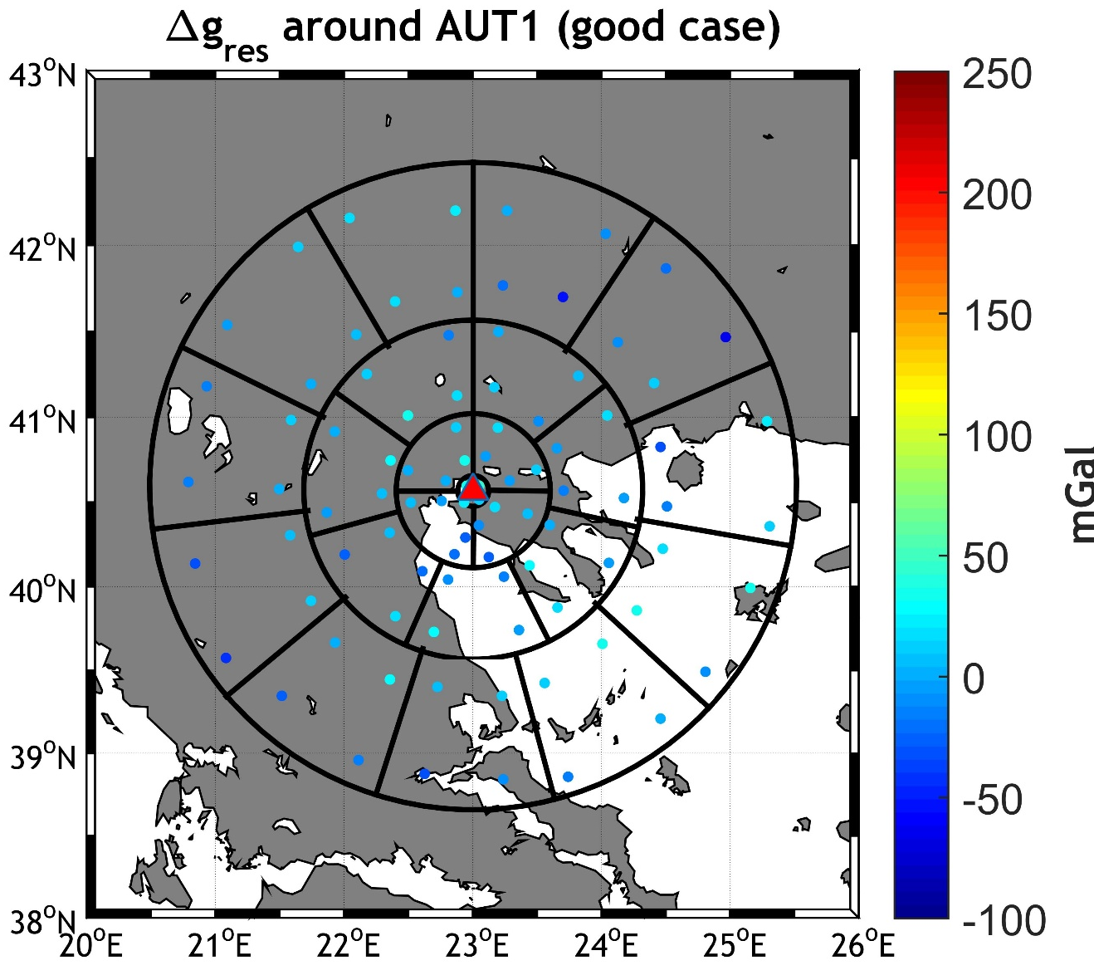
$N_{AUT1}^{}$ & $W_{AUT1}^{}$ modeling
Good distribution as per the JWG0.1.2 recommendation

Slide 46
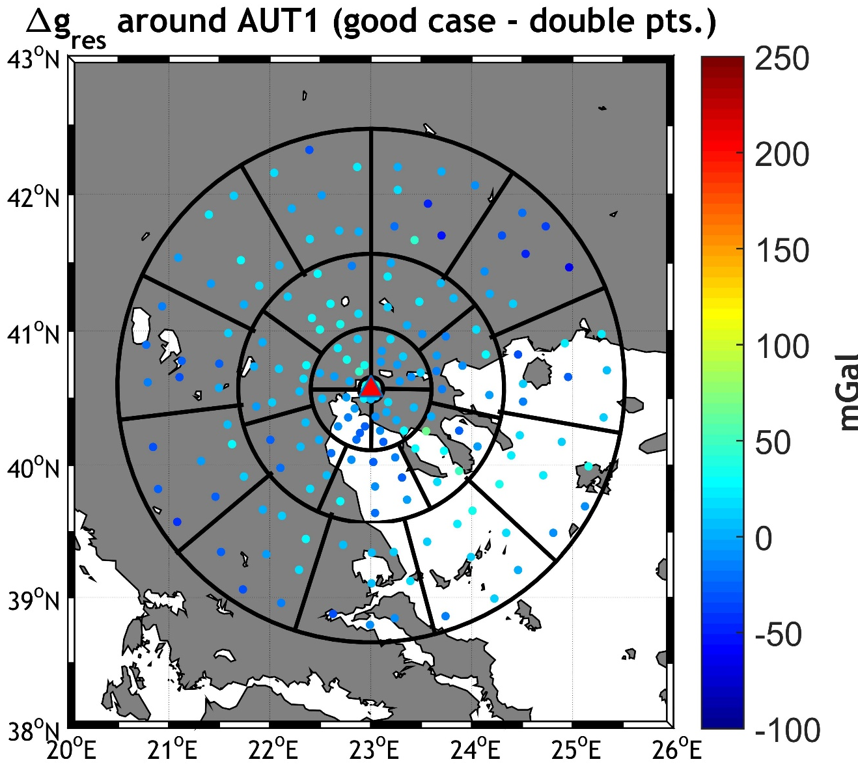
$N_{AUT1}^{}$ & $W_{AUT1}^{}$ modeling
Good distribution as per the JWG0.1.2 recommendation (x2)

Slide 47
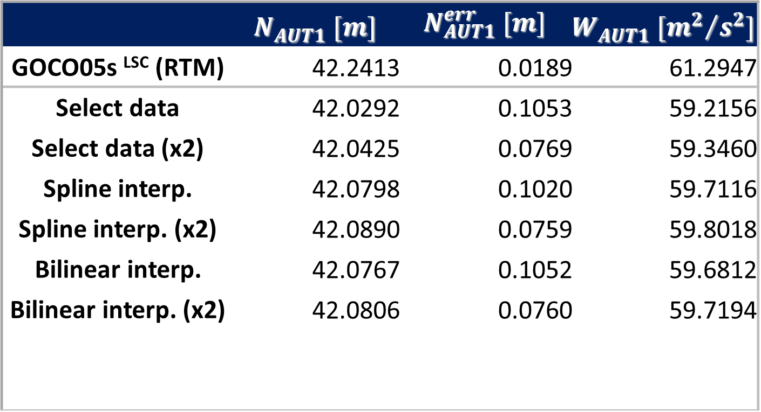
$N_{AUT1}^{}$ & $W_{AUT1}^{}$ modeling
Statistics of the estimated geoid and potential at AUT1
 | $$N_{AUT1}^{} [m]$$ | $$N_{AUT1}^{err} [m]$$ | $$W_{AUT1}^{} [{m^{2}}/{s^{2}}]$$
GOCO05s ^{LSC} (RTM) | 42.2413 | 0.0189 | 61.2947
Select data | 42.0292 | 0.1053 | 59.2156
Select data (x2) | 42.0425 | 0.0769 | 59.3460
Spline interp. | 42.0798 | 0.1020 | 59.7116
Spline interp. (x2) | 42.0890 | 0.0759 | 59.8018
Bilinear interp. | 42.0767 | 0.1052 | 59.6812
Bilinear interp. (x2) | 42.0806 | 0.0760 | 59.7194

Slide 48

$N_{AUT1}^{}$ & $W_{AUT1}^{}$ modeling
Bad distribution contrary to the JWG0.1.2 recommendation

Slide 49
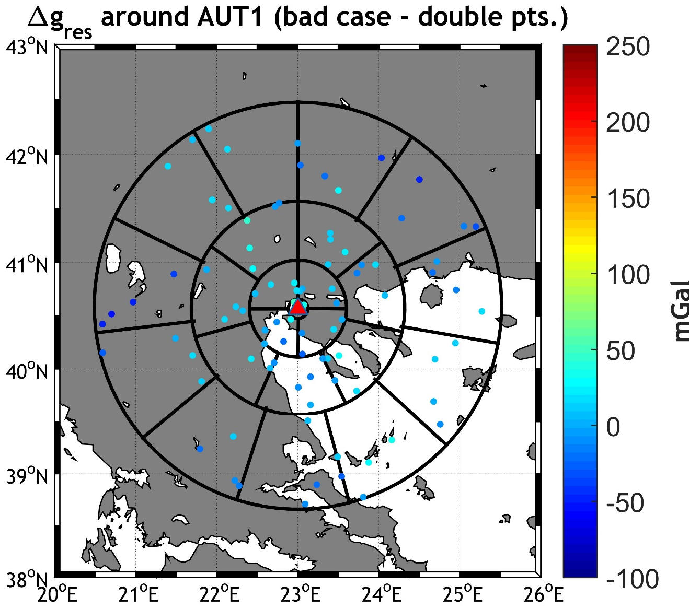
$N_{AUT1}^{}$ & $W_{AUT1}^{}$ modeling
Bad distribution contrary to the JWG0.1.2 recommendation (x2)

Slide 50
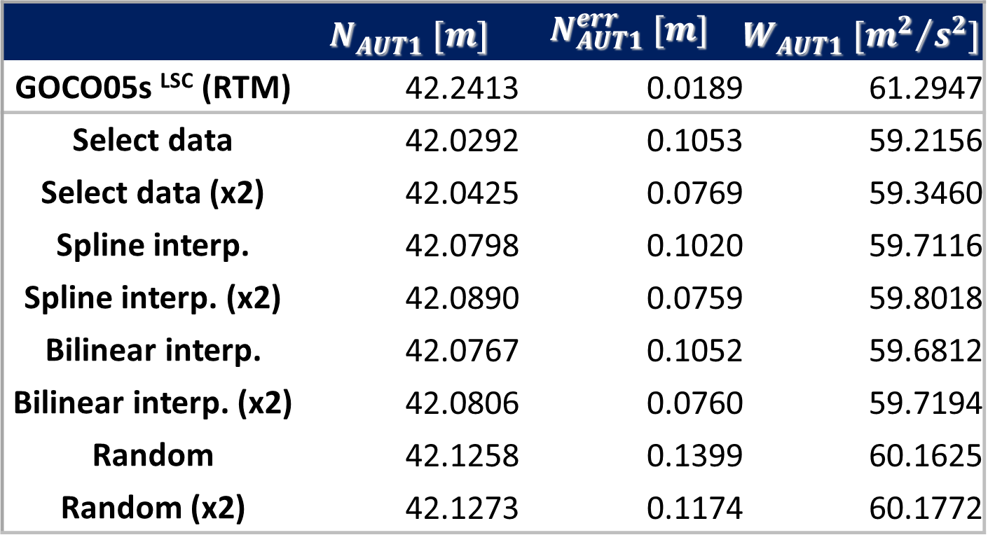
$N_{AUT1}^{}$ & $W_{AUT1}^{}$ modeling
Statistics of the estimated geoid and potential at AUT1
 | $$N_{AUT1}^{} [m]$$ | $$N_{AUT1}^{err} [m]$$ | $$W_{AUT1}^{} [{m^{2}}/{s^{2}}]$$
GOCO05s ^{LSC} (RTM) | 42.2413 | 0.0189 | 61.2947
Select data | 42.0292 | 0.1053 | 59.2156
Select data (x2) | 42.0425 | 0.0769 | 59.3460
Spline interp. | 42.0798 | 0.1020 | 59.7116
Spline interp. (x2) | 42.0890 | 0.0759 | 59.8018
Bilinear interp. | 42.0767 | 0.1052 | 59.6812
Bilinear interp. (x2) | 42.0806 | 0.0760 | 59.7194
Random | 42.1258 | 0.1399 | 60.1625
Random (x2) | 42.1273 | 0.1174 | 60.1772

Slide 51
$N_{AUT1}^{}$ & $W_{AUT1}^{}$ modeling
Effect of data distribution and density
Use the GOCO5s LSC-based solution employing all data as reference and then evaluate the impact of data distribution and sampling
But use RTM from dv_ell2016 and ERTM2016

Slide 52
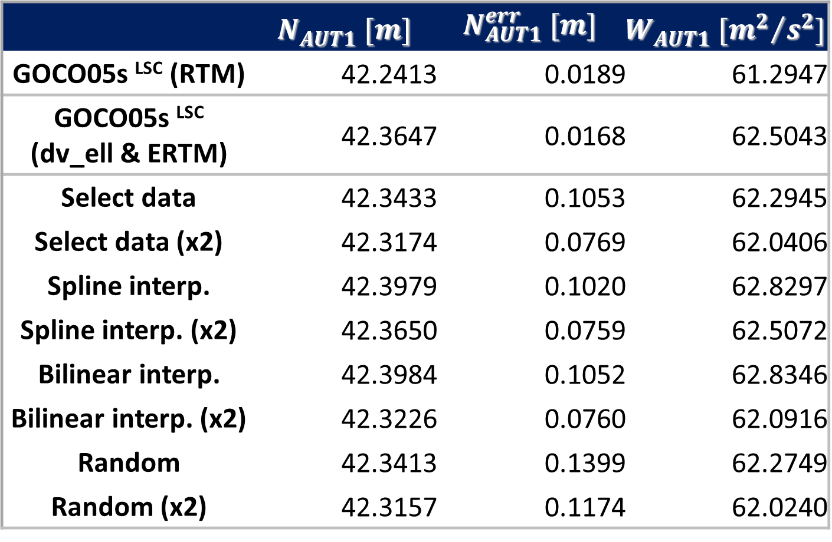
$N_{AUT1}^{}$ & $W_{AUT1}^{}$ modeling
Statistics of the estimated geoid and potential at AUT1
 | $$N_{AUT1}^{} [m]$$ | $$N_{AUT1}^{err} [m]$$ | $$W_{AUT1}^{} [{m^{2}}/{s^{2}}]$$
GOCO05s ^{LSC} (RTM) | 42.2413 | 0.0189 | 61.2947
GOCO05s ^{LSC} (dv_ell & ERTM) | 42.3647 | 0.0168 | 62.5043
Select data | 42.3433 | 0.1053 | 62.2945
Select data (x2) | 42.3174 | 0.0769 | 62.0406
Spline interp. | 42.3979 | 0.1020 | 62.8297
Spline interp. (x2) | 42.3650 | 0.0759 | 62.5072
Bilinear interp. | 42.3984 | 0.1052 | 62.8346
Bilinear interp. (x2) | 42.3226 | 0.0760 | 62.0916
Random | 42.3413 | 0.1399 | 62.2749
Random (x2) | 42.3157 | 0.1174 | 62.0240

Slide 53







$N_{AUT1}^{}$ & $W_{AUT1}^{}$ modeling
Prediction accuracy w.r.t. the observed gravity @AUT1
GOCO05s^{LSC} (RTM)
$$ε_{AUT1}^{Δg}=0.8815 mGal$$
GOCO05s^{LSC} (dv_ell&ERTM)
$$ε_{AUT1}^{Δg}=0.2839 mGal$$
GOCO05s^{LSC} (dv_ell&ERTM - JWG)
$$ε_{AUT1}^{Δg}=2.043 mGal$$
GOCO05s^{LSC} (dv_ell&ERTM – JWGx2)
$$ε_{AUT1}^{Δg}=1.1303 mGal$$
EGM2008 ^{LSC} (RTM)
$$ε_{AUT1}^{Δg}=1.7961 mGal$$
XGM2016^{LSC} (RTM)
$$ε_{AUT1}^{Δg}=0.5719 mGal$$
SBFS (smooth)
$$ε_{AUT1}^{Δg}=0.7711 mGal$$

Slide 54

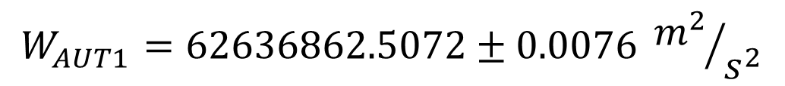


$N_{AUT1}^{}$ & $W_{AUT1}^{}$ modeling
The final, recommended, potential of the AUT1 IHRF station, using LSC, all data and dv_ell&ERTM
with spline interpolation and 2x the points
$$N_{AUT1}^{}=42.3647±0.0168 m$$
$$W_{AUT1}^{}=62636862.5043±0.0017 {m^{2}}/{s^{2}}$$
$$N_{AUT1}^{}=42.3650±0.0759 m$$
$$W_{AUT1}^{}=62636862.5072±0.0076 {m^{2}}/{s^{2}}$$

Slide 55

$N_{AUT1}^{}$ & $W_{AUT1}^{}$ modeling
The final, recommended, potential of the AUT1 IHRF station, using LSC, all data and dv_ell&ERTM (WGS84 & TF)
To GRS80 and MT
$$N_{AUT1}^{}=42.3647±0.0168 m$$
$$W_{AUT1}^{}=62636862.5043±0.0017 {m^{2}}/{s^{2}}$$
$$N_{AUT1}^{GRS80 MT}=41.3987±0.0168 m$$
$$W_{AUT1}^{GRS80 MT}=62636853.0347±0.0017 {m^{2}}/{s^{2}}$$

Slide 56


$N_{AUT1}^{}$ & $W_{AUT1}^{}$ modeling
The final, recommended, potential of the AUT1 IHRF station, using LSC, all data and dv_ell&ERTM (WGS84 & TF)
To GRS80 and MT
To GRS80 ZT
$$N_{AUT1}^{}=42.3647±0.0168 m$$
$$W_{AUT1}^{}=62636862.5043±0.0017 {m^{2}}/{s^{2}}$$
$$N_{AUT1}^{GRS80 MT}=41.3987±0.0168 m$$
$$W_{AUT1}^{GRS80 MT}=62636853.0347±0.0017 {m^{2}}/{s^{2}}$$
$$N_{AUT1}^{GRS80 ZT}=41.4248±0.0168 m$$
$$W_{AUT1}^{GRS80 MT}=62636853.2914±0.0017 {m^{2}}/{s^{2}}$$

Slide 57
CONCLUSIONS
The use of a satellite only model and then (classic) RTM is not sufficient, given the problems (still) in bathymetry.
Using dv_ell2016 coupled by ERTM2016 (scales up to 200 m) seems promising.
It provides the most consistent results with errors up to 5 cm in the geoid prediction, irrespective of the data distribution.
If interpolation/gridding is needed, then splines are to be preferred.
Other modifications of Stokes kernel need to be checked as well as the GBVP approach

Slide 58
Sincere thanks to (誠にありがとう):
    Verena Lieb and Michael Schmidt for the SBFs computations
    Christian Hirt and Martin Willberg for the discussions on the evaluation of RTM through dv_ell2016 and ERTM2016
    Roland Pail and Thomas Gruber for the XGM2016 coefficients

