Slide 1
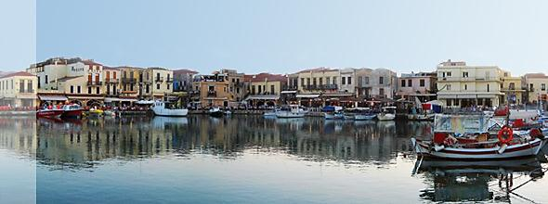
POST-SURGERY CONTACT LENS FITTING
Vassilis Fotinakis, M.Sc.

Slide 2

POST-SURGERY CONTACT LENS FITTING
Post – Refractive Surgery
Post Corneal Transplant
Post corneal cross-linking

Slide 3
POST REFRACTIVE SURGERY
POST RADIAL KERATOTOMY
POST PRK ( Myopic / Hyperopic )
POST LASIK (Myopic / Hyperopic )
Generally dealing with:
1. Post surgery remaining refractive errors
2. Iatrogenic ectasias and keratoconus
3. Decentered optical zones, elevated incisional
scars, etc…

Slide 4
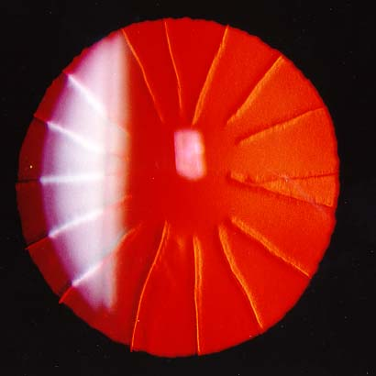
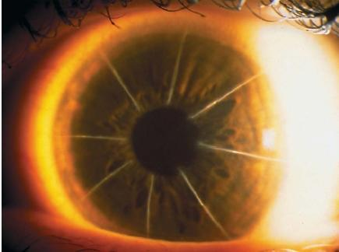
RADIAL KERATOTOMY (RK)
Radial keratotomy (RK) is a refractive surgical procedure to correct myopia, developed in 1974 by Svyatoslav Fyodorov. In RK, incisions are made with a diamond knife. Incisions that penetrate the corneal stroma in a depth of up to 90% of the corneal thickness

Slide 5
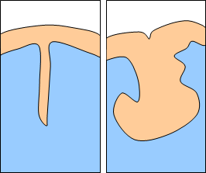
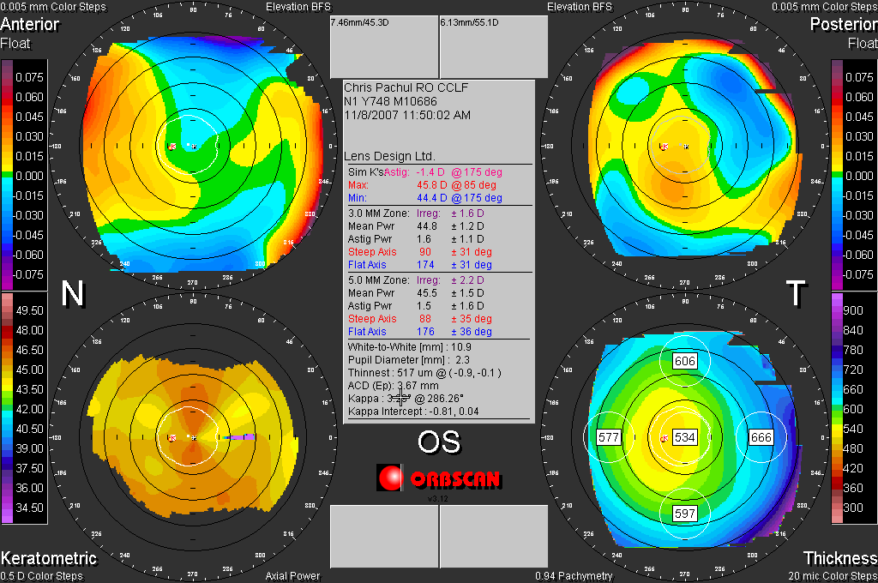
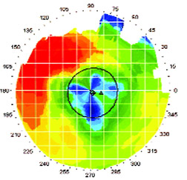
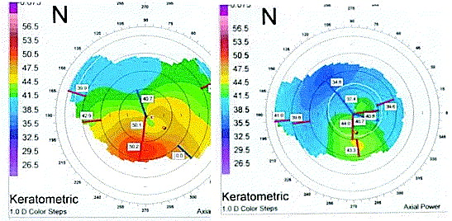
POST RK TOPOGRAPHY

Slide 6
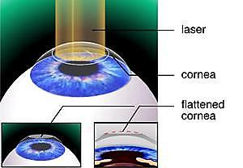
PRK
A corneal tissue subtraction/ablation technique in which an excimer laser is used to remove tissue to alter the shape of the cornea. The high energy UV light (193 nm) is delivered to the cornea through a pulsating spot or slit

Slide 7
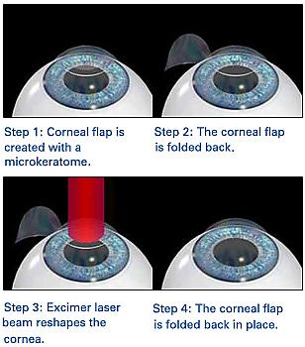
LASIK
The most popular laser surgery technique in which a corneal flap is created either by a mechanical microkeratome or a femtosecond laser one, the flap is folded back revealing the clear stroma on which the excimer laser acts and subtracts corneal tissue.

Slide 8
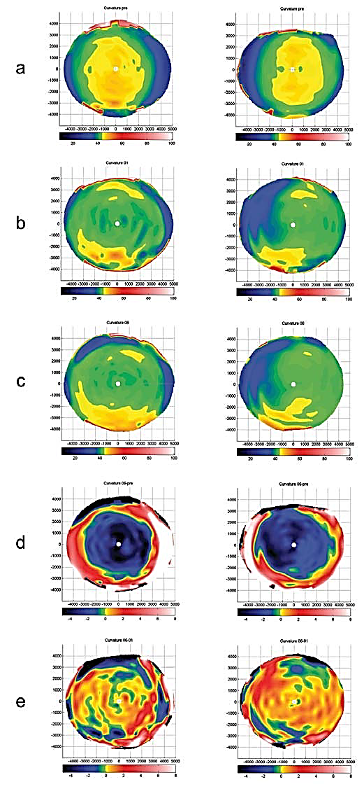
POST LASER SURGERY CHANGES IN CORNEAL TOPOGRAPHY
Main feature of corneal topography after PRK/LASIK is a markedly flattened central corneal area of 6-8 mm.

Slide 9
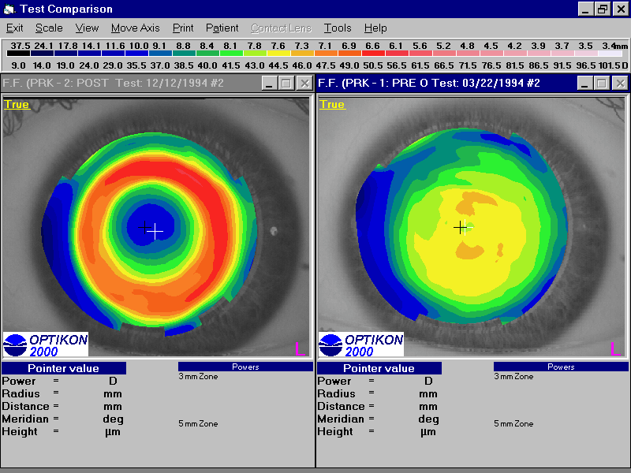
POST LASER SURGERY CHANGES IN CORNEAL TOPOGRAPHY

Slide 10
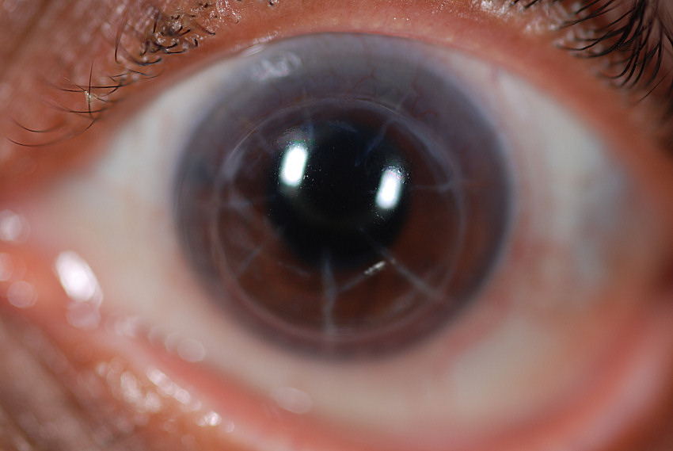
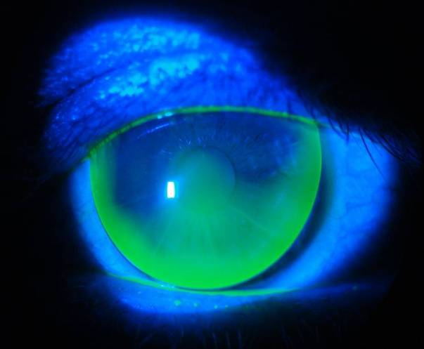
POST RK CONTACT LENSES
Post RK cornea challenges
Central versus mid peripheral
cornea
Irregular astigmatism
Elevation of incisional scars
Fluctuating refractive error
Corneal neovascularization
Post operative glare and
photophobia

Slide 11
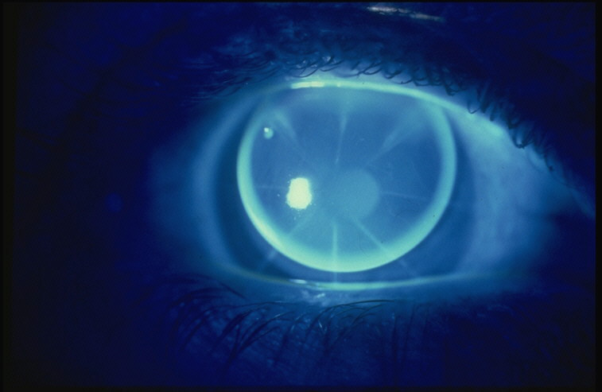
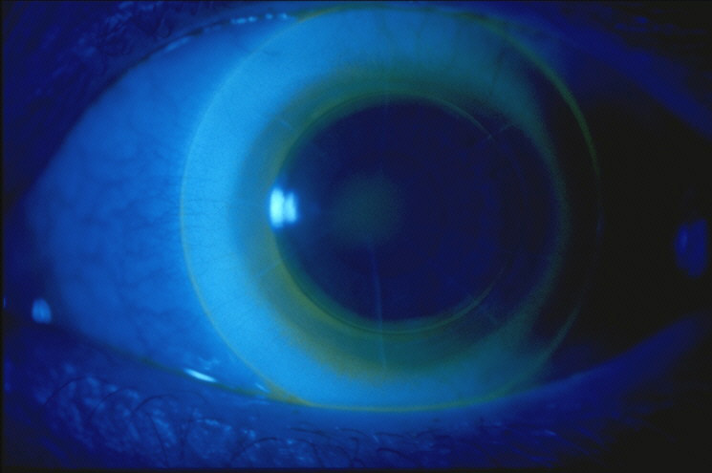
Post Refractive Surgery CL Fitting
RGP(High Dk/l, large diameter usually , tint for glare and UV protection) – also Piggy Back
SOFT (SPHERIC OR TORIC)
HYBRID
SCLERALS

Slide 12
Post Refractive Surgery CL Fitting
CL fitting should be delayed for 3 to 6 months
BOZR should be selected following either
Computerized corneal mapping
Peripheral keratometry
Preoperative keratometric readings

Slide 13
Post Refractive Surgery CL Fitting
Very flat central area
Loss of steep apex to aid centration
Large diameter for stability
Large BOZD to avoid flare
Fit to “normal periphery”
Cases of corneal ectasia or decentered ablations are most challenging

Slide 14
Post Refractive Surgery CL Fitting
BOZR is suggested to approximately equal the corneal curvature 4.00 mm temporal to the centre of the cornea (can be estimated with corneal topography and/or a modified keratometer peripheral reading)
For example if central K readings are 8,80 along 180 and 850 along 90 and reading at 4.00 mm temporally is 7. 85 then the first selected BOZR should be 7.85

Slide 15
Post Refractive Surgery CL Fitting
The cornea usually flattens by about 0,1 mm from centre to mid-periphery. After RK flatenning slightly increases and mid peripheral readings should be about 0,2mm flatter than the preoperative central corneal readings. (e.g. for pre-op central K reading 770x180/7,50x90, mid peripheral readings should be 7,90 post-op and this should be the first selected BOZR).
Alternatively, if the other eye has not been operated add 0.20 mm to the central K readings of that eye.

Slide 16
THE DIAMETER ISSUE: SIZE MATTERS !
In general, after refractive surgery the difference – sometimes marked – between the central treated part and the mid periphery and far corneal periphery makes CL fitting rather challenging. It is difficult with simple designs to have a fair alignment in both central and peripheral cornea, especially for significant refractive corrections. Thus, in RK/ PRK/LASIK, in the case of RGP lenses, large lens diameters and large BOZDs are preferred as the yield much more stable lenses and vision.
Aspherics also seem to perform better as they distribute lens mass more evenly across the cornea and they deal slightly better with spherical aberrations.

Slide 17
SLIT LAMP and other stories….
Fluorescein assessment is important but never expect a textbook pattern
Usually there will be some central pooling and mid peripheral bearing
Go for maximum comfort and best optical correction. Usually what gives best comfort and acuity might be the best regardless of fluorescein pattern
Expect re-fitting possibilities and be ready to manage any mild complications
You can always opt for topography-based lens design. Technology can now deliver.
Use High DK/t materials that also feature satisfactory rigidity in order to avoid lens flexure

Slide 18
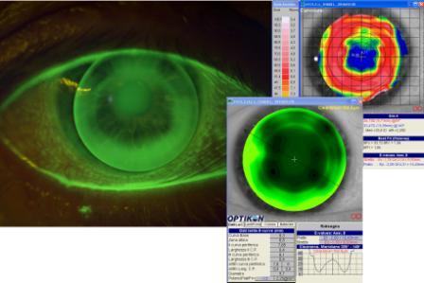
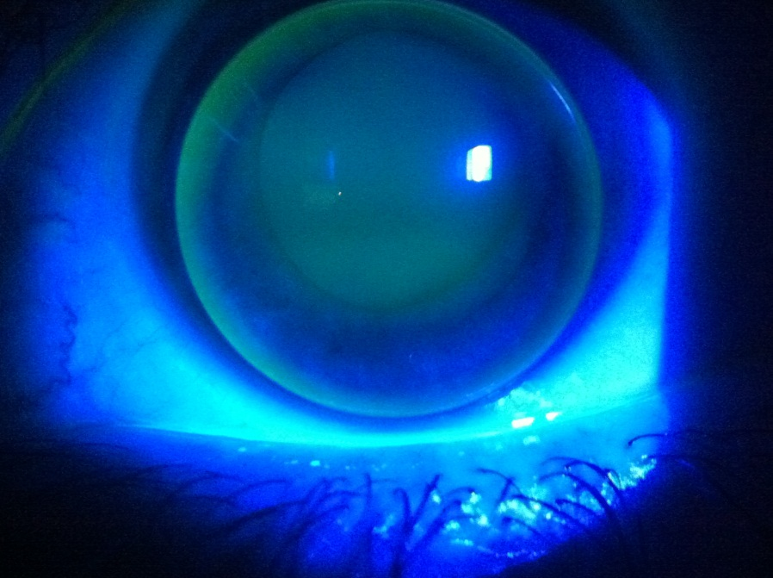
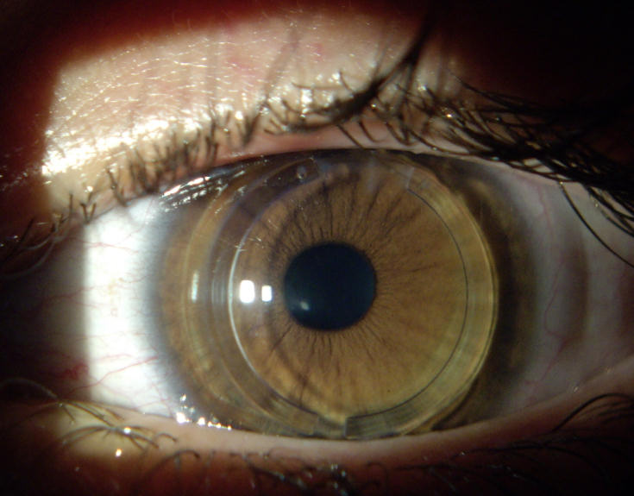
POST Refractive Surgery RGP lenses

Slide 19
POST Refractive Surgery RGP lenses
http://www.youtube.com/watch?v=HPZn_1-T6js&feature=autoplay&list=UUAbZXC3J0hFVsRkDYGhmXiQ&playnext=1
http://www.youtube.com/watch?v=ppT3aZFwLbM&feature=relmfu
http://www.youtube.com/watch?v=6vfis1LXVBc&feature=relmfu
Nice video presentations from Paul Rose on his own design lenses

Slide 20
OTHER RGP ALTERNATIVES
Large diameter semi-scleral rigid lenses – Best centration and stability - Diameters 13,5-16,00 mm – High Dk materials – Need to have a proper diagnostic set.
Reverse Geometry RGP lenses – Especially for high refractive corrections they might provide the best alternative. Post surgery cornea is oblate rather than prolate and RG lenses with central radius flatter than the peripheral one have a theoretical advantage. Fitting based on topography and mid peripheral radii. Go for a fit that exhibits some apical clearance and mid peripheral alignment. Computer programs integrated in modern topography instruments can help a lot.

Slide 21
POST – LASIK ECTASIA
Iatrogenic keratoconus and has to be treated like that.
Several RGP designs, soft customized lenses and hybrids
can be applied…
I would personally opt for the latter two options

Slide 22
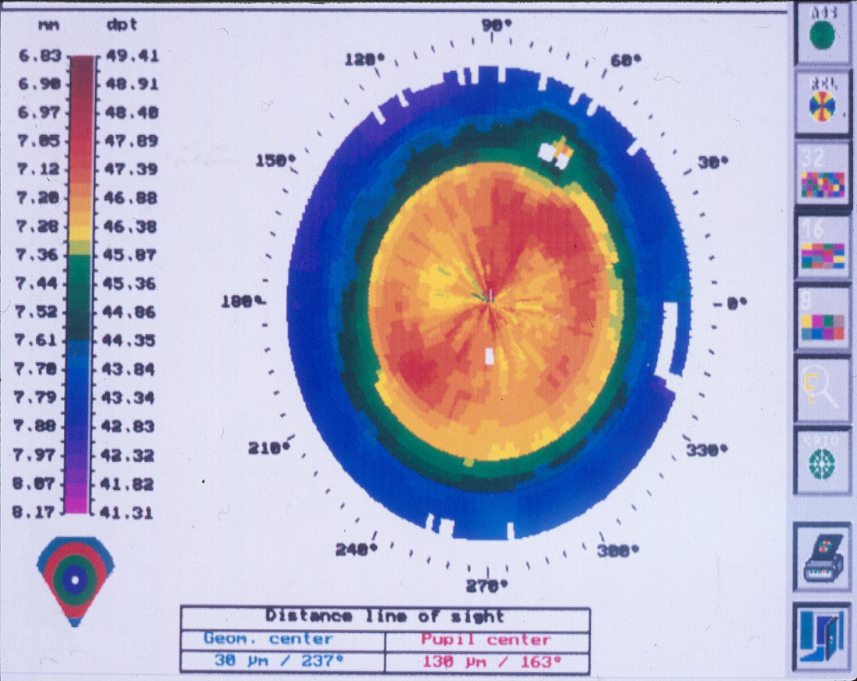
LASIK FOR HYPEROPIA
Excessive removal of tissue can lead to central
corneal bulge
“Pseudo keratoconus”
Pigment ring around cone
Can have very steep
central K’s
Aim to flatten central ”cone”
Fit using keratoconic fitting set

Slide 23
POST Refractive Surgery SOFT LENSES
CUSTOMIZED SOFT LENSES FOR THE IRREGULAR CORNEA
Kerasoft IC is the most known example but there also other manufacturers (e.g. Eyeart, etc…)
Can be designed and manufactured with the aid of topography images
Fully Tailor-made
Periphery is configurable to suit the individual eye
Sector Management to fit even the most complex corneal distortions
Optional reverse geometry on steep peripheral fits
Tailor-made to meet the needs of the individual eye
Easy to handle 74% water content Silicone Hydrogel material for increased oxygen permeability and comfort
Also available in high water content Hydrogel for annual replacement options
Some of them feature Wavefront optics to provide enhanced visual acuity
Simple Fitting System-Fitting sets
Wide Range of Parameters (also toric, multifocal…)

Slide 24
POST Refractive Surgery SOFT LENSES
Pros and Cons
Pros :
Satisfactory Oxygen performance
Fully tailor-made
Wide range of parameters
Producing less or no scarring and can act also as bandage lens
Provides protection from foreign bodies and wind, good for exterior recreational activities, sports, etc.
Very hard to fall out of the eye or be misplaced

Slide 25
POST Refractive Surgery SOFT LENSES
Pros and Cons
Cons :
As they lack a rigid surface, in most cases they will not yield maximum visual acuity
Tend to impinge on the scleral conjuctiva, yielding a “sucking” effect
Sometimes can be hard to extract from the eye
More prone to allergic conjuctivitis and infections due to their soft material. Maybe best to use with peroxide systems.

Slide 26
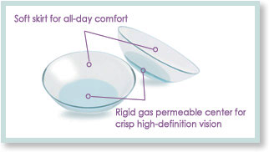
HYBRID LENSES
RGP center and Soft peripheral “skirt”.
First it was Saturn, then Softperm, now Synergeyes or Eyeart family of lenses
The RGP centre is now very highly permeable while the soft periphery has recently been upgraded to SiH in a certain lens (Duette – officialy designed just for astigmatism correction)

Slide 27
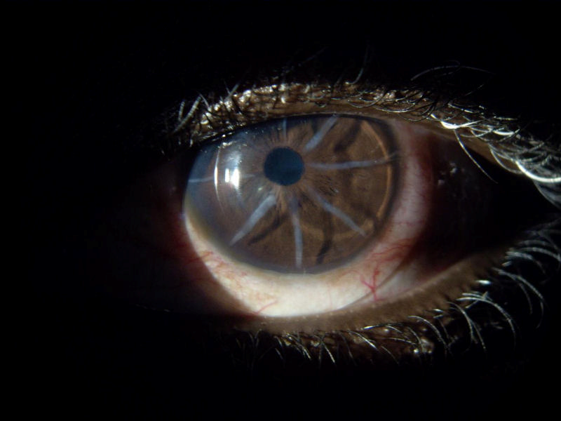
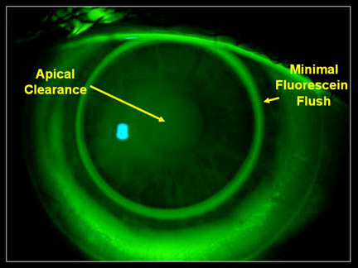
HYBRID LENSES
Always use trial sets – examine fluorescein patterns closely - leave 30 minutes for safe over-refraction. With new High Dk materials they seem a very interesting alternative to RGPs
There might be an issue with midperipheral pressure and topography changes, so frequent monitoring is a must. Sometimes difficult to insert and exert in small eyes, rather expensive too. There are videos about ideal handling even in YouTube

Slide 28
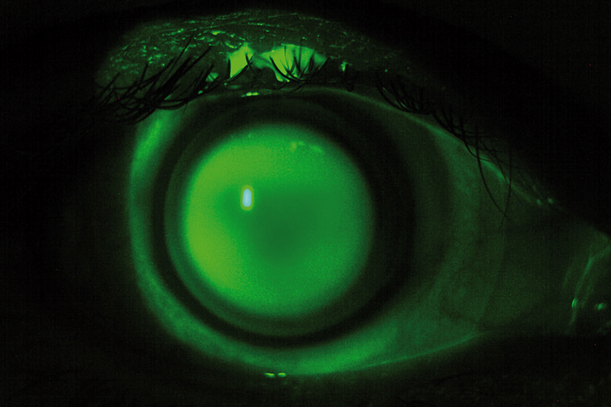
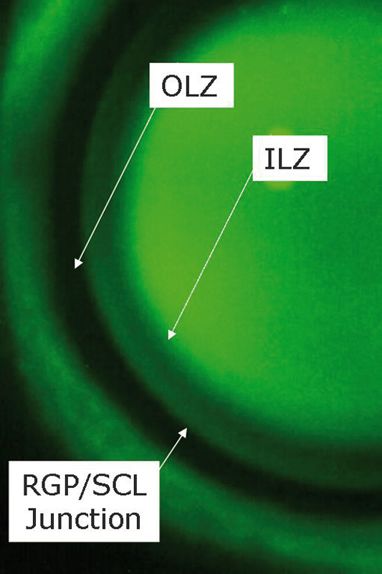
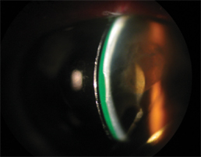
HYBRID LENSES
Clearkone Synergeyes lens, ideal fit
Fitting profile at the slit lamp of a Hybrid lens

Slide 29
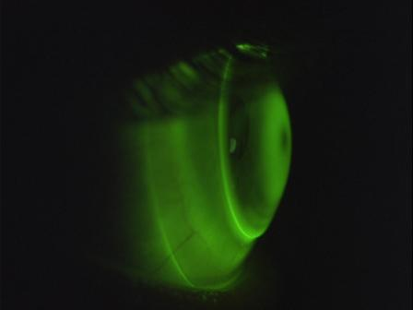
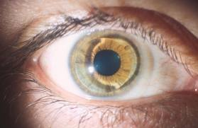
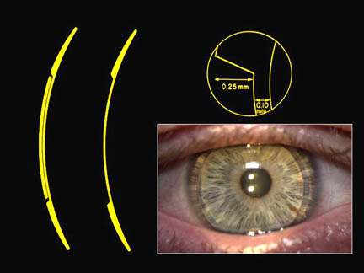
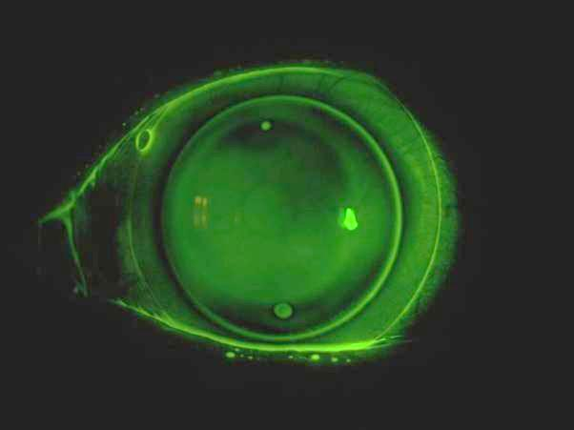
PIGGY BACK LENSES
Use High Dk materials for both soft carrier lens and RGP lens. Frequently low minus or low plus powers are indicated for the soft lenses, yielding more normalized curvatures for the RGP lens to sit on. However, it may be possible to use a stronger minus power and decrease the residual RGP lens power and have a thinner lens and a larger BOZD as a result….SO DON’T BE AFRAID TO EXPERIMENT

Slide 30
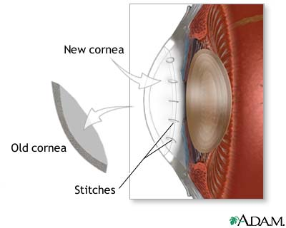
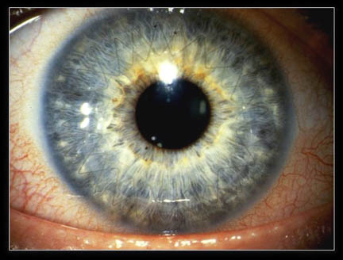
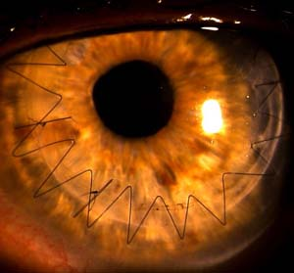
CORNEAL TRANSPLANT
PENETRATING KERATOPLASTY
LAMELLAR (OR DEEP LAMELLAR KERATOPLASTY)
MAIN REASONS: A) KERATOCONUS, PMD, BULLOUS KERATOPATHY, CORNEAL DYSTROPHIES AND SCARRING, etc…..
TIME OF FIT : 8-20 MONTHS POST SURGERY, UNLESS THERE IS URGENT NEED FOR VISION

Slide 31
CORNEAL TRANSPLANTS AND CONTACT LENSES
Post Surgery residual ametropia and usually high, and not always very regular astigmatism
Eccentric grafts, tilted grafts
Central region stands proud of the host tissue
Commonly found plateaus, islands and other geographical features…..

Slide 32
POST CORNEAL GRAFT LENSES
RGPs usually large diameter ones (Reverse geometries sometimes )
Hybrid lenses and piggy back systems, mainly the former
Sclerals and mini sclerals
Soft customized lenses, frequently featuring reverse geometries

Slide 33
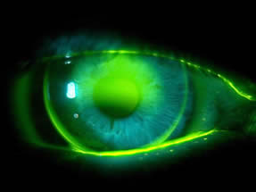
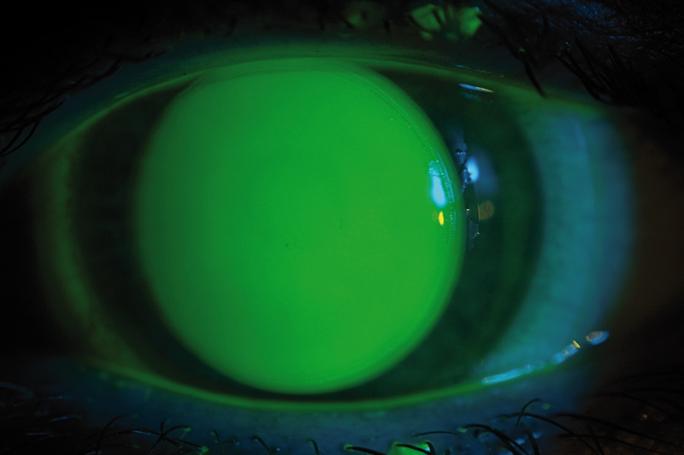
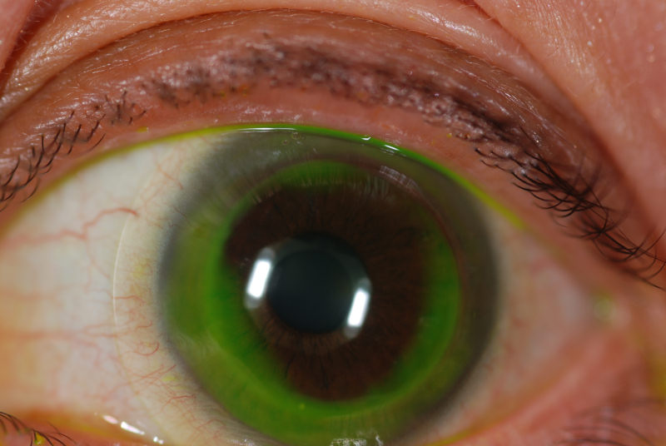
POST CORNEAL GRAFT LENSES
Large diameter RGP lens
Synergeyes PS Hybrid lens
SYNERGEYES PS LENS OVER TRANSPLANTED CORNEA

Slide 34
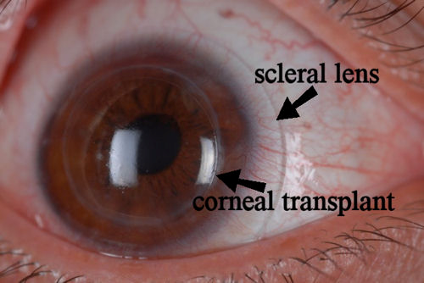
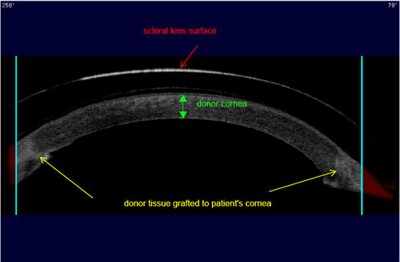
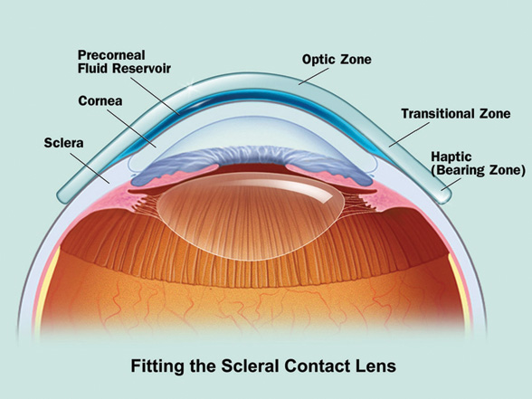
POST CORNEAL GRAFT LENSES

Slide 35
POST CROSS-LINKING FITTING – DOES IT REALLY MATTER ?
Central and paracentral/midperipheral curvatures may change
Previous RGP pair does not fit well – especially if it is a small diameter one.
New optical prescription
Frequently surgeons ask for refitting into soft lenses as they are more afraid of scarring – particularly if there has also been an additional laser treatment which is allegedly related to stromal haze after the procedure (e.g. Athens Protocol ? )

Slide 36

Thank you all for your attention
Questions will be answered at the
beach with a well chilled cocktail in hand

